Slide 1
F# Type Providers “Statically Typed Language Support for Internet-scale Information Spaces” Overview + Exotica
Don Syme, F# Community Contributor, @dsyme
In conjunction with many others in F# Community

Slide 2
Proposition 1 The world is information-rich

Slide 3
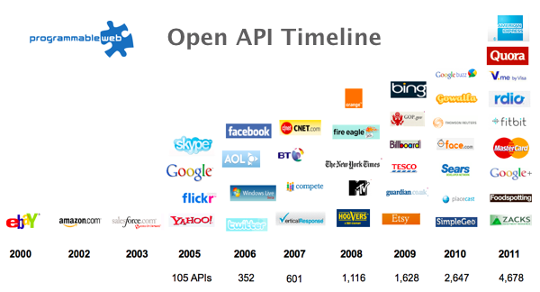
The Information Revolution

Slide 4
Proposition 2 Modern programming is intensely information-rich

Slide 5
Proposition 3 Our languages are information-sparse

Slide 6
Proposition 4 This is a problem (especially for strongly-typed languages)

Slide 7
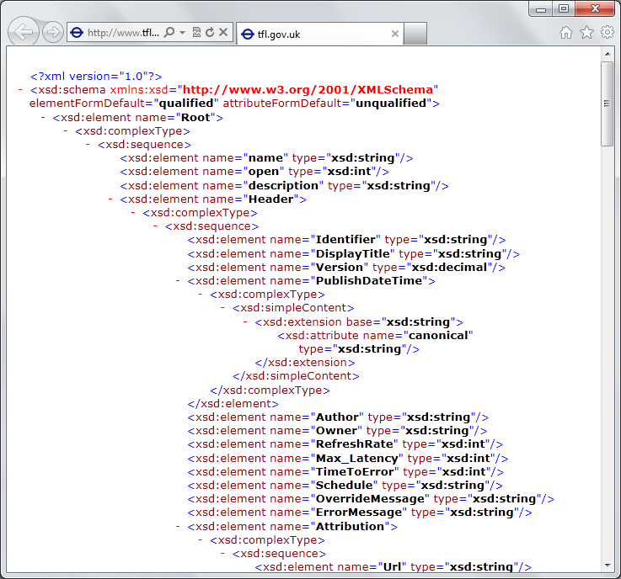
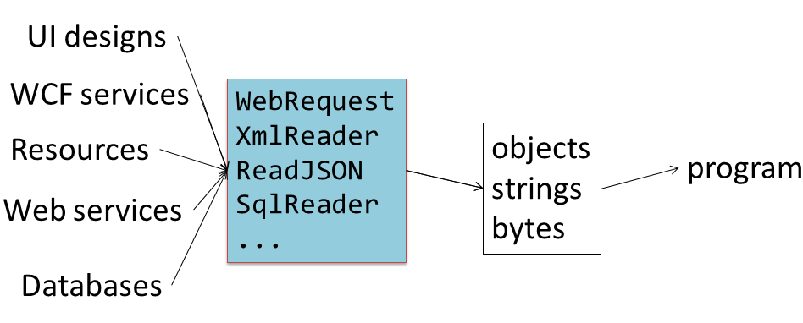
The developer’s perspective
Languages do not integrate information
Non-intuitive
Not simple
Disorganised
Static
High friction

Slide 8
We need to bring information into the language… At internet-scale, strongly tooled, strongly typed

Slide 9
Paradigm Locator
Statically Typed
Dynamically Typed

Slide 10
Paradigm Locator
Statically Typed
Dynamically Typed
A major search is on!
make statically typed langs more dynamic
make dynamically typed langs more static
apply modertated static typing much more broadly

Slide 11
This R&D is done in the context of the open language F#
Lots of good reasons for that, see our tech report
“Strongly Typed Language Support for Internet-Scale Information Spaces”

Slide 12
A bit about F#...

Slide 13
F# is Open Source F# is Cross Platform
fsharp.org
fsharp.org/use/mac
fsharp.org/use/linux
fsharp.org/use/android
fsharp.org/use/ios
fsharp.org/use/windows
fsharp.org/use/freebsd

Slide 14
F# is changing…
F# runs on many platforms
“F# is for Windows”

Slide 15
F# is changing…
F# has many contributors
“Microsoft
makes F#”

Slide 16
F# is changing…
Many perspectives
http://fsharp.org
One perspective
(Microsoft’s)
http://msdn.microsoft.com

Slide 17
Learn more
fsharp.org
fsharp.org/testimonials
fsharp.org/teaching/research.html

Slide 18
Back to the main topic…

Slide 19
We need to bring information into the language… At internet-scale, strongly tooled, strongly typed

Slide 20
Demo: Integrate all of freebase.com “as if it were a library” 40M entities, 1Billion facts, 24,000 types, 65,000 properties

Slide 21
Demo: F# to WorldBank

Slide 22
A Type Provider is…. “Just like a library” “A design-time component that computes a space of types and methods on-demand…” “An adaptor between data/services and the .NET type system…” “On-demand, scalable compile-time provision of type/module definitions…”

Slide 23
Theme #1 On-Demand Type Environment = Internet Scalable

Slide 24
On-Demand Type Provision
let data = Freebase.GetDataContext()
1. Compiler/IDE requests metadata for symbol GetDataContext
Provider reports return type of FreebaseDataContext
data.
2. Compiler/IDE requests contents of type FreebaseDataContext
Provider asks Freebase metadata service for top-level domains
Provider reports top-level domains of Freebase as properties of the type
data.Society
3. Compiler/IDE requests metadata for symbol Society
...

Slide 25
Theme #2 Many Data Sources, One Mechanism

Slide 26
Note: Language still contains no data Open architecture You can write your own type provider

Slide 27
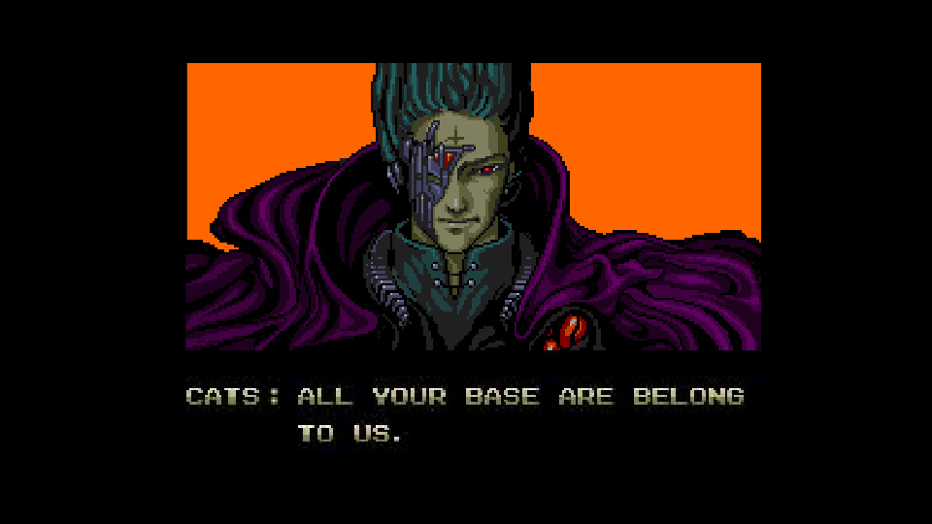
All your types are belong to us….
types

Slide 28
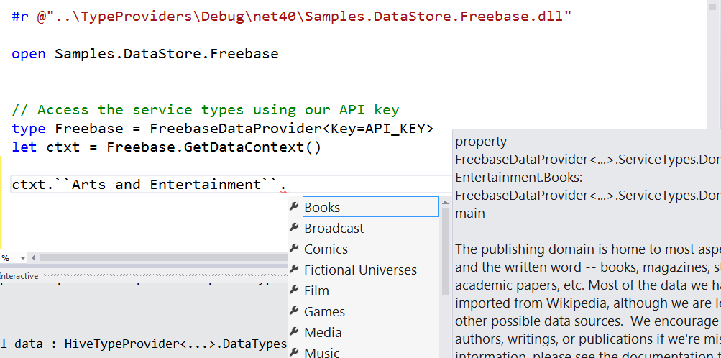
Freebase

Slide 29
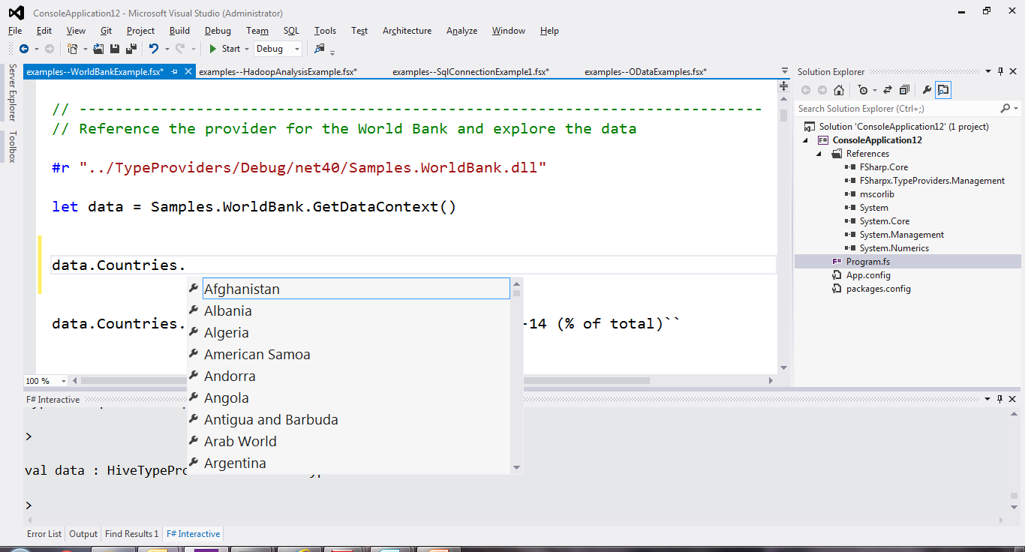
World Bank

Slide 30
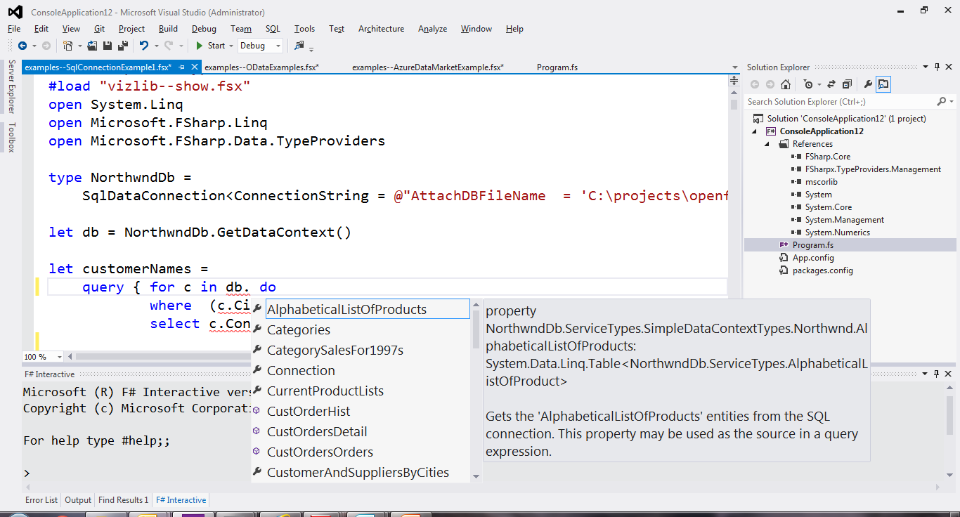
SQL

Slide 31
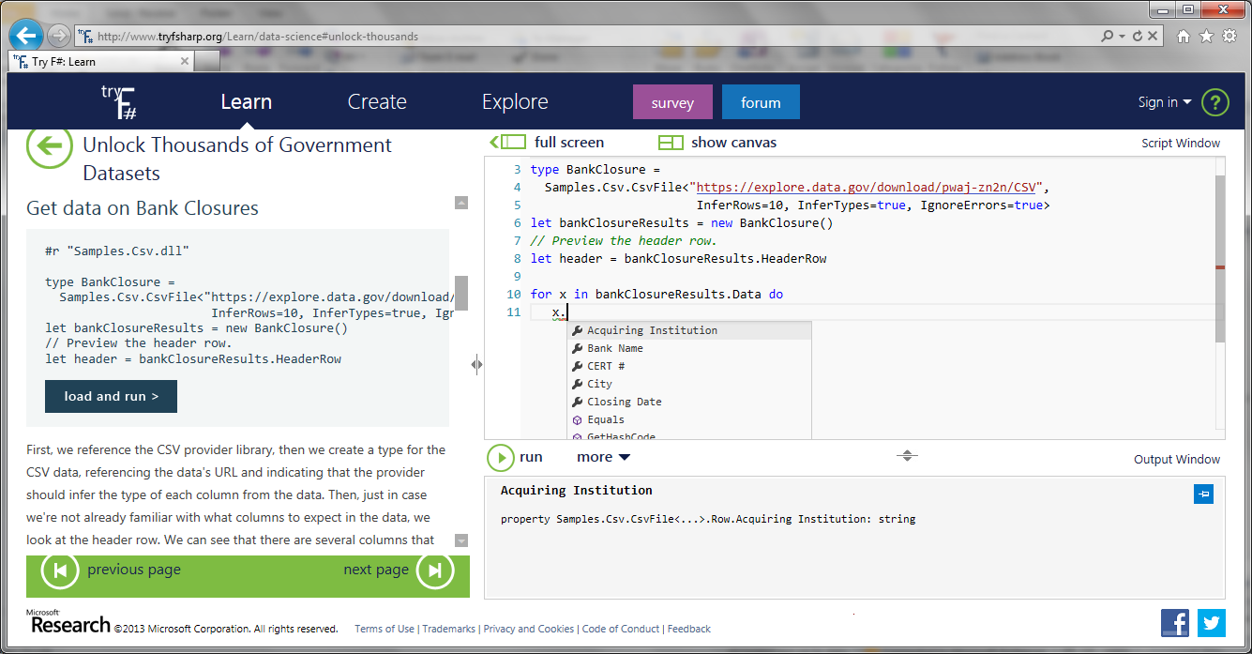
CSV

Slide 32

JSON

Slide 33
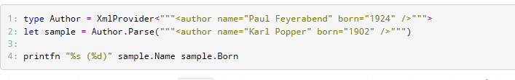
XML

Slide 34
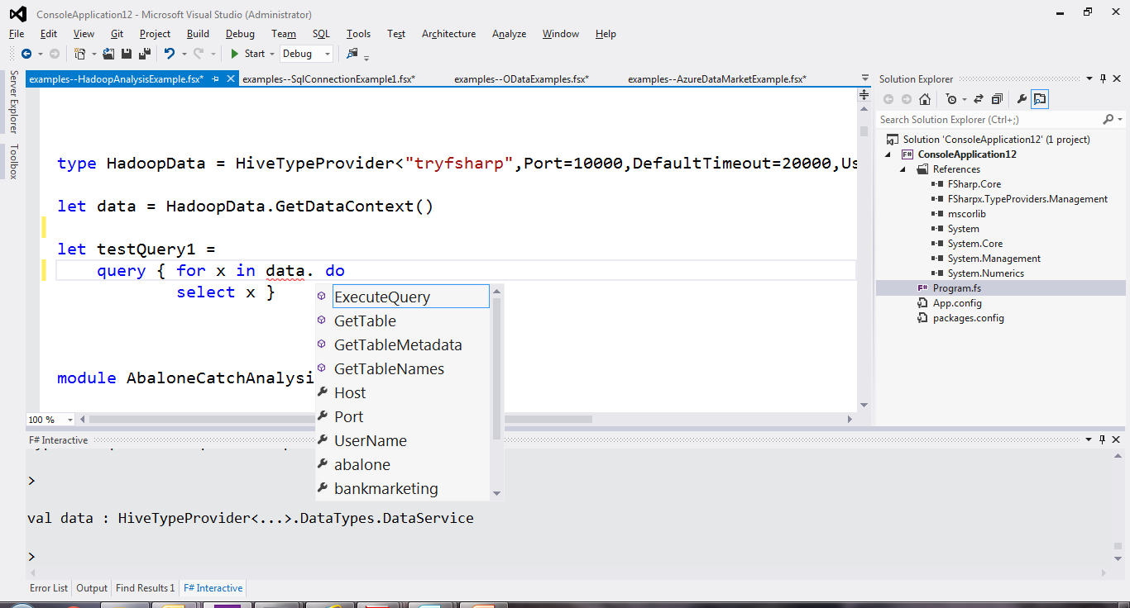
Hadoop/Hive

Slide 35
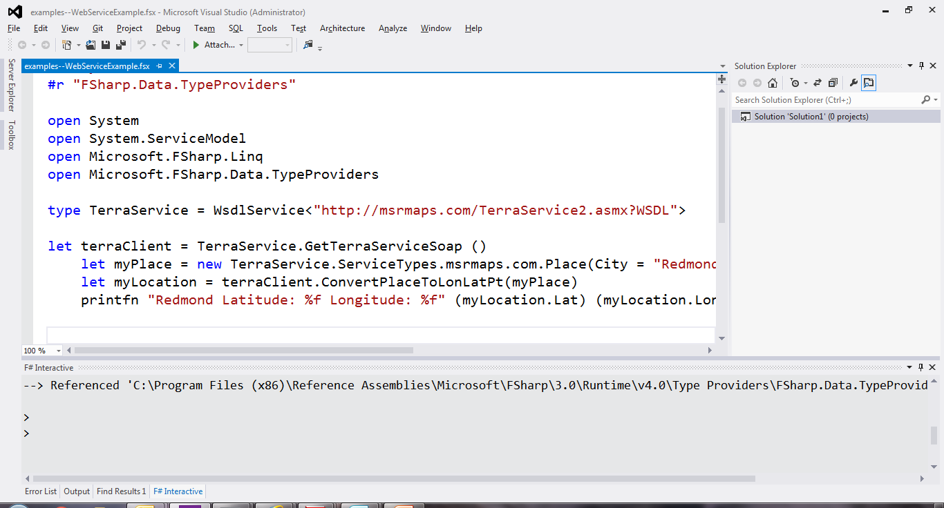
WSDL

Slide 36
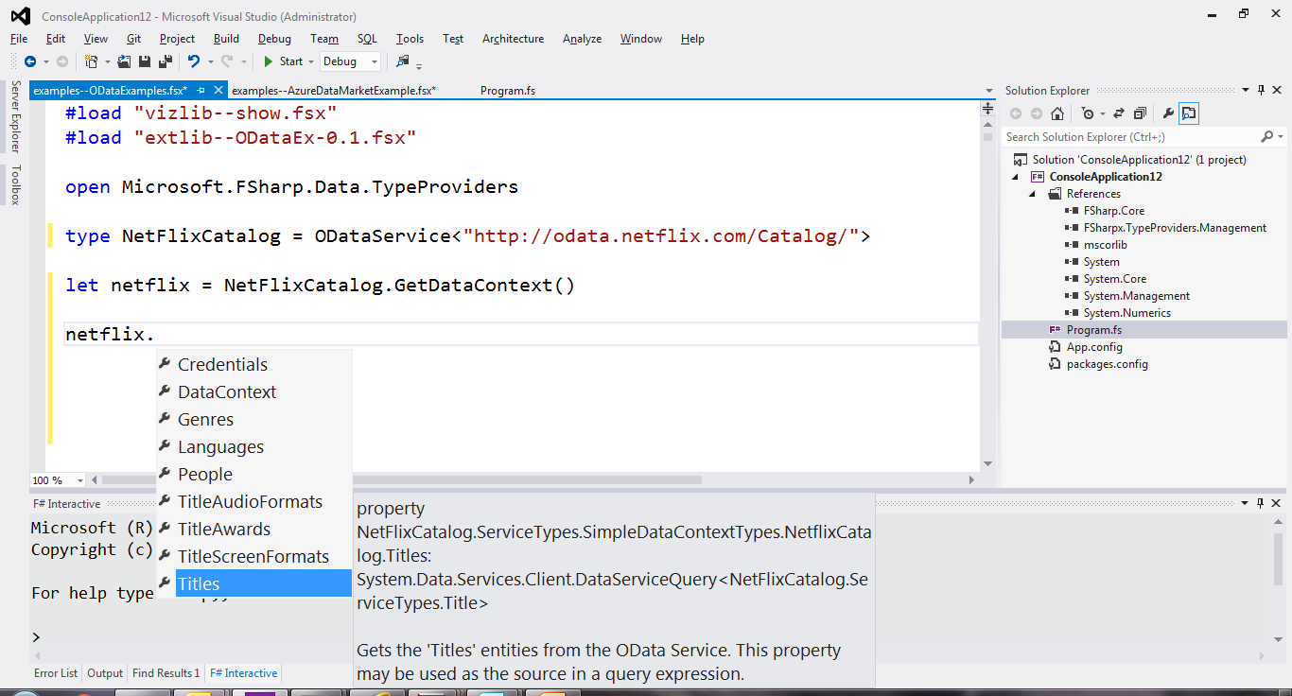
OData

Slide 37
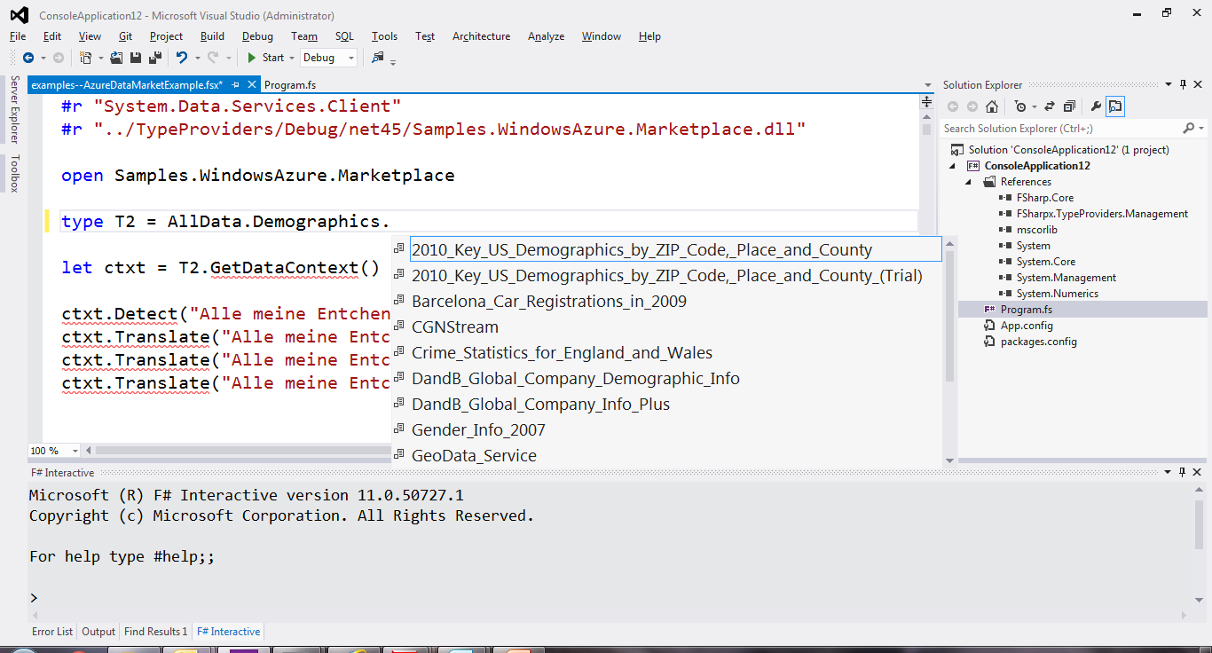
Azure Data Market

Slide 38
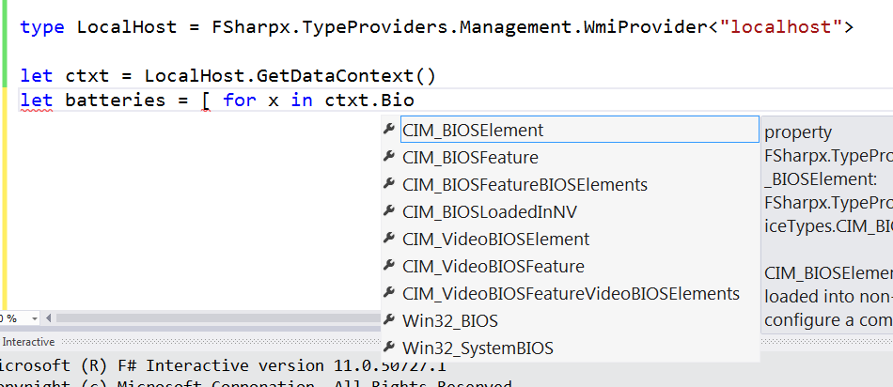
WMI

Slide 39
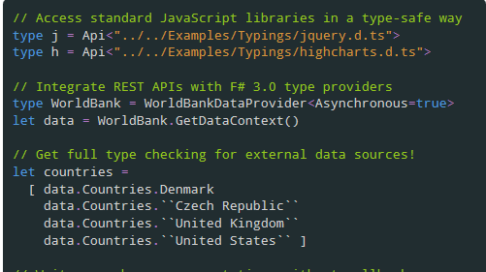
JavaScript/TypeScript

Slide 40

Matlab

Slide 41
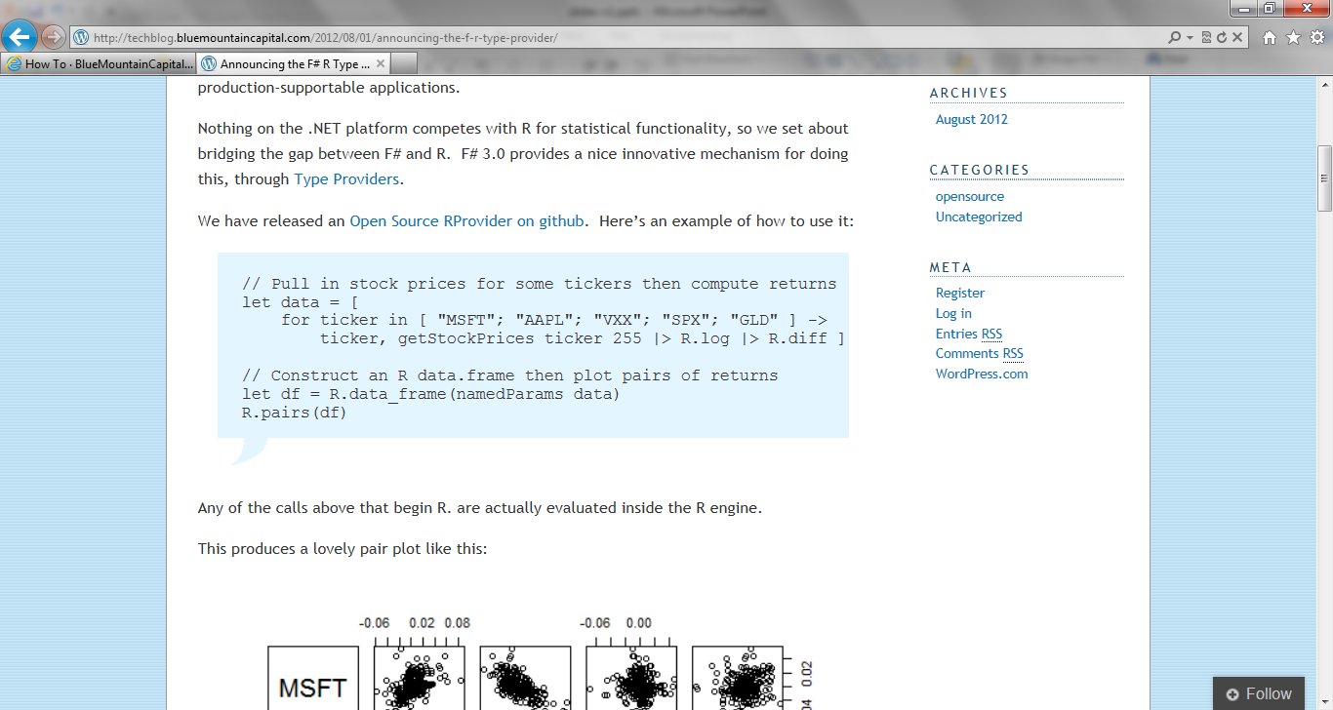
R

Slide 42
Look for FSharp.Data on GitHub

Slide 43
Theme #3 Data and Types at Multiple Scales

Slide 44
Data at Multiple Scales
From Everything to Individuals
Data Scripters need to work with different granularities of schematization
data.AllEntites
data.Automotive.``Automobile Models``
data.Automotive.``Automobile Models``.Individuals.``Porsche 911``
…Only a language that supports massively scalable metadata can operate at all these levels
Every stable entity can get a unique type

Slide 45
Theme #4 Programming Type Systems v. Information Space Metadata Synergy or Conflict? Examples: Types, Schema, Constraints, Units of Measure, Security Information, Documentation, Definition Locations, Help , Provenance, Privacy, Ratings, Rankings, Search…

Slide 46
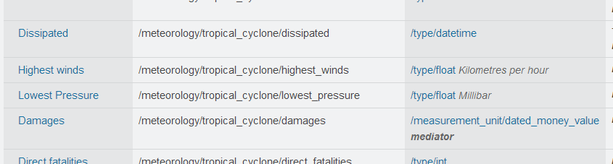
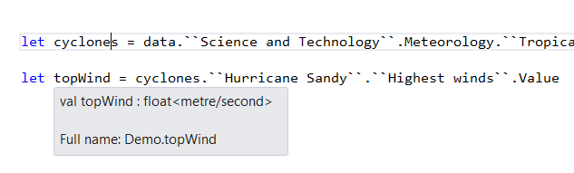
Providing Units of Measure
If the metadata contains units…
via F#’s Units of Measure
…then these can be projected into the programming language.

Slide 47
Theme #5 Schema Change

Slide 48
Hard problem, some progress…
Many, many data sources are surprisingly stable
Support “invalidation signals” from providers at design-time
Erasure makes compiled code much less fragile
Some data sources support “snapshot dates” (c.f. Datomic, Freebase)
Data scripting has low exposure

Slide 49
Some Research Questions
Can incorporate schema change policies?
Can temporal and probabilistic metadata be useful for typing or tooling?
Can we provide all the data in the enterprise (e.g. SAP or Reuters)?
Temporal types? Probabilistic types? Reactive types?
Can we model and verify provider components?
Can richer constraints, security, privacy and provenance annotations be provided?
Can we provided types be mutually recursive?

Slide 50
Related Work
Ur
Gosu
Scala Type Macros
Scheme/Lisp Macros
Idris
Template Haskell
…

Slide 51
Learn more
Questions?
tryfsharp.org
fsharp.org

