Slide 1
F# Async/Parallel/Reactive
MSR Cambridge TAB 2010
Don Syme + the F# team

Slide 2

Shipped in Visual Studio 2010

Slide 3
Outline
F# Async – the programmer’s perspective
Overview
Demos
MiniAsync
How to add an async modality to a language
The General F# Syntactic Mechanism

Slide 4
F# is a Parallel Language
(Multiple active computations)
F# is a Reactive Language
(Multiple pending reactions)
e.g.
GUI Event
Page Load
Timer Callback
Query Response
HTTP Response
Web Service Response
Disk I/O Completion
Agent Gets Message

Slide 5
Computational Model Example
✰ (e.g. Click)
Single Threaded GUI
Pending
Reactions
!
✰
(e.g. I/O
response)
...
!
!
!
...
Handlers (callbacks)

Slide 6
React!
async { let! res = <async-event>
... }
React to a GUI Event
React to a Timer Callback
React to a Query Response
React to a HTTP Response
React to a Web Service Response
React to a Disk I/O Completion
Agent reacts to Message

Slide 7
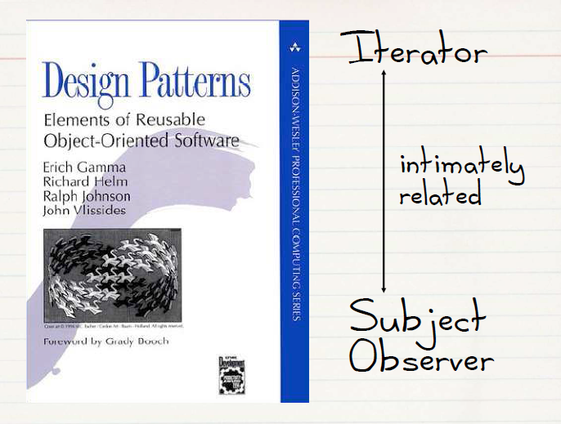
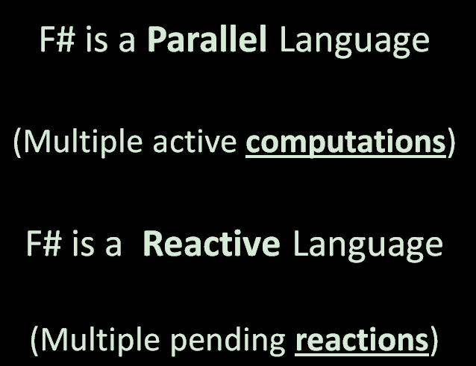
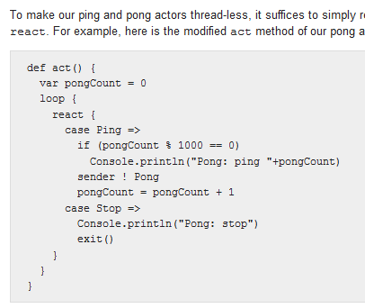
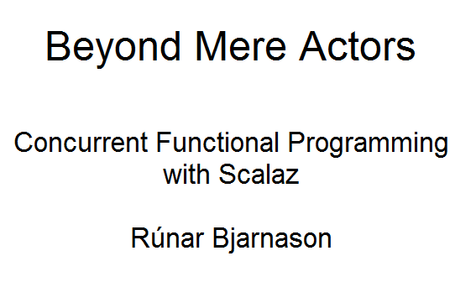

Slide 8
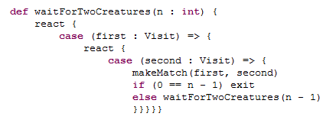
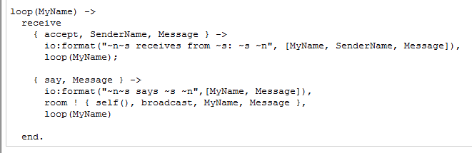
Scala
Erlang
F#
async { let! image = ReadAsync "cat.jpg"
let image2 = f image
do! WriteAsync image2 "dog.jpg"
do printfn "done!"
return image2 }

Slide 9
The many uses of F# async { ... }
Sequencing I/O requests
Sequencing CPU computations and I/O requests
async { let! lang = detectLanguageAsync text
let! text2 = translateAsync (lang,"da",text)
return text2 }
async { let! lang = detectLanguageAsync text
let! text2 = translateAsync (lang,"da",text)
let text3 = postProcess text2
return text3 }

Slide 10
The many uses of F# async { ... }
Parallel CPU computations
Parallel I/O requests
Async.Parallel [ async { return (fib 39) };
async { return (fib 40) }; ]
Async.Parallel
[ for target in langs ->
translateAsync (lang,target,text) ]

Slide 11
The many uses of F# async { ... }
Repeating tasks
Repeating tasks with immutable state
async { let state = ...
while true do
let! msg = queue.ReadMessage()
<process message> }
let rec loop count =
async { let! msg = queue.ReadMessage()
printfn "got a message"
return! loop (count + msg) }
loop 0

Slide 12
The Computational Model (Multicore Java/C#/F#/...)
✰ (e.g. Click)
Single Threaded GUI
(separated state)
Background
Work Item
Queue(s)
Pending
Reactions
!
✰
(e.g. I/O
response)
...
!
!
!
...
Thread Pool
Handlers (callbacks)

Slide 13
async { ... }
Asynchronous "non-blocking" action
async { let! image = ReadAsync "cat.jpg"
let image2 = f image
do! WriteAsync image2 "dog.jpg"
do printfn "done!"
return image2 }
Continuation/
Event callback/
Task residue
You're actually writing this (approximately):
async.Delay(fun () ->
async.Bind(ReadAsync "cat.jpg", (fun image ->
let image2 = f image
async.Bind(writeAsync "dog.jpg",(fun () ->
printfn "done!"
async.Return())))))

Slide 14
Demos: Web Translation

Slide 15
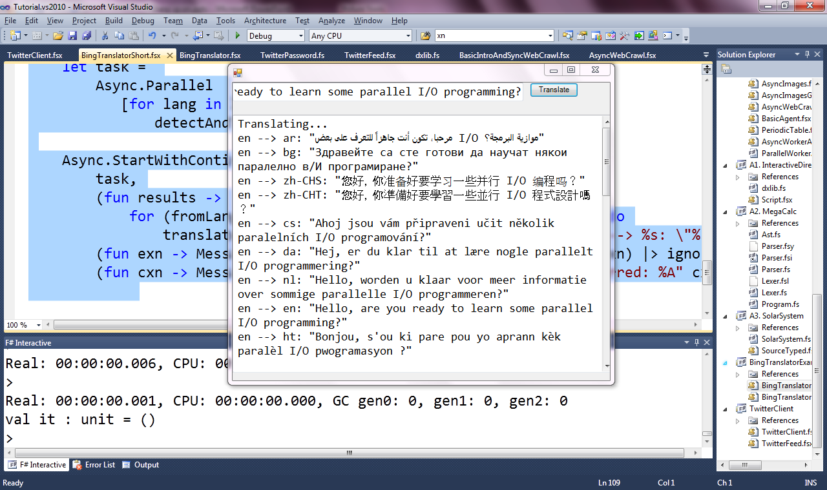

Slide 16
F# async
Parallel
Agents
Server

Slide 17
F# async
Parallel
Server
Agents

Slide 18
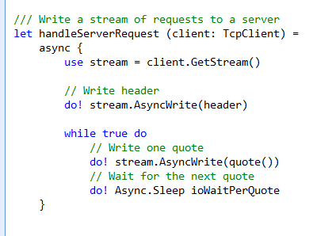
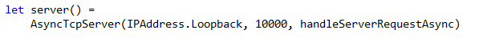
F# example: Serving 5,000+ simultaneous TCP connections with ~10 threads
React!
React!
React!

Slide 19
F# async
Parallel
Server
Agents

Slide 20
F# async
Parallel
Server
Agents

Slide 21
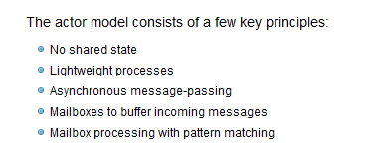

Slide 22
One Agent
let agent =
Agent.Start(fun inbox ->
async { while true do
let! msg = inbox.Receive()
printfn "got message %s" msg } )
agent.Post "three"
agent.Post "four"
Note:
type Agent<'T> = MailboxProcessor<'T>

Slide 23
100,000 Agents
let agents =
[ for i in 0 .. 100000 ->
Agent.Start(fun inbox ->
async { while true do
let! msg = inbox.Receive()
printfn "%d got message %s" i msg })]
for agent in agents do
agent.Post "hello"
Note:
type Agent<'T> = MailboxProcessor<'T>

Slide 24
Demos: Agents

Slide 25
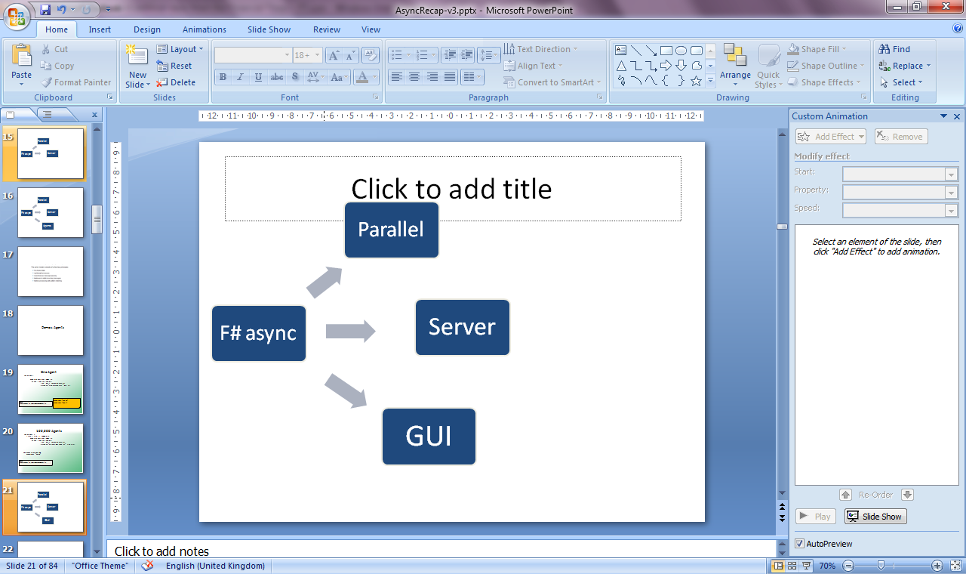
F# async
Parallel
Server
Agents

Slide 26
Demo: WebSharper

Slide 27
Taming Asynchronous I/O
using System;
using System.IO;
using System.Threading;
public class BulkImageProcAsync
{
public const String ImageBaseName = "tmpImage-";
public const int numImages = 200;
public const int numPixels = 512 * 512;
// ProcessImage has a simple O(N) loop, and you can vary the number
// of times you repeat that loop to make the application more CPU-
// bound or more IO-bound.
public static int processImageRepeats = 20;
// Threads must decrement NumImagesToFinish, and protect
// their access to it through a mutex.
public static int NumImagesToFinish = numImages;
public static Object[] NumImagesMutex = new Object[0];
// WaitObject is signalled when all image processing is done.
public static Object[] WaitObject = new Object[0];
public class ImageStateObject
{
public byte[] pixels;
public int imageNum;
public FileStream fs;
}
public static void ReadInImageCallback(IAsyncResult asyncResult)
{
ImageStateObject state = (ImageStateObject)asyncResult.AsyncState;
Stream stream = state.fs;
int bytesRead = stream.EndRead(asyncResult);
if (bytesRead != numPixels)
throw new Exception(String.Format
("In ReadInImageCallback, got the wrong number of " +
"bytes from the image: {0}.", bytesRead));
ProcessImage(state.pixels, state.imageNum);
stream.Close();
// Now write out the image.
// Using asynchronous I/O here appears not to be best practice.
// It ends up swamping the threadpool, because the threadpool
// threads are blocked on I/O requests that were just queued to
// the threadpool.
FileStream fs = new FileStream(ImageBaseName + state.imageNum +
".done", FileMode.Create, FileAccess.Write, FileShare.None,
4096, false);
fs.Write(state.pixels, 0, numPixels);
fs.Close();
// This application model uses too much memory.
// Releasing memory as soon as possible is a good idea,
// especially global state.
state.pixels = null;
fs = null;
// Record that an image is finished now.
lock (NumImagesMutex)
{
NumImagesToFinish--;
if (NumImagesToFinish == 0)
{
Monitor.Enter(WaitObject);
Monitor.Pulse(WaitObject);
Monitor.Exit(WaitObject);
}
}
}
public static void ProcessImagesInBulk()
{
Console.WriteLine("Processing images... ");
long t0 = Environment.TickCount;
NumImagesToFinish = numImages;
AsyncCallback readImageCallback = new
AsyncCallback(ReadInImageCallback);
for (int i = 0; i < numImages; i++)
{
ImageStateObject state = new ImageStateObject();
state.pixels = new byte[numPixels];
state.imageNum = i;
// Very large items are read only once, so you can make the
// buffer on the FileStream very small to save memory.
FileStream fs = new FileStream(ImageBaseName + i + ".tmp",
FileMode.Open, FileAccess.Read, FileShare.Read, 1, true);
state.fs = fs;
fs.BeginRead(state.pixels, 0, numPixels, readImageCallback,
state);
}
// Determine whether all images are done being processed.
// If not, block until all are finished.
bool mustBlock = false;
lock (NumImagesMutex)
{
if (NumImagesToFinish > 0)
mustBlock = true;
}
if (mustBlock)
{
Console.WriteLine("All worker threads are queued. " +
" Blocking until they complete. numLeft: {0}",
NumImagesToFinish);
Monitor.Enter(WaitObject);
Monitor.Wait(WaitObject);
Monitor.Exit(WaitObject);
}
long t1 = Environment.TickCount;
Console.WriteLine("Total time processing images: {0}ms",
(t1 - t0));
}
}
let ProcessImageAsync () =
async { use inStream = File.OpenRead(sprintf "Image%d.tmp" i)
use! pixels = inStream.ReadAsync(numPixels)
let pixels' = TransformImage(pixels,i)
use outStream = File.OpenWrite(sprintf "Image%d.done" i)
do! outStream.WriteAsync(pixels') }
let ProcessImagesAsyncWorkflow() =
Async.Run (Async.Parallel
[ for i in 1 .. numImages -> ProcessImageAsync i ])
Processing 200 images in parallel
Equivalent F#, more robust

Slide 28
Part 2: MiniAsync
How to add “async” to a language

Slide 29
The Basic Recipe
1. Add an asynchronous modality to your language
“async expressions” (F#)
“async methods” (C#, Scala)
“asyncerators” (fantasy language X)
Reuse and augment control-flow syntax
let, match, while, for, try-with, try-finally, bind/await, return, ...
Modality gives asynchronous interpretation to these
2. Add library primitives
According to richness of computational environment

Slide 30
MiniAsync
expr =
| ...
| async { aexpr }
aexpr =
| let! pat = expr in aexpr
| return expr
library +=
Async.StartImmediate
Async.Sleep
: Async<T>
: Async<T> * (T -> Async<U>) -> Async<U>
(bind)
: Async<unit> -> unit
(start as co-routine)
: int -> Async<unit>
(Primitive to sleep)

Slide 31
Assumptions on Host Language
Making all code “async” is not feasible for performance or semantic reasons
normally the case, since “fast” code likes to have extra resources handy, like stack
some execution environments must be fundamentally non-blocking (Javascript, Realtime)
We may want a modal split for engineering reasons
The available threading model is not sufficiently lightweight
e.g. 1MB stack/thread + other overheads

Slide 32
MiniAsync
expr =
| ...
| async { aexpr }
aexpr =
| let! pat = expr in aexpr
| return expr
| try aexpr with pat -> aexpr
| try aexpr finally expr
| while expr do aexpr
| let pat = expr in aexpr
| match expr with pat -> aexpr
| return! expr
| expr
library +=
Async.StartImmediate

Slide 33
MiniAsync
expr =
| ...
| async { aexpr }
aexpr =
| let! pat = expr in aexpr
| return expr
| try aexpr with pat -> aexpr
| try aexpr finally expr
| while expr do aexpr
| let pat = expr in aexpr
| match expr with pat -> aexpr
| return! expr
| expr
library +=
Async.StartImmediate
Note, these ones really
assume an impure
language

Slide 34
Computational Model #1 (Javascript)
✰ (e.g. Click)
Single Threaded GUI
Pending
Reactions
!
✰
(e.g. I/O
response)
...
!
!
!
...
Handlers (callbacks)

Slide 35
MiniAsync (reactive)
expr =
| ...
| async { aexpr }
aexpr =
| let! pat = expr in aexpr
| return expr
library +=
Async.StartImmediate
Async.Sleep(n) : Async<unit>
webRequest.AsyncGetResponse() : Async<unit>
Primitive to
await web response

Slide 36
The Computational Model (Multicore Java/C#/F#/...)
✰ (e.g. Click)
Single Threaded GUI
(separated state)
Background
Work Item
Queue(s)
Pending
Reactions
!
✰
(e.g. I/O
response)
...
!
!
!
...
Thread Pool
Handlers (callbacks)

Slide 37
MiniAsync (multicore)
expr =
| ...
| async { aexpr }
aexpr =
| let! pat = expr in aexpr
| return expr
| try aexpr with pat -> aexpr
| try aexpr finally expr
| while expr do aexpr
| let pat = expr in aexpr
| match expr with pat -> aexpr
| return! expr
| expr
library +=
Async.StartImmediate
Async.RunSynchronously
Async.Parallel
Async.StartChild
+ I/O, affinity, cancellation primitives...
: Async<T> -> T
(start & blocking wait)
: Async<T>[] -> Async<T[]>
(start & blocking wait)
: Async<T> -> Async<T>
(queue in thread pool & return promis)

Slide 38
Part 3: The General Syntactic Mechanism in F#
Computation Expressions

Slide 39
Uses
seq { ... }
async { ... }
asyncSeq { ... }
eventually { ... }

Slide 40
Operation | Signature | LINQ syntax (one use) | F# syntax (monad use) | F# syntax (monoid use)
return | A → M<A> | select e | return e | --
bind | M<A> → (A → M<B>) → M<B> | from x in e | let! x = e ... | --

Slide 41
Operation | Signature | LINQ syntax (one use) | F# syntax (monad use) | F# syntax (monoid use)
return | A → M<A> | select e | return e | --
bind | M<A> → (A → M<B>) → M<B> | from x in e | let! x = e ... | --
seqM | M<unit> → M<A> → M<A>) |  | ... ; ...
iterM | seq<A> → (A → M<unit>) → M<unit> |  | for x in e ... | --
whileM | (unit → bool) → M<unit> → M<unit> |  | while x do ...

Slide 42
Operation | Signature | LINQ syntax (one use) | F# syntax (monad use) | F# syntax (monoid use)
return | A → M<A> | select e | return e | --
bind | M<A> → (A → M<B>) → M<B> | from x in e | let! x = e ... | --
seqM | M<unit> → M<A> → M<A>) |  | ... ; ...
iterM | seq<A> → (A → M<unit>) → M<unit> |  | for x in e ... | --
whileM | (unit → bool) → M<unit> → M<unit> |  | while x do ...
append | M<A> → M<A> → M<A> |  |  | ... ; ...
yield | A → M<A> |  |  | yield e
appendFor | seq<A> → (A → M<B>) → M<B> |  |  | for x in e ...
appendWhile | (unit → bool) → M<A> → M<A> |  |  | while x do ...

Slide 43
Case Study: Making the F# Language Service More Reliably Reactive
Basic architecture:
single GUI thread (VS)
single background thread (F# compiler services)
The problem:
The F# compiler uses enough mutable state that type-checking is single threaded.
We can’t afford for the background worker to be unresponsive
The solution:
Computations are “chopped and spliced” into < ~25ms.

Slide 44
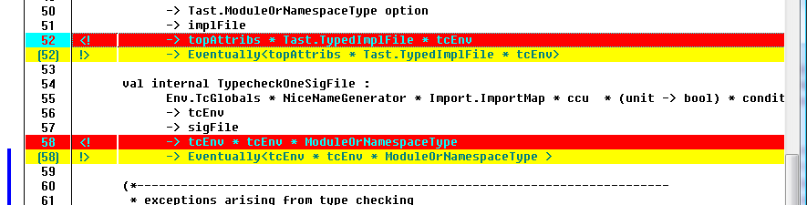

Slide 45
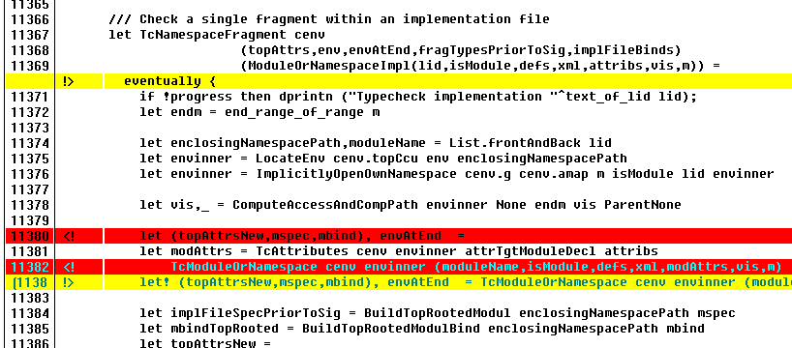

Slide 46
Generality – e.g. Type Indexed Monads
type MonadBuilder() with
member Return : 'a -> M<'a,'idx>
member Bind: M<'a,'idx> * ('a -> M<'b,'idx>) -> M<'b,'idx>
let monad = MonadBuilder()

Slide 47
Very general monadic/monoidal syntax
In a strict language
Haskell monadic syntax now looks very “bare”. Time for a rethink?
Applicable to any functional language which aspires to have multi-paradigm elements
Including pure languages

Slide 48
Summary

Slide 49
Summary
F# “async” finalized in F# 2.0 (2010)
Based on an “async modality”, syntax, library
Efficient, simple, regular with rest of language
For Server, GUI, HTML5, agent programming
Massively simplifies async/parallel/reactive programming
Model is potentially applicable to many languages
Basic idea published in “Expert F#”, 2007
Summaries in subsequent papers (Petricek, Syme)
[Confidential] C# adopting “async” modality for C# 5.0

Slide 50
Possible Future Directions
Formalize MiniAsync
give language variations in C#, Java, Javascript, Haskell, etc.
give library variations for different domains
compare & contrast to the huge related literature
Variations
Pure core language?
Impure core language without data races? (c.f. F#/Axum agent language)
Splitting code into sync/async is a variation on the pure/IO split of Haskell.
i.e. there is more than one choice about where to split, even for a “safe” language.

Slide 51
Questions?

Slide 52
use - background
open System.IO
open System.Collections.Generic
let readAllLines(file) =
use inp = File.OpenText file
let res = new List<_>()
while not(inp.EndOfStream) do
res.Add(inp.ReadLine())
res.ToArray()
“use” =
C# “using”

Slide 53
use
open System.IO
open System.Collections.Generic
let readAllLines(file) =
let inp = File.OpenText file
try
let res = new List<_>()
while not(inp.EndOfStream) do
res.Add(inp.ReadLine())
res.ToArray()
finally inp.Close()
use is sugar for try/finally

Slide 54
use
open System.IO
open System.Collections.Generic
let readAllLines(file) =
async { let! inp = File.AsyncOpenText file
try
let res = new List<_>()
while not(inp.EndOfStream) do
let! line = inp.AsyncReadLine()
res.Add(line)
res.ToArray()
finally inp.Close() }
we can use the same sugar here

Slide 55
use
open System.IO
open System.Collections.Generic
let readAllLines(file) =
async { use inp = File.OpenText file
let res = new List<_>()
while not(inp.EndOfStream) do
let! line = inp.AsyncReadLine()
res.Add(line)
res.ToArray() }

Slide 56
A Popular Question
Today’s multi-paradigm languages all tend to include embedded, richer computational sub-languages
Scala
Extensible Monadic Generator Expressions
C#
Iterators for generated sequences
LINQ for extensible data queries
C# 5.0 async programming
Haskell
List Comprehensions
Monadic Syntax
Arrow Syntax
Python
Generators/Consumers

Slide 57
Examples
Same control language, very different computational interpretation (on-demand, state-machine)
C# generators/iterators
public IEnumerator<string> GetEnumerator()
{
yield return "New York";
yield return "Paris";
yield return "London";
}
// Method that takes an iterable input (possibly an array)
// and returns all even numbers.
public static IEnumerable<int> GetEven(IEnumerable<int> numbers)
{
foreach (int i in numbers)
if ((i % 2) == 0)
yield return i;
}

Slide 58
Full F# Syntax & Translation
expr = ...
| expr { cexpr } -- let v = expr in v.Delay(fun () -> «cexpr»)
| { cexpr }
| [| cexpr |]
| [ cexpr ]
cexpr = let! pat = expr in cexpr -- v.Bind(expr,(fun pat -> «cexpr»))
| use pat = expr in cexpr -- v.Using(expr,(fun pat -> «cexpr»))
| do! cexpr1 in cexpr2 -- «let! () = cexpr1 in cexpr2»
| do expr in cexpr -- «let () = cexpr1 in cexpr2»
| for pat in expr do cexpr -- v.For(expr,(fun pat -> «cexpr»))
| while expr do cexpr -- v.While((fun () -> expr),
v.Delay(fun () -> «cexpr»))
| if expr then cexpr else cexpr -- if expr then «cexpr1» else «cexpr2»
| if expr then cexpr -- if expr then «cexpr1» else v.Zero()
| cexpr; cexpr -- v.Combine(«cexpr1», v.Delay(fun () -> «cexpr2»))
| return expr -- v.Return(expr)
| return! expr -- v.ReturnFrom(expr)
| yield expr -- v.Yield(expr)
| yield! expr -- v.YieldMany(expr)
| match expr with [pat -> cexpr]+ -- ...
| try cexpr finally cexpr -- ...
| try cexpr with pat -> cexpr -- ...

Slide 59
Recap:
Add a general mechanism for de-sugared control flow in a strict functional language
Doesn’t commit to underlying use of resumptions/continuations/co-routines/state-machines
F# compiler knows how to optimize seq { ... } to state machines
We have made that syntax is uniform with F# control flow syntax

Slide 60
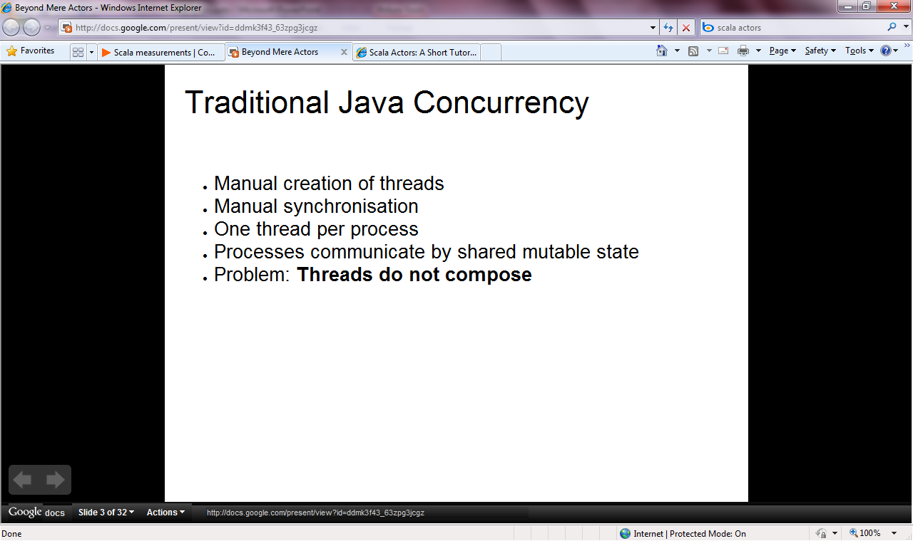

Slide 61
