Slide 1




Wayqu! Natural
Wayqu!
Disaster prediction model
.
. .
isaste re i i
Alejandro Pastor

Slide 2
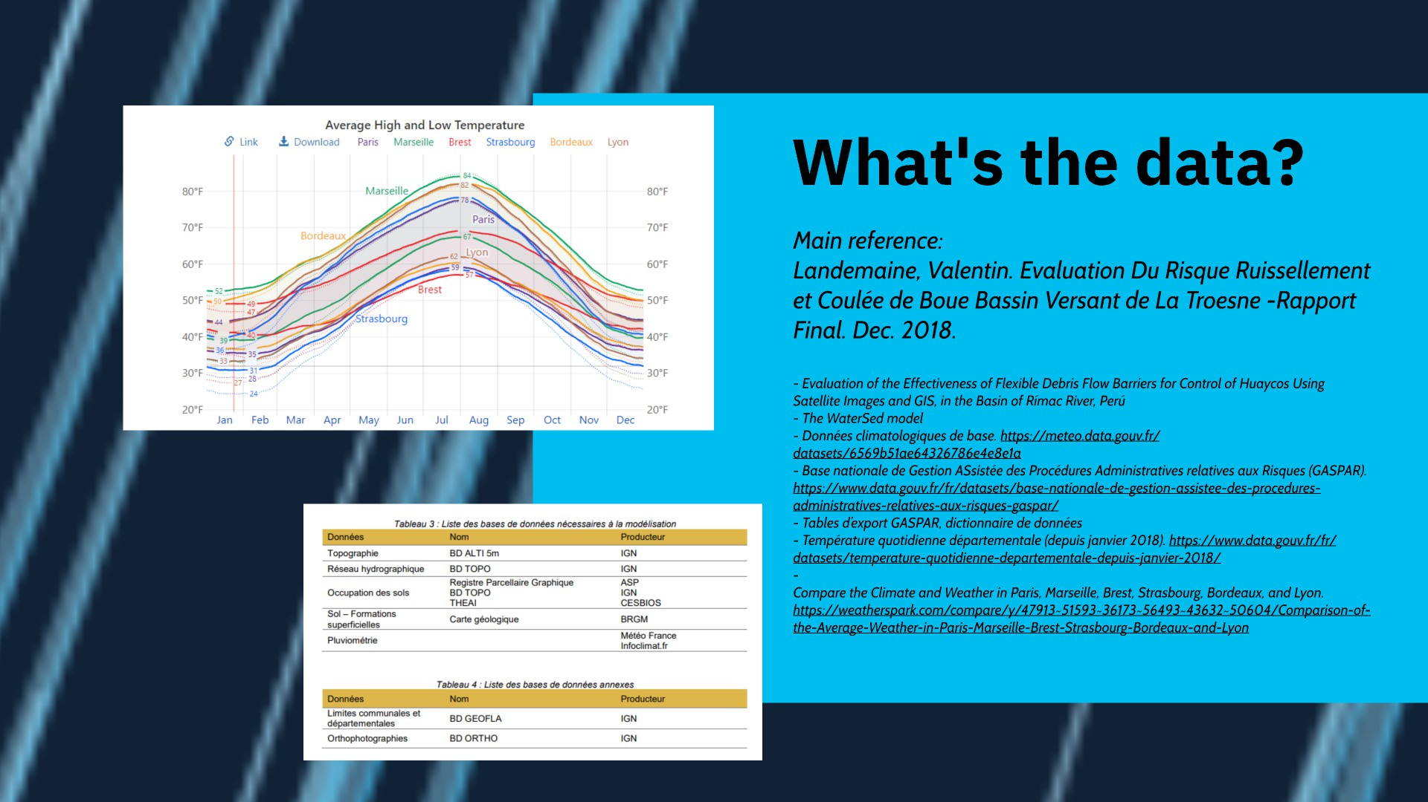

Slide 3
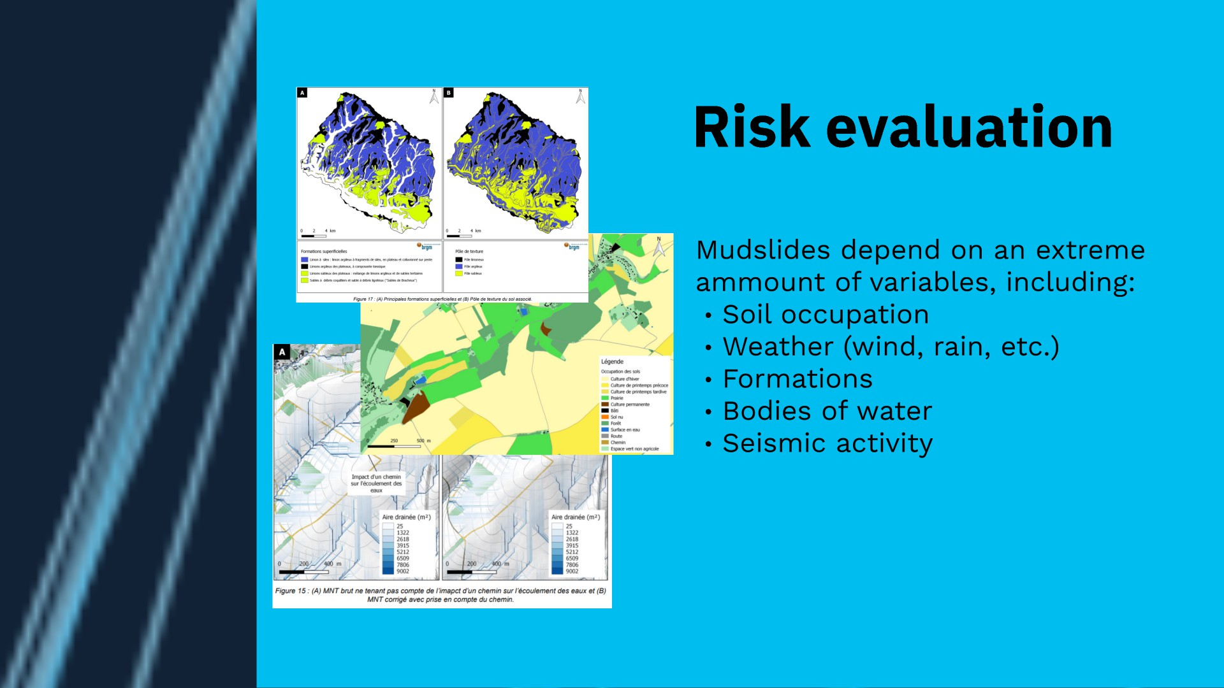

Slide 4
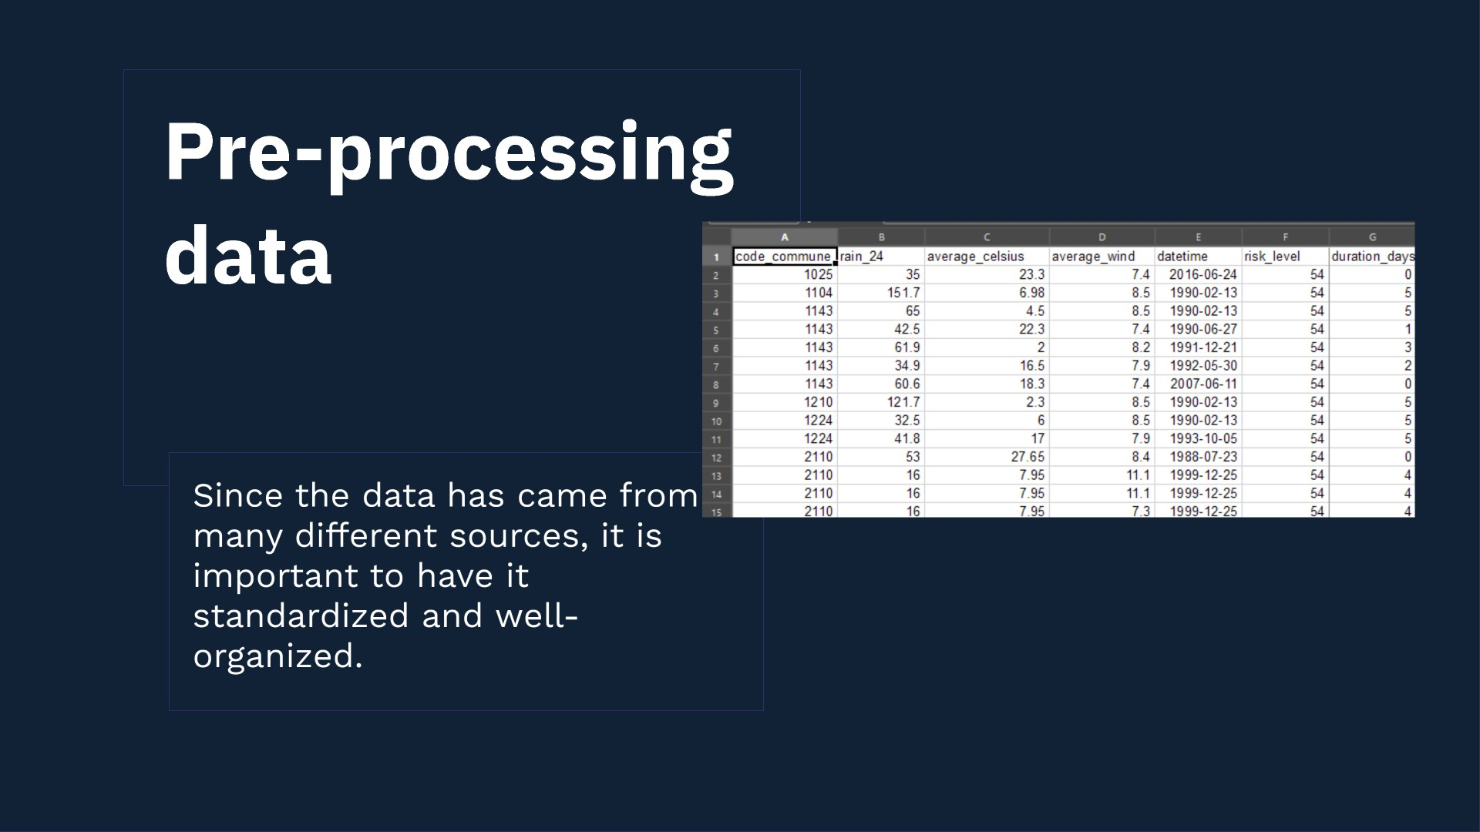

Slide 5


Slide 6
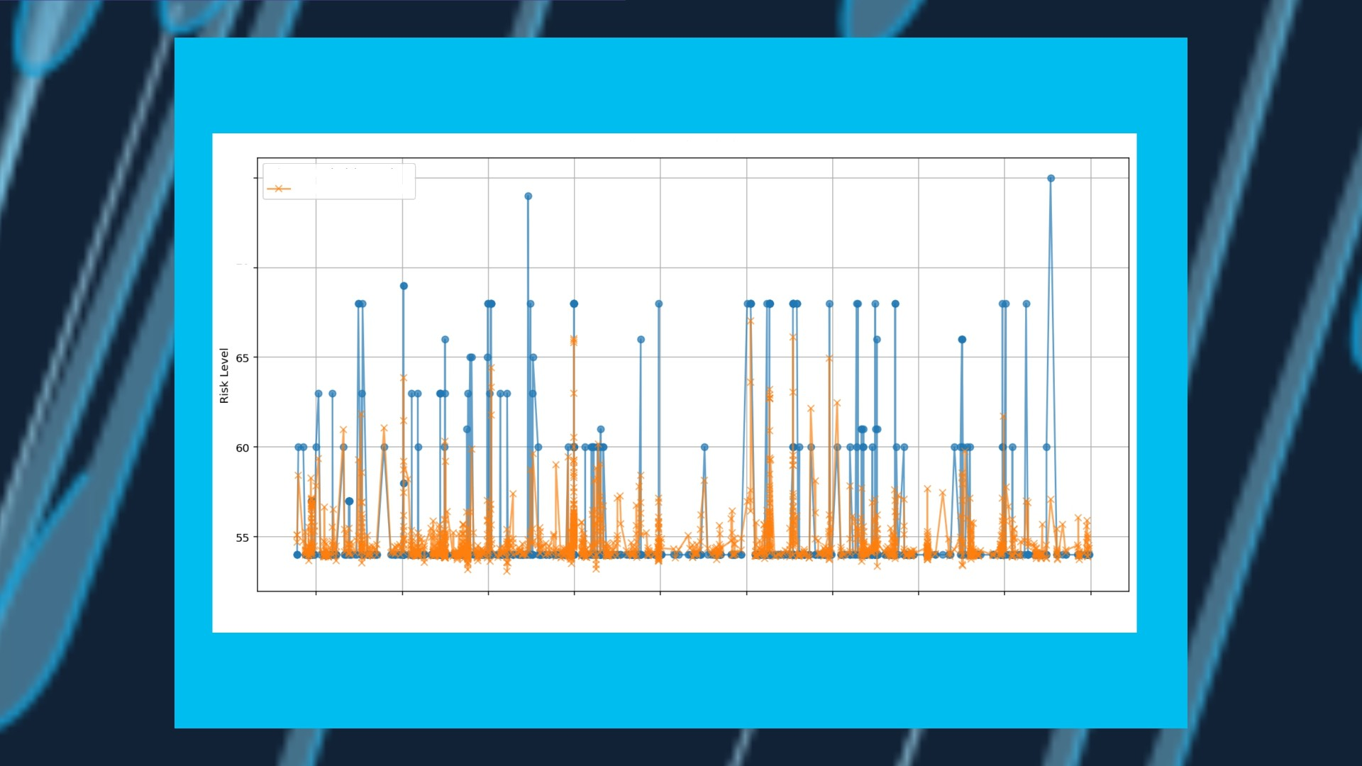
Actual vs Predicted Risk Levels
7›
Actual Risk Level
Predicted Risk Level
70
1988
l99Z
1996
ZOOO
Z004
Z008
Z0l2
2016
2020
2024
Date

