Slide 1

Github 101
Surrey Code Camp
By Derrick Gold (@TheDerrickGold)
http://derrickgold.com
These slides were intentionally made verbose for those who could not attend the presentation. ☺

Slide 2
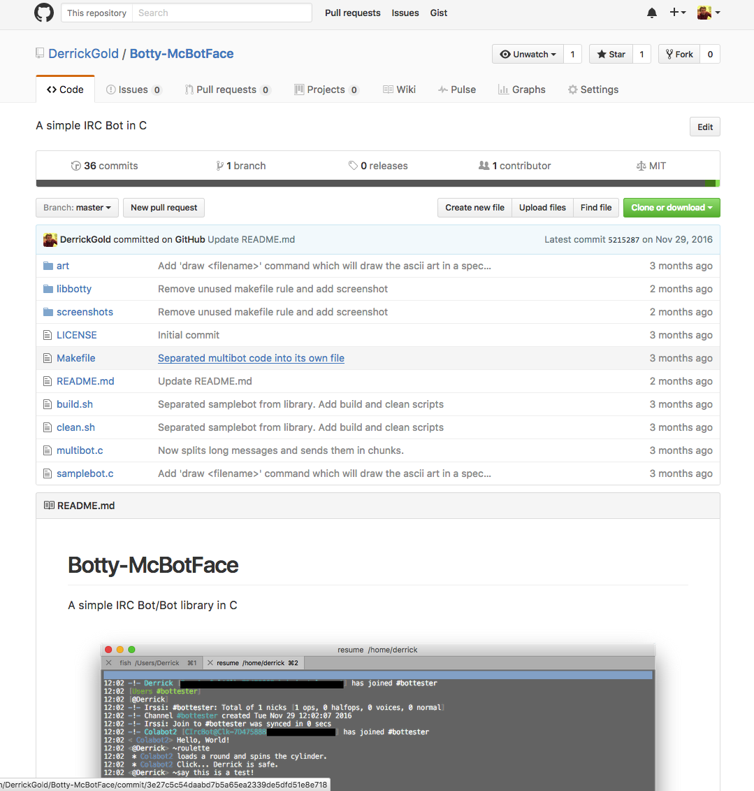
What is Github?
A Platform for collaborative and/or personal programming projects that utilize a tool called “Git”.
Surrey Code Camp
Provides online hosting/backup of your project’s source code, and a convenient web interface for displaying and managing access to your project.
Having your projects all accumulated in one place creates a great in-depth portfolio of your work for tech recruiters and companies alike.*
*Your mileage may vary depending on the company.
Source: Botty-McBotFace by Derrick Gold
https://github.com/DerrickGold/Botty-McBotFace

Slide 3
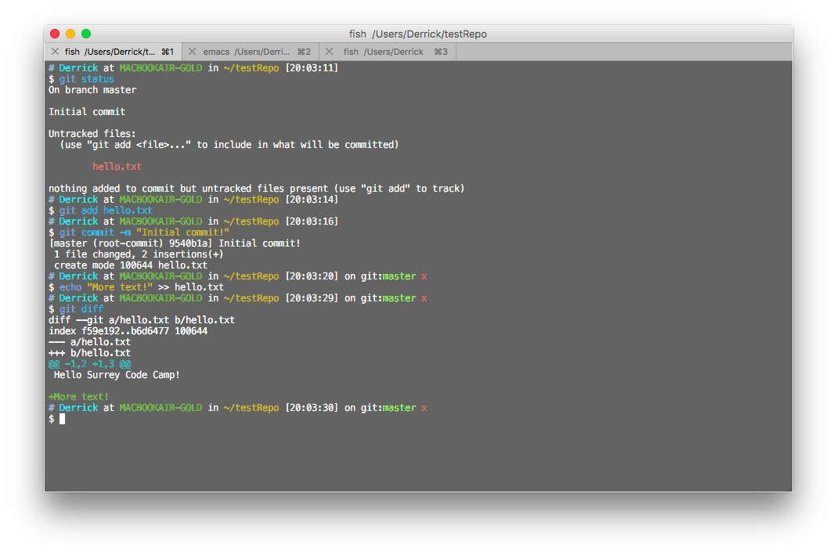
What is Git?
A revision control system for collaborative or personal projects.
Used to keep track of what changes are made to the code base and who made what changes.
Surrey Code Camp
This exists as a tool that is used on your machine which interacts with a remote hosting platform (e.g. Github, GitLab, Bitbucket, etc.).
If used properly, creates a history of incremental changes that can be reverted at any point.
Sample repository managed using the command line Git interface.

Slide 4
Definitions
Here are some definitions for the terminology used when describing typical Git usage.
Surrey Code Camp
Repository: This refers to your project’s code base. On your local machine it is the top most folder that encompasses your entire project. Remotely, it’s the Github page that was created for your specific project.
Clone: This is an action that is performed by Git to create a local copy of a repository from a remote server.
Pull: This Git action downloads any incremental changes that have been made remotely after your initial clone. This how you would retrieve any changes made by your collaborators.

Slide 5
Definitions Cont.
Push: This Git action will send your local incremental changes to the remote repository. This will allow your collaborators to pull your changes to their system.
Surrey Code Camp
Commit: This Git action will create an incremental snapshot of your local changes made to the repository along with a description of what changed. This snapshot is a point of return if something breaks, and is what is sent to the remote server when you push your changes.
Merge: This action is used to help resolve non-deterministic changes between two commits. This situation arises when you attempt to pull or push new changes with your local repository that is out of sync with the remote repository. With the merge action, you will have to manually select what changes to keep between commits in order to merge them into one.

Slide 6
Definitions Cont. 2
Branch: Creating a branch in a repository will allow you to continue working on your own series of changes while storing them remotely, without affecting any code that exists on other branches. A Git project by default has a Master branch that all code is typically pushed to, unless otherwise specified.
Surrey Code Camp
Forking: This is a Github specific action that creates an exact copy of a remote repository on Github, and clones it to your Github account, which you can then clone to your local machine.
As a result, this copy is under your ownership where you are free to push changes to it; these changes will not affect the original repository that was forked.

Slide 7
High Level Git View
Surrey Code Camp
Sample Repository with multiple branches
Graph created by Wojciech Frącz
http://jsfiddle.net/fracz/guan1oz1/374/

Slide 8
Typical Git/Github Workflow
For starting a new project:
Create the repository on Github
Clone the repository to your local machine
Surrey Code Camp
For continuing work on your local repository:
Use git add to select the files you’ve modified for your commit
Once you have your changes added, use git commit to create a snapshot, and attach a message to this commit indicating what you’ve changed
Use git pull to retrieve any remote changes, and merge them or rebase them as necessary
Finally use git push to send your commits to the remote repository for others to pull

Slide 9
Open Source Workflow
Github makes it really easy to contribute to other projects that exist on Github.
By default only the owner of a repository can push changes to their repository (for security purposes). Other users can be granted permissions individually, but this is not ideal for massive projects where hundreds of people could be contributing.
Github allows users to make a request to the repository owner to pull changes that they’ve made on their own fork of the original repository. This action is known as a Pull Request.
Surrey Code Camp

Slide 10
Open Source Workflow cont.
Ensure that you have the repository of the project you wish to contribute to forked on your Github account
Clone your forked repository to your local machine
Make your changes to cloned repository and push it to your fork of the project repository
On your forked repository page on Github, create a pull request to the original repository.
If the original repository maintainer deems your changes acceptable, they will accept your pull request and merge your changes into their repository!
Surrey Code Camp

Slide 11
Some Common Practices
Make commits often: these are your points of return if something breaks and you need to jump back to a point your code where it was working before
Make useful commit messages: these let others know what has been changed quickly without having to read through the code
the first line of your commit message should be a broad description of your change (max 50 characters long). Indepth details can be added on further lines. The messages will look nicer on the Github page.
Do not commit files to the repository that can be generated. The repository should only contain the files necessary for the project to ‘build’ on your machine; this helps to remove redundant files and decreases the overall size of your repository for when you need to pull or clone
Use branches to implement your own features separate from the master branch. This allows you to make any necessary changes without affecting the main codebase until it is ready to be merged in.
Surrey Code Camp

Slide 12
Github Practice Activity
Now that you are familiar with the basic concept of git and Github, here is a simple activity. Your goal is to simply add your name to the specified text file.
Make sure you have a Github account and are logged in
Fork this repository to your Github account: https://github.com/Surrey-Code-Camp/Lightning-Talks
Clone your fork to your local machine
In the Github-101 folder, there is a text file called signup.txt; add your name to the bottom of the list
Push your changes to your fork
On your forked repository Github page, make a pull request
Lets see what happens!
Surrey Code Camp

