Slide 1
GUI with JavaFX #2 Lab #8 COMP3021 2022 Spring ChengPeng Wang(cwangch@cse.ust.hk) Yiyuan Guo(yguoaz@cse.ust.hk) Bowen Zhang(bzhangbr@cse.ust.hk) Heqing Huang(hhuangaz@cse.ust.hk)

Slide 2
Objectives of This Lab
Learn How to Use More GUI Widgets with JavaFX.
Learn How to Handle Input / Output with JavaFX.

Slide 3
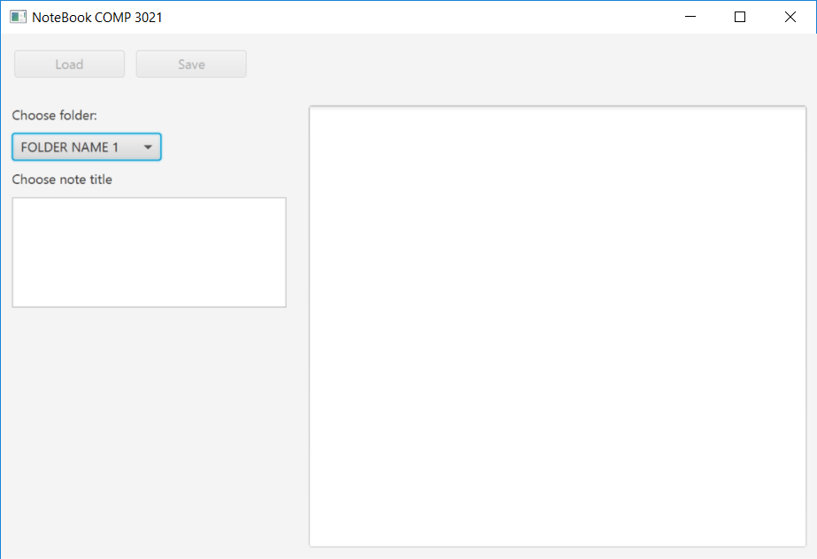
Recap of Lab 6
In previous lab, we have already designed the GUI with JavaFX shown in the left picture.
In this lab, we are going to do more things based on our previous design.

Slide 4
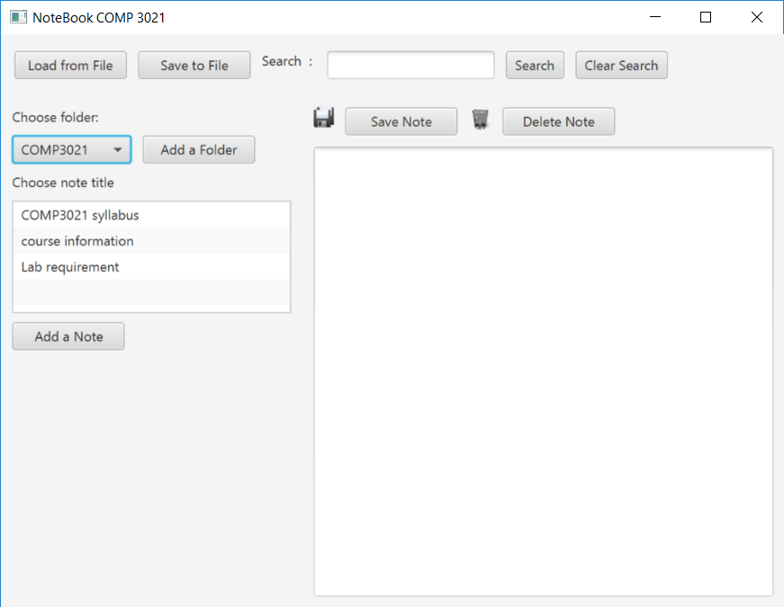
In this Lab
LOAD FROM FILE
/SAVE TO FILE
(In order to differentiate with “Save Note”, we change the names of these two buttons to “Load from File” and “Save to File”)
1
In this lab, we are going to add three more major functionality to this GUI.
2
ADD NEW FOLDER/NOTE
3
UPDATE/DELETE NOTE

Slide 5

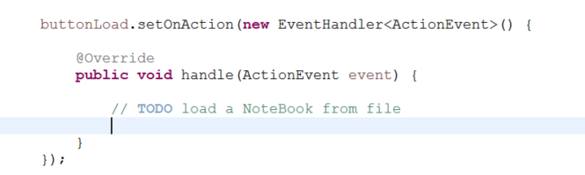
Task 1: Load from File / Save to File
Set setDisable()to false or remove it.
Add event handlers to those two buttons like what you did to buttonSearch.

Slide 6
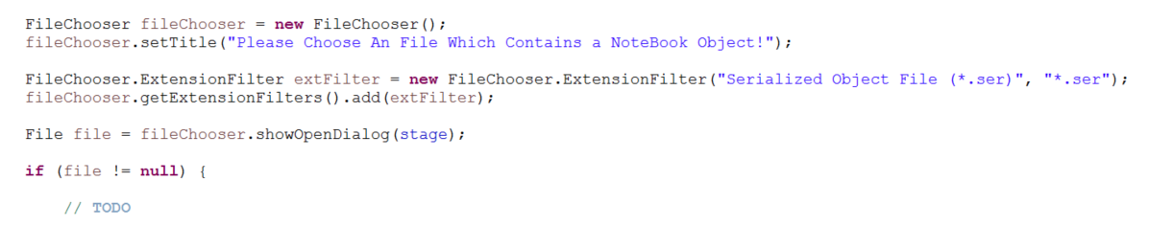
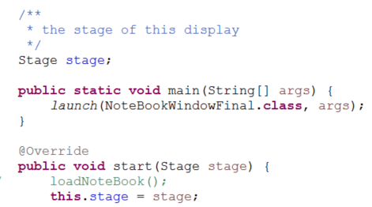
Task 1: Load from File / Save to File
3. Choose a file to load from.
Here, we use javafx.stage.FileChooser;
1
set the title of the choose window
2
Add a file filter to choose a specific type of files. Here, we set to “.ser”, which is the type of the file we created in Lab 4.
Show and open the dialog.
Here, the parameter is stage. In order to do so, we created a new variable called stage to store the stage of the current GUI.
3
4
If the chosen file is not null, we continue loading the file.
You can try to pass showOpenDialog() with parameter null, and please see the difference☺

Slide 7
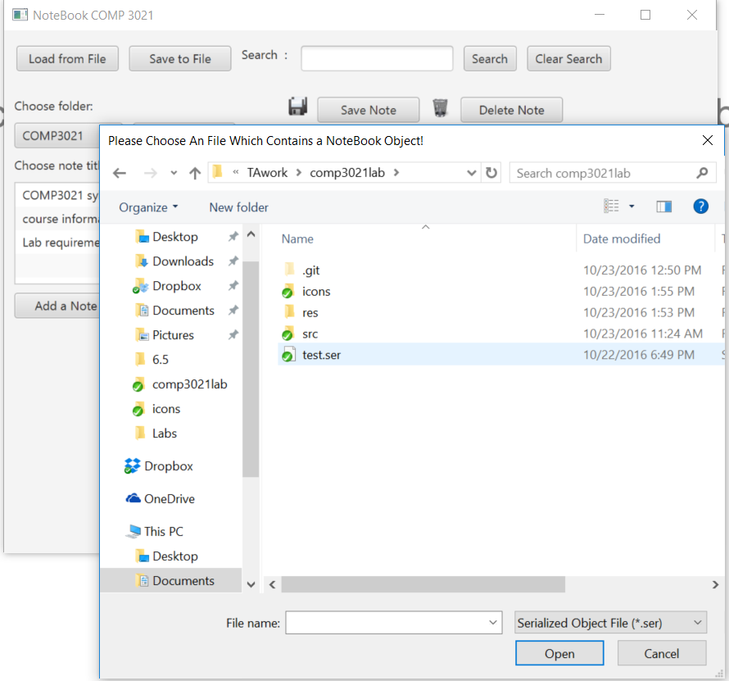
Task 1: Load from File / Save to File
3. Choose a file to load from.
If your code is correct, when you click the load button, it will pop up the following window for you to select a file.
Please select an file which contains a NoteBook object.
We provided a file “test.ser”.
Please download it from

Slide 8
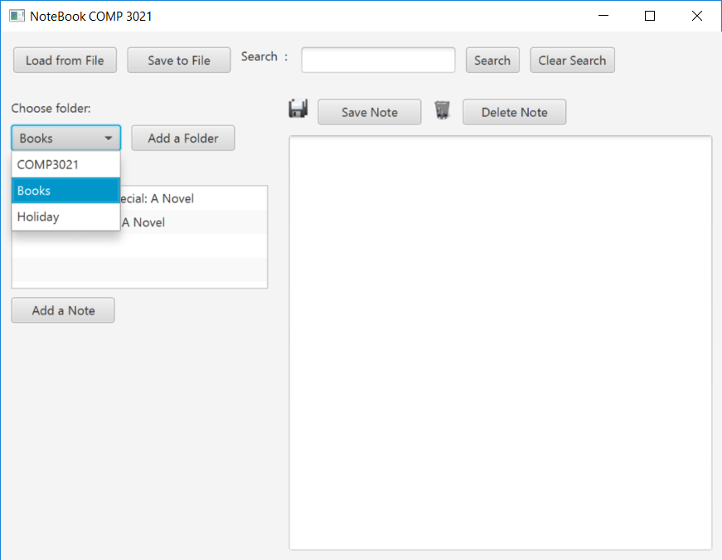
Task 1: Load from File / Save to File
4. Update the display
If the file is correctly selected, initialize the NoteBook object from the file and update the display.
You can add a new function overloading the previous loadNoteBook()function which initialize the note variable from file.
private void loadNoteBook(File file) {
// TODO
}
private void loadNoteBook() {
NoteBook nb = new NoteBook();
……

Slide 9
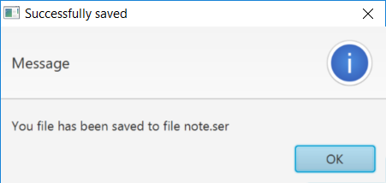
Task 1: Load from File / Save to File
5. Save to File
Conduct the same pressures to “Save to File”.
It will pops up a file selection windows when clicking the save button.
Save all the content of the NoteBook to the file selected.
If it’s successfully saved, pop ups a message window using Alert widget.
Alert alert = new Alert(AlertType.INFORMATION);
alert.setTitle("Successfully saved");
alert.setContentText("You file has been saved to file " + file.getName());
alert.showAndWait().ifPresent(rs -> {
if (rs == ButtonType.OK) {
System.out.println("Pressed OK.");
}
});

Slide 10
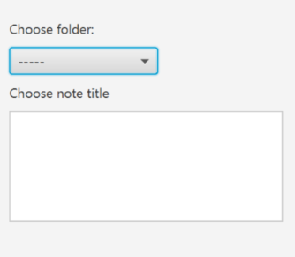
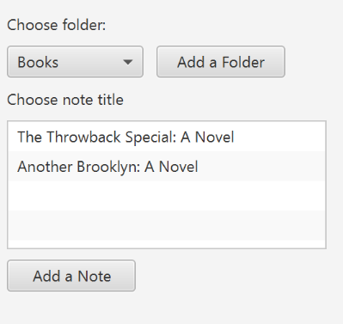
Task 2: Create New Folders/Notes
Add two new buttons “Add a Folder” and “Add a Note”
Previously, these widgets were organized by a VBox.
Now, in order to add one button to the right of the ComboBox,
you may need to group the ComboBox and the button to a HBox.
VBOX
HBOX
LISTVIEW
BUTTON

Slide 11
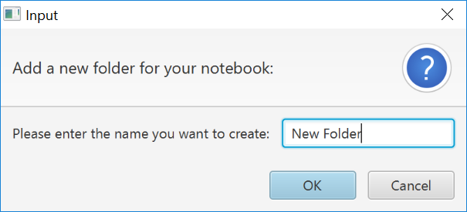
Task 2: Create New Folders/Notes
2. Add event hander to “Add a Folder” button.
Use TextInputDialog to interact with users.
You can input the new folder name through text input dialog.
TextInputDialog dialog = new TextInputDialog("Add a Folder");
dialog.setTitle("Input");
dialog.setHeaderText("Add a new folder for your notebook:");
dialog.setContentText("Please enter the name you want to create:");
// Traditional way to get the response value.
Optional<String> result = dialog.showAndWait();
if (result.isPresent()){
// TODO
}

Slide 12
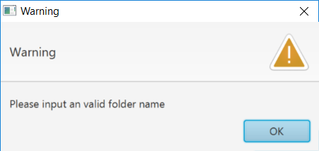
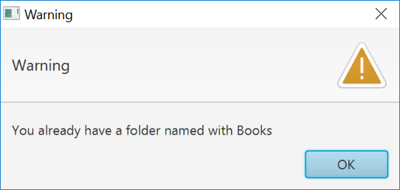
Task 2: Create New Folders/Notes
3. Check the validity of the input folder name.
If the input is an empty string
If the notebook already has a folder with the input name
Please deal with these cases and pop up warning message windows for users.
You can finish this using Alert widget as described before.

Slide 13
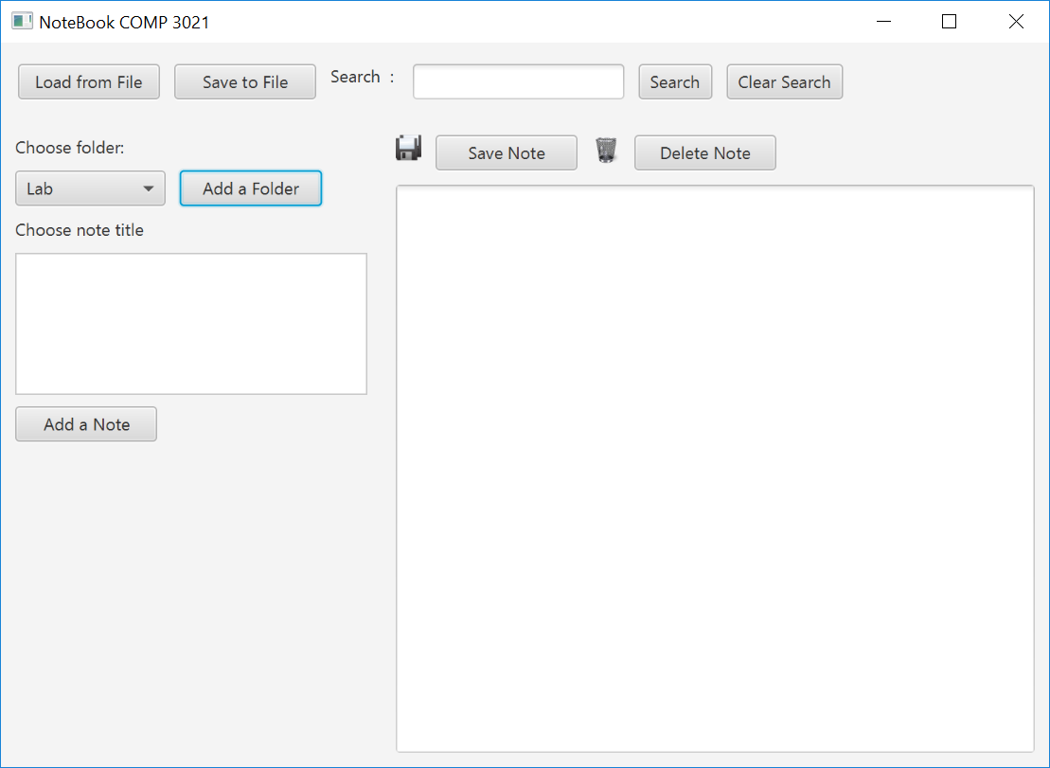

Task 2: Create New Folders/Notes
4. Update the note and display
If the input folder is valid, please add a new folder to the notebook.
In order to do so, you need to create a new function addFolder() in NoteBook.
public void addFolder(String folderName) {
// TO DO
}
Please update the display accordingly to make the newly added folder selected..

Slide 14
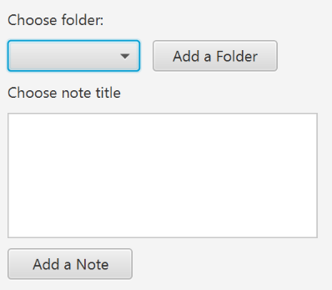
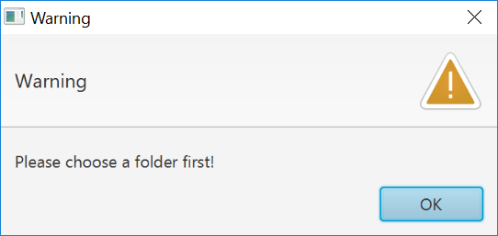
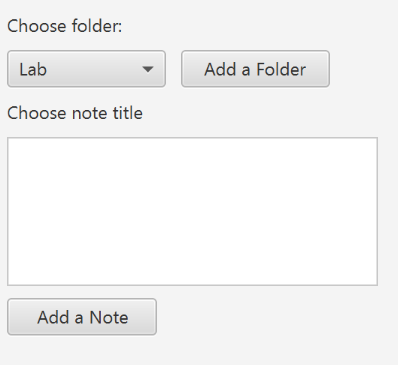
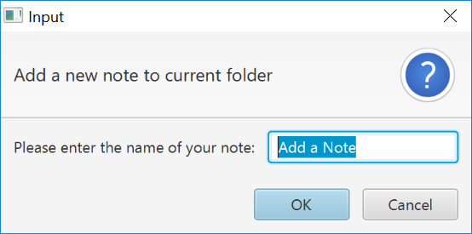
Task 2: Create New Folders/Notes
4. Add a new Note
First, check whether a folder is selected or not.
If a folder is not selected, give a warning message!
Because we need to insert a note to a specified folder.
If a folder is currently selected, then ask for input of the note name.
(the note added is a TextNote, and only the title is required for input)

Slide 15
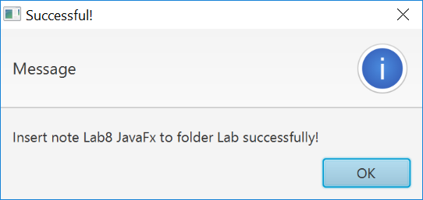
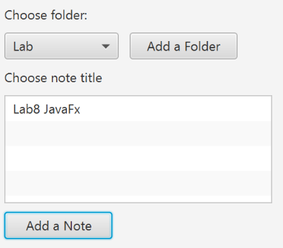
Task 2: Create New Folders/Notes
4. Add a new Note
Create a new Note to the selected folder.
You can call method
note.createTextNote(currentFolder, inputNoteName);
If successfully inserted, pops up a message.
Then update the list view.

Slide 16
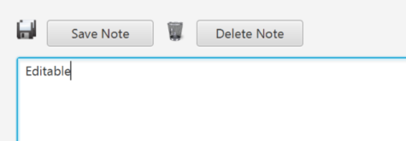
Task 3: Update the Content of a Note
1. Create a new member variable called currentNote.
This is used to store the name of the current note selected.
/**
* current search string
*/
String currentSearch = "";
/**
* current note selected by the user
*/
String currentNote = "";
2. Make the TextArea widget editable and add two new buttons.
textAreNote.setEditable(true);
Please also add two icons for save and delete
You can display images using ImageView. The two icon files are provided, and can be downloaded from the lab webpage.
ImageView saveView = new ImageView(new Image(new File("save.png").toURI().toString()));
saveView.setFitHeight(18);
saveView.setFitWidth(18);
saveView.setPreserveRatio(true);

Slide 17
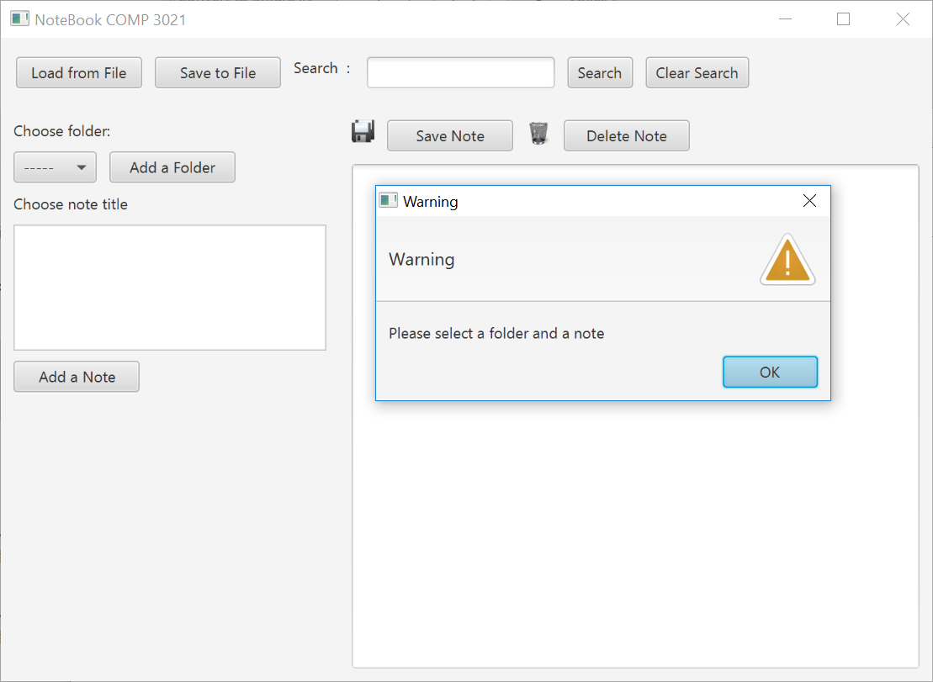
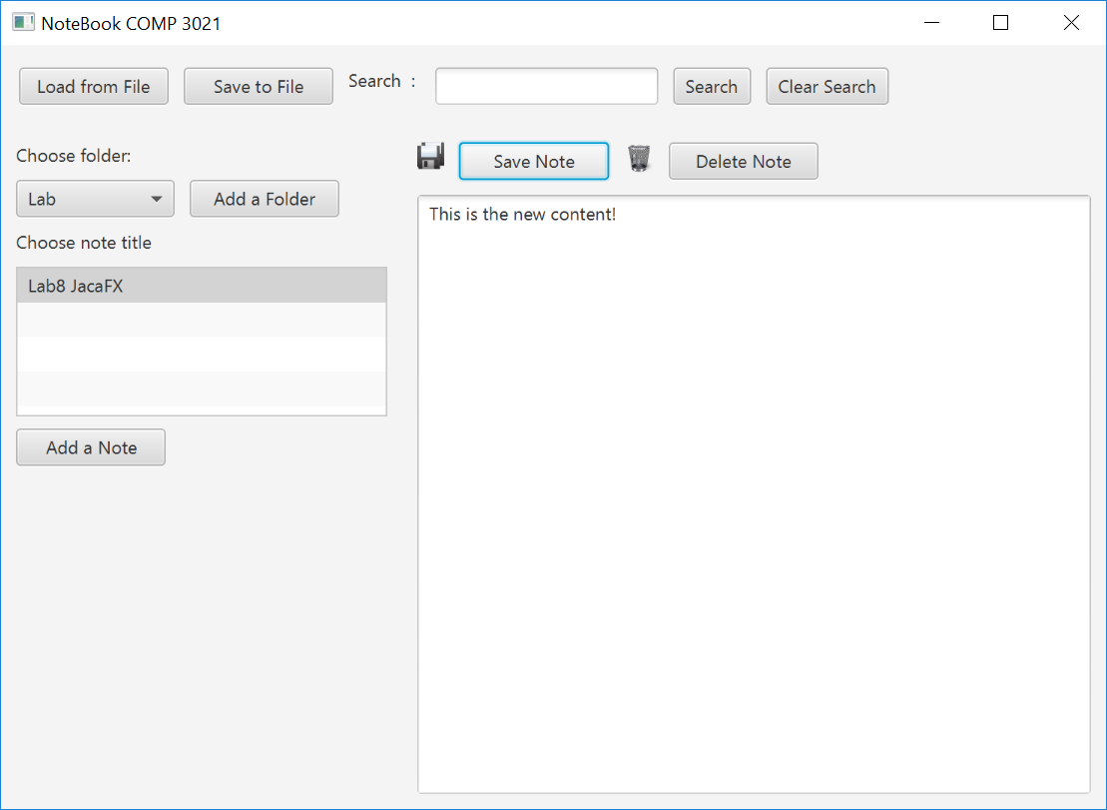
Task 3: Update the Content of a Note
1. Add event handler to button “Save Note”
First check whether currently a folder and a note have been selected yet.
If not, you can not save and please give a warning message.
Otherwise, save the content of the TextArea to the current Note selected.

Slide 18
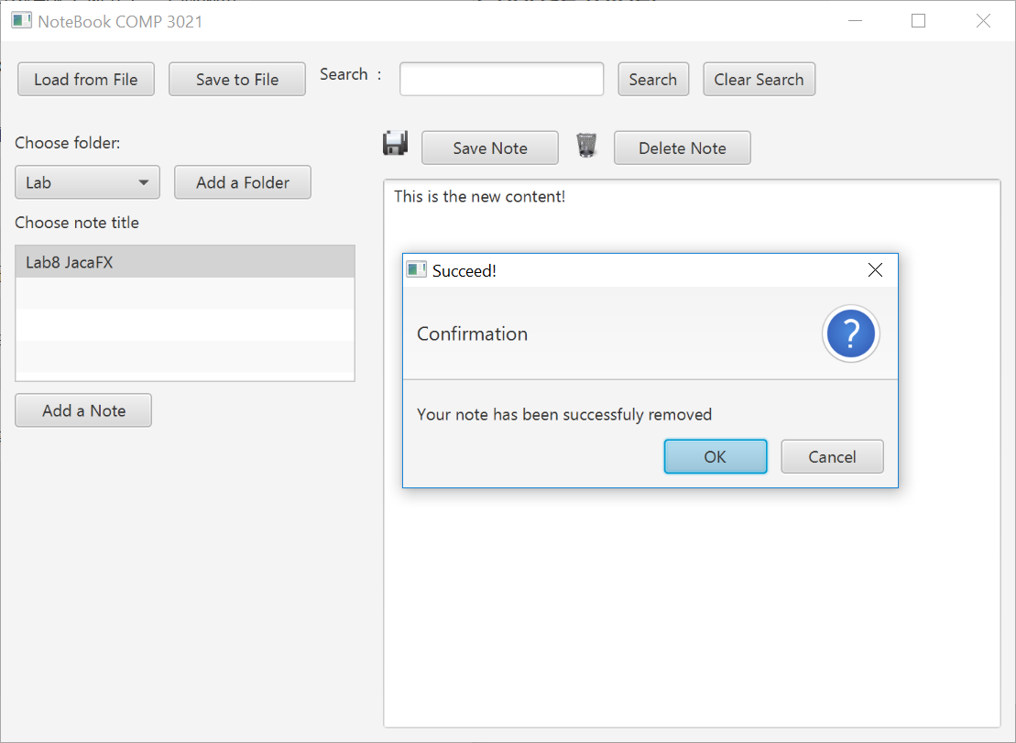
Task 3: Update the Content of a Note
2. Add event handler to button “Delete Note”
First check whether currently a folder and a note have been selected yet.
If not, you have no note to delete and please give a warning message.
Otherwise, please delete the currently selected note from the folder selected.
Please give a confirmation message if
the Note is deleted successfully.

Slide 19
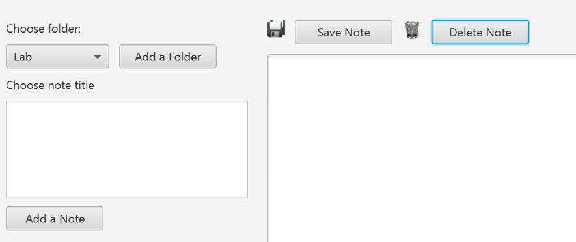
Task 3: Update the Content of a Note
2. Add event handler to button “Delete Note”
In order to finish this task, you need to add a new function
removeNotes(String title) to class Folder.
public boolean removeNotes(String title) {
// TODO
// Given the title of the note, delete it from the folder.
// Return true if it is deleted successfully, otherwise return false.
}
If the note is deleted successfully, please remember to update the list view.
The List View is Updated

Slide 20
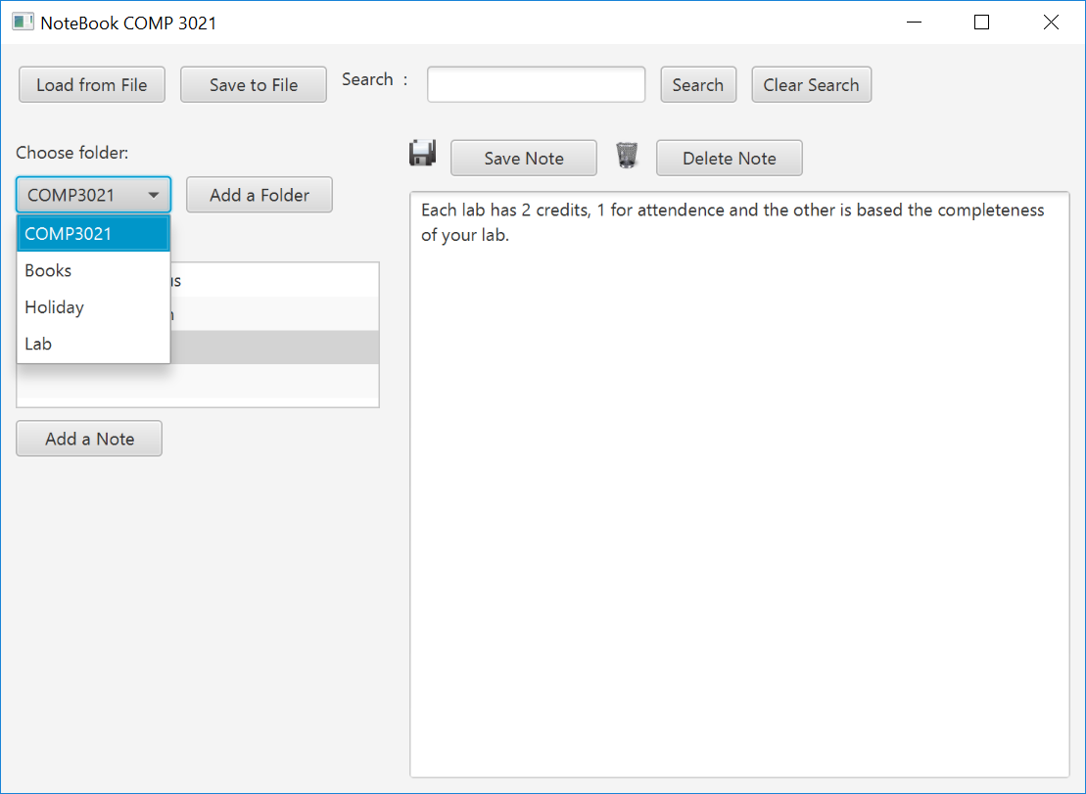
Show a demo of your program to the TAs

Slide 21
END OF LAB #8
Don’t forget to commit and push your code.

