Slide 1
Creating Classes and Objects Lab #2 COMP3021 2022 Spring
ChengPeng Wang(cwangch@cse.ust.hk) Yiyuan Guo(yguoaz@cse.ust.hk) Bowen Zhang(bzhangbr@cse.ust.hk) Heqing Huang(hhuangaz@cse.ust.hk))

Slide 2
Objectives of this lab
Learn How to Create a Class.
Attributes, constructors, getters and setters, equals(), toString().
Learn How to Inherit a Class
Classes and subclasses
this and super
Learn How to Create an Instance of a Class (Object)
Creating new objects, comparing objects, call member functions

Slide 3
Lab Project’s Introduction

Slide 4
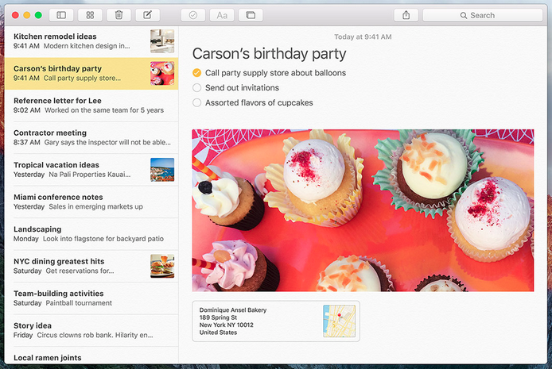
At the end of this course you will have implemented a NoteBook program in Java
Implemented incrementally during the lab sessions

Slide 5
Notebook
Study
Work
Note 1
Note 1
……
Note N
Note N
Folder 1
Folder N
Create, edit, store and delete notes
Notes are grouped in folders
Notes contain either text or images

Slide 6
LAB #2 Introduction

Slide 7
LAB #2 Overview
Task 1: Create five classes based on a given class diagram
NoteBook, Folder, Note, TextNote, ImageNote
Task 2: Implement some basic functionalities
Insert a new note
Task 3: Test your implementation and show the result to the TAs

Slide 8
Useful Java background
ArrayList
A notebook may contains many folders, a folder may contains many notes
We use java.util.ArrayList to store these folders and notes
How to create an ArrayList object?
How to add a new element in the list?
How to iterate over the elements of an ArrayList ?
ArrayList<Folder> folders = new ArrayList<Folder>();
ArrayList<Note> notes = new ArrayList<Note>();
Types of the elements
Create a new Folder
Folder f = new Folder(folderName);
folders.add(f);
Add the object f in folders
for (Folder f : folders){
}

Slide 9
Useful Java background
Date
We will record the creation date of a note
In Java, we use class java.util.Date to get this information
To get the current Date you can do as follows
Date date = new Date(System.currentTimeMillis());

Slide 10
LAB #2 Instructions

Slide 11
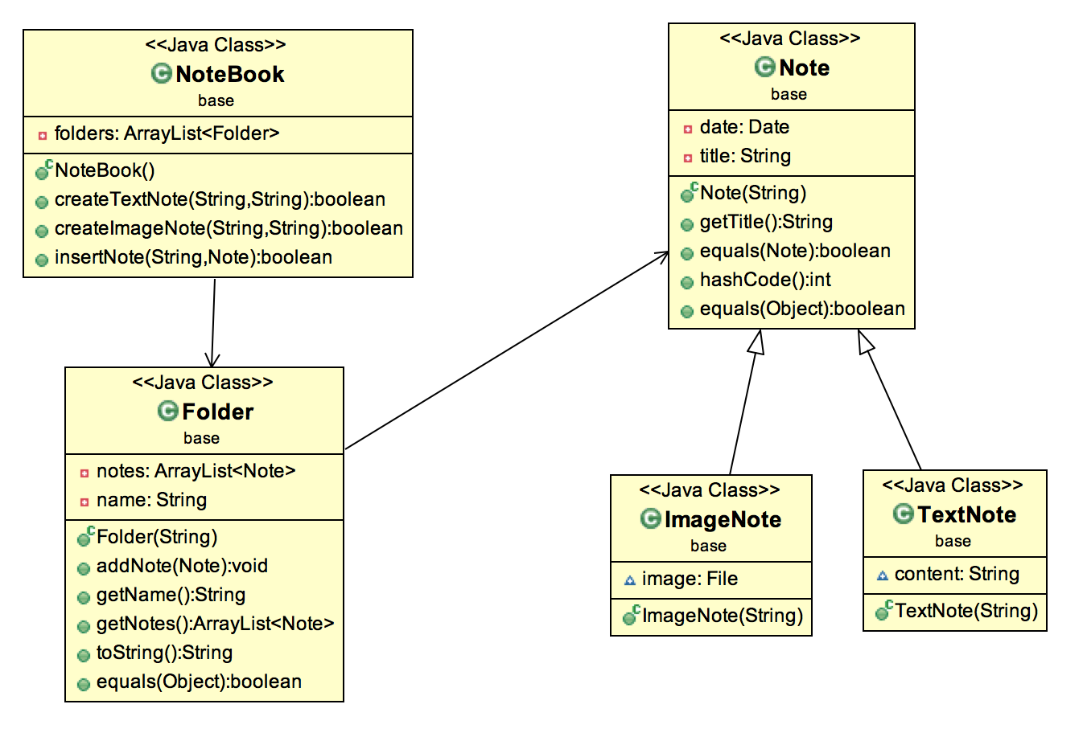
Class Diagram

Slide 12
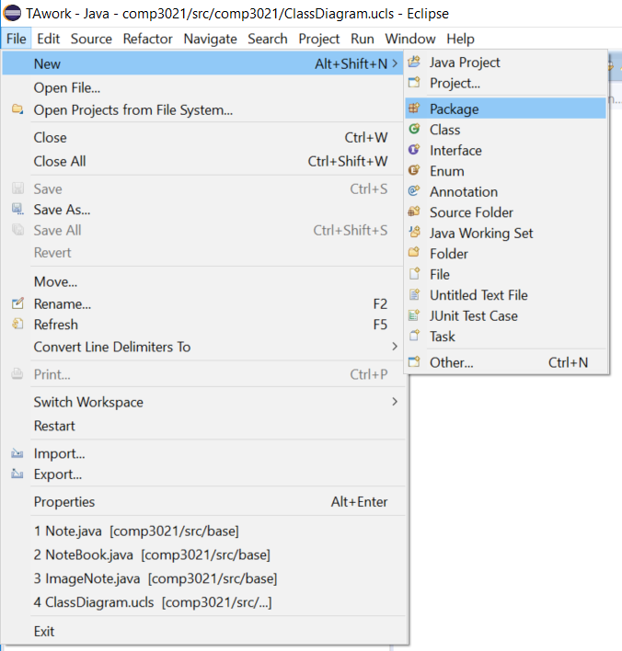
Create package “base”
Open Eclipse (you can find it in C:\Eclipse)
Open the project comp3021lab that you created in lab1
Create a package named “base”

Slide 13
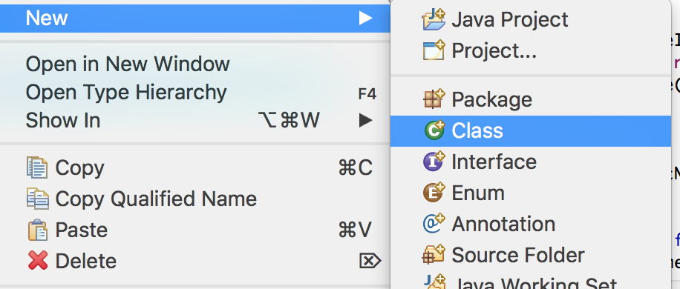
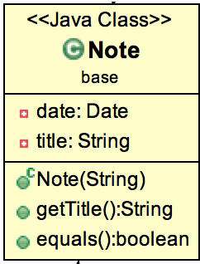
Create class Note
Create class Note inside package base
Right click on package base
new -> Class
public class Note {
Date date;
private String
public Note(String title){
this. = title;
date = new
}
Two private class fields
Constructor takes as argument the String title
Create all attributes, constructors and member functions as described in the class diagram.

Slide 14
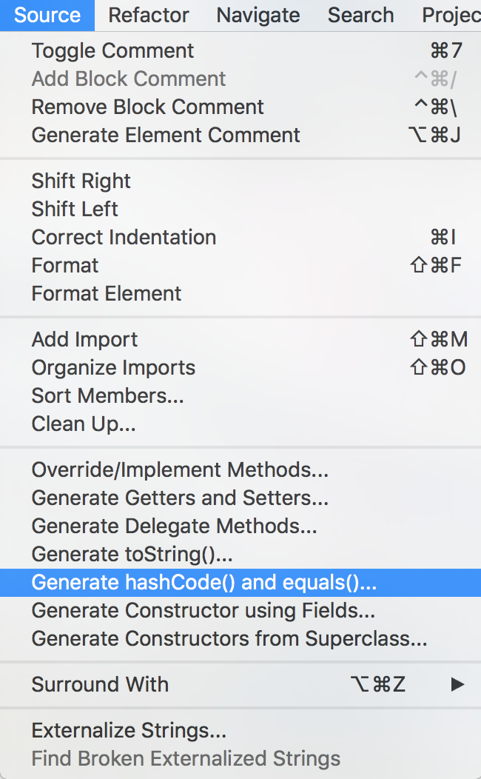
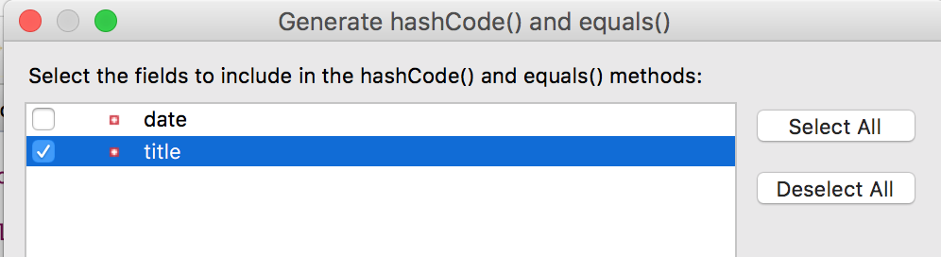
Details of function “equals()”
This function is designed for comparing whether two Note objects are the same
In this lab, two notes are the same if their titles are the same.

Slide 15
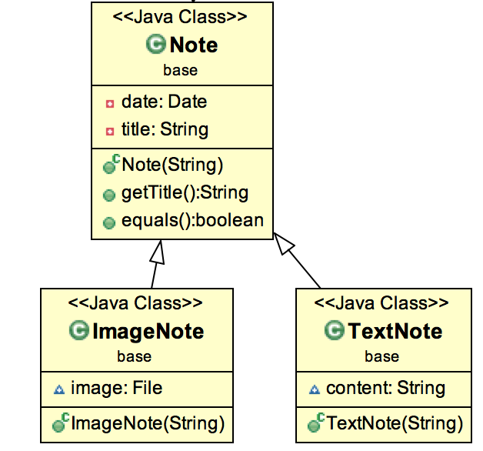
Create class TextNote and ImageNote
ImageNote and TextNote are subclasses of Class Note
Create all attributes, constructors and member functions as described in the class diagram
public class ImageNote extends Note {
subCLasses
Use super() to initialize the parent class’ attributes.
public ImageNote(String title){
super(
}
java.io.File

Slide 16
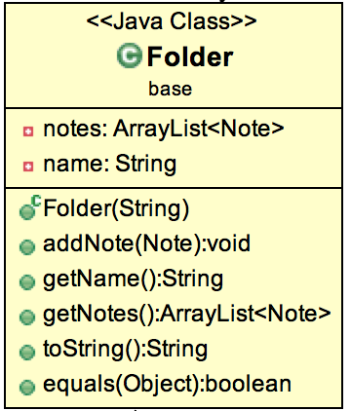
package base;
import java.util
public class Folder {
private ArrayList<Note> notes;
private
public Folder(String name) {
notes = new
}
public void addNote
notes.add(
}
public getName(){
return
}
public ArrayList getNotes() {
return notes;
}
}
Create class Folder
Create class Folder inside package base
Create all attributes, constructors and member functions as described in the class diagram

Slide 17

Class Folder
Details of function “equals()”
Details of function “toString()”
Two folders are equal if they have the same name
This function is designed for printing out the information of a Folder.
Output format:
Scan the elements of the list “notes”
<Folder Name> : <Number of Text Notes> : <Number of Image Notes>
@Override
public String toString() {
int nText = 0;
int nImage = 0;
// TODO
return name + ":" + nText + ":" + nImage;
}
Use instanceof to determine an object belongs to which class.

Slide 18
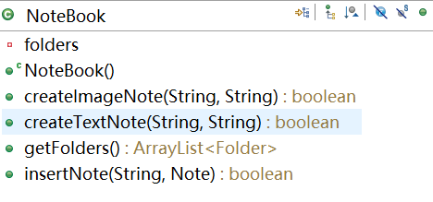
Create class NoteBook
Create class NoteBook inside package base
Create all attributes, constructors and member functions as described in the class diagram

Slide 19
Create class NoteBook
Create an instance of TextNote or ImageNote.
Call member function insertNote() to insert the note to the corresponding folders.
public class NoteBook {
private
public NoteBook() {
f
}
public boolean createTextNote(String folderName, String title) {
TextNote note = new TextNote( );
return insertNote(folderName,
}
public boolean createImageNote(String folderName, String title) {
ImageNote note =
return insertNote
}
public ArrayList<Folder> getFolders() {
}

Slide 20
Details of function “insertNote(String folderName,Note note)”
This function is designed to insert a note to a folder with name folderName
Step 1:
Check if an object Folder with name folderName already exists in the NoteBook
If yes, get the object Folder with name folderName
If not,create a new object Folder using the folder name specified, and add
it to the Notebook (inside ArrayList folders)
Step 2:
Check if among the notes contained in the folder there is one with the same title of the Note in input.
If yes, output an error message and return false
If not, we add the note in input to the folder and return true
For Step 2 use the equals methods that we created

Slide 21
Class NoteBook
Hints of a possible implementation of the method
public boolean insertNote(String folderName, Note note) {
Folder f = null;
for (Folder f1 : folders) {
.equals
}
if (f == null) {
}
for (Note n : f.getNotes()) {
TODO
}
TODO

Slide 22
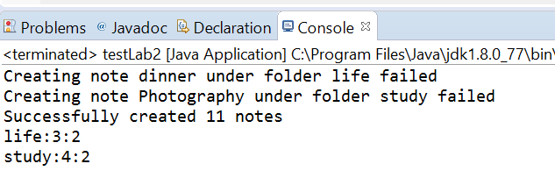
Test your code
Download the TestLab2.java class from the course website https://course.cse.ust.hk/comp3021/labs/lab2/TestLab2.java
Copy and paste the java source file in the package ”base”
Run the main function of this class and show your results to TAs.
Sample Output:

Slide 23
END OF LAB #2
Don’t forget to commit and push your code.

