Slide 1
Using Threads in Java Lab #8 COMP3021 2016 Fall Bowen Zhang(bowen.zhang@connect.ust.hk)

Slide 2
Objectives of this lab
Learn how to create and use Java Threads
Learn why they are important
Learn how to synchronize and coordinate multiple threads

Slide 3
Outline
Introduction on Java Threads and how to use them (5 minutes)
You have 4 exercises to complete
Show your code to TAs for marking

Slide 4
How to create and launch Threads?
public class ThreadExample {
public static void main(String[] args) throws Throwable {
new ThreadExample().runThread();
}
public void runThread(){
Thread t1 = new Thread(new MyTask());
t1.start();
}
class MyTask implements Runnable{
@Override
public void run(){
//things to do
}
}
}

Slide 5
How to get a result from a Thread?
class MyTask implements Runnable {
private int input;
private int output;
public MyTask(int input) {
this.input = input;
}
public int getOutput() {
return output;
}
@Override
public void run(){
output = doSomething(input);
}
}
MyTask task1 = new MyTask(10));
Thread t1 = new Thread(task1);
t1.start();
try {
t1.join(); // wait until t1 is done
} catch (InterruptedException ie) {
ie.printStackTrace();
}
System.out.println(task1.getOutput());

Slide 6
EXERCISE # 1

Slide 7
Exercise # 1: Why threads are important in JAVAFX?
Download the UnresponsiveUI.java class from the course website https://course.cse.ust.hk/comp3021/labs/UnresponsiveUI.java
Create the package “lab7”
Copy the class in the package you just created

Slide 8
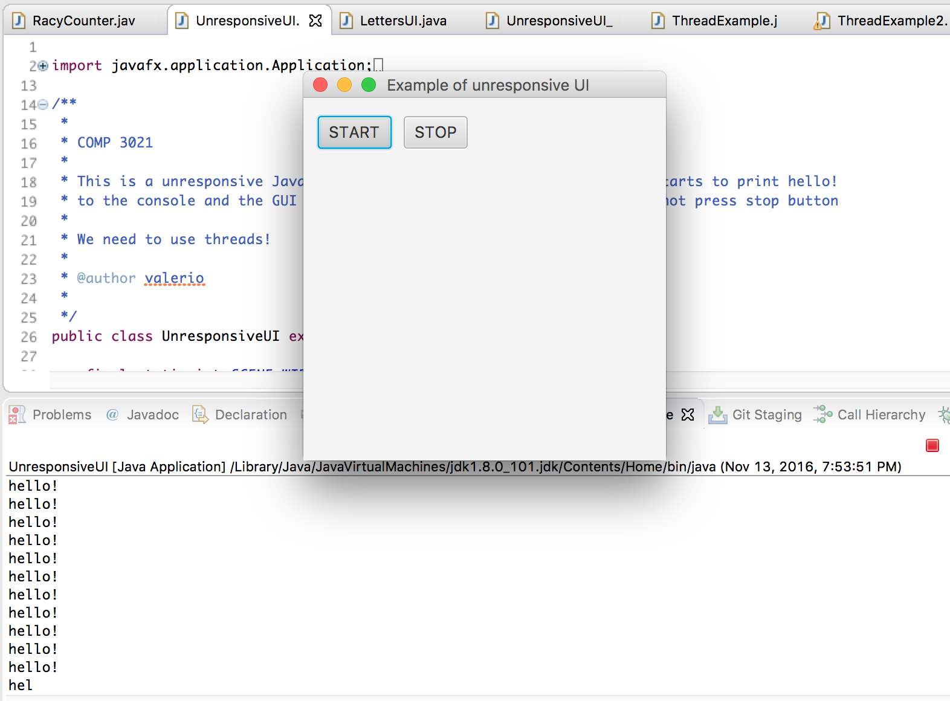
Exercise # 1: Why threads are important in JAVAFX?
This is a unresponsive JavaFX GUI Once you press start, the program starts to print “hello!” to the console and the GUI becomes unresponsive and therefore you cannot press stop button!
PRESS START
GUI DOES NOT RESPOND PRESS HERE

Slide 9
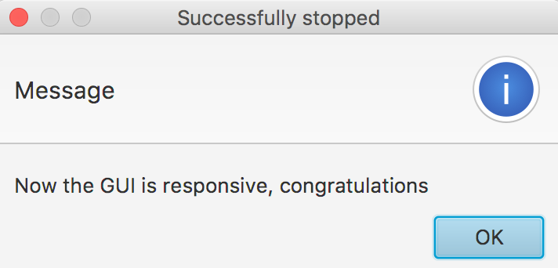
Exercise # 1: Why threads are important in JAVAFX?
Create a thread that is invoked when the button start is pressed
The exercise is completed if you can press the STOP button after pressing the START button. A messagebox will appear
buttonStart.setOnAction(new EventHandler<ActionEvent>() {
@Override
public void handle(ActionEvent event) {
stop = false;
while (!stop) {
System.out.println("hello!");
}
}
});
MAKE A THREAD EXECUTE THIS

Slide 10
EXERCISE # 2

Slide 11
Exercise # 2: Why threads can make your program run faster?
Download the FindMax.java class from the course website https://course.cse.ust.hk/comp3021/labs/FindMax.java
Create the package “lab7”
Copy the class in the package you just created

Slide 12
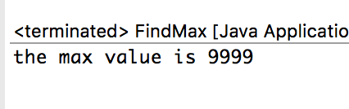
Exercise # 2: Why threads are important in JAVAFX?
This is a class that prints the maximum value of a given array of 90 elements
This is a single threaded version.
Create a multi-thread version with 3 threads,
one thread finds the max among the cells [0,29]
another thread the max among the cells [30,59]
another thread the max among the cells [60,89]
Compare the results of the three threads and print at console the max value.
private int findMax(int begin, int end) {
// you should NOT change this function
int max = array[begin];
for (int i = begin + 1; i <= end; i++) {
if (array[i] > max) {
max = array[i];
}
}
return max;
}

Slide 13
EXERCISE # 3

Slide 14
Exercise # 3: How to avoid race condition?
Download the RacyCounter.java class from the course website https://course.cse.ust.hk/comp3021/labs/RacyCounter.java
Create the package “lab7”
Copy the class in the package you just created

Slide 15
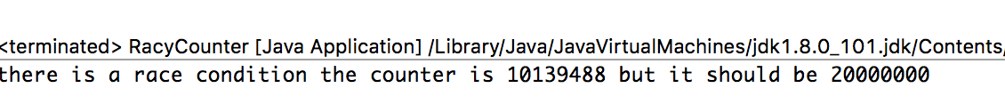
Exercise # 3: How to avoid race condition?
In this class there are two threads that increment concurrently a shared counter 10 Millions times each.
At the end of the execution the counter should have a value of 20 Millions.
However, due to race condition this is not the case
THREAD 1
THREAD 2
temp = 5
int temp = counter;
counter = temp +1;
int temp = counter;
counter = temp +1;
temp = 5
counter = 6
counter = 6
race conditions counter should be 7

Slide 16
Exercise # 3: How to avoid race condition?
Synchronized blocks can avoid race condition
THREAD 1
THREAD 2
synchronized(lock){
}
temp = 5
int temp = counter;
counter = temp +1;
counter = 6
synchronized(lock){
}
temp = 6
int temp = counter;
counter = temp +1;
counter = 7
lock must be the same object instance
or it can be the same static reference, for example synchronized(MyClass.class)

Slide 17
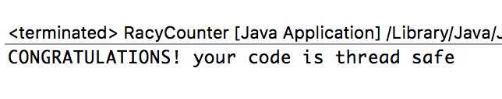
Exercise # 3: How to avoid race condition?
Add a synchronized block to prevent the race condition
You have completed this exercise if you can see at the console the following message
private class MyTask implements Runnable{
@Override
public void run(){
for (int i = 0; i < ITERATIONS; i++) {
//add synchronization here
int temp = counter;
counter = temp +1;
}
}
}

Slide 18
EXERCISE # 4

Slide 19
Exercise # 4: How to control threads execution?
Download the LettersUI.java class from the course website https://course.cse.ust.hk/comp3021/labs/LettersUI.java
Create the package “lab7”
Copy the class in the package you just created

Slide 20
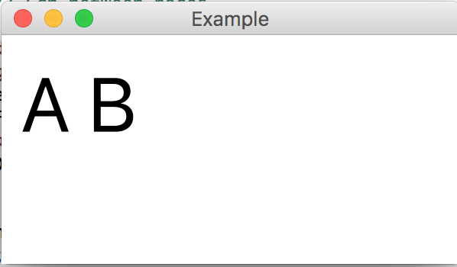
Exercise # 4: How to control threads execution?
This JavaFX application displays 3 letters
A, B, C intermittently.
At each letter is associated a Thread.
The letters appear and disappear for a random period of time that ranges from 1 to 3 seconds. We achieve this using Thread.sleep(time);
Random rn = new Random();
int range = 3000 - 1000 + 1;
int randomNum = rn.nextInt(range) + 1000;
Thread.yield();
Thread.sleep(randomNum);

Slide 21
Exercise # 4: How to control threads execution?
STEP 1:
You have to add two more letters “D” and “E”, therefore two more threads.
Launch the Threads like is done for the letters A, B and C
STEP2:
You have to control the threads and make that only one letter can be visible at a given time. For example, situation like this should not be possible

Slide 22
Exercise # 4: How to control threads execution?
If a letter (Thread) is ready to appear, it has to wait if another letter (Thread) is currently visible in the screen.
Once the letter that is currently visible decides to disappear, it notifies that one of the waiting letters can now appear
Implement it with wait/notify in method showText
THREAD 1
THREAD 2
synchronized (lock) {
while (!condition) {
try {
lock.wait();
} catch (InterruptedException e) {
e.printStackTrace();
}
}
synchronized (lock) { condition = true; lock.notify();
}

Slide 23
Exercise # 4: How to control threads execution?
You can use the object instance this, in this case you can omit this
public synchronized void showText(Text text, boolean show) {
…………
this.wait();
…….
this.notify();
}
SAME AS
public synchronized void showText(Text text, boolean show) {
…………
wait();
…….
notify();
}

Slide 24
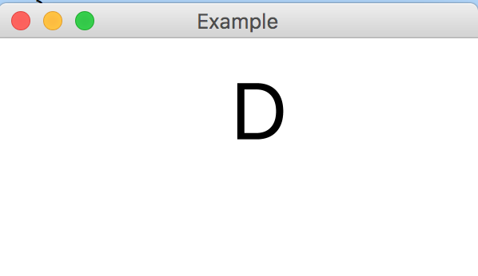
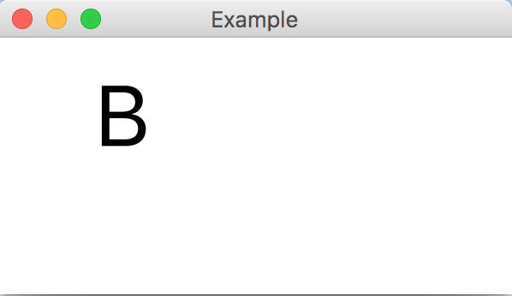
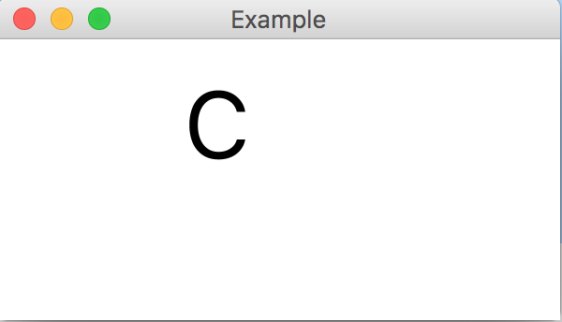
Exercise # 4: How to control threads execution?
You finish the exercise if only one letter can be visible at a given time

Slide 25
END OF LAB #8
Don’t forget to commit and push your code.

