Slide 1
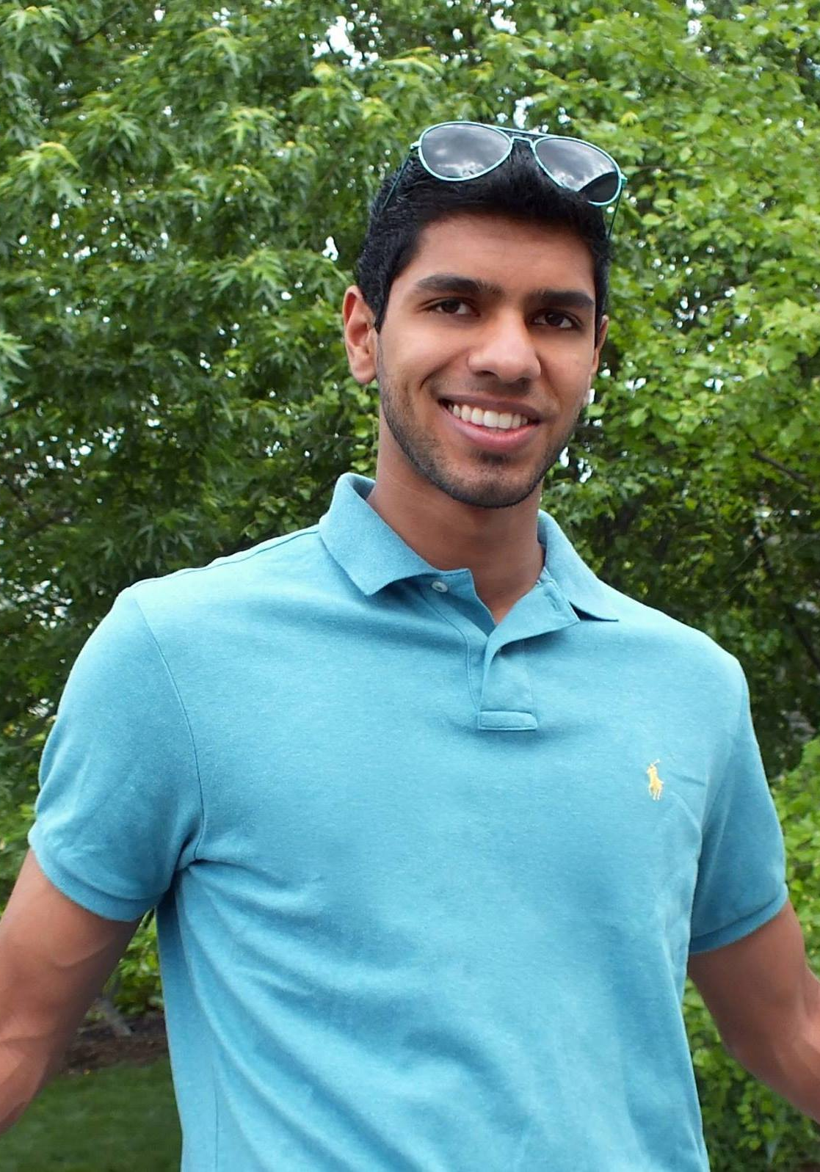
Chandan Singh
I received my BS in Computer Science and Math from the University of Virginia
My research interests are in computational neuroscience, statistical learning, and Nicolas Cage movies
I love playing/watching basketball and soccer
Look forward to meeting you!
Coder, researcher, brain-lover, barber, occasional athlete, easy mac connoisseur, Catan master, fish owner, Swiftie

