Slide 1
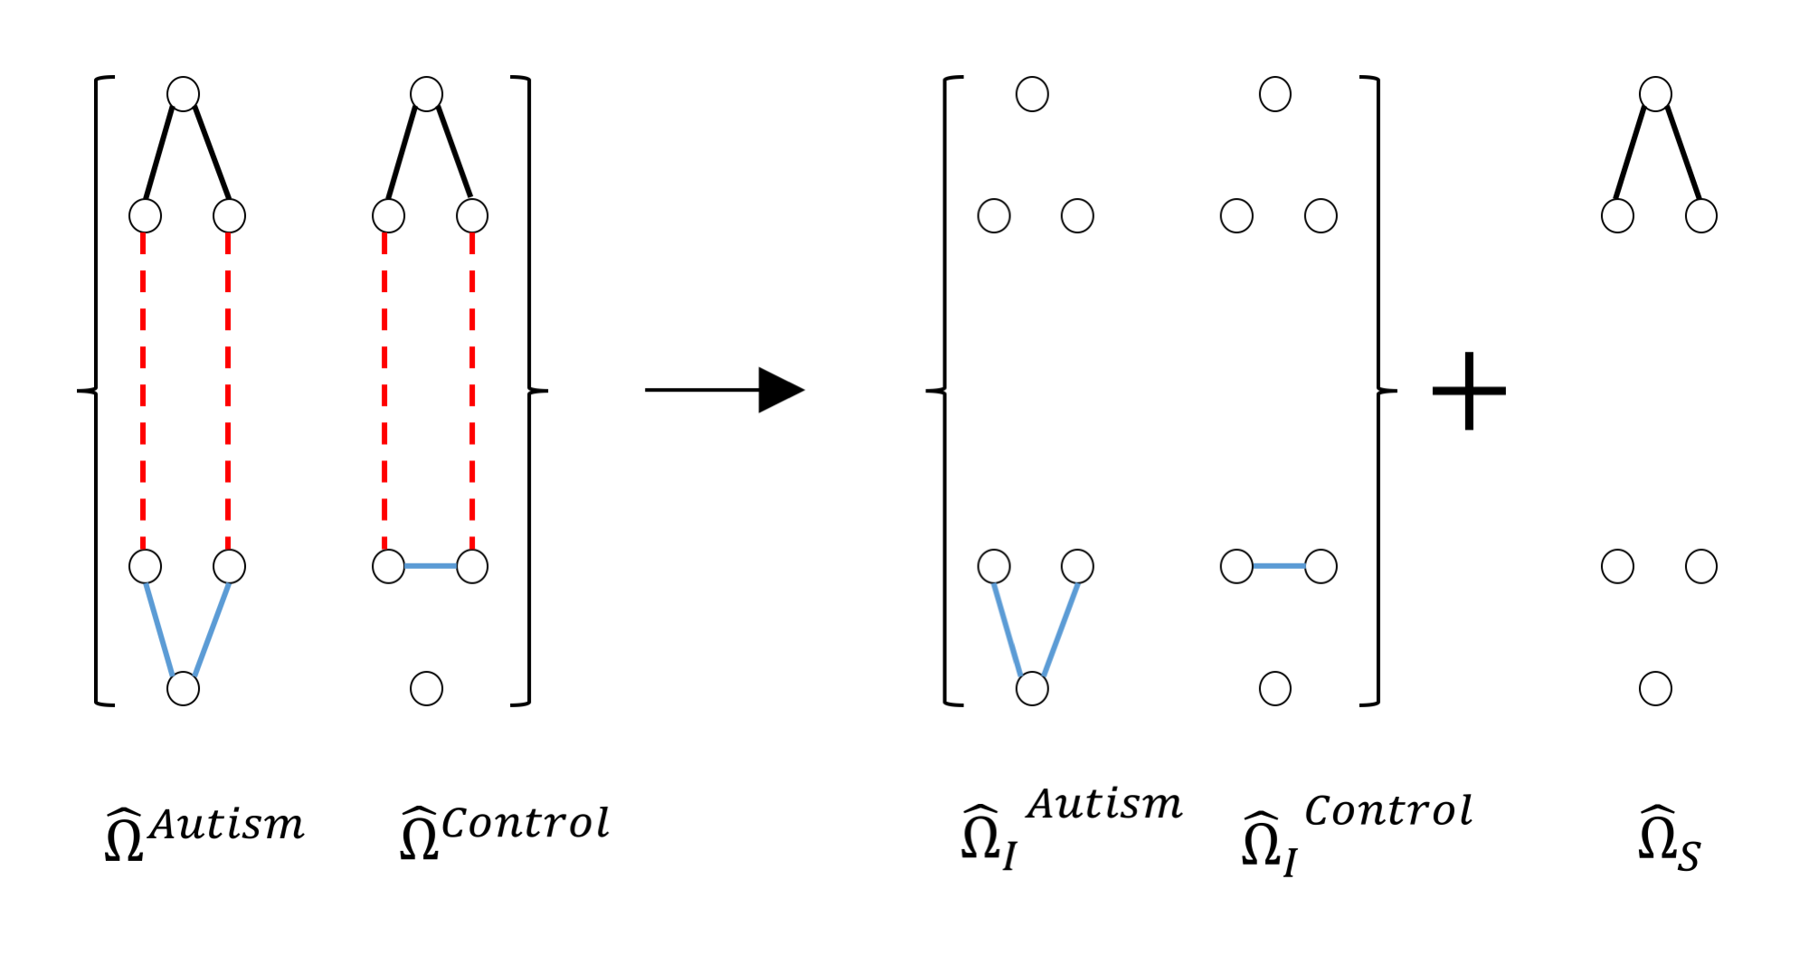
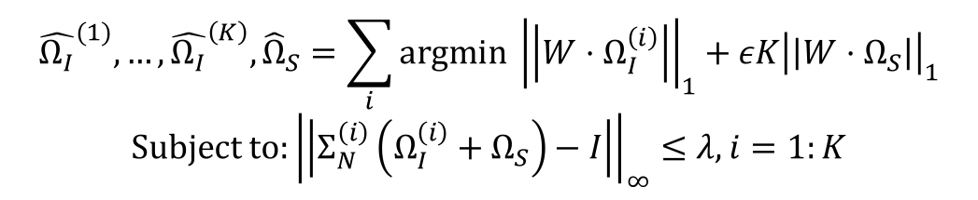
W-SIMULE: A Constrained, Weighted-𝓁1 Minimization Approach for Joint Discovery of Heterogeneous Neural Connectivity Graphs
$${\hat{Ω_{I}}}^{(1)},…,{\hat{Ω_{I}}}^{\left(K\right)},{\hat{Ω}}_{S}=\sum_{i}{\text{argmin} {\left|\left|W⋅Ω_{I}^{\left(i\right)}\right|\right|}_{1}+εK{\left|\left|W⋅Ω_{S}\right|\right|}_{1}}$$
$$\text{Subject} \text{to}:{\left|\left|Σ_{N}^{\left(i\right)}\left(Ω_{I}^{\left(i\right)}+Ω_{S}\right)−I\right|\right|}_{∞}≤λ, i=1:K$$
Sparsity
Multi-task learning with K groups
A prior matrix of positive weights W
A nonparanormal assumption
Chandan Singh, Beilun Wang, Yanjun Qi

