Slide 1

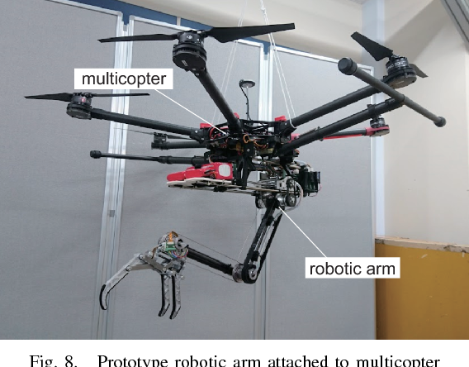


Control of an UAM
Field and Service Robotics
Acampora Giulio: P38000258
Del Sorbo Alessandra: P38000289
Professor:
Ruggiero Fabio
05.05.2025

Slide 2


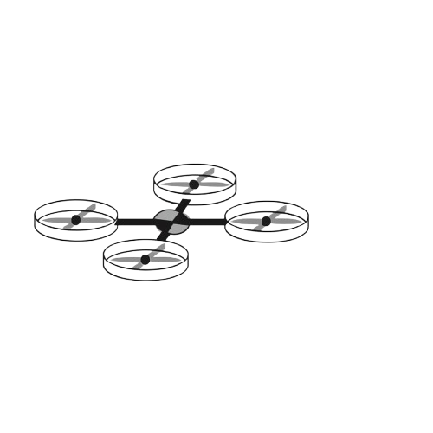


Field and Service Robotics
CONTROL STRATEGIES
Different approaches
Centralized Strategy
Decentralized Strategy
Separate subsystems with individual controllers
Single controller manages the entire UAM based on its
complete, coupled dynamic model
mutual effects as external disturbances

Slide 3
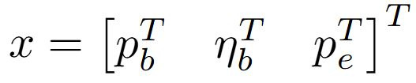
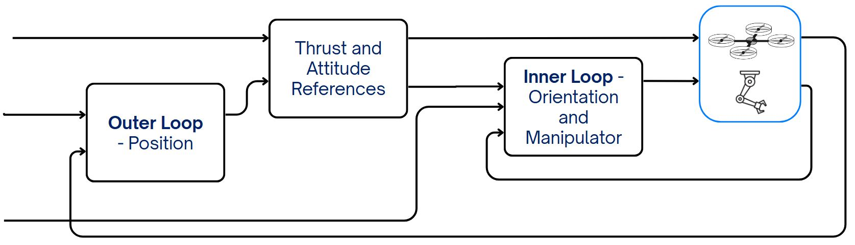
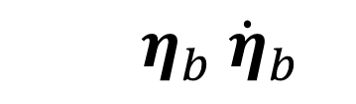


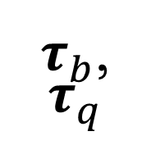
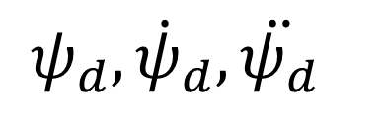

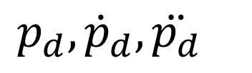
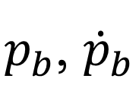
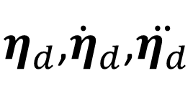
Field and Service Robotics
CENTRALIZED
Cartesian Impedence Control
$$ψ_{d}, {\dot{ψ}}_{d}, \ddot{ψ_{d}}$$
$$u_{T}$$
$τ_{b}$,
$$τ_{q}$$
$$μ_{d}$$
$η_{d}$,${\dot{η}}_{d}$,$\ddot{η_{d}}$
$$p_{d}, {\dot{p}}_{d}, \ddot{p_{d}}$$
$$η_{b} {\dot{η}}_{b}$$
$p_{b}$, ${\dot{p}}_{b}$
$$p_{e} {\dot{p}}_{e}$$
$p_{e,d}$ ${\dot{p}}_{e,d} \ddot{p_{e,d}}$

Slide 4
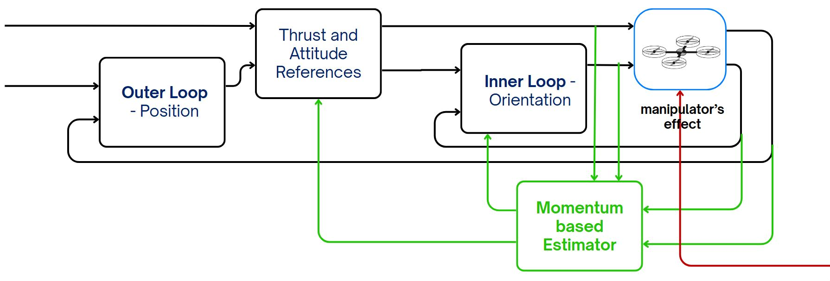
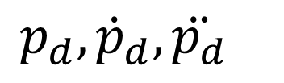

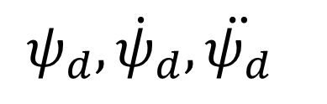
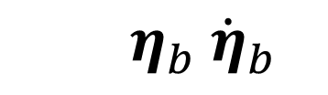
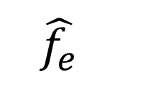
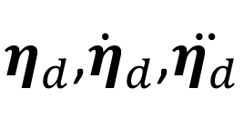


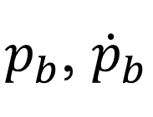

Field and Service Robotics
DECENTRALIZED
UAV
Passivity-based Controller + Momentum based Estimator
$$ψ_{d}, {\dot{ψ}}_{d}, \ddot{ψ_{d}}$$
$$u_{T}$$
$$μ_{d}$$
$$τ_{b}$$
$η_{d}$,${\dot{η}}_{d}$,$\ddot{η_{d}}$
$$p_{d}, {\dot{p}}_{d}, \ddot{p_{d}}$$
$$η_{b} {\dot{η}}_{b}$$
$p_{b}$, ${\dot{p}}_{b}$
$$\hat{τ_{e}}$$
$$\hat{f_{e}}$$

Slide 5
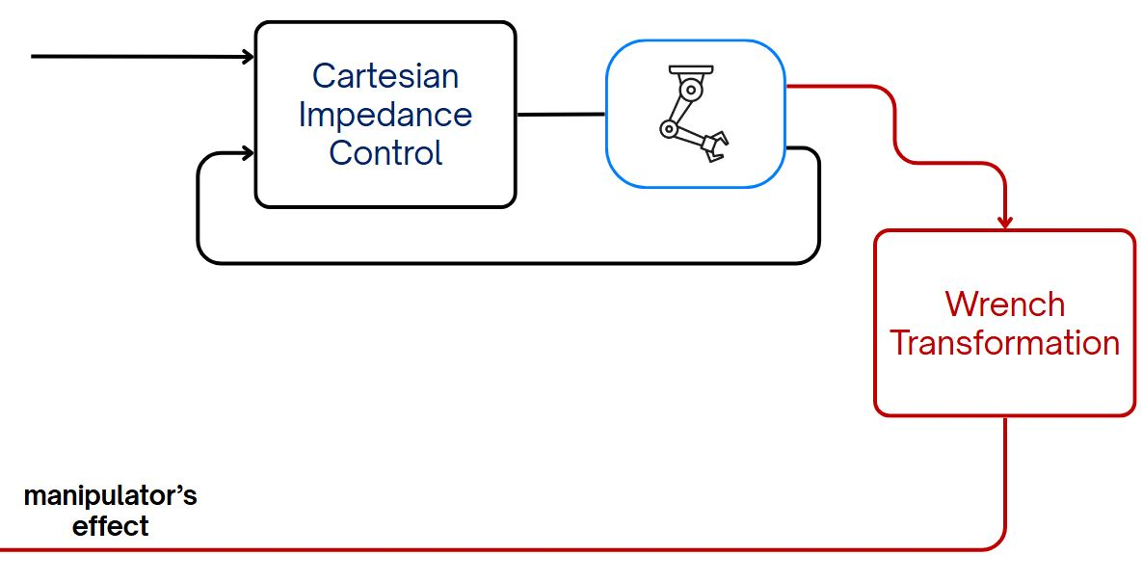
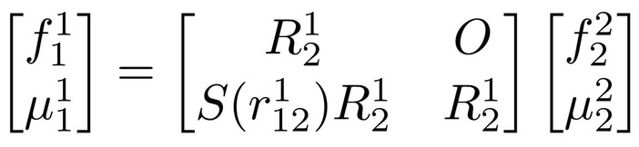




Field and Service Robotics
DECENTRALIZED
Manipulator - Cartesian Impedence Control
$$p_{e,d }^{b}{\dot{p}}_{e,d}^{b} {\ddot{p}}_{e,d}^{b}$$
$$τ_{q}$$
$$w_{e}^{e} R_{e}^{b} p_{e }^{b}$$
$$p_{e }^{b}{ \dot{p}}_{e}^{b}$$

Slide 6
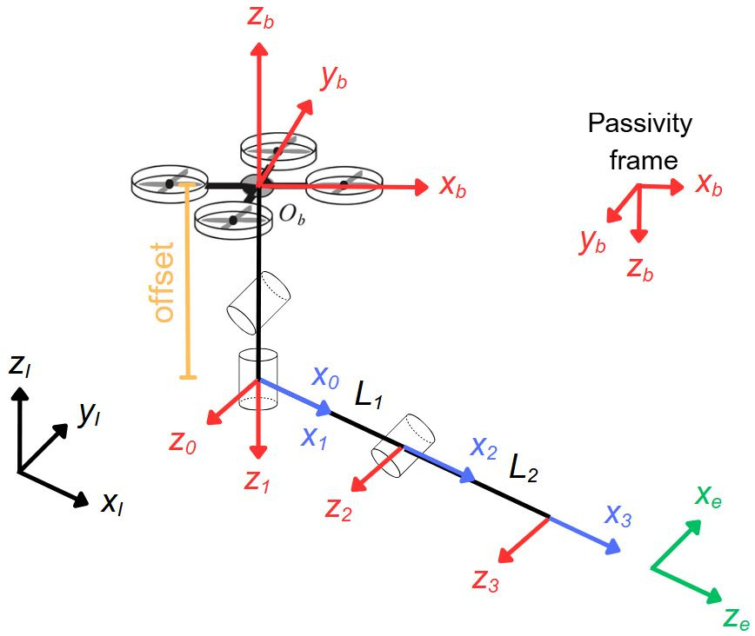
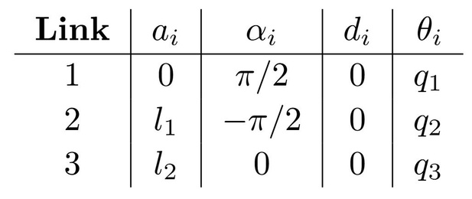
Field and Service Robotics
D-H table for the manipulator
Quadrotor with 3-DOF manipulator
System Modelling

Slide 7
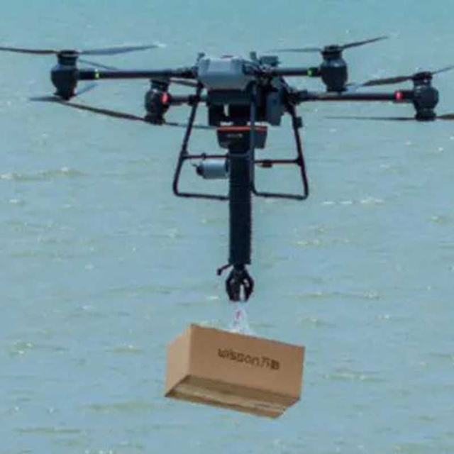
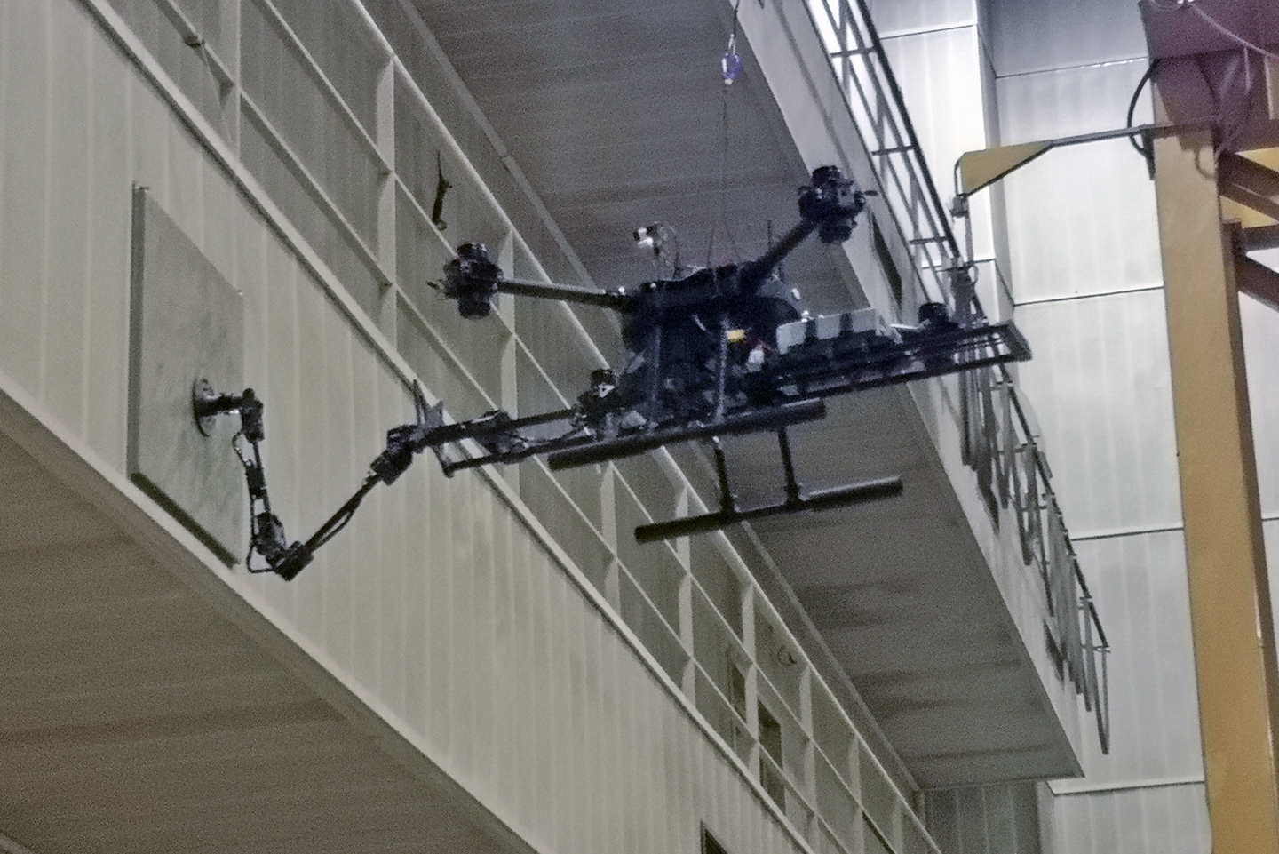
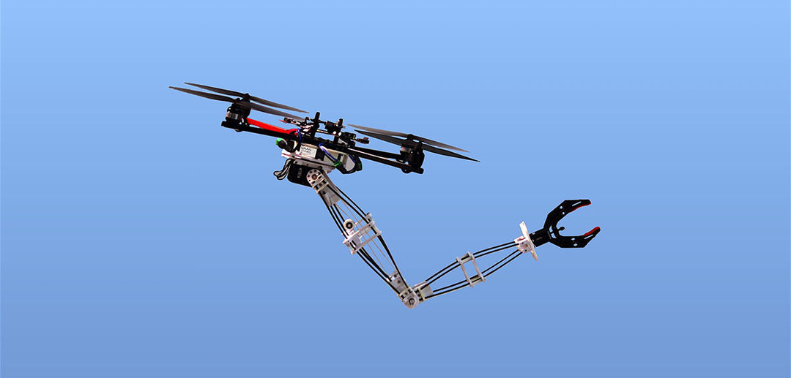
Field and Service Robotics
Simulation
scenarios
To assess the effectiveness of the proposed control strategies
Disturbance Rejection
Trajectory Execution
Load Handling
UAM behavior under external perturbations, such as wind
gusts or collisions with obstacles, while maintaining quasi-static hovering stability
manipulator’s ability to follow a prescribed trajectory while
the UAV sustains a stable hovering position
system performance when the manipulator interacts with or carries
an external load

Slide 8
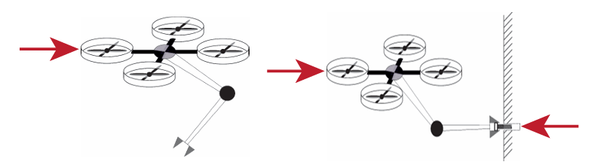
Field and Service Robotics
Disturbance Rejection Case Studies
Evaluate the UAM's behavior under external perturbations while maintaining a stable hover
Simulation Setup:
Three Case Studies:
Case A1: Rigid Behavior under wind disturbance
Initial State: Hovering with manipulator at
q = [-π/2, 0, π/2]
Case A2: Compliant Behavior under wind disturbance
Case B: Mixed behavior under wind disturbance and contact force

Slide 9
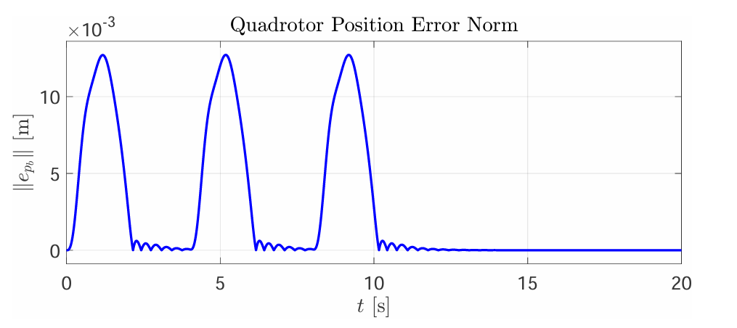
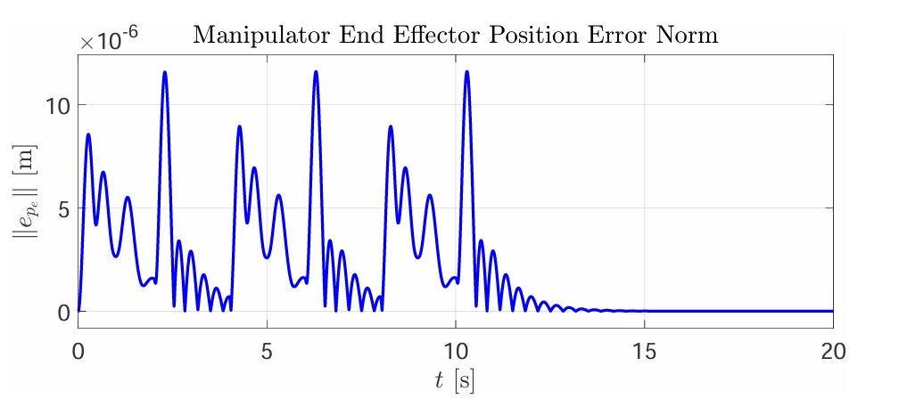
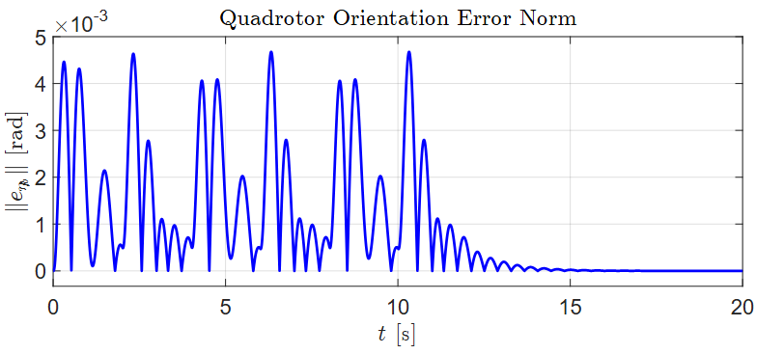

Field and Service Robotics
Centralized Control:
Case A1 Rigid Behavior
Quick error convergence after the disturbance stops
Extremely small end-effector error
Gains: stiffness of $K_{p}$ = 80 $I_{9}$ and a damping ratio tuned to 0.8
Low peak orientation error

Slide 10
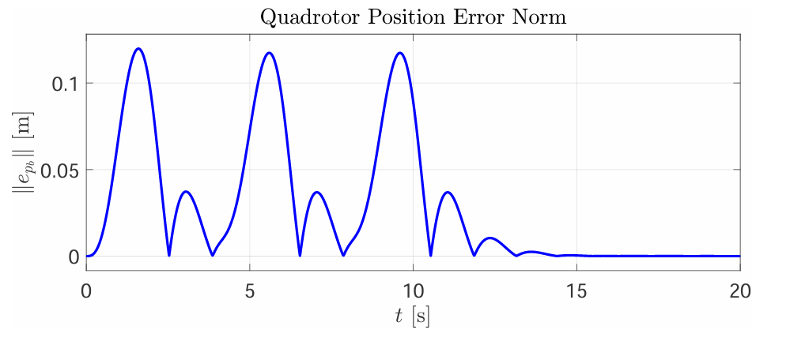
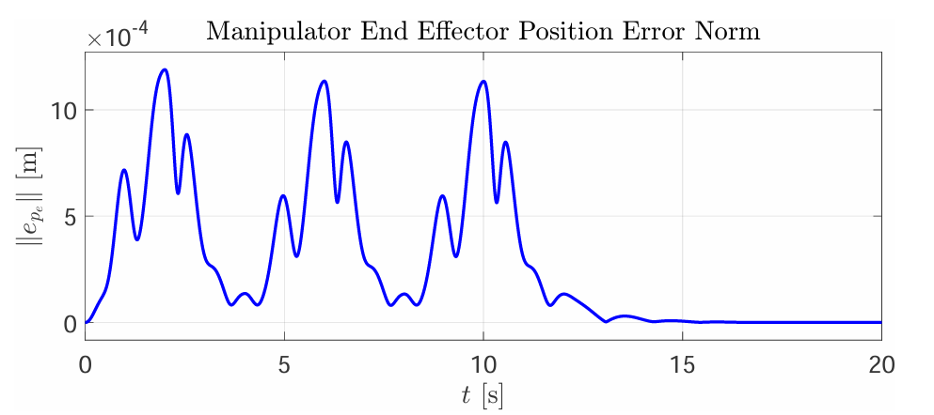
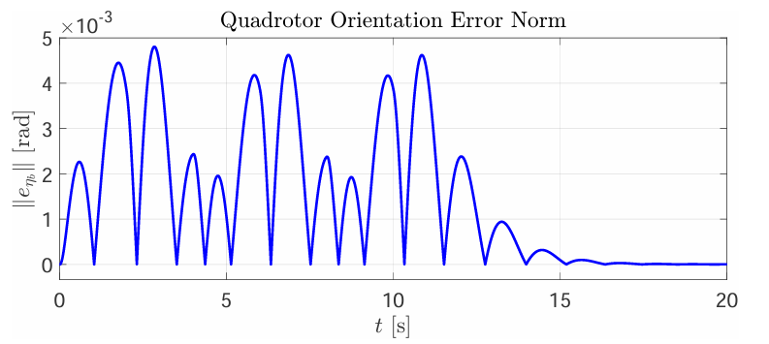

Field and Service Robotics
Centralized Control:
Case A2 Complian Behavior
Peak quadrotor position error is an order of magnitude higher
Extremely small end-effector error
Gains: stiffness of $K_{p}$ = 10 $I_{9}$ and a damping ratio tuned to 0.5
Larger peak orientation error

Slide 11
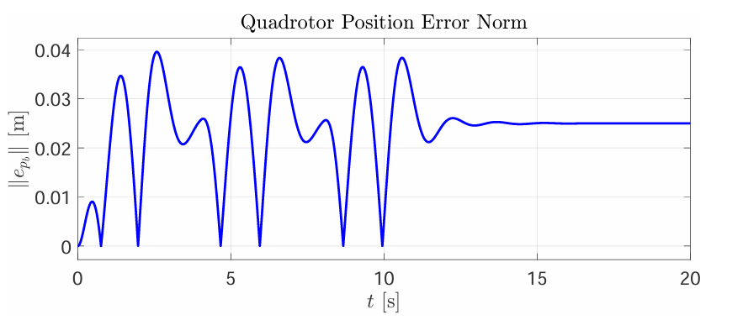
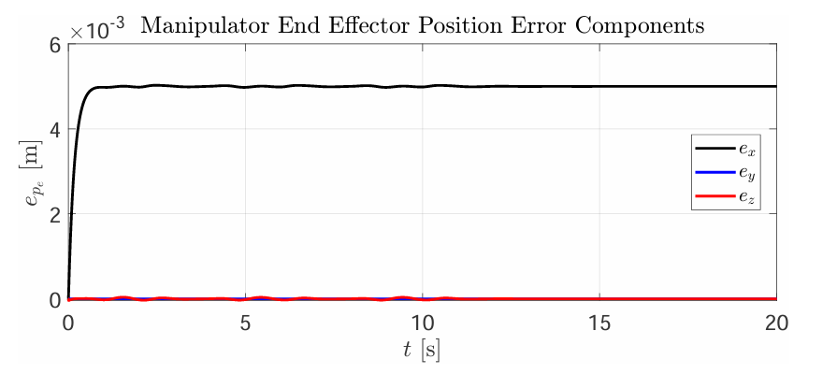
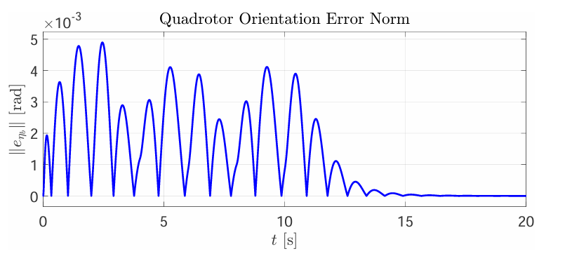
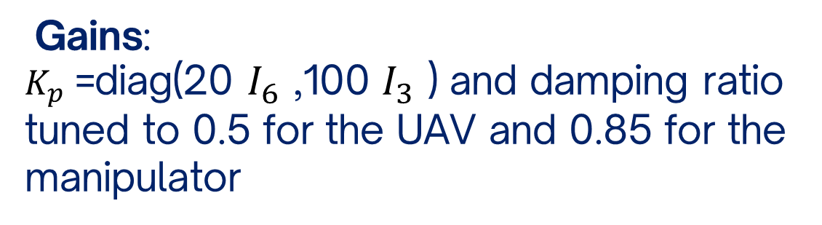
Field and Service Robotics
Centralized Control:
Case B External Wrench on Manipulator
The error settles to a non-zero steady-state value due to tha constant contact force
Significantly larger errors that converge to zero post-disturbance
Gains:
$K_{p}$ =diag(20 $I_{6}$ ,100 $I_{3}$ ) and damping ratio tuned to 0.5 for the UAV and 0.85 for the manipulator
Oscillatory pattern for the first 10 seconds

Slide 12
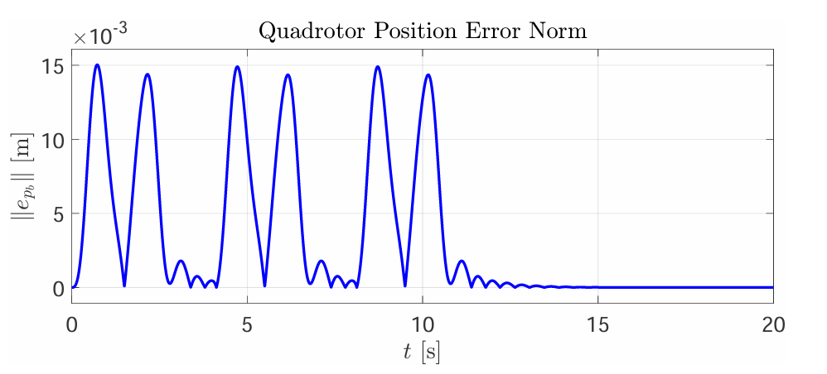
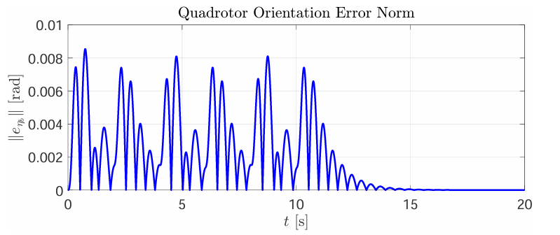
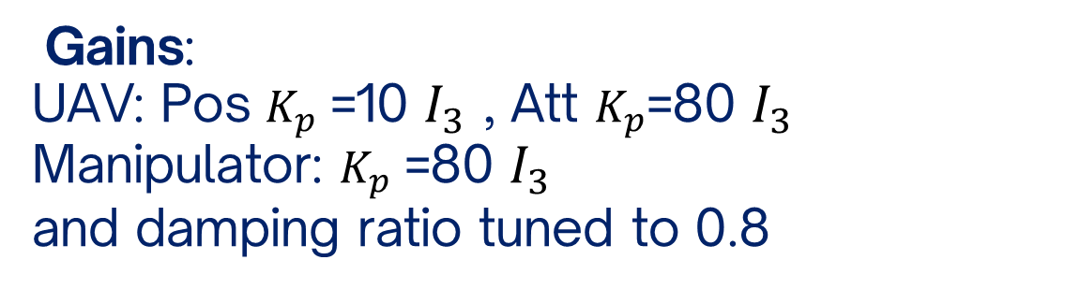
Field and Service Robotics
Decentralized Control:
Case A1 Rigid Behavior
Quick error convergence after the disturbance stops
The manipulator's end-effector position error remains exactly zero
Gains:
UAV: Pos $K_{p}$ ​=10 $I_{3}$ ​, Att $K_{p}$=80 $I_{3}$
​Manipulator: $K_{p}$ ​=80 $I_{3}$
and damping ratio tuned to 0.8
Small peak orientation error

Slide 13
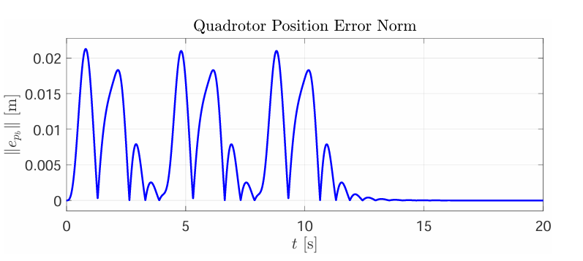
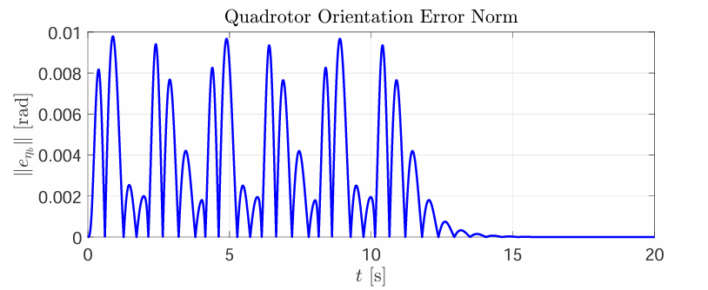

Field and Service Robotics
Decentralized Control:
Case A2 Complian Behavior
Quick error convergence after the disturbance stops
The manipulator's end-effector position error remains exactly zero
Gains:
UAV: Pos $K_{p}$ ​=10 $I_{3}$ , Att $K_{p}$ ​=50 $I_{3}$
Manipulator: $K_{p}$ ​=10 $I_{3}$
and damping ratio tuned to 0.5
Oscillatory pattern for the first 10 seconds

Slide 14
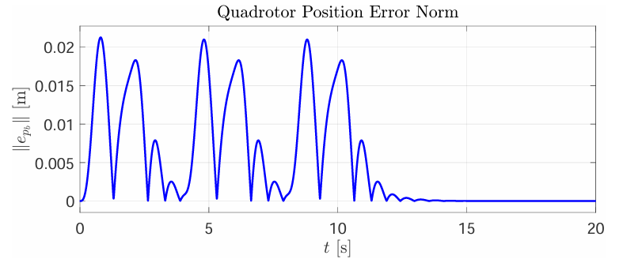
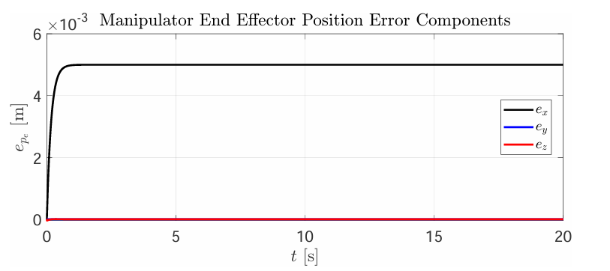
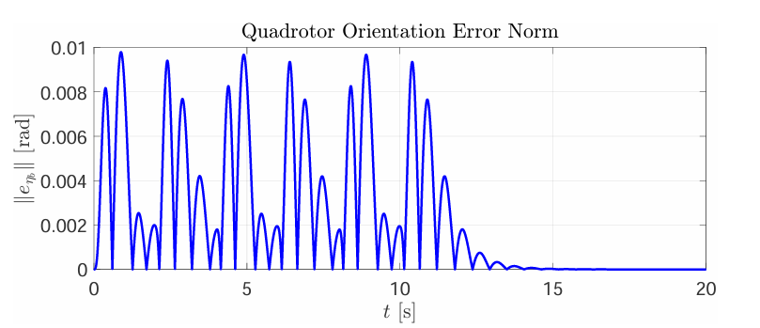
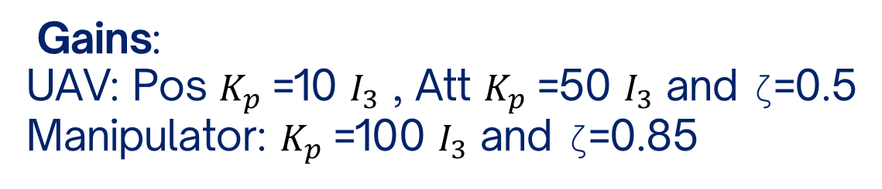
Field and Service Robotics
Decentralized Control:
Case B External Wrench on Manipulator
Quick error convergence after the disturbance stops
Gains:
UAV: Pos $K_{p}$ ​=10 $I_{3}$ ​, Att $K_{p}$ ​=50 $I_{3}$ and ζ=0.5
​Manipulator: $K_{p}$ ​=100 $I_{3}$ and ζ=0.85
Oscillatory pattern for the first 10 seconds

Slide 15
Field and Service Robotics
Comparative Analysis: Advanced Scenarios
Scenario 1: Manipulator Trajectory Execution
Scenario 2: Manipulator Trajectory Execution with a Payload
The objective of this analysis is to evaluate how centralized and decentralized controllers manage internal dynamic disturbances and external loads

Slide 16
Field and Service Robotics
Scenario 1: Moving Manipulator Trajectory
Analyze the performance of each control strategy when the manipulator executes a planned trajectory without any external forces
Simulation Parameters:
Task: The end-effector moves from its initial configuration to a new target position: [0.1561,0,−0.2061] relative to the UAV body frame
Gains: Set to "rigid" configuration (Case A1)

Slide 17
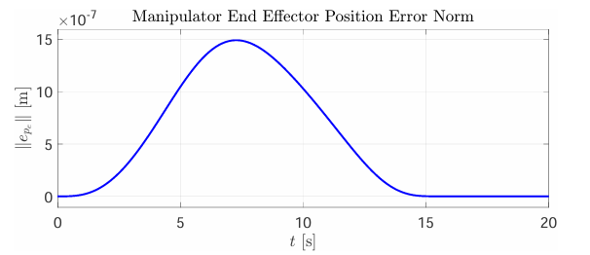
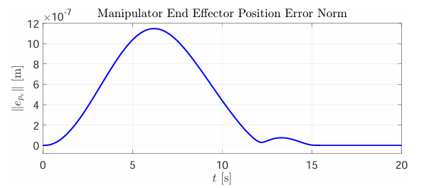
Field and Service Robotics
Scenario 1 Results: End Effector performance
Centralized Strategy
Decentralized Strategy
For end effector tracking accuracy, both architectures are highly effective solutions

Slide 18
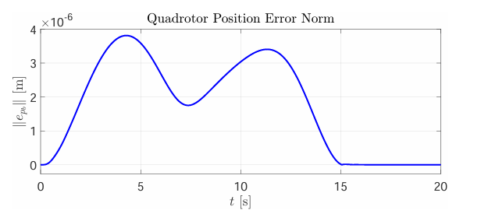
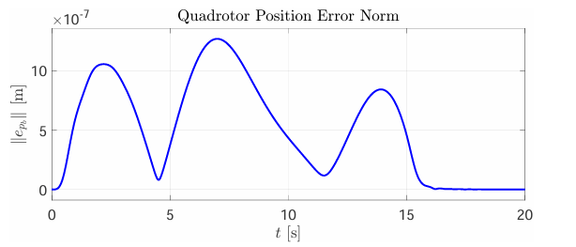
Field and Service Robotics
Scenario 1 Results: UAV Performance
Centralized Strategy
Decentralized Strategy

Slide 19
Field and Service Robotics
Scenario 2: Moving Manipulator with a Payload
Simulation Parameters:
Task: The manipulator follows the same trajectory as in Scenario 1
Gains: Set to "rigid" configuration (Case A1)
Load: A constant vertical force of 1.47 N is applied to the end-effector, simulating a 0.15 kg payload
Evaluate controller performance during trajectory execution while the end-effector carries a constant load

Slide 20
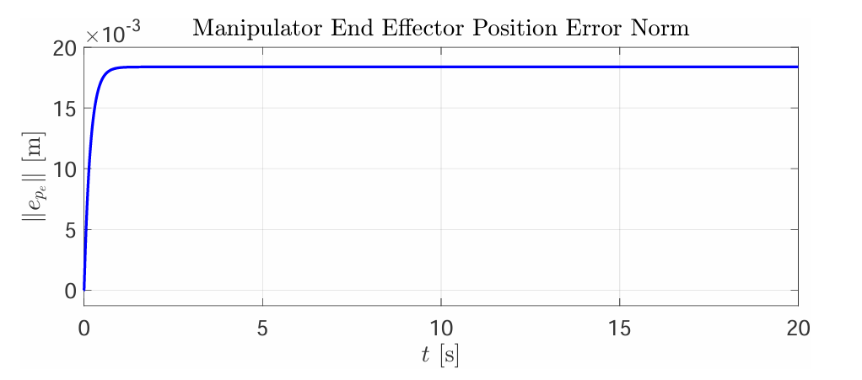

Field and Service Robotics
Scenario 2 Results: End Effector performance
Centralized Strategy
Decentralized Strategy
This is the behavior of an impedance controller, which allows for displacement under a persistent force (the payload's weight)

Slide 21


Field and Service Robotics
Scenario 2 Results: UAV Performance
Centralized Strategy
Decentralized Strategy
The decentralized controller achieves better hovering performance due to its simplified structure

Slide 22
Field and Service Robotics
Conclusions
Centralized Strategy
Decentralized Strategy
Provides a globally optimal and coordinated solution, treating the UAM as a single entity
Excels at task isolation. The decoupling allows the UAV to focus solely on maintaining its position
This leads to shared effort but can reduce the hovering accuracy of the UAV when the manipulator is under a constant load
Offers superior hovering performance when the manipulator interacts with payloads or the environment. This is a significant advantage for tasks requiring a stable aerial base

Slide 23

Field and Service Robotics
thank you

