Slide 1
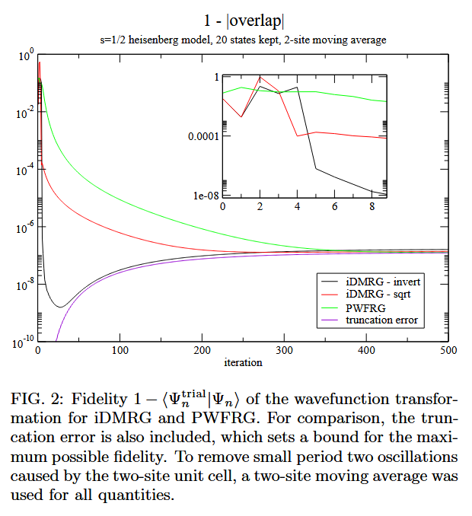
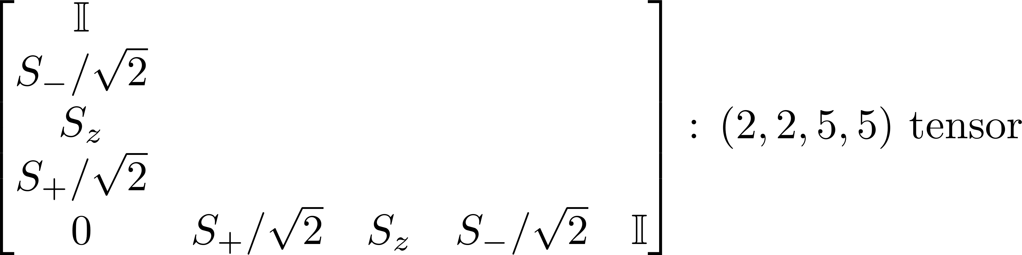
DMRG on anti-ferromagnetic S=1/2 Heisenberg chain
Machine Learning and Computational Physics Final Project
SungBin Lee, Sehyun Oh, and Junsu Kim
Dept. of Physics and Astronomy, Seoul National University

Slide 2
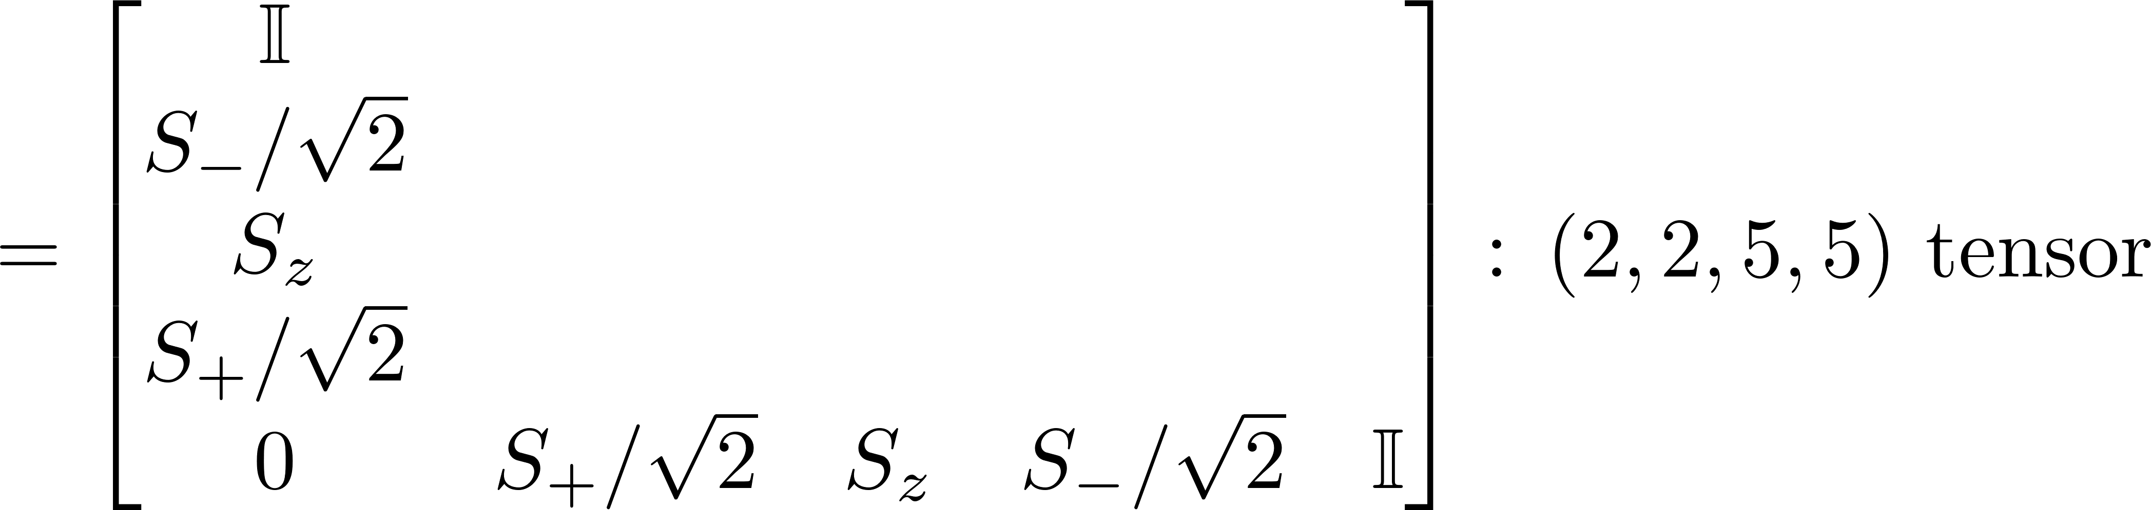
DMRG on anti-ferromagnetic S=1/2 Heisenberg chain
S. R. White, PRL (1992)
2
3
4
1

Slide 3
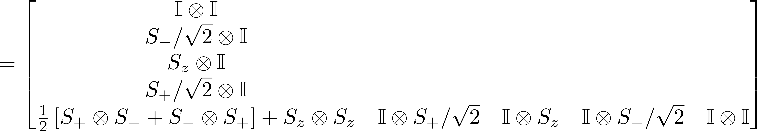
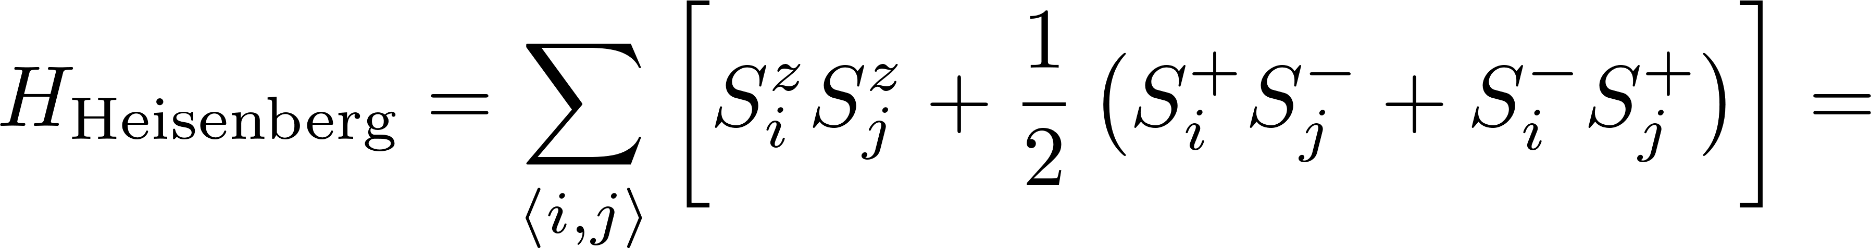
DMRG on anti-ferromagnetic S=1/2 Heisenberg chain
2
2
3
4
4
1
1
2
2
2
4
1
1
1

Slide 4
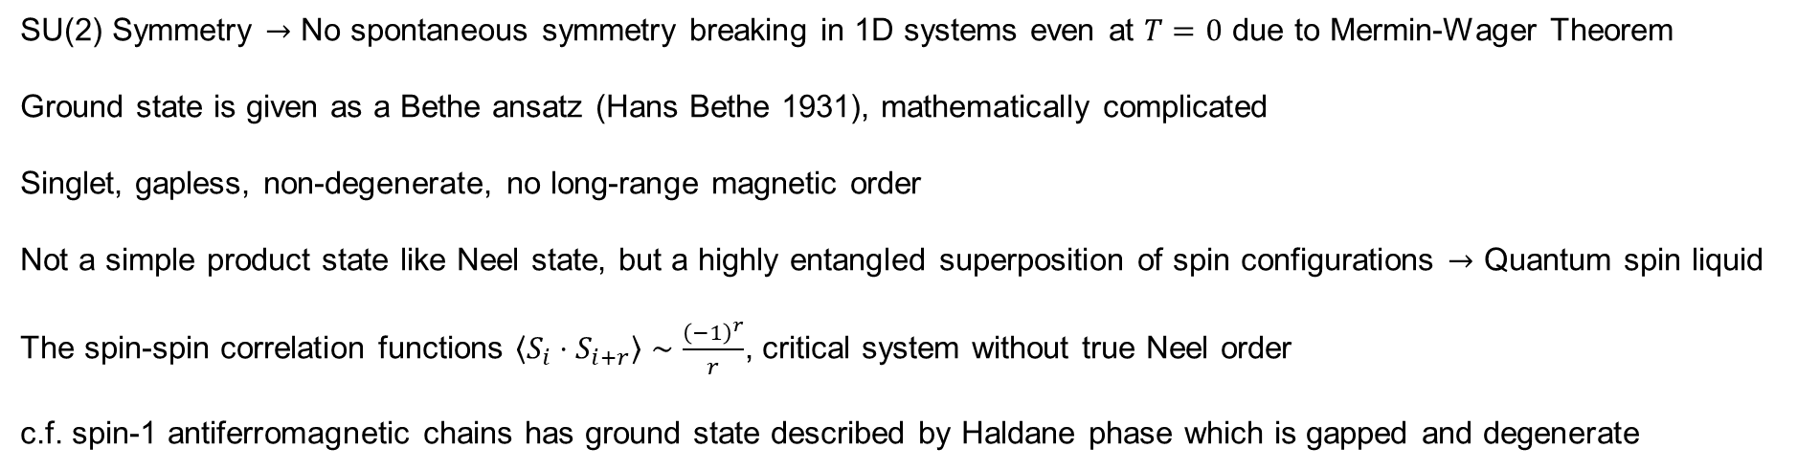
DMRG on anti-ferromagnetic S=1/2 Heisenberg chain
Ground state
SU(2) Symmetry $→$ No spontaneous symmetry breaking in 1D systems even at $T=0$ due to Mermin-Wager Theorem
Ground state is given as a Bethe ansatz (Hans Bethe 1931), mathematically complicated
Singlet, gapless, non-degenerate, no long-range magnetic order
Not a simple product state like Neel state, but a highly entangled superposition of spin configurations $→$ Quantum spin liquid
The spin-spin correlation functions $\left\langle S_{i}⋅S_{i+r}\right\rangle ∼\frac{{\left(−1\right)}^{r}}{r}$, critical system without true Neel order
c.f. spin-1 antiferromagnetic chains has ground state described by Haldane phase which is gapped and degenerate

Slide 5
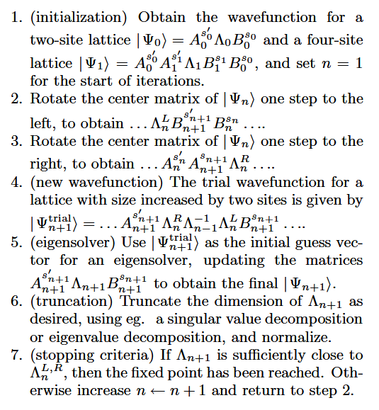
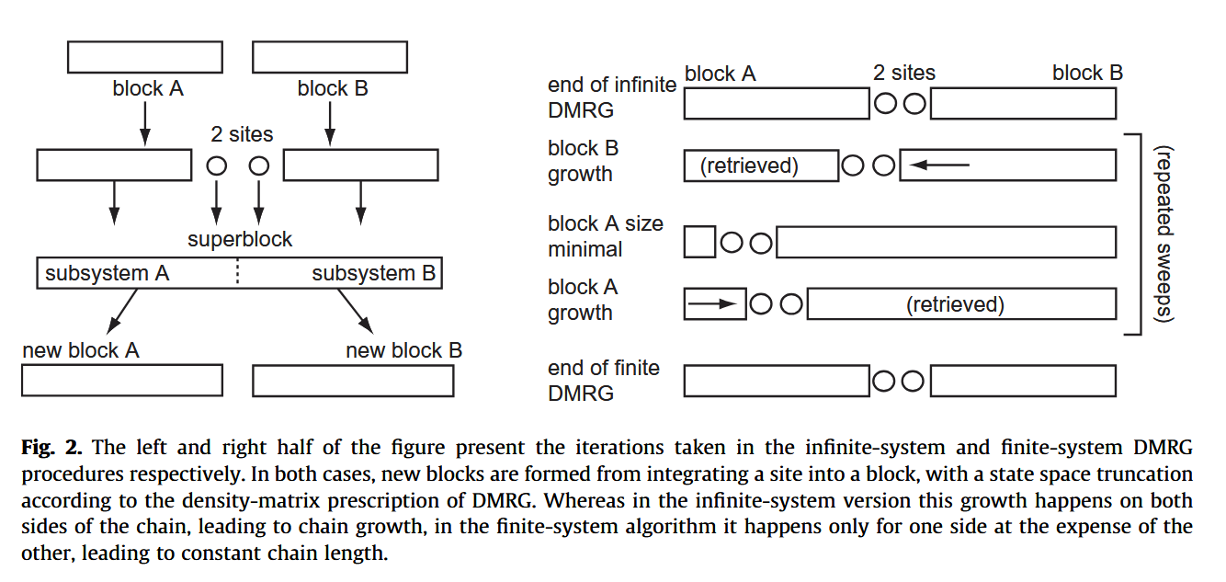
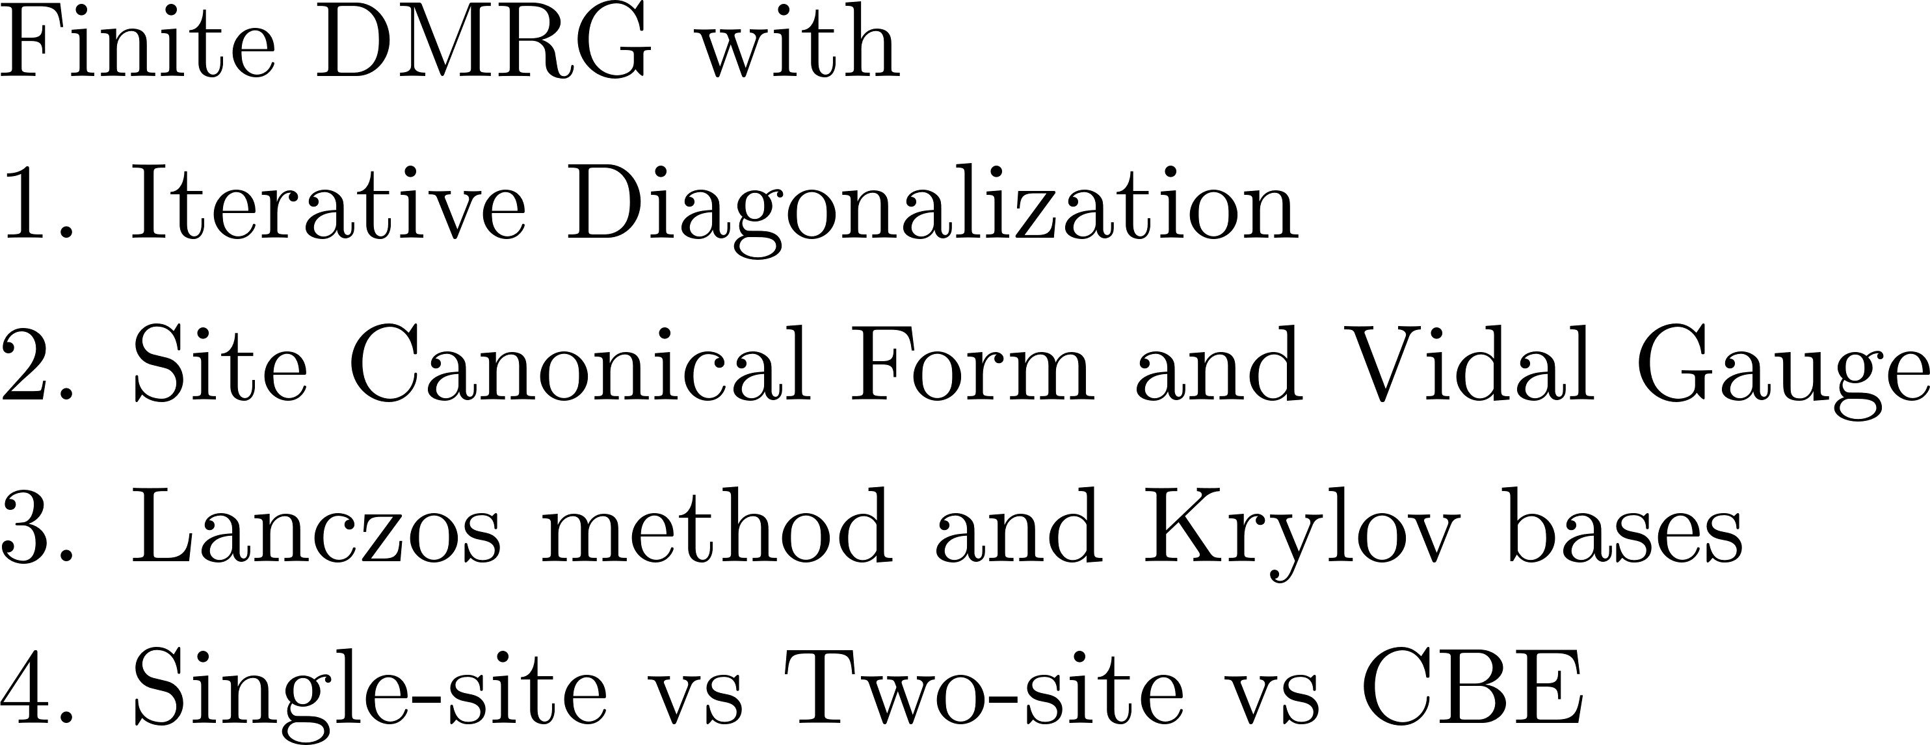
DMRG on anti-ferromagnetic S=1/2 Heisenberg chain
iDMRG vs finite DMRG
I. P. MuCulloch, arXiv (2008)

Slide 6
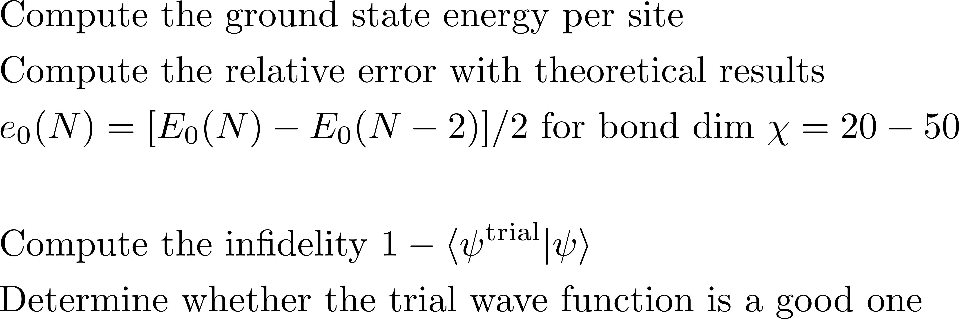
DMRG on anti-ferromagnetic S=1/2 Heisenberg chain
Computing ground state energy and ground state wave function
I. P. MuCulloch, arXiv (2008)

