Slide 1
DMRG on various one-dimensional Hamiltonians
Machine Learning and Computational Physics Final Project
SungBin Lee, Sehyun Oh, and JunSoo Kim
Dept. of Physics and Astronomy, Seoul National University

Slide 2
시작하기 앞서…
본 프로젝트의 모든 결과물은 아래 조건을 준수하였습니다.
Python 기본 패키지(e.g. numpy)에서 시작
하이레벨 패키지 미사용(e.g. TeNPy, torch.nn)
Laptop / Desktop 수준의 컴퓨팅 자원 활용
CPU와 CUDA에서 모두 작동하도록 설계
וְהָיָ֣ה רֵאשִׁיתְךָ֣ מִצְעָ֑ר וְ֝אַחֲרִיתְךָ֗ יִשְׂגֶּ֥ה מְאֹֽד
네 시작은 미약(微弱)하였으나 네 나중은 심히 창대(昌大)하리라
욥기 8장 7절, 개역 성경

Slide 3
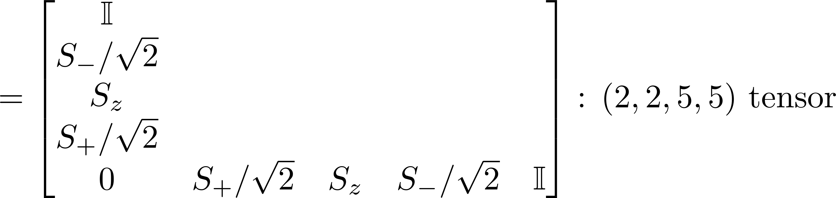
DMRG on anti-ferromagnetic S=1/2 Heisenberg chain
S. R. White, PRL (1992)
2
3
4
1

Slide 4
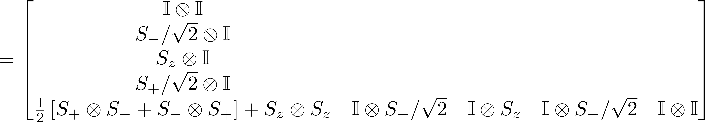
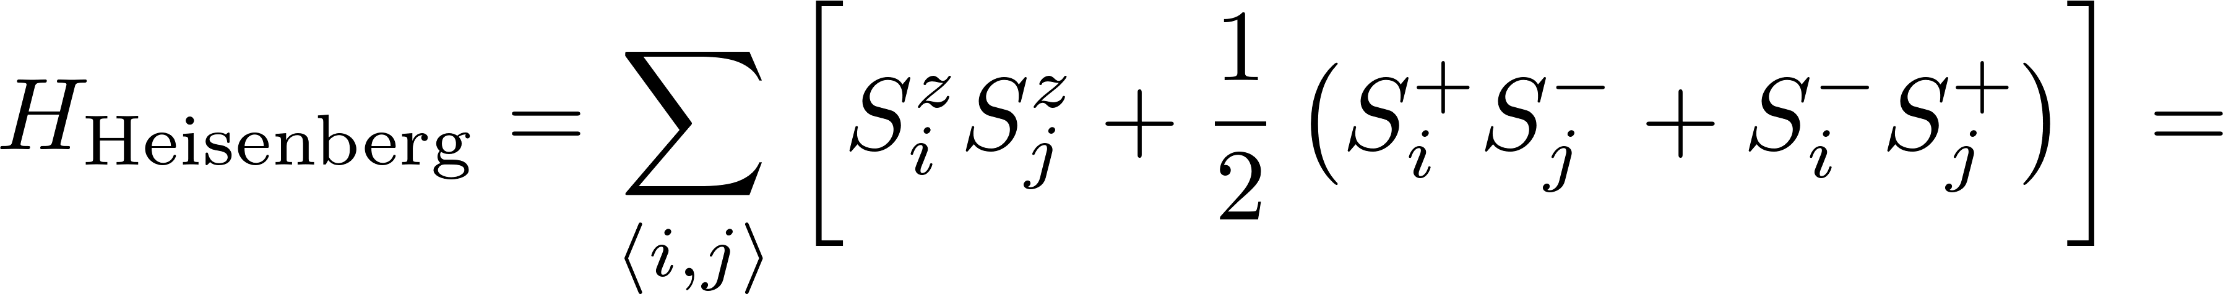
DMRG on anti-ferromagnetic S=1/2 Heisenberg chain
2
2
3
4
4
1
1
2
2
2
4
1
1
1

Slide 5
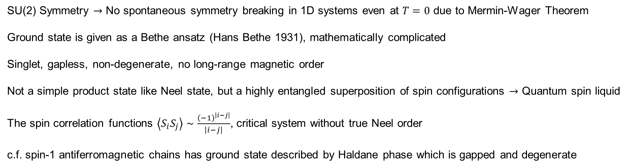
Anti-ferromagnetic Heisenberg chain
SU(2) Symmetry $→$ No spontaneous symmetry breaking in 1D systems even at $T=0$ due to Mermin-Wager Theorem
Ground state is given as a Bethe ansatz (Hans Bethe 1931), mathematically complicated
Singlet, gapless, non-degenerate, no long-range magnetic order
Not a simple product state like Neel state, but a highly entangled superposition of spin configurations $→$ Quantum spin liquid
The spin correlation functions $\left\langle S_{i}S_{j}\right\rangle ∼\frac{{\left(−1\right)}^{\left|i−j\right|}}{\left|i−j\right|}$, critical system without true Neel order
c.f. spin-1 antiferromagnetic chains has ground state described by Haldane phase which is gapped and degenerate

Slide 6
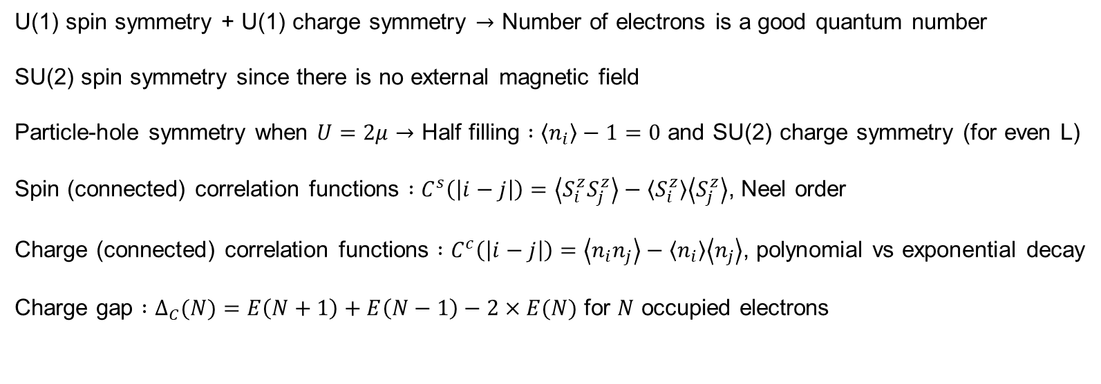
(Single-orbital) Fermi-Hubbard model
U(1) spin symmetry + U(1) charge symmetry $→$ Number of electrons is a good quantum number
SU(2) spin symmetry since there is no external magnetic field
Particle-hole symmetry when $U=2μ→$ Half filling $:\left\langle n_{i}\right\rangle −1=0$ and SU(2) charge symmetry (for even L)
Spin (connected) correlation functions $:C^{s}\left(\left|i−j\right|\right)=\left\langle S_{i}^{z}S_{j}^{z}\right\rangle −\left\langle S_{i}^{z}\right\rangle \left\langle S_{j}^{z}\right\rangle$, Neel order
Charge (connected) correlation functions $:C^{c}\left(\left|i−j\right|\right)=\left\langle n_{i}n_{j}\right\rangle −\left\langle n_{i}\right\rangle \left\langle n_{j}\right\rangle$, polynomial vs exponential decay
Charge gap $:Δ_{C}(N)=E\left(N+1\right)+E\left(N−1\right)−2×E(N)$ for $N$ occupied electrons

Slide 7
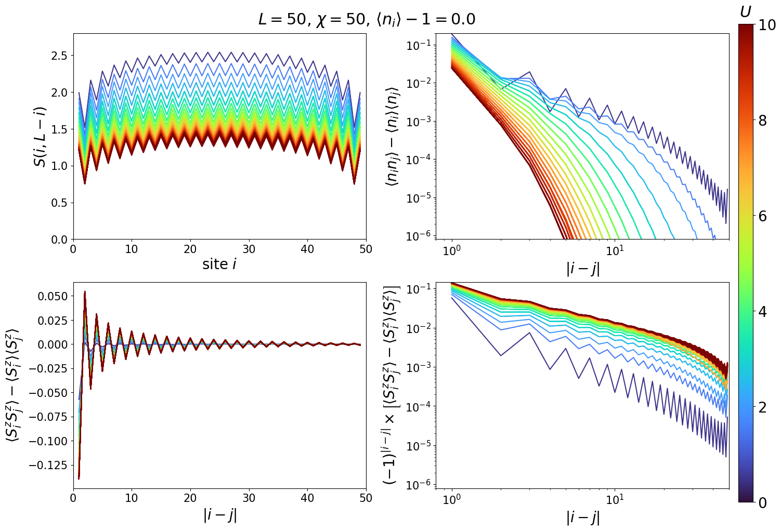

Slide 8
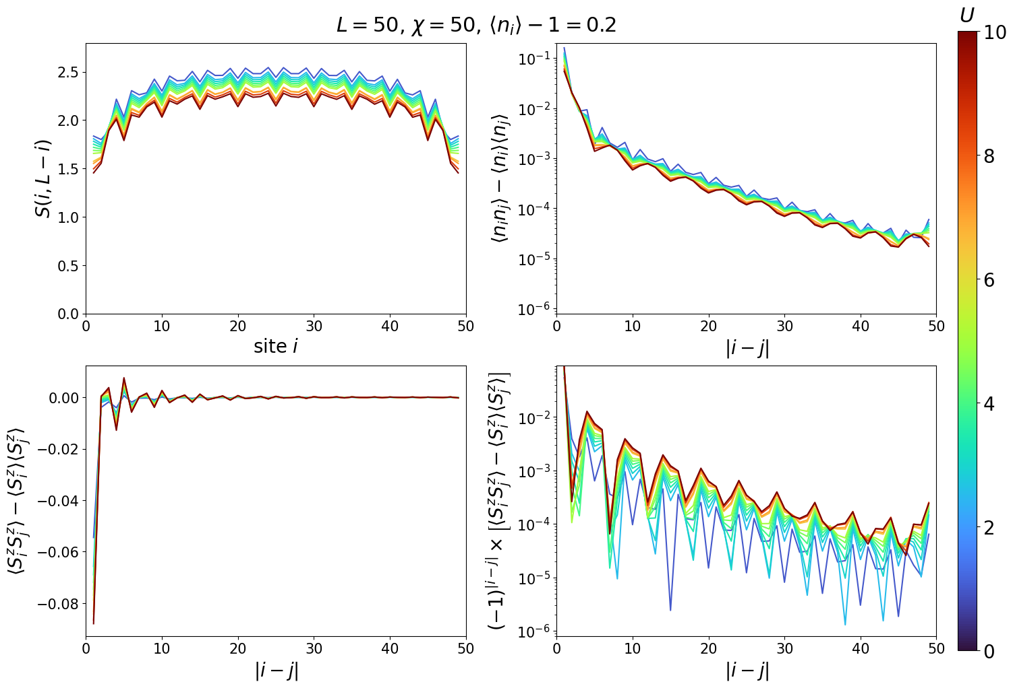

Slide 9
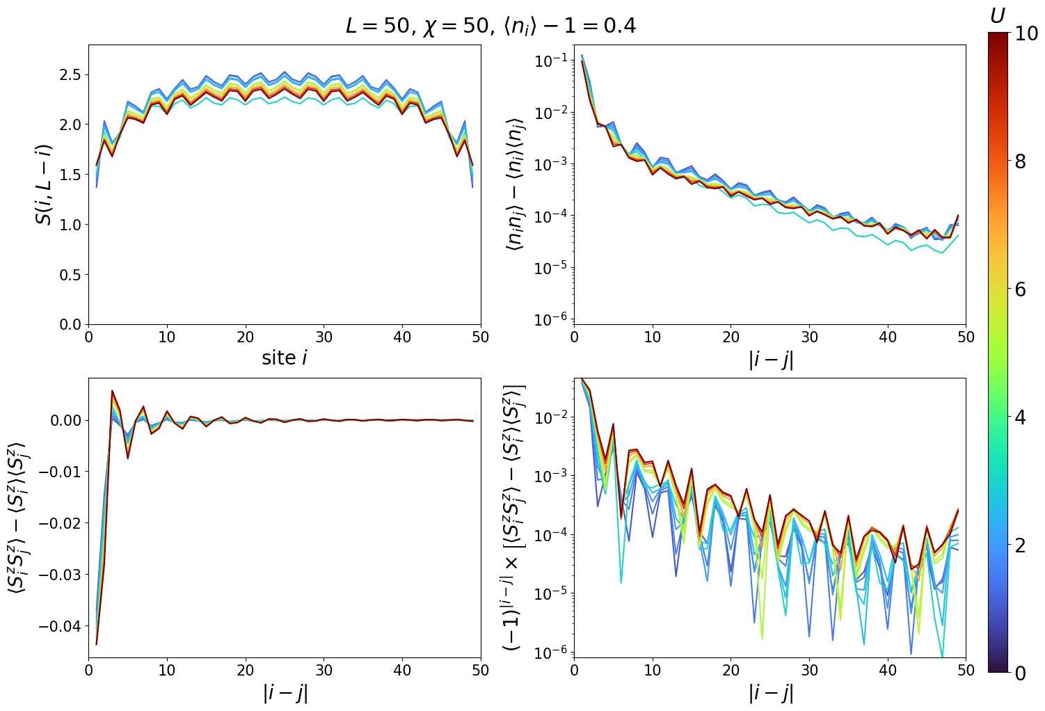

Slide 10
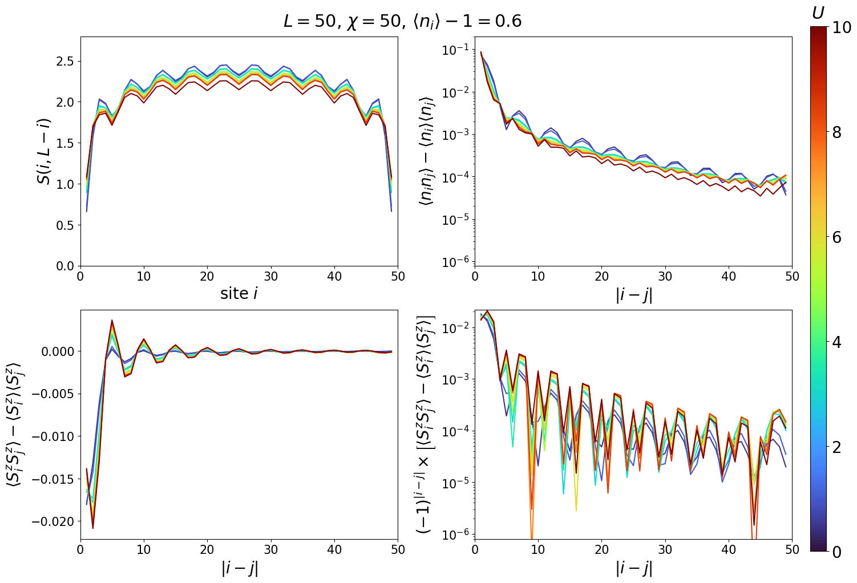

Slide 11
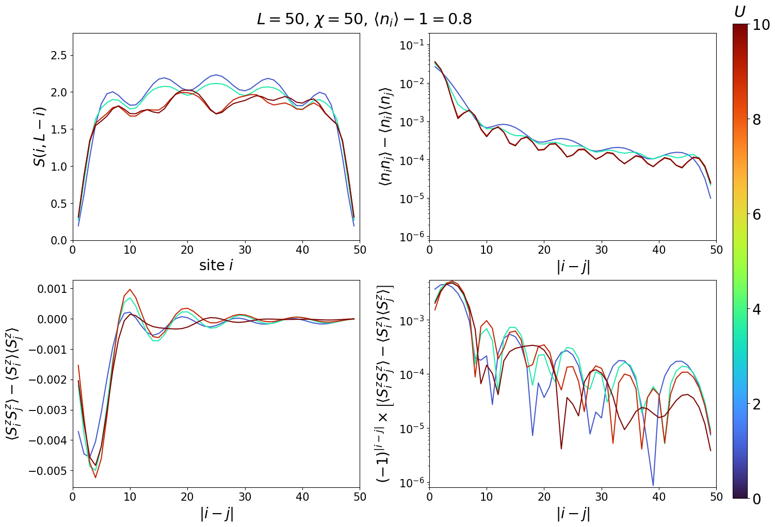

Slide 12
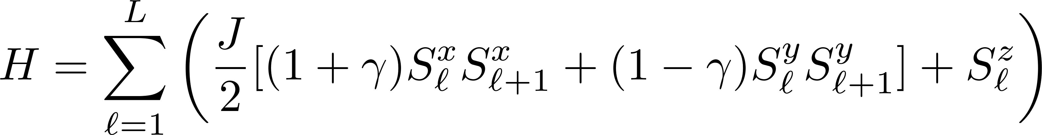
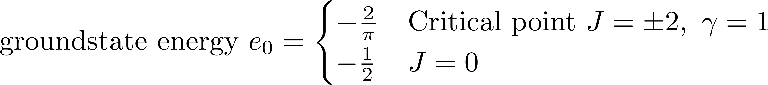
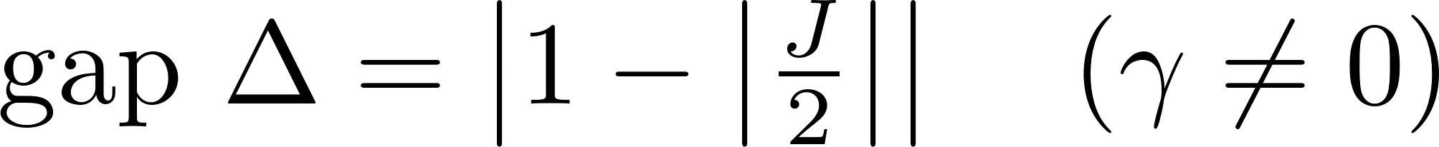
Heisenberg XY model

Slide 13
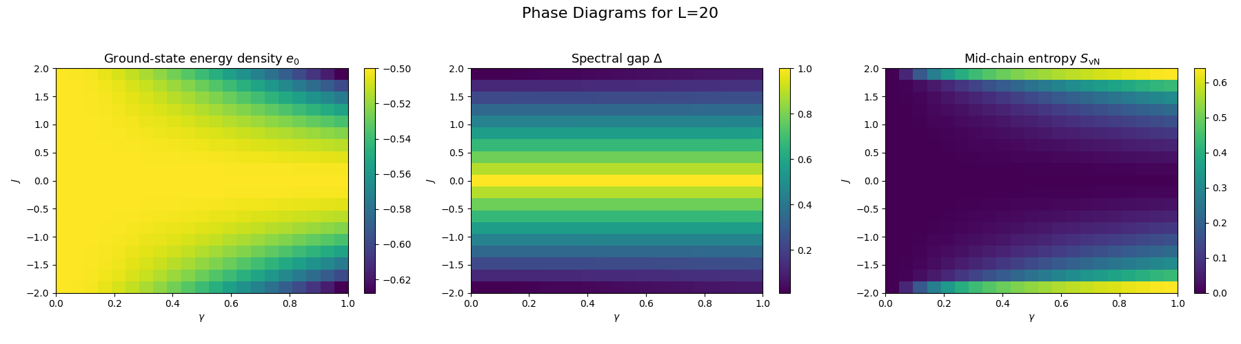


Slide 14
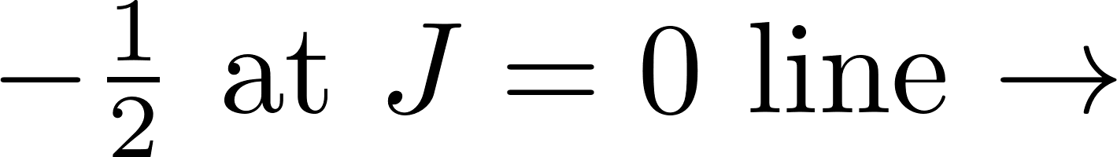
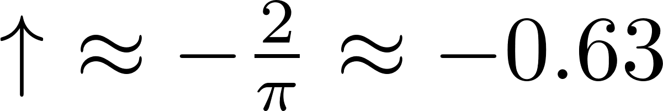
Detailed phase diagram

Slide 15
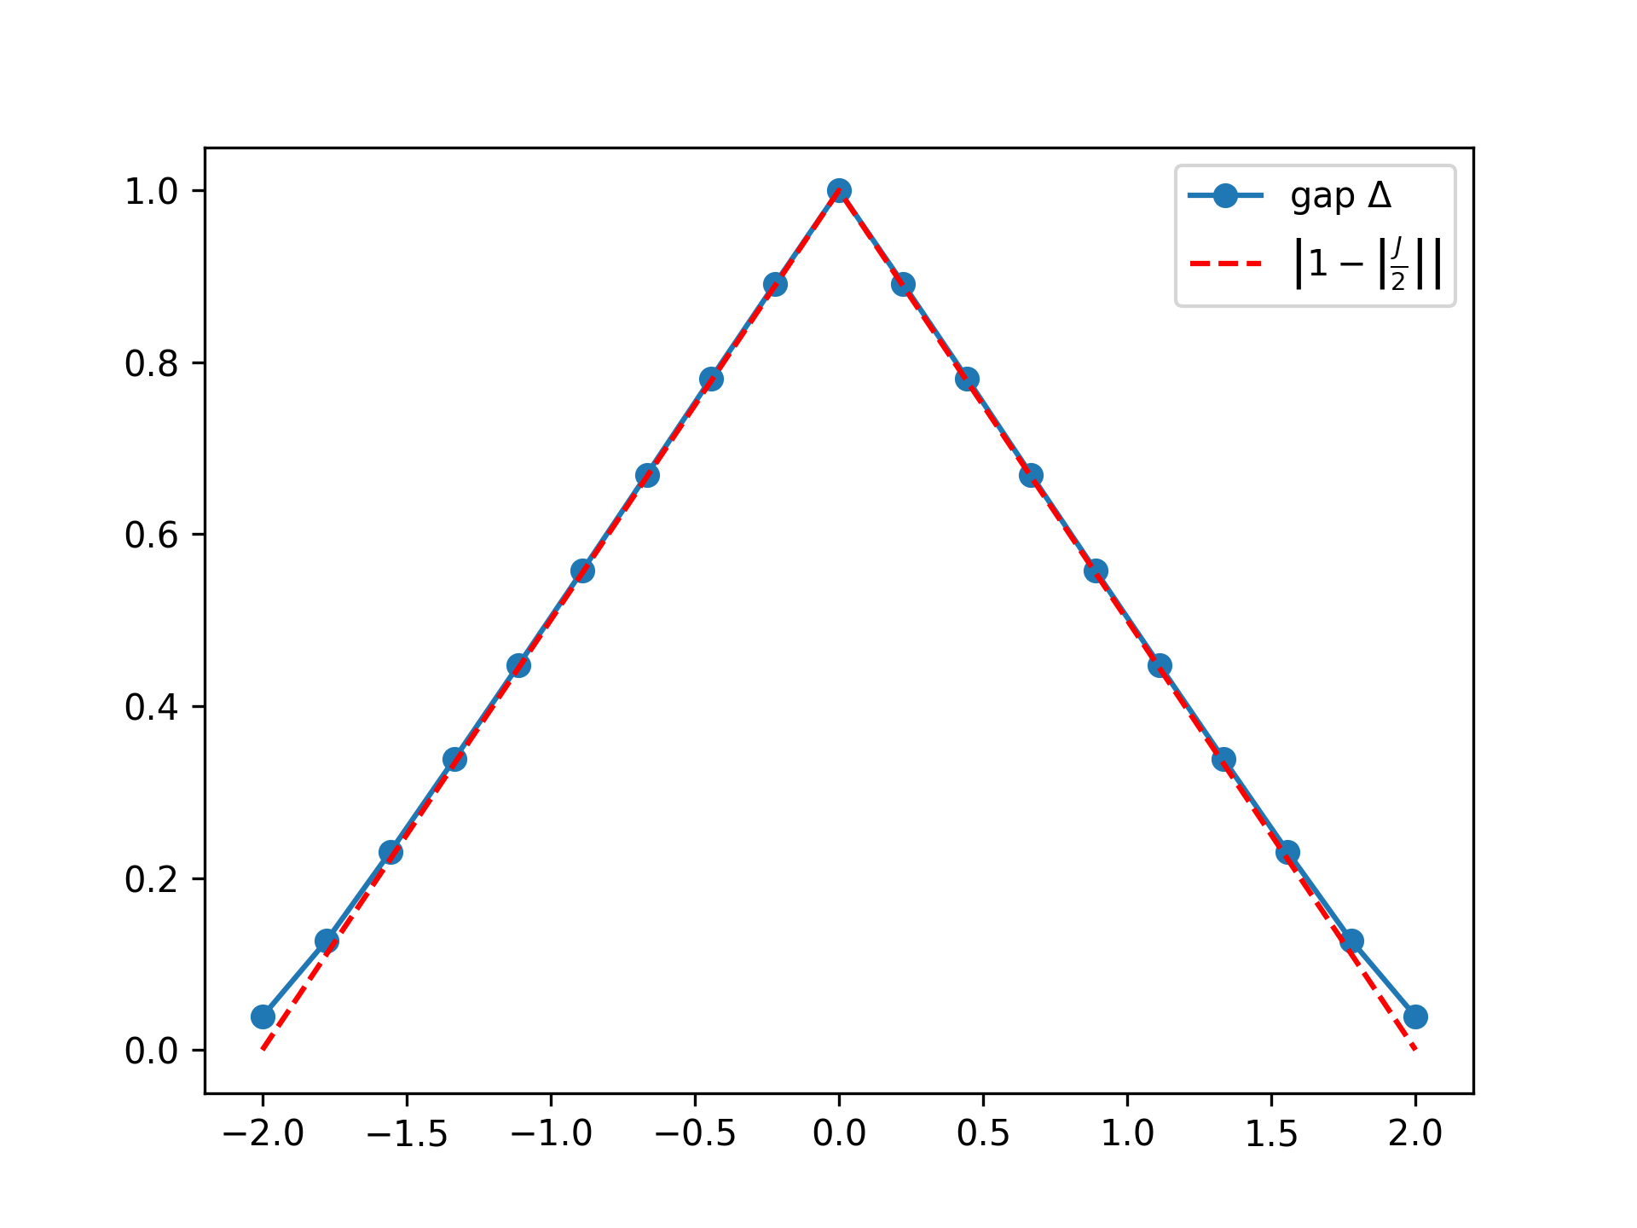
Detailed phase diagram

Slide 16
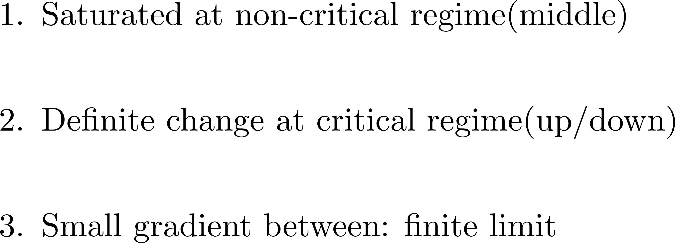
Detailed phase diagram

Slide 17
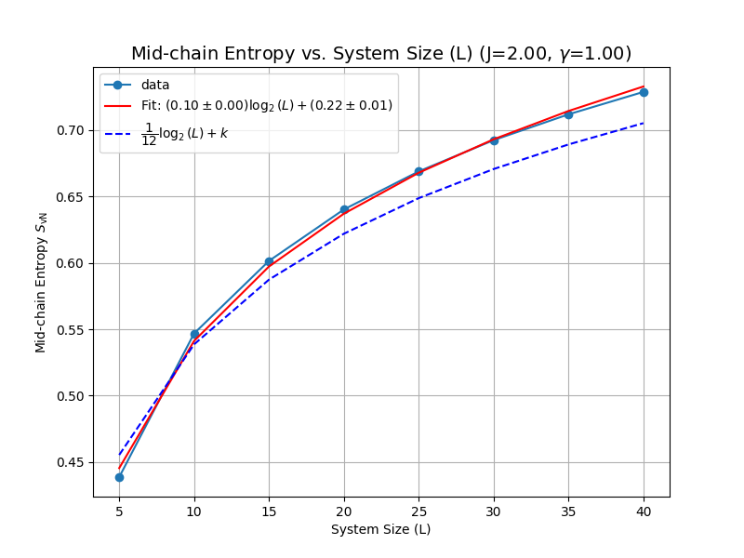
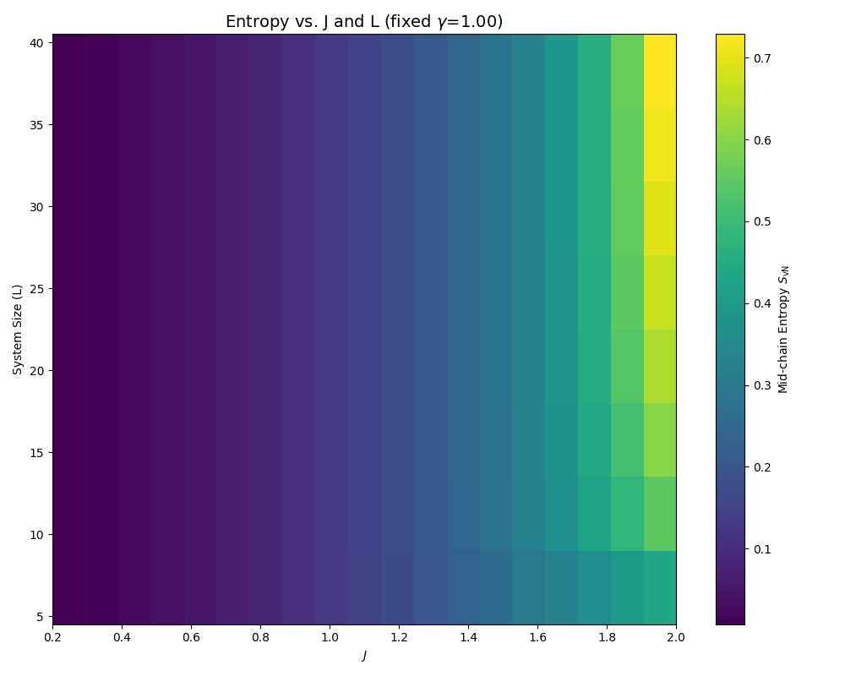
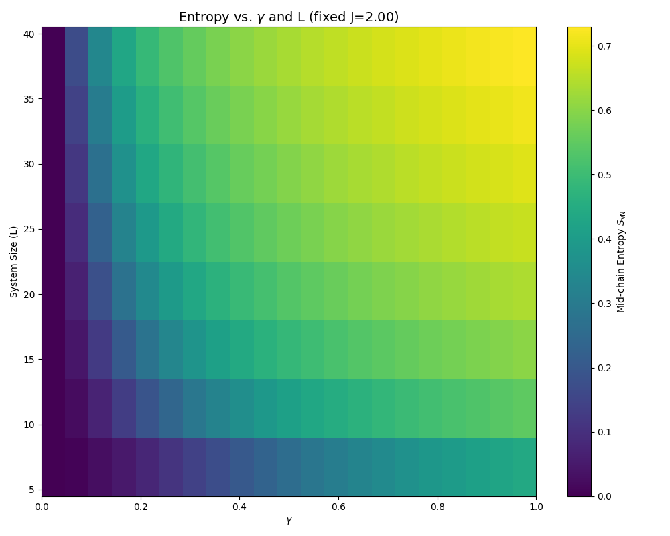
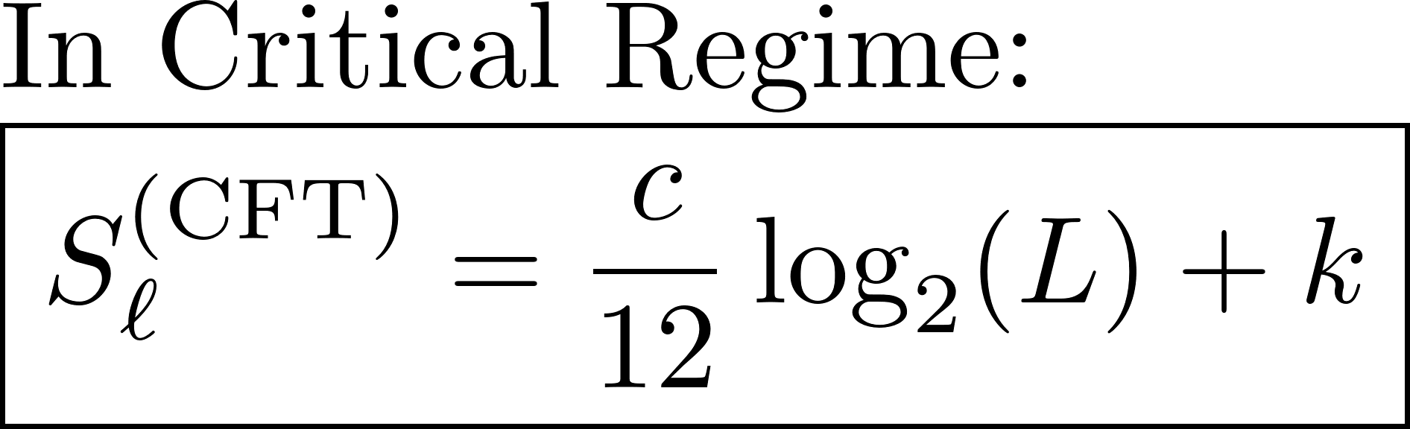
Mid-chain entropy: log(L) behavior

Slide 18
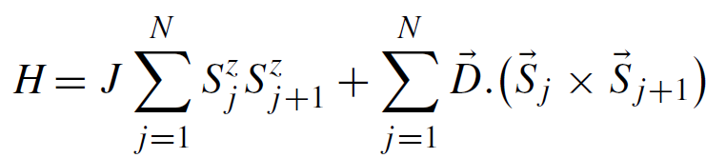
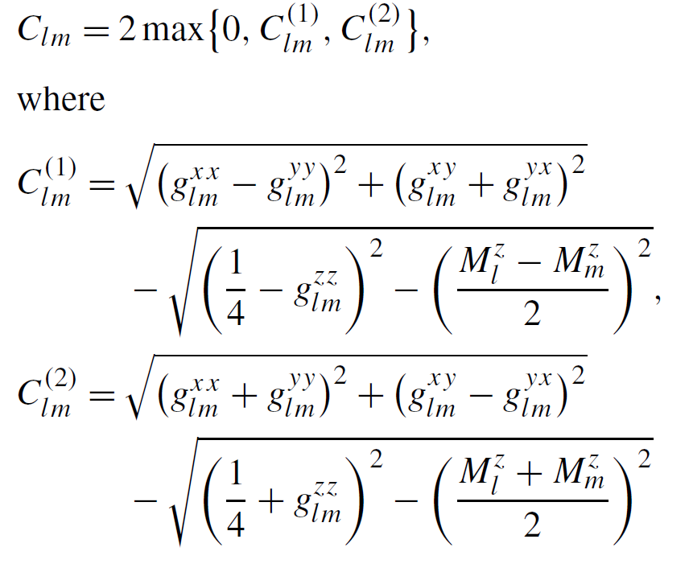
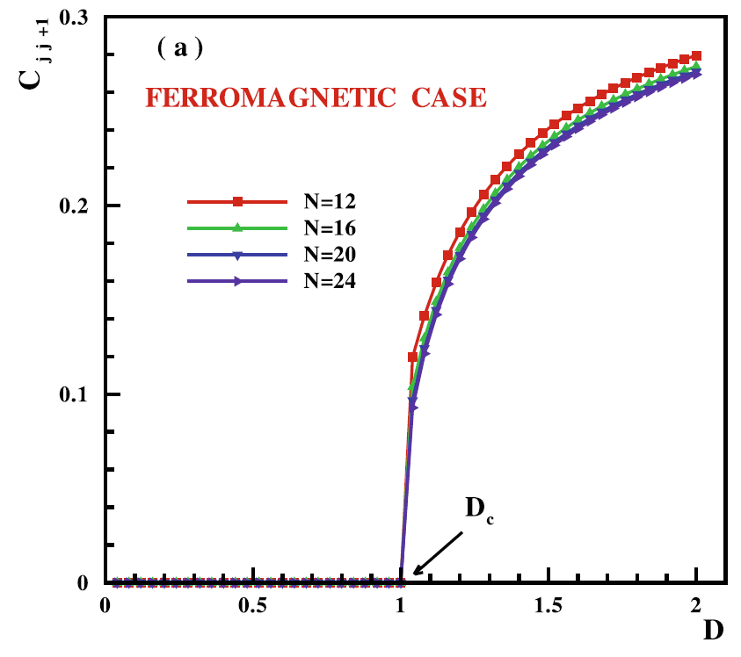
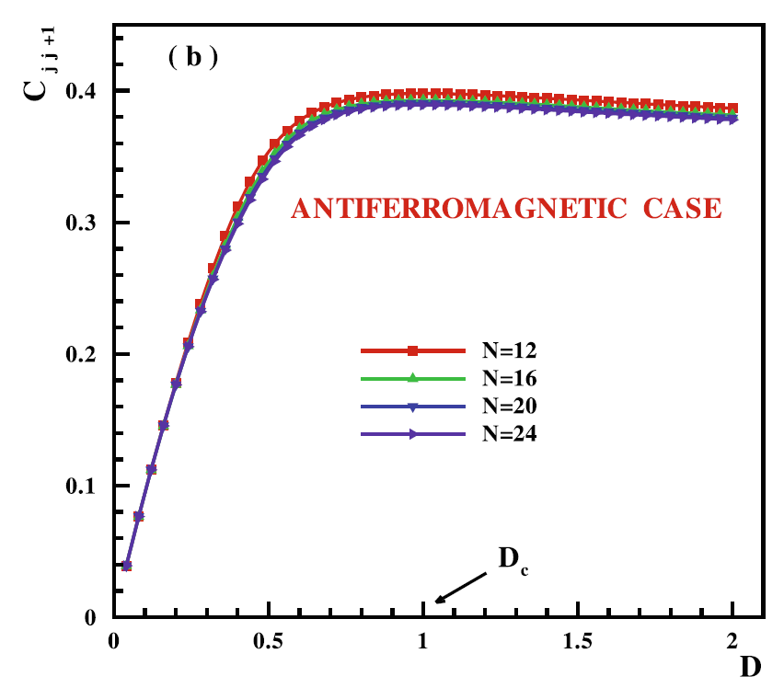

Entanglement Study of the 1D Ising + DM Interaction Model
1D Ising Model + DM Interaction could induce spiral-FM and spiral-AFM phase and a commensurate - incommensurate quantum phase transition (QPT) at Dc=|J|.
Concurrence quantifies the pairwise entanglement btw two spins
Which is an indicator of QPT.
Could we capture QPT with DMRG? (Paper used Lanczos for approx. ED)
J. Vahedi, JSNM (2012)

Slide 19
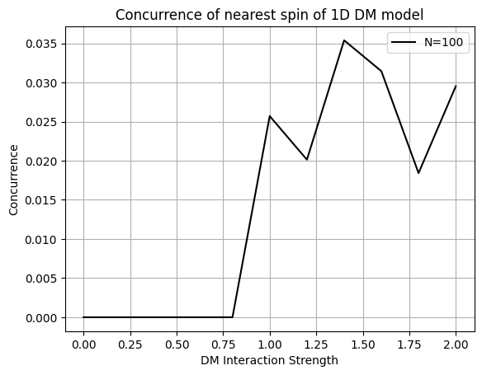
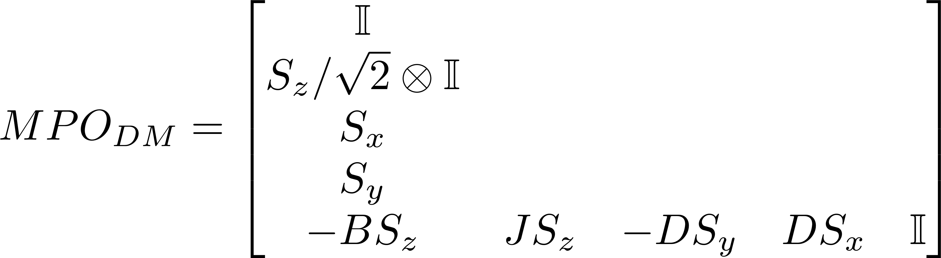
Entanglement Study of the 1D Ising Model with DM interaction
DMRG Setting:
J = 1 (FM), L = 100, Nkeep = 30
QPT occurs at Dc=J=1 in FM case
Concurrence fluctuation after the QPT?
(1) Open Boundary condition? (Paper used PBC)
(2) Existence of metastable states?

