Slide 1
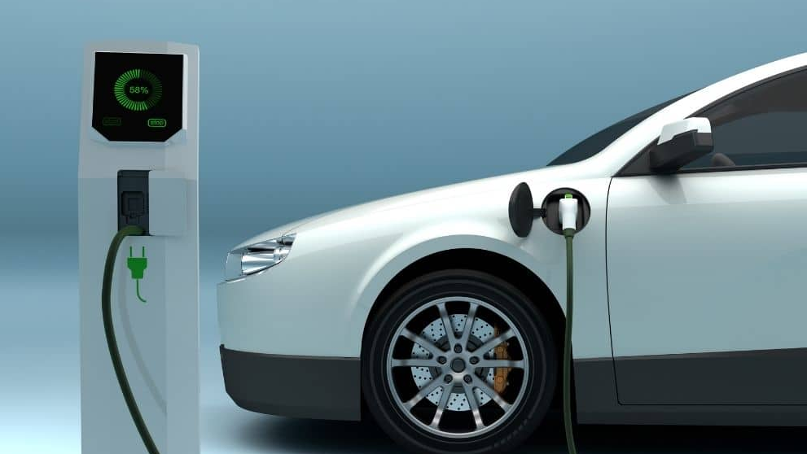


THE FUTURE OF ROAD MAINTENANCE IN THE ERA OF ELECTRIC VEHICLES AND EMERGING TECHNOLOGIES PRESENTATION BY THE ARMFA SOUTHERN AFRICA FOCAL GROUP (ASAFG)
22ND ARMFA/AFERA GENERAL ASSEMBLY
MONROVIA - LIBERIA
17 - 20 NOVEMBER 2025

Slide 2
Speaker Profile
Mr. Benitany Randimby
Chief Executive Officer
Road Fund Madagascar

Slide 3
Presentation Overview
Global Adoption of Electric Vehicles
Africa Adoption of Electric Vehicles
Africa’s Readness to Electric Vehicles Adoption
Impact of Electric Vehicles on Future Road Maintenance
Addressing the Risks of Electric Vehicles on Road Maintenance
Leveraging Technologies for Road Maintenance and Preservation
Key Takeaways

Slide 4
Global Adoption of Electric Vehicles
Electric Vehicles are here to stay.
The global count of electric cars in use at the end of 2024 was 55.8 million and this is growing quickly.
There were 17.4 million new electric vehicles registered worldwide in 2024, and this is an increase of 17% on the previous year.
Globally, over 1-in-5 (22%) of new cars sold in 2024 were electric.
Source: International Energy Agency, Global EV Outlook 2025

Slide 5
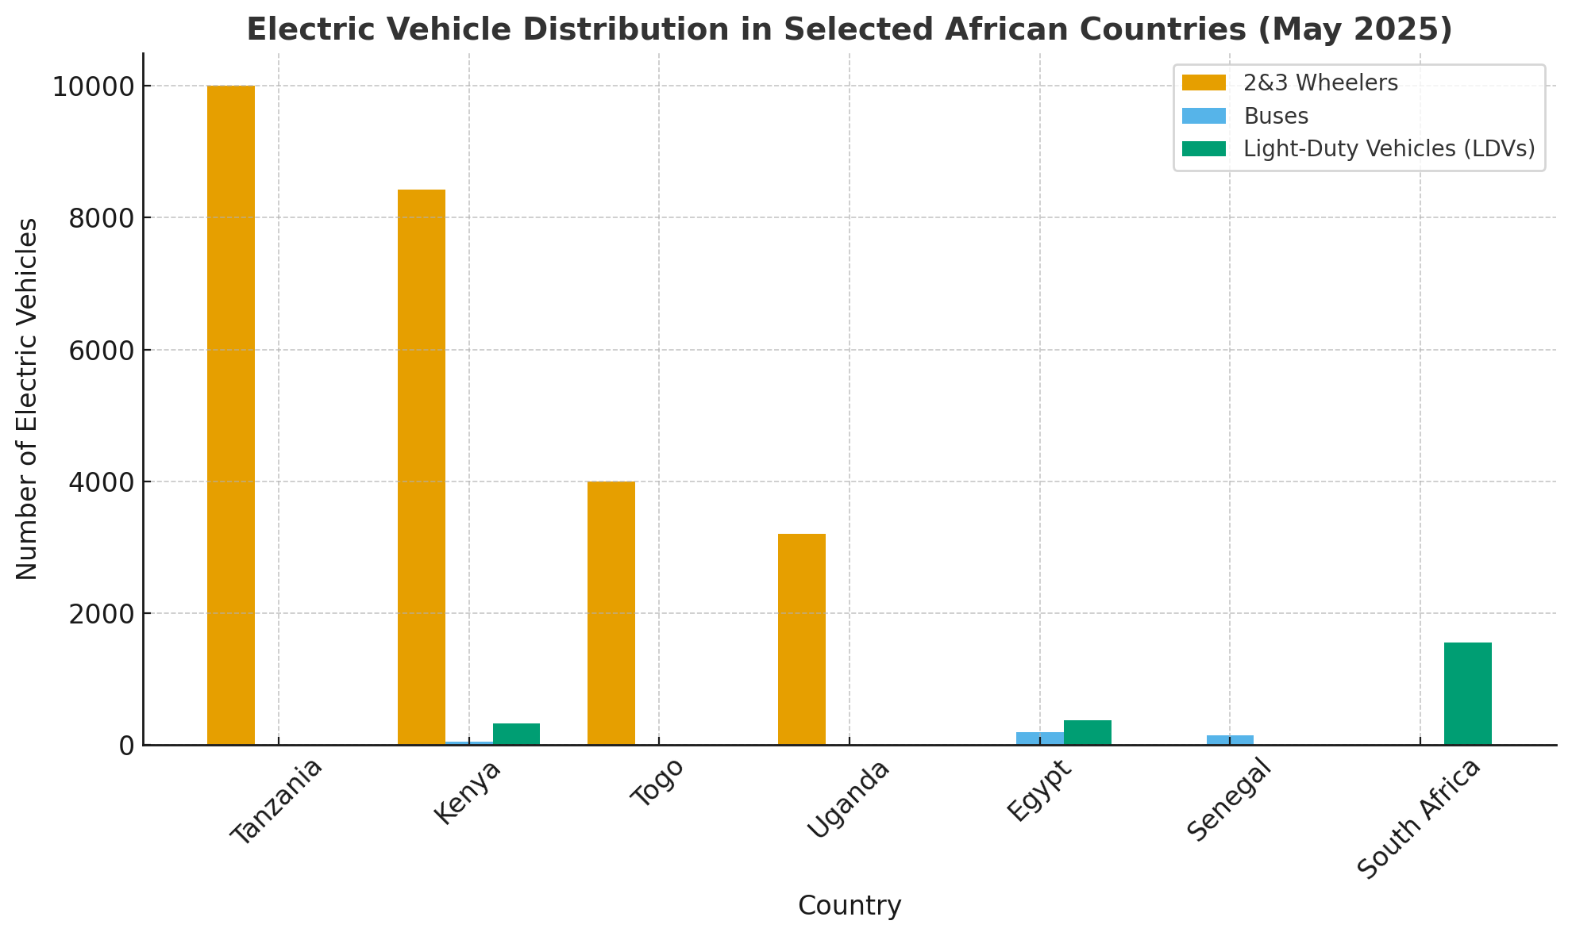
Africa Adoption of Electric Vehicles
According to Africa E-Mobility Report 2025: Trends, Policies, and Investments in Electric Mobility, Africa is moving towards EV adoption.
Three-wheelers (≈30,000 units).
Tanzania leads with around 10,000, Kenya (8,421), Togo (4,000), and Uganda (3,200)
Electric buses (545 total)
Egypt (200), Senegal (155), and Kenya (54)
Light-duty vehicles (4,778 total)
South Africa (1,559), Egypt (380), and Kenya (326)

Slide 6
Africa’s Readness to EVs Adoption
The policy framework for e-mobility in Africa is still in its early stages.
Most governments are experimenting with pilot projects and limited fiscal incentives, mainly targeting public and commercial transport rather than private EVs.
Only Egypt and Rwanda have comprehensive e-mobility ecosystems (covering policy, regulations, fiscal/non-fiscal incentives, and integration with the energy sector).
About 13 African countries — including Kenya, Rwanda, Uganda, Ethiopia, Morocco, Togo, Algeria, South Africa, Egypt, Angola, Zimbabwe, Ghana, and Nigeria — have national Electric Vehicles Strategies, but many struggle with implementation, funding constraints, and weak regulatory follow-through.

Slide 7
E-Mobility Policy Landscape by Country
Source : Africa E-Mobility Report 2025: Trends, Policies, and Investments in Electric Mobility

Slide 8
Factors Influencing Africa’s Adoption of Electric Vehicles
The Electric Vehicles market in Africa is also growing fast. Some countries are making significant progress in embracing electric vehicles.
Governments’ commitments to the UN Paris 2015 Agreement. EVs are now a strategy to reduce carbon footprint. There are EV tax incentives in place.
Most countries depend on fuel imports, making EVs an attractive economic solution. Governments would like to cut down on rising fuel imports costs.
With ever improving technologies, the current EV challenges will soon be resolved.

Slide 9
Impact of Electric Vehicles on Future Road Maintenance
Reduced Road Maintenance Funding. Fuel levies are projected to decline with increasing EV adoption. Resulting in reduced funding for maintenance and accelerated road network deterioration.
Accelerated Road Wear and Tear. EVs increased weight and improper tire pressure will lead to accelerated road wear and tear, necessitating frequent and increased maintenance.
Increased Demand for Smart Infrastructure. Charging stations need to be integrated, Smart roads with energy supply conduits, charging lanes, or data sensors.

Slide 10
Addressing the Risks of Electric Vehicles: A Proactive Stance
Road Funds should acknowledge the global shift towards EVs and its inevitable impact on fuel levies, the most traditional Road Fund revenue stream.
There is an urgent need to explore and implement alternative funding models and to adapt road user charging systems to the realities of electric vehicles
Road Funds should exploit the opportunities presented by new technologies to enhance road maintenance efficiency and sustainability.
Emerging smart technologies represent a strategic opportunity to modernize road asset management systems and practices

Slide 11
Diversifying the Road Fund Revenue Streams
The dwindling fuel levies call for alternative sources of Road Fund revenues and better road management systems and practices, including:
Road tolling. Tolling is derisking fuel levy overreliance in Zambia and Zimbabwe
Distance-based RUCs. Namibia is implementing Mass Distance Charges
Public Private Partnerships (PPPs). The case of Zimbabwe and Zambia
All potential sources. Collecting from all current potential sources – Vehicle licenses and registration, overload fines and abnormal load fees
Road Funds bonds: Issuance of bonds to frontload maintenance backlog clearance. The case of Malawi.
OPRC and RAMS: Output and Performance-based Road Contracting (OPRC) and robust Road Asset Management Systems (RAMS)

Slide 12
Road User Charges Adapted to Electric Vehicles
Circulation Tax | Energy Consumption Tax | Distance Base Charge
An annual fee based on the value of the vehicle, like a road tax, regardless of use | A charge on consumption of electricity which powers EVs at charging stations | Applying a fee for EVs based on weight and distance could be fairer and more efficient
Guarantees more stable and predictable revenue | A more proportional contribution to road use, like a levy on fuel per litre | Allow EVs and other more fuel-efficient vehicles to contribute towards road maintenance.
Less efficient as it does not reflect the actual use of roads | Could work with commercial charging stations and not with residential plugs | Raises privacy/technology concerns regarding the monitoring of mileage

Slide 13
Challenges with Taxing Electric Vehicles
Public acceptance: May encounter resistance from users who may consider the measures discouraging the adoption of EVs.
Technical implementation: Would require robust systems to ensure accuracy and efficiency of data collection and management
Legal vacuum: Would need studies of the best legal arrangements to incorporate the taxation of EVs in specific or existing laws.
Inter-institutional coordination: Would require coordination with other stakeholders to ensure harmonization of standards/procedures

Slide 14
Addressing the Electric Vehicles Taxation Hurdles
Public Awareness: Conducting proactive awareness campaigns and stakeholder engagements to ensure acceptance of new funding models
Regulatory Changes: Introducing legal and regulatory changes necessary to integrate EVs & emerging technologies into road preservation strategies
Privacy Protection: Investing in robust data management and privacy protection for any usage-based taxation systems
Equitability: Ensuring that the agreed taxation policies balance fiscal needs (revenues generation) with environmental goals

Slide 15
Leveraging Technologies for Road Maintenance and Preservation
Embracing technology: Exploring and piloting relevant smart technologies to reduce road maintenance costs and increase operational efficiencies in revenue collection and axle load control enforcement.
For example, use of smart technologies for monitoring and conducting tests and surveys. Virtual reality or use of drones could be faster and cheaper than visual inspection
Potential Collaborations: Collaborations with local universities, research institutions and technology providers.
For example, Smart road monitoring: Sensor systems for early damage detection in Namibia;

Slide 16
Key Takeaways
Electric and fuel-efficient vehicles are here to stay. Fuel levies are falling. It is time for Road Funds to investigate and apply distance-based financing models.
Continuous assessment of the impact of EVs and emerging technologies on road user charges should be part of the Road Funds’ strategic focus if the Road Funds are to be proactive.
Road Funds should explore additional ways of raising resources to cover the gap created by the progressive reduction in fuel levies, including collecting from all current potential sources.
ARMFA and Road Funds should promote research and use of emerging technologies for climate-resilient roads and low road maintenance solutions.
Navigating the transition to electric mobility requires collaborative and adaptive approach to ensure equitable, efficient and environmentally responsible systems.

Slide 17
THANK YOU.
MERCI.
OBRIGADO.

