Slide 1
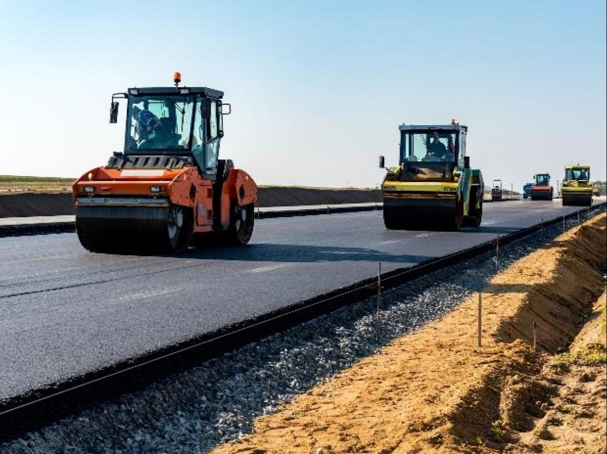
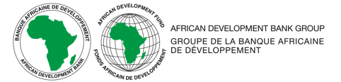
Infrastructure Development and Maintenance “The Forefront of PPP and Maintenance Management for Sustainable Infrastructure Development” 18 November 2025 Infrastructure and Urban Development DEPARTMENT African Development Bank

Slide 2

Topics
The Road Sector in Africa
Bank Support to the Road Sector in Africa
Technical Overview of Sustainable Road Maintenance Program for Africa (SRMPA)
SRMPA Phase 2
Conclusion

Slide 3











the road sector in Africa
Road transport predominates on the continent :
80% of freight traffic
About 90% of passenger traffic
Countries have developed extended their road networks, but they remain largely inadequate in terms of length
and density:
2.5 million kilometers, of which only 27% are surfaced, compared with 60% in India and 66% in China
204 km of roads per 1,000 km², compared with 944 km per 1,000 km² worldwide
Major investments have been made but not in network maintenance:
Since the 1980s, USD 150 billion has been invested in the road sector in sub-Saharan Africa.
Over the next decade, 30% of this investment will be lost due to lack of maintenance
Maintenance includes:
Routine: work planned and carried out throughout the year to maintain and preserve the road. Periodic: multi-year renewal of the surface course or resurfacing course of an unpaved road to repair wear resulting from traffic by
Maintenance includes:
Routine maintenance: work planned and carried out throughout the year to maintain and preserve the road.
Periodic maintenance: multi-year renewal of the surface course or resurfacing by gravelling or other means of the wearing course of an unpaved road to repair wear resulting from trafﬁc
Access to rural areas is worse, with only 34% of the population within two (2) km of an all-weather road, compared with 50% in other parts of the developing world.
Source: AfDB Road Asset Management Study 2020
The absence or inadequacy of network maintenance will add to the new needs requiring ﬁnancing of USD 140 billion by 2030

Slide 4
Bank support to roads sector
Road Sector Support 2011- 2023
Focus on PPP Operations 2006 -2017
The Road sub sector accounted for 60% of total funding of Transport sector between 2011- 2023.
Sectoral distribution of the Bank’s downstream financing support to PPPs
3.8 Billion US$
Sector | %
Power | 57
Transport | 37
Agriculture | 4
Industry and Mining | 2
20.8 Billion US$
Between 2006 and 2017 ,65 PPP-related operations in 29 countries equivalent to US$ 3.8 Billion
Transport sector represents 37%
Upstream activities, i.e. enabling policy, regulatory and governance in period amount to US$ 884 million

Slide 5






GENESIS of Sustainable Road Maintenance Program for Africa (SRMPA)
GI Hub and MDB partners: African Development Bank, Asian Infrastructure Investment Bank, Asian Development Bank, European Bank for Reconstruction and Development, Inter-American Development Bank, Islamic Development Bank, World Bank, World Bank Global Infrastructure Facility.
The program’s purpose is to help governments and investors in the roads sector in emerging markets make roads more sustainable by providing access to a pipeline of technology-enabled solutions
Expressions of Interest kicked off in March 2023 for providers to share examples of innovations for scale up in road maintenance.
May 2023, GI Hub announced the 5 top innovations
SRMPA developed by AfDB and aligned to the GI Hub outcomes of testing and piloting innovation for sustainable road maintenance.

Slide 6
Overview of Sustainable Road Maintenance Program for Africa (SRMPA)
Positioning climate change considerations centrally in maintenance planning.
SRMPA is expected to promote sustainable, climate resilient and safer road infrastructure by conducting two studies per selected country as below:
Conducting Climate Risk and Vulnerability Assessments to identify the right InfraTech solutions to address the unique climate related damages on the road network; and
Innovative sustainable financing mechanism development, e.g., PPP.
Promoting and supporting Output and Performance Based Road Contracts hinged on private sector participation.
Lead the identification and structuring of innovative financing arrangements for road maintenance projects through blended financing and working in partnership with various agencies and partners.
AfDB is engaging and will partnering with several institutions and agencies in the design and implementation of the Program. SRMPA targets at 6 countries at the first phase and will be completed by end of this year.
Royal HaskoningDHV was the consultant assigned to implement the technical analysis.

Slide 7
Country selection indicators
Objectives:
Define overall characteristics of the road network in African countries, what is the current quality of the road network, if road maintenance is a priority for each country, and if the country is eligible for specific investment windows from AfDB.
Use indicators to inform selection of further countries the SRMPA.
Key Factors Considered:
Country-level characteristics
Eligibility for AfDB Investments
Road network characteristics
Investment programs available
Private sector investments
Climate hazards of relevance
Available information

Slide 8
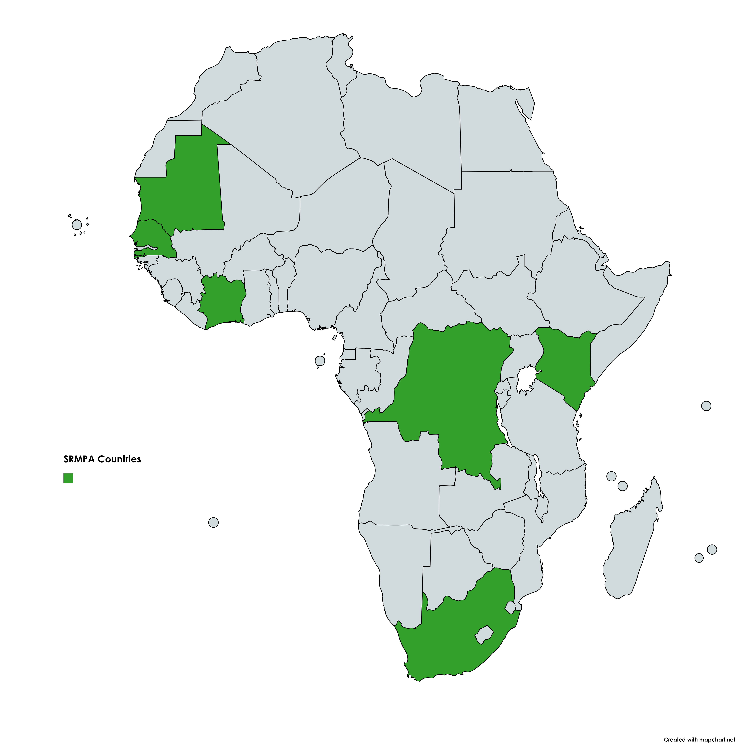
Sustainable Road Maintenance Program for Africa (SRMPA)
Selected Countries
South Africa – Southern Africa
Kenya – East Africa
Democratic Republic of Congo (DRC) – Central Africa
Senegal – West Africa
Ivory Coast – West Africa
Mauritania – North Africa.
Mauritania
Senegal
Ivory Coast
Kenya
DRC
South Africa

Slide 9
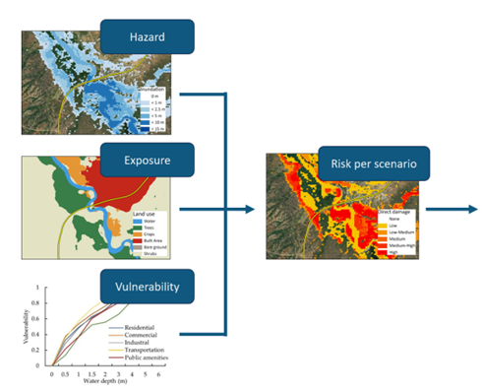
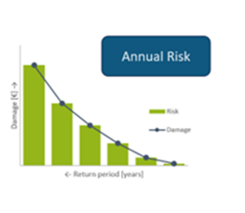
Climate risk and vulnerability assessment
Risk is defined as “Risk=Hazard x Exposure x Vulnerability”.
Hazard: extreme temperature (days above 35ºC and 40ºC) and pluvial and fluvial flooding (flood depth/extent).
Exposure: roads and bridges of primary transport network.
Vulnerability: relation between intensity of hazard and the degree of damage or loss caused.
For this Assignment, we calculate risk quantitatively using a risk index score between 0 and 100 for the road infrastructure assets.
The risk index score can be used to determine which roads or bridges are at high or low risk, allowing prioritization of investments in assets that are most at high risk.

Slide 10
identification OF Infra tech options
For this study, we have categorized InfraTech options into 3 sub-categories:
Engineering solutions: especially in terms of innovation in road construction and routine road maintenance, plays a significant role in reducing the initial cost associated with construction of new and prioritized road infrastructure but also reducing annual road maintenance budget requirements.
Road asset management: RAMS play a crucial role in helping road authorities prioritize spending of roads maintenance budgets. They are important to further prioritize limited budgetary allocation for infrastructure maintenance and risk mitigation interventions needed to maintain and improve the overall condition of the road network against climate risks such as exposure to extreme heat and flooding.
Early warning system: EWS involve a multifaceted approach that integrates hardware (management measures and infrastructure), software (data analytics, processing, and dissemination), and orgware (organisational or institutional aspects such as policies and guidelines). They can help to identify damages at an early stage and inform on the need to repair and/or replace assets at the appropriate time.

Slide 11
ROAD MAINTENANCE financing
Decentralized financing of local roads – If local governments and private organizations are to carry out decentralized functions effectively, they must have adequate revenues, as well as the authority to make expenditure decisions . Revenues can be raised locally or transferred from the central government.
Road funds – special accounts, administered and managed by independent organization, into which certain revenues are deposited and can then only be accessed by the roads administration. There must be a separation of money collected from road users into a utility charge that is use-related and into a tax that is paid into general revenue.
Private financing – Includes private concessions, public toll roads, PPPs, and community fund raising by targeting local taxation. Successful private finance contracts rely upon a number of pre-conditions, including:
Economic stability
Financial viability.
Attitudes towards risks and rewards
Completion undertakings
Availability of finance
Government support
Complexity
Patience and perseverance

Slide 12
ROAD MAINTENANCE FUNDING
Road toll - users pay directly for their contribution to the use of the road. More transparent for private financiers. But the administrative cost of collecting tolls can be high and is not suitable for all roads - a high traffic level is required to be feasible;
Fuel levies - reflects usage of road space directly and is an efficient funding source to administer. Poor proxy for road damage, as heavy vehicles cause far more damage to the road pavement and only use marginally more fuel;
Annual vehicle licenses - enables a progressive fee that match the relative degree of pavement damage caused by different classes of vehicle;
International transit fees - can be collected at points of entry and exit;
Overloading fees - charges on freight transport who go over maximum weight loads. However, the desire is to eliminate overloading, so these fees should not be used for planning purposes - same as any other revenues made from traffic violation fines;
Congestion charging - suitable for urban areas. Mechanisms available for this include parking charges, cordon charges and area licence fees;
Charging utilities - charging utilities for the use of road space, either when they are carried above the road, or buried within it. This is certainly more applicable when utilities are being installed or maintain, since the use of road space is being denied to the principle customers;
Donor funds;
Capital gains from investments.

Slide 13
PUBLIC-PRIVATE PARTNERSHIPS
Topic | Key Considerations
Role for the Private Sector | The private sector can be responsible for the design, construction, operation, and maintenance of a PPP project depending on the type of contract structure. To integrate climate adaptation and resilience into PPPs, the private partner should build capacity to understand climate risks and the entry points to integrate climate risk assessments, resilient design, appraisal of adaptation options, among others, into the PPP project cycle.
Governance / Enabling Environment | PPPs require a strong framework for implementation, political support, legal and technical expertise to develop and manage contract and projects. The capacity on climate risks, adaptation and resilience should be present in both public and private partners.
Risk Allocation | The allocation of risk between the public and private partner should consider the risk profile and revenue of the project, the expertise/service provided by the private partner, and the institutional / economic strength of the public partner. Furthermore, it requires a common understanding and trust among partners to ensure the project will be effectively implemented.
Payment Mechanism / Revenue Stream | The remuneration in PPPs is based on user-fees or availability payments, with contractual specifications and requirements that create an incentive for the private partner to optimize the performance of the infrastructure under different climatic conditions. At the same time, since the benefits from climate-resilient infrastructure PPPs often do not result in direct revenues for the project but provide instead provide wider social, economic, and environmental benefits, the public sector should incentivize private partners to innovate and ensure that co-benefits are created and quantified.
Adaptation Benefits | The remuneration in PPPs is based on user-fees or availability payments, with contractual specifications and requirements, that create an incentive for the private partner to optimize the performance. This provides the opportunity to integrate climate resilience and innovations, such as nature-based solutions, into infrastructure PPP projects to generate additional benefits to the project. Given the long-term contract of a PPP, these principles should be integrated from early stage in the PPP project cycle since a more climate-resilient design can reduce operational and maintenance costs in the future and avoid damages from climate change impacts. Moreover, there are different entry points across the PPP project cycle to integrate physical climate risks and resilience. The World Bank and the Global Center on Adaptation developed guidance for practitioners to integrate climate resilience into infrastructure PPP projects (see Other Useful Resources section).

Slide 14
Key lessons from Ppp projects
Lesson 1: Successful road PPP projects or programs require high-level government championing.
Lesson 2: A programmatic approach with standardized documents generates many benefits, among which the reduction in transaction costs for both public and private stakeholders is the most notable.
Lesson 3: Public authorities need to take a realistic look at the local road contracting industry before scaling their road PPP projects or programs.
Lesson 4: the User-Pays PPP model is not easily replicable when scaling up private participation in the road sector in SSA.
Lesson 5: Annuity Payments funded by a clear ring-fenced mechanism, independent from annual public budgeting cycle, can strongly enhance a project's bankability.
Lesson 6: Tolls or other forms of distance-based charges can be successfully implemented. They require strong political support, a transparent tolling policy and visible improvements for road users.
Lesson 7: National Infrastructure Banks (NIBs) can play a key role in assisting in the implementation of road PPP projects or programs.
Lesson 8: Coordinated MDB support can be instrumental to the success of road PPP projects or programs.

Slide 15

POTENTIAL FINANCING MECHANISMS FOR INFRA TECH
Public budgets & dedicated funds
National / regional budgets, road / infrastructure funds, trust funds.
Financed from general revenues, taxes and fees (fuel, vehicle, carbon, surcharges).
Direct user charges & road pricing
Charges linked to use of ITS and road assets: service fees, project / network tolling, congestion charging, distance-based charges.
Require clear added value to users and robust legal / institutional framework.
Business-related & commercial charges
Charges to businesses benefiting from road/ITS (petrol stations, parking, concessions, advertising, data services).
Often need specific regulations to capture and ring-fence cash flows.
Loans & bonds
Commercial (climate) loans; government, DFI and project (climate) bonds; social impact bonds.
Provide upfront financing but require predictable revenue streams for debt service.

Slide 16
POTENTIAL FINANCING MECHANISMS FOR INFRA TECH
Equity & PPP structures
Private equity stakes in projects / SPVs; PPPs based on availability payments or volume / traffic risk (DBFM, toll road and traffic-information concessions).
Depend on stable PPP framework and bankable risk allocation.
Grants & concessional funds
DFI “green” grants and trust funds; NGO / philanthropic grants for climate resilience and road safety.
Time-bound but can improve project viability and de-risk private capital.
Private sector co-funding
Direct or indirect contributions from mining, logistics and other firms (access roads, concession fees, permit fees, insurance-linked contributions).
Justified by dependence on reliable road access.
Efficiency & risk-based mechanisms
Life-cycle cost savings from better design / maintenance; savings on risk coverage and insurance.
Require integrated planning of construction and long-term O&M and functioning insurance markets.
Land & property value capture (J1)
Capture part of land / property value increases around improved corridors (e.g. strategic land acquisition, betterment levies).
Needs strong legal basis and clear link between investment and value uplift.

Slide 17

SRMPA PHASE 2 – CALL FOR PROPOSALS & STRATEGIC PARTNERSHIPS
Phase 1 – Completed Dec 2024
Climate vulnerability assessment of national road networks in 6 countries.
InfraTECH options identified for climate-resilient roads.
Sustainable road financing mechanisms developed.
Phase 2 – Call for Proposals & Pilots
Launch Call for Proposals for InfraTECH solutions to mitigate climate damage to roads.
Review proposals and select workable options for pilot implementation.
Develop proof-of-concept framework and assess sustainable financing models for road maintenance using InfraTECH.
Flagship Phase 2 Partnerships & Studies
Japan Consortium (Shimizu–Kao–Nippon Road): PET asphalt concrete using recycled PET bottles (circular economy).
Aerosense (Japan): Drone and AI-based surveying, monitoring and analytics for road condition assessment.
JGC Corporation: Feasibility studies for Sustainable Aviation Fuel (SAF) in African markets.
DB Engineering & Consulting (Germany): Rail and multimodal transport cooperation.
ACEF / KOAFEC (Korea): Strategic assessment of waste plastics/tyres and GTR low-noise asphalt PFS in up to 6 countries (5–10% LCC savings).
KSP – Liberia: Road asset protection through strengthened overload management (legal framework, WIM systems, data-driven enforcement, capacity building, Korean ITS expertise).

Slide 18

Conclusion
Smarter use of every maintenance dollar SRMPA targets resources where they protect the most people, assets and economic activity, while opening space for private sector participation.
Climate risk at the core CRVA is the analytical backbone, mapping hazard, exposure and vulnerability on primary roads and bridges to guide priorities.
Financing as the enabler Predictable, ring-fenced maintenance funding is essential to crowd in private capital and sustain InfraTech investments.
Value for ARMFA members
Identify and prioritise pilot corridors and assets.
Co-design pilots aligned with existing mandates and funding tools.
Better link road-fund financing with InfraTech deployment, leveraging AfDB partnerships.
Scaling climate-smart maintenance SRMPA offers an integrated framework,climate analytics, InfraTech and innovative financing which are fully aligned with the AGM theme and reliant on close collaboration to scale beyond the initial six pilots.

Slide 19
THANK YOU
MERCI BEAUCOUP

