Slide 1

Learn Python Programming

Slide 2
Install Requirements
Download and install Python:
https://www.python.org/downloads/
Download and install Visual Studio Code:
https://code.visualstudio.com/
Download and install Git:
https://git-scm.com/downloads/

Slide 3
1
Git Basics

Slide 4
Introduction
Git is a version control system.
Git helps you keep track of code changes.
Git is used to collaborate on code.
GitHub is the largest host of source code in the world.

Slide 5
Configuration
Current version
git --version
Configure Git
git config --global user.name 'alee-rezaa'
git config --global user.email 'alee_rezaa@outlook.com'

Slide 6
Basic Commands
Some useful commands
git init
git clone
git status
git add 'file'
git add .
git commit -m 'message'
git commit -am 'message'
git pull
git push

Slide 7
2
Python Basics

Slide 8

Introduction
Python is a popular programming language.
It was created by Guido van Rossum, and released in 1991.
It is used for web development, software development, mathematics, system scripting, etc.

Slide 9
Syntax
Variables
x = 5
y = 'Hello World!'
Comments
# This is a comment.
Indentation
if 5 > 2:
print('Five is greater than two!')

Slide 10
Output and Input
Display output on the screen
print('Hello World!')
print('Hello' + ' World!')
print('Hello', ' World!')
print('Hello', 'World', sep = ' ', end = '!')
Take input from user
name = input('Enter your name: ')
print('Hello', name)

Slide 11
Variables
Containers for storing data values
x = 4
x = 'Sally'
print(x)
Assign multiple values
x, y, z = 'Orange', 'Banana', 'Cherry'
One value to multiple variables
x = y = z = 'Orange'

Slide 12
Data Types
Get the type
x = -5j
print(type(x))
Casting
a = str(3)
b = int(3)
c = float(3)
d = bool(3)
Text
Numeric
Sequence
str
int
float
complex
list
tuple
range
Mapping
Set
Boolean
Binary
None
dict
set
frozenset
bool
bytes
bytearray
memoryview
NoneType

Slide 13
Numbers
Three numeric types
a = 1 # int
b = 2.8 # float
c = 1j # complex
Functions
min() max() abs()
Operators
+ - * / % ** //

Slide 14
Strings
Single line and multiline string
a = 'Hello!'
b = '''Hello!
How are you?'''
F-strings
name, age = 'Alireza' , 24
message = f'Hello {name}, you are {age} years old!'
Operators
+ *

Slide 15
Booleans
True or False
a = True
b = False
c = 10 >= 9
d = 10 == 9
e = 10 > 9 and 2 + 2 == 5
e = 10 > 9 or 2 + 2 == 5
f = not 2 + 2 == 5
Operators
< <= > >= == != and or not

Slide 16
Collections
Lists
fruits = ['apple', 'banana', 'cherry']
Tuples
fruits = ('apple', 'banana', 'cherry')
Sets
fruits = {'apple', 'banana', 'cherry’}
Dictionaries
fruits = {'apple': 'green', 'banana': 'yellow', 'cherry': 'red'}

Slide 17
Lists
Ordered, changeable, and allow duplicate values
fruits = ['apple', 'banana', 'cherry', 'apple', 'cherry']
print(fruits[0], fruits[-3], fruits[1:3], fruits[:-1], fruits[0:-1:2], fruits[::-1])
print('orange' in fruits)
print(len(fruits))
Update Lists
fruits[3] = 'orange'
fruits.append('kiwi')
fruits.remove('banana')
fruits.pop(3)

Slide 18
Tuples
Ordered, unchangeable, and allow duplicate values
fruits = ('apple', 'banana', 'cherry', 'apple', 'cherry')
print(fruits[0], fruits[-3], fruits[1:3], fruits[:-1], fruits[0:-1:2], fruits[::-1])
print('orange' in fruits)
print(len(fruits))
Update tuples
fruitsList = list(fruits)
fruitsList[3] = 'orange'
fruitsList.remove('banana')
fruits = tuple(fruitsList)

Slide 19
Sets
Unordered, unchangeable, and no duplicate values
fruits = {'apple', 'banana', 'cherry'}
print('orange' in fruits)
print(len(fruits))
Update sets
fruits.add('orange')
fruits.remove('banana')
fruits.pop()

Slide 20
Join Sets
Join Sets
students = {'Ali', 'Zahra', 'Bahram'}
workers = {'Zahra', 'Bahram', 'Nahid'}
allMembers = students.union(workers)
wortudents = students.intersection(workers)
notWortudents = students.symmetric_difference(workers)
nonworkingStudents = students - workers
nonstudentWorkers = workers - students

Slide 21
Dictionaries
Ordered, changeable, and no duplicate values
fruits = {'apple': 'green', 'banana': 'yellow', 'cherry': 'red'}
print(fruits['apple'])
print('orange' in fruits)
print(len(fruits))
print(fruits.keys())
print(fruits.values())
Update Dictionaries
fruits['apple'] = 'red'
fruits['kiwi'] = 'green'
fruits.pop('banana')

Slide 22
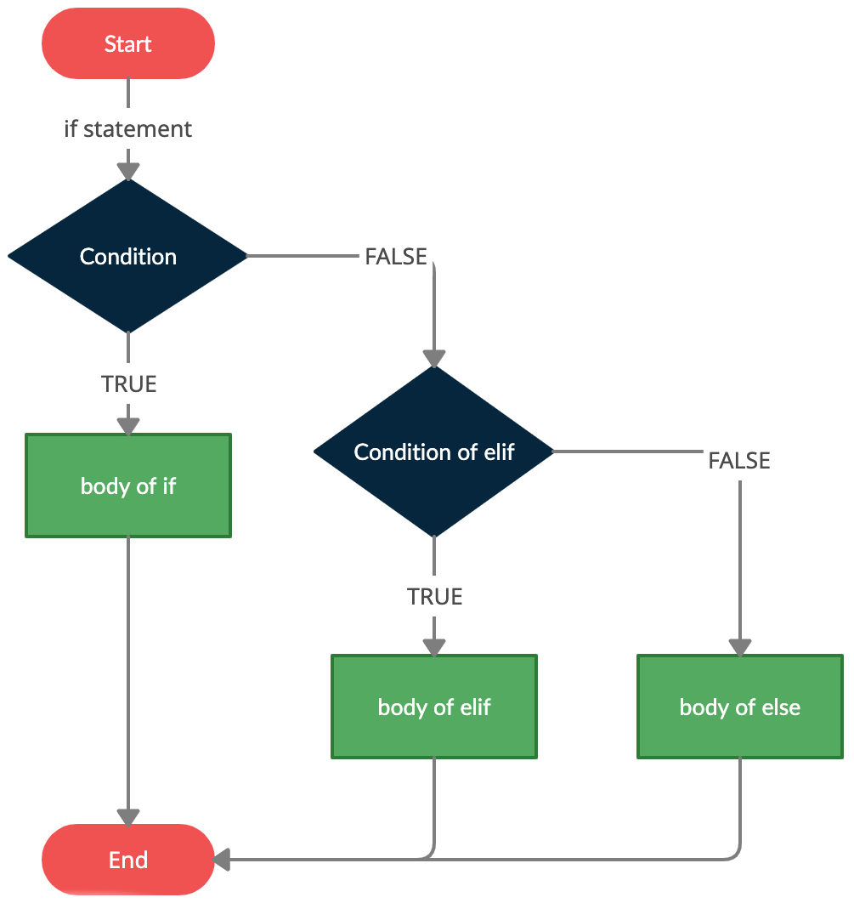
If Statements
If statement
a, b = 200, 100
if a > b:
print('a')
elif a < b:
print('b')
else:
print('=')
Shorthand if statement
a, b = 200, 100
print('a') if a > b else print('b') if a < b else print('=')

Slide 23
Nested If Statements
Nested if
score = 18
if score >= 10:
print('Pass')
if score >= 18:
print('with grade A!')
elif score >= 15:
print('with grade B!')
elif score >= 12:
print('with grade C!')
else:
print('with grade D!')
else:
print('Fail!')

Slide 24
Match Case
Switch statement
language = input('What is the programming language you want to learn? ')
match language:
case 'JavaScript':
print('You can become a web developer.')
case 'Python':
print('You can become a Data Scientist.')
case 'PHP':
print('You can become a backend developer.')
case 'Solidity':
print('You can become a Blockchain developer.')
case _:
print('The language doesn't matter, what matters is solving problems.')

Slide 25
While Loops
Execute a set of statements as long as a condition is true
i = 1
while i < 10:
print(i)
i += 1
else:
print(f'Finished after {i} loops')

Slide 26
For Loops
Iterating over a collection
for fruit in ['apple', 'banana', 'cherry']:
print(fruit)
else:
print('Finished!')
Iterating over a string
for letter in 'apple':
print(letter)
Looping Through a Range
for number in range(20):
print(number)
for number in range(5, 20):
print(number)
for number in range(5, 20, 2):
print(number)

Slide 27
Break and Continue
Break and continue
for i in range(10):
if i == 2:
continue
if i == 5:
break
print(i)
else:
print(f'Finished after {i} loops')

Slide 28
Nested Loops
Nested while and for loops
number = 2
adjectives = ['big', 'tasty']
fruits = ['apple', 'banana', 'orange']
while number < 5:
for adjective in adj:
for fruit in fruits:
print(f'{number} {adjective} {fruit}s')
number += 1

Slide 29
Functions
Blocks of code which only run when they are called
def greeter():
print('Hello!')
greeter()
Arguments and return
def greeter(firstName, lastName):
greeting = f'Hello {name}!'
return greeting
message = greeter('Alireza', 'Nezhadshamsi')
print(message)

Slide 30
Function Arguments
Keyword arguments
def greeter(firstName, lastName):
return f'Hello {firstName} {lastName}!'
print(greeter(lastName = 'Nezhadshamsi', firstName = 'Alireza'))
Default parameter value
def greeter(firstName = 'Dear', lastName = 'user'):
return f'Hello {firstName} {lastName}!'
print(greeter('Alireza', 'Nezhadshamsi'))

Slide 31
Function Types
Type Annotations
def fullName(firstName: str, lastName: str) -> str:
return f'{firstName.title()} {lastName.title()}'
print(fullName('Alireza', 'Nezhadshamsi'))

Slide 32
Nested Functions
.

Slide 33
Lambda
Small anonymous functions
greeter = lambda: print('Hello')
print(greeter())
Arguments
greeter = (lambda name = 'Dear user': f'Hello {name}!')
print(greeter(name = 'Alireza'))

Slide 34
Lambda
Nested lambda
high_ord_func = lambda x, func: x + func(x)
high_ord_func(2, lambda x: x * 2)
high_ord_func(2, lambda x: x * x)
Single Expression
(lambda x: (x % 2 and 'odd' or 'even'))(7)

Slide 35
Try Except
Test a block of code for errors and handle the error
try:
print(x)
except NameError:
print('Variable x is not defined')
except:
print('Something else went wrong')
else:
print('Nothing went wrong')

Slide 36
Exceptions
Handle the error
try:
print(x)
except Exception as e:
print(e)
Raise an error
x = -1
if x < 0:
raise Exception("Please enter a posetive number")

Slide 37
3
Python Modules

Slide 38
Introduction
A module is a file containing a set of functions you want to include in your application.
To create a module just save the code you want in a file with the file extension .py.
Python module index: https://docs.python.org/3/py-modindex.html
Using a module
import myModule as m
m.greeter('Alireza') # Functions
importedName = m.name # Variables
Import from a module
from mymodule import greeter, name

Slide 39
Datetime
Import and use datetime
import datetime
now = datetime.datetime.now()
print(now)
myBirthday = datetime.datetime(1999, 1, 5)
print(myBirthday.strftime('%x'))
print(myBirthday.strftime('%A'))
print((now - myBirthday).days)

Slide 40
Math
Import and use math
import math
print(math.sqrt(64))
print(math.ceil(1.4))
print(math.floor(1.4))
print(math.pi)

Slide 41
JSON
JSON is a syntax for storing and exchanging data.
Import and use math
import json
myJson = '{ "name": "Alireza", "age": 24}'
myDict = json.loads(x)
myDict['age'] = 29
anotherJson = json.dumps(x)
String
Number
Array
str
int
float
list
tuple
Object
Boolean
Null
dict
bool
NoneType

Slide 42
Packages
A package contains all the files you need for a module.
PIP is a package manager for Python packages, or modules if you like.
Python package index: https://pypi.org/
Download a package
pip install numpy
Remove a package
pip uninstall numpy
List packages
pip list

Slide 43
4
Data Science

Slide 44
Numpy Introduction
NumPy stands for Numerical Python.
NumPy is a Python library used for working with arrays. It also has functions for working in domain of linear algebra, fourier transform, and matrices.
NumPy aims to provide an array object that is up to 50x faster than lists. Arrays are very frequently used in data science. The array object in NumPy is called ndarray.
Numpy documentation: https://numpy.org/doc/
Import
import numpy as np

Slide 45
Numpy Arrays
Creat
arr0 = np.array(1)
arr1 = np.array([1, 2, 3])
arr2 = np.array([[1, 2, 3], [2, 3, 4]])
arr3 = np.array([[[1, 2, 3], [2, 3, 4]], [[3, 4, 5], [4, 5, 6]]])
print(arr0.ndim, arr1.ndim, arr2.ndim, arr3.ndim)
Slice
arr = np.array([[1, 2, 3, 4, 5], [6, 7, 8, 9, 10]])
print(arr[1, 5], arr[1, 1:4], arr[0:2, 1:4])

Slide 46
Numpy Data Types
Check
arr = np.array([1, 2, 3, 4])
print(arr.dtype)
Define
arr = np.array([1, 2, 3, 4], dtype = 'S')
print(arr.dtype)
Convert
arr = np.array([1, 2, 3, 4])
newArr = arr.astype('S')
print(arr.dtype, newArr.dtype)
i
f
Integer
u
Float
c
O
V
Object
Void
Unsigned integer
Complex float
S
String
b
Boolean
U
Unicode string
m
Timedelta
M
Datetime

Slide 47
Numpy Copy and View
Copy is a new array, and view is just a view of the original array.
arr = np.array([1, 2, 3, 4, 5])
viewArr = arr.view()
copyArr = arr.copy()
arr[0] = 10
print(viewArr, copyArr)
print(viewArr.base, copyArr.base)

Slide 48
5
Pandas

Slide 49
Introducion
.

Slide 50
6
Machine Learning

Slide 51
Matplotlib
.

Slide 52
Scikit-learn
.

Slide 53
7
Web Scraping

Slide 54
Thanks!
You can find me at:
t.me/alee_rezaa
alee_rezaa@outlook.com

Slide 55
89,526,124
Whoa! That’s a big number, aren’t you proud?

