Slide 1



AI-POWERED MOCK INTERVIEW SYSTEM
Full Stack Web Development
Muhammad Ashar Javed (223576)
Ali Hassan (223583)
Aamir Hussain (223568)
Session: F-22
Instructor: Muhammad Rashaf Jamil

Slide 2
EXECUTIVE SUMMARY
Web-based mock interview platform.
Provides real-time AI feedback.
Built with React, Firebase, and GPT-4/Gemini.
Supports voice and text inputs.
Privacy-first: no video stored.

Slide 3
PROJECT OBJECTIVES
1 | Realistic interviews
2 | Constructive feedback
3 | Easy onboarding
4 | Privacy assured

Slide 4

SCOPE OF WORK
IN SCOPE:
Web app with dashboard
Interview flow with AI feedback
Firebase hosting/auth
OUT OF SCOPE:
Native apps
HR analytics
Multilingual voice support

Slide 5
TARGET USERS
Fresh Graduates – practice behavioral & tech rounds.
Mid-Career Switchers – prepare for domain-specific interviews.
Career Coaches / Bootcamps – assign interviews to students.

Slide 6
SYSTEM ARCHITECTURE
React frontend → Firebase hosting & Firestore
Auth via Clerk
AI scoring via Cloud Functions (GPT-4/Gemini)
WebRTC + Web Speech API

Slide 7
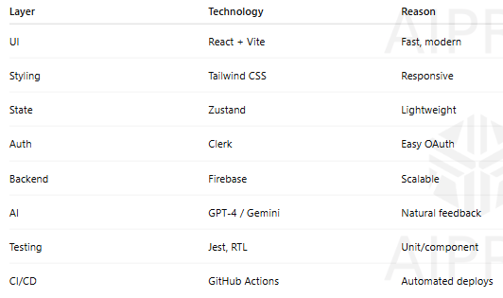
TECHNOLOGY STACK

Slide 8
KEY FEATURES
Social/email login
Interview creation wizard
Voice & text answer options
Real-time transcription
AI scoring & feedback
Dashboard with actions
Dark mode + accessibility

Slide 9
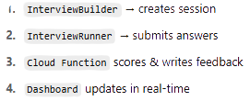
DATA FLOW

Slide 10
UI DESIGN & KEY FEATURES
Simple, clean OAuth Sign-In
Step-by-step interview builder
Webcam + mic toggle during interview
Feedback shown in accordion format
Dashboard with quick actions
AI SDK lazy-loaded; Firestore writes optimized

Slide 11
UI DESIGN & KEY FEATURES
Simple, clean OAuth Sign-In
Step-by-step interview builder
Webcam + mic toggle during interview
Feedback shown in accordion format
Dashboard with quick actions
AI SDK lazy-loaded; Firestore writes optimized

Slide 12
CONCLUSION
The AI-Powered Mock Interview System offers a smart, user-friendly platform for job seekers to practice and improve their interview skills. By combining real-time AI feedback with a modern tech stack, it ensures a seamless and effective experience. With strong privacy controls, responsive design, and scalable architecture, the application stands out as a valuable tool for both individuals and training institutes. Future enhancements like multilingual support, gamification, and mobile access will further strengthen its impact as a comprehensive career preparation solution.

Slide 13
THANK YOU

