Slide 1
How PayPal launched a global app in 140+ countries simultaneously
IMUG
Sept 15th, 2016
Lucas Welti

Slide 2
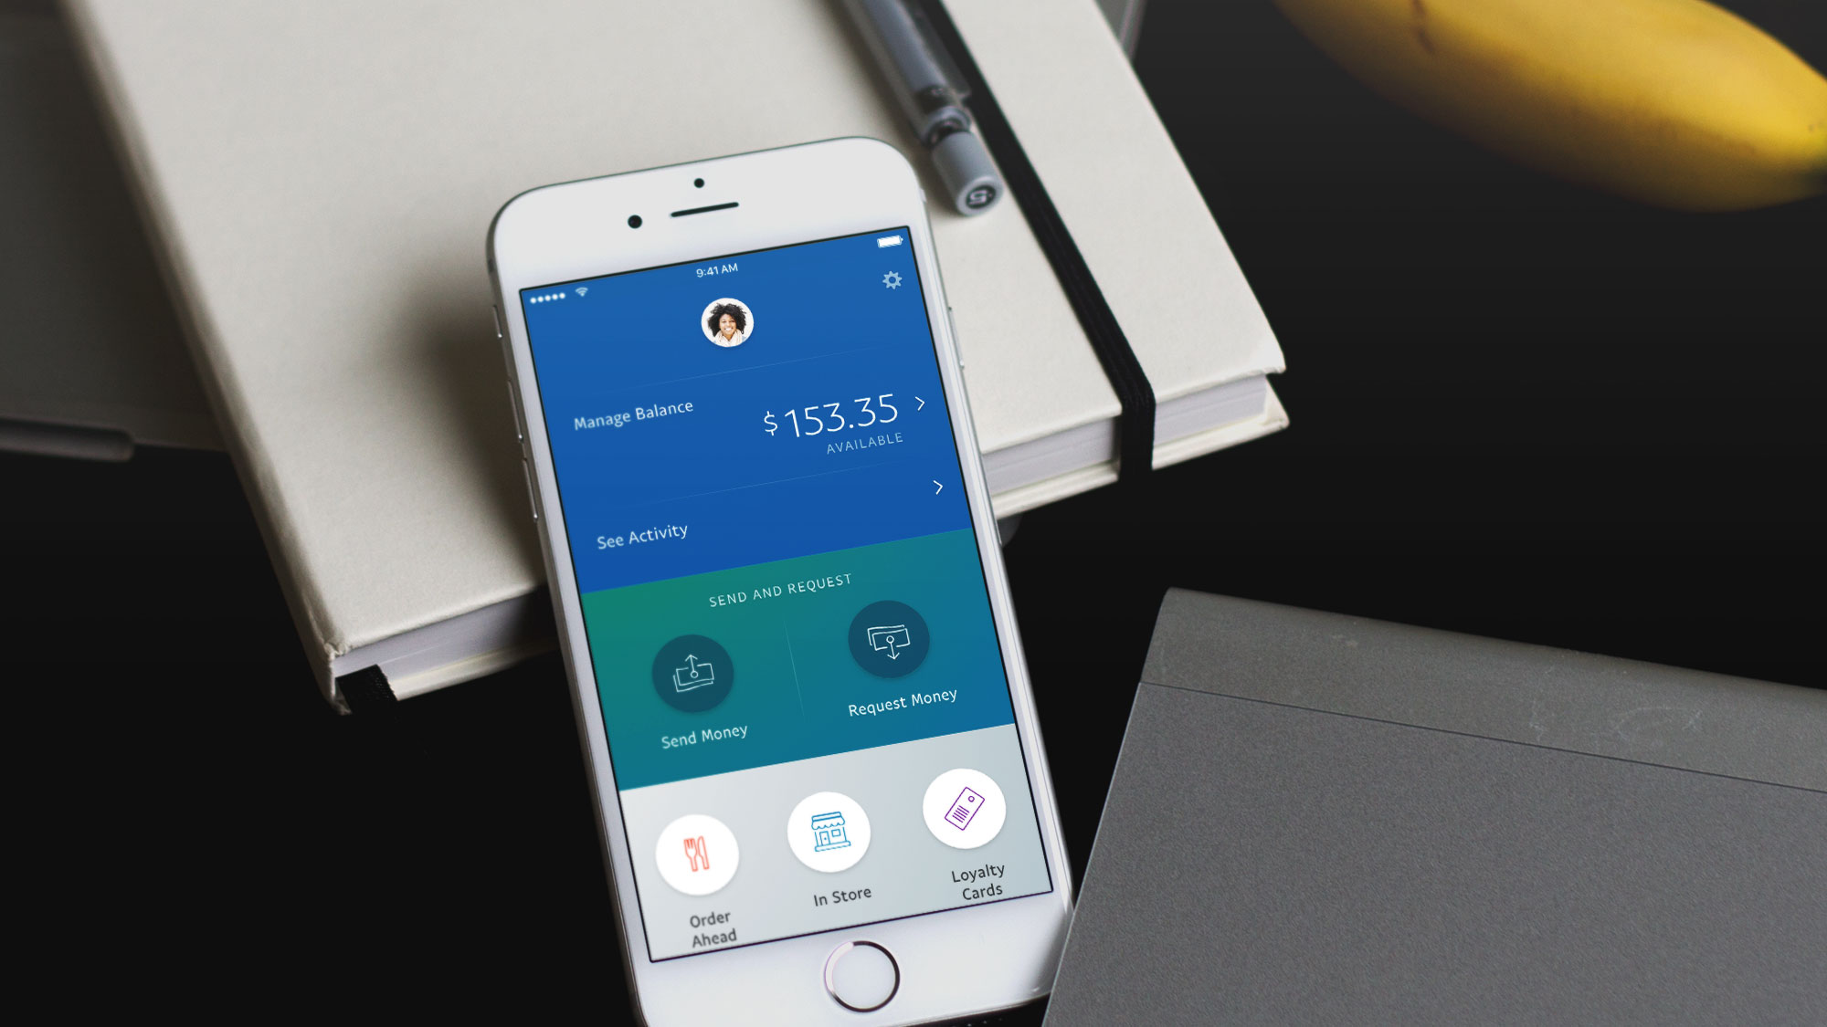

Slide 3
Agenda
Introduction
Goals
Challenges
G11n i18n Enablement

Slide 4
Introduction
The new PayPal App was introduced the week of Feb 17th.
Available in more than 25 markets and 17 different languages since Day 1!

Slide 5
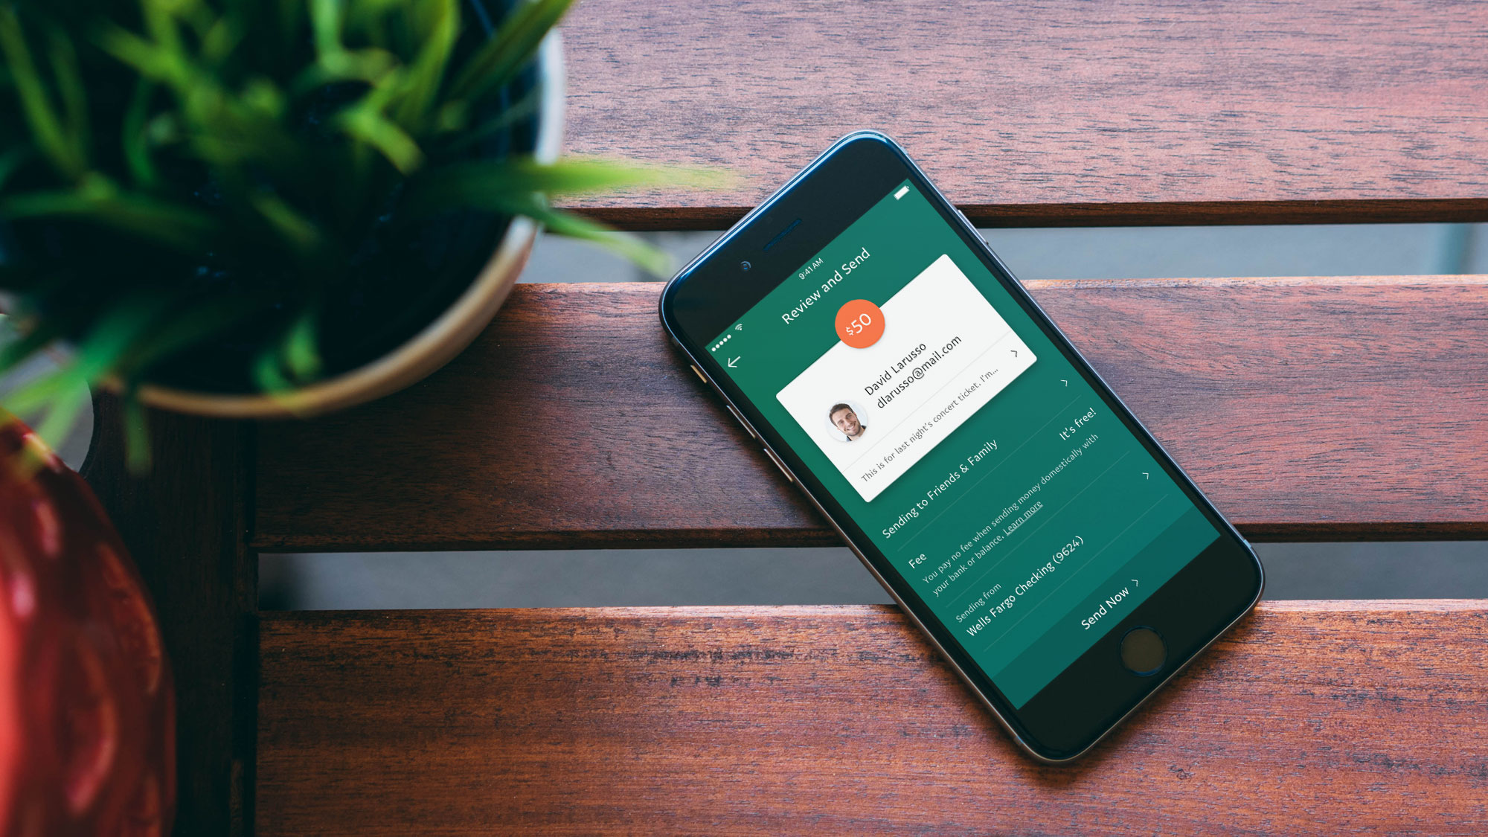

Slide 6
Question
How many of you have the PayPal app installed?
How many of you have a US PayPal account?
How many of you have a PayPal account outside US?
How many of you have your device language settings in your native language?

Slide 7
Goals
Make it available not only in the US market.
Provide good quality content, from the Linguistic perspective and Internationalization Formatting.
Same User Experience: Desktop, Web Mobile, iOS & Android

Slide 8
Technical Challenges
Integrate with more than one mobile platform:
Android (Java)
iOS (Objective-C, Swift)
Collaborating across many teams ensuring internationalization of all product features is ready for launch.

Slide 9
Technical Challenges…
Supporting more than one language per Country
Extending the standard: Global configuration limitations e.g country specific locales
Extending Formatters
Maintaining parity with desktop
G11n data optimization (app data footprint)

Slide 10
More than one Language
Supporting more than one language per Country
Example:
Germany:
German
English
United States
English
Spanish
French
Chinese

Slide 11
Extending the standard
Global configuration limitations e.g country specific locales
Germany:
de
en-DE (not in CLDR)
United States
en
es-US
fr-US (not in CLDR)
zh-US (not in CLDR)

Slide 12
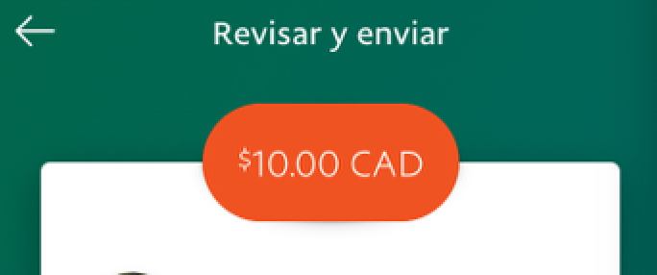
Extending I18n Formatters Currency
$ 1,234.56 USD

Slide 13
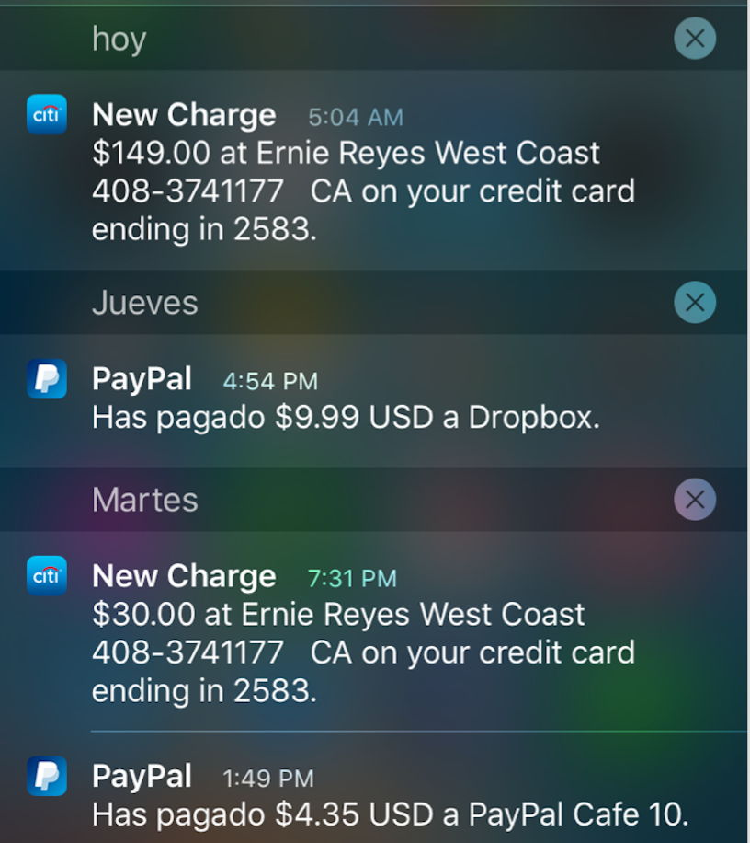
Extending I18n Formatters Currency

Slide 14
Extending I18n Formatters Date
(en-DE) 21/03/2016
(de) 21.03.2016

Slide 15
Adding 18n Formatters Name
{GIVENNAME} {SURNAME}
or
{SURNAME}{GIVENNAME}

Slide 16
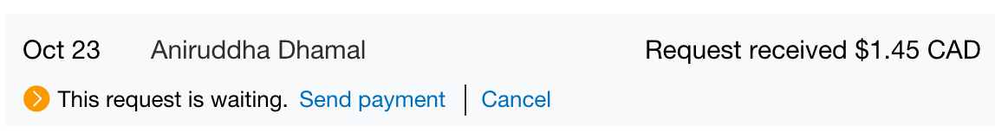
Adding 18n Formatters Name

Slide 17
Adding 18n Formatters Address
{LINE1}, {LINE2}, {CITY}, {STATE} {POSTAL_CODE}
or
〒{POSTAL_CODE} {STATE}​{city}{​line1}{​line2}

Slide 18
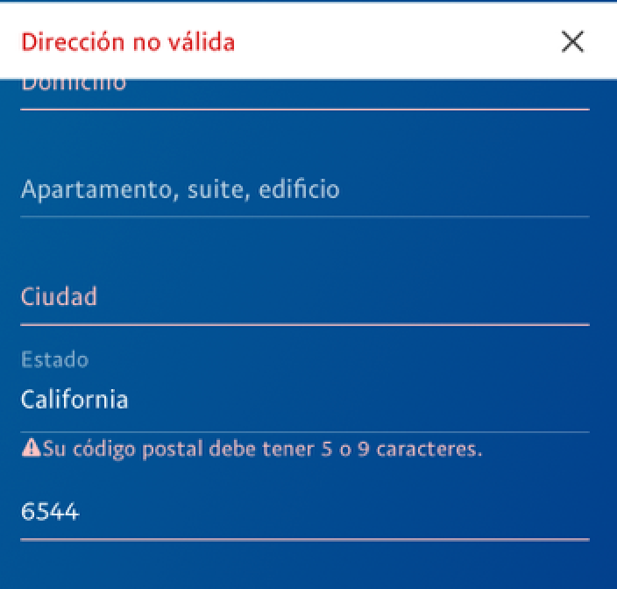
Adding 18n Formatters Address

Slide 19
I18n Architecture review
Source Content (English)
Design
Code

Slide 20
Review Source Content
BAD
KEY1 = “Help us understand the activity between”;
KEY2 = “through”;
KEY3 = “.”;
Composed message: KEY1 + date + KEY2 + date + KEY3
Output (in English): : “Help us understand the activity between 1/1/2016 through 3/15/2016.”
Output (in Japanese): “私たちは間の活動を理解するのに役立ち2016年1月1日スルー2016年3月15日”
GOOD
KEY1 = “Help us understand the activity between {start_date} through {end_date}.”;
Output (in English): “Help us understand the activity between 1/1/2016 through 3/15/2016.”
Output (in Japanese): “私たちは2016年1月1日と2016年3月15日の間に活動を理解するのに役立ちます。”

Slide 21
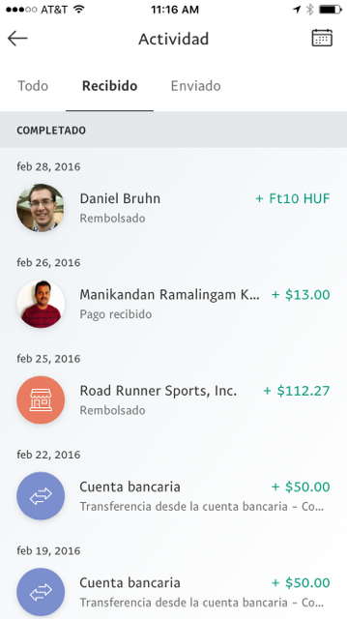
UX/UI Review
Review UX/UI Designs in order to catch possible issues.

Slide 22
Code Review
Set up Architecture reviews
Share our I18n Best Practices with different teams, this was done during dedicated Brown
Provide technical guidance
Review Code Pull Requests
Collect new requirements

Slide 23
G11n Data optimization
Providing Metadata only for supported Markets
Providing Content only for those supported Markets

Slide 24
Questions?

