Slide 1
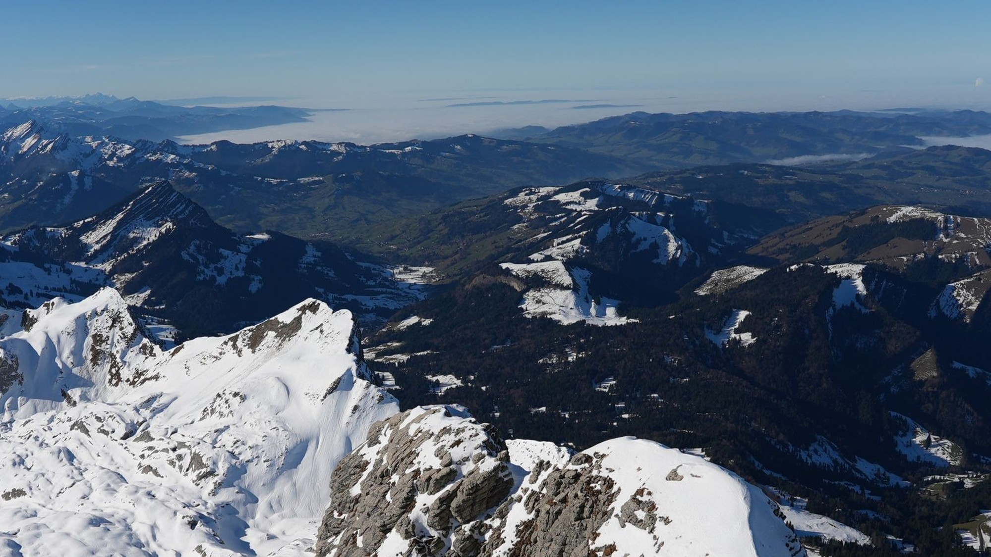
BLACKLABS
PRESENTS
BLACKLENS.
One vision. One brand. A cinematic presence.
BRAND EXPERIENCE / WEBSITE REDESIGN / 2026

Slide 2
BLACKLABS / BRAND & DIGITAL
01
AN IDEA BECOMES A BRAND.
The story behind BlackLens.
01 / BLACKLABS
02 / EVOLUTION
03 / BLACKLENS
The beginning: a space for technical projects, hobbies, ideas and experiments.
A passion for filmmaking grows into the ambition to develop professionally.
An independent brand for creative film services with a personal signature.

Slide 3
BLACKLABS / BRAND & DIGITAL
02
OUR MISSION.
BlackLabs creates the digital brand experience for BlackLens.
PASSION BECOMES
PRESENCE.
A premium website that does not pretend to be a large agency, but showcases genuine passion, filmmaking skills and growth.

Slide 4
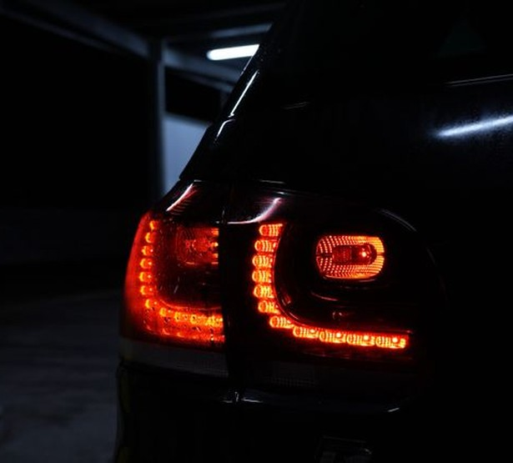
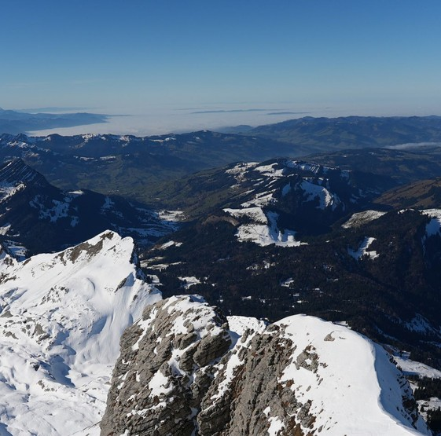
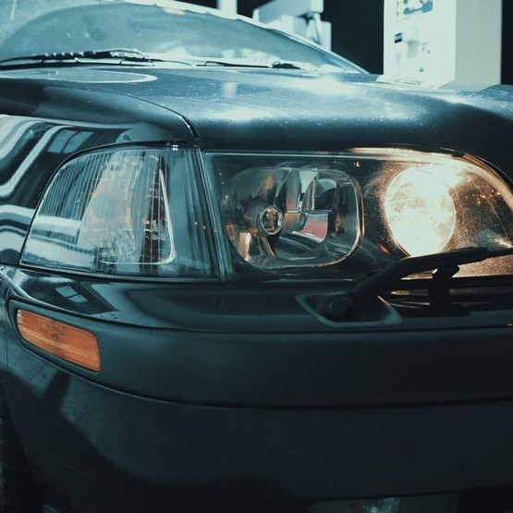
BLACKLABS / BRAND & DIGITAL
03
THE VISUAL DNA.
Cinematic / Minimal / Editorial / Emotional

Slide 5
BLACKLABS / BRAND & DIGITAL
04
THE COLOR PALETTE.
Six colors. Each one visible, defined and purposeful.
CINEMATIC BLACK
CHARCOAL
WARM WHITE
#090A0C Primary background
#17191C Sections / cards
#F6F4F0 Text / light surfaces
MUTED GREY
CHAMPAGNE
STEEL BLUE
#ACB0B5 Secondary text
#D9B899 Buttons / highlights
#526D79 Optional accent

Slide 6
BLACKLABS / BRAND & DIGITAL
05
COLORS IN ACTION.
Beyond HEX codes: see the palette in a real interface.
VISUAL HIERARCHY
BLACKLENS
White: headlines
Grey: supporting text
Champagne: key actions
Charcoal: subtle surfaces
Stories you can feel.
START A PROJECT

Slide 7
BLACKLABS / BRAND & DIGITAL
06
TYPOGRAPHY & GRID.
Fewer effects. Greater impact.
GESCHICHTEN,
DIE BLEIBEN.
Headlines: Instrument Sans / Aptos Display fallback
Body: Lexend / Aptos fallback
Generous whitespace, consistent 8 px grid

Slide 8
BLACKLABS / BRAND & DIGITAL
07
WEBSITE ARCHITECTURE.
A seamless path from first impression to inquiry.
01
HOME
Emotion & overview
02
PROJECTS
Explore the work
03
SERVICES
Discover our services
04
ABOUT ME
Build trust
05
CONTACT
Start a project

Slide 9

BLACKLABS / BRAND & DIGITAL
08
HOME: THE FIRST IMPRESSION.
One film still. One statement. One clear action.
STORIES
YOU CAN FEEL.
Film production, aerial cinematography and editing — with a passion for every detail.

Slide 10
BLACKLABS / BRAND & DIGITAL
09
HOME: THE STORY FLOW.
Every section follows a clear sequence.
01 / HERO
Large film still or showreel + two CTAs
02 / SERVICES
Film production, aerial footage, post-production
03 / PORTFOLIO
Four featured projects
04 / ABOUT ME
Personal story and portrait
05 / PROCESS
Idea → Planning → Shoot → Edit
06 / CONTACT
Closing CTA linked directly to the contact form

Slide 11

BLACKLABS / BRAND & DIGITAL
10
ABOUT ME: TIMO.
The person behind the camera.
21 JAHRE.
EINE GROSSE VISION.
I have been making videos since childhood. Today, I want to grow, work more professionally and develop my own cinematic style through BlackLens.

Slide 12
BLACKLABS / BRAND & DIGITAL
11
ABOUT ME: MY STORY.
Proposed website copy — personal rather than promotional.
I’m Timo, 21 years old, and I’ve been interested in filmmaking since childhood. What began with curiosity and simple videos has grown into a genuine passion over the years.
First, I founded BlackLabs — a space for my hobbies, technical projects and experiments. Later, I created BlackLens as my own brand for film services.
Today, I want to take my work to the next level. I learn something new every day and love filming, editing videos and exploring new visual ideas with my Sony FX3.

Slide 13
BLACKLABS / BRAND & DIGITAL
12
ABOUT ME: THE DREAM.
The vision driving BlackLens forward.
“MY DREAM IS
TO ONE DAY BRING
MY OWN FEATURE FILM
TO THE BIG
SCREEN.”

Slide 14
BLACKLABS / BRAND & DIGITAL
13
OUR SERVICES.
Three disciplines. One shared ambition.
FILM PRODUCTION
AERIAL CINEMATOGRAPHY
EDITING & COLOR
Creative cinematography, composition, movement and visual storytelling.
Fresh perspectives, landscapes and dynamic aerial shots — subject to applicable regulations.
Rhythm, sound, visual language and color come together to tell a story.

Slide 15

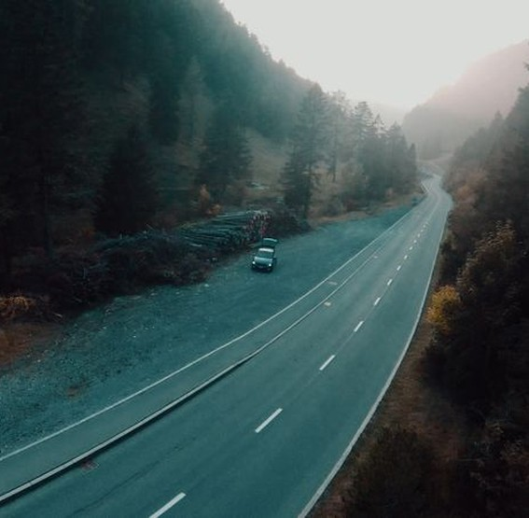
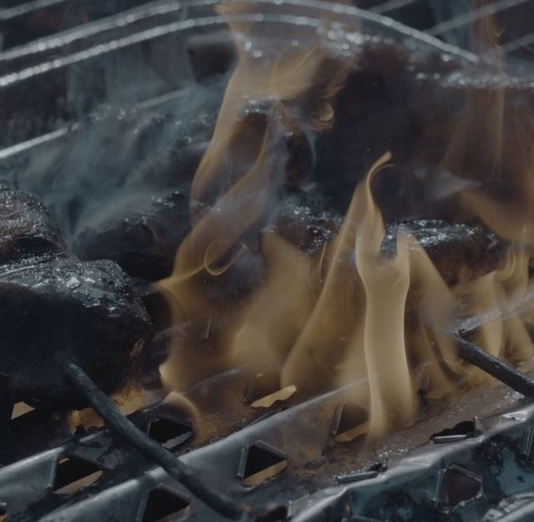
BLACKLABS / BRAND & DIGITAL
14
PROJECTS & PORTFOLIO.
Let the visuals take center stage.

Slide 16
BLACKLABS / BRAND & DIGITAL
15
PROJECT PAGES.
A reusable layout for every project.
LARGE HERO IMAGE
Title, category and visual atmosphere.
THE STORY
A short project description and creative approach.
IMAGES & VIDEO
Gallery or video player with clear controls.
KEEP EXPLORING
Next project / Back to overview / Get in touch.

Slide 17
BLACKLABS / BRAND & DIGITAL
16
CONTACT: SIMPLE & PERSONAL.
A direct path from interest to inquiry.
LASS UNS
ETWAS SCHAFFEN.
office@blacklabs.ch
+41 79 726 74 56
Instagram: @BlackLens.ch
Rickstrasse 6, 9037 Speicherschwendi

Slide 18
BLACKLABS / BRAND & DIGITAL
17
CONTACT FORM.
Clearly defined fields and system messages.
REQUIRED FIELDS
Name, email, project type, message, privacy consent.
OPTIONAL
Timeline and approximate budget.
SUCCESS
“Thank you! Your message has been sent.”
ERROR
“Your inquiry could not be sent. Please try again.”

Slide 19
BLACKLABS / BRAND & DIGITAL
18
MOTION WITH PURPOSE.
Cinematic motion — used intentionally.
INTRO
Soft logo and headline fade-in
HERO
Slow zoom, never distracting
SCROLL
Sections gently reveal from below
HOVER
Image zoom 1.035 and subtle arrow motion
ACCESSIBILITY
Disable animations for reduced-motion preferences

Slide 20
BLACKLABS / BRAND & DIGITAL
19
MOBILE FIRST.
The premium experience must work on every screen.
DESKTOP
TABLET
SMARTPHONE
Large hero, three-column grid, spacious imagery.
Flexible two-column layouts and tighter spacing.
Single column, large touch targets, clear navigation and readable text.

Slide 21
BLACKLABS / BRAND & DIGITAL
20
TECHNICAL EXCELLENCE.
Great design must also work reliably.
PERFORMANCE
Optimized images and video, lazy loading, no layout shifts.
SEO
Unique page titles, metadata, sitemap and clean URLs.
ACCESSIBILITY
Keyboard access, focus states, contrast and alt text.
FORM
Server-side validation, spam protection and tested email delivery.
SECURITY
HTTPS and no confidential credentials in the frontend.

Slide 22
BLACKLABS / BRAND & DIGITAL
23
THE NEXT STEP.
From presentation to implementation.
CONCEPT → APPROVAL → DESIGN → DEVELOPMENT → LAUNCH
BlackLabs defines the direction. BlackLens gets a digital presence that can grow with the brand.

Slide 23
BLACKLABS / FOR BLACKLENS
DIE GESCHICHTE
BEGINNT JETZT.
BLACKLENS • FILM • VISION • PASSION

