Slide 1


Slide 2
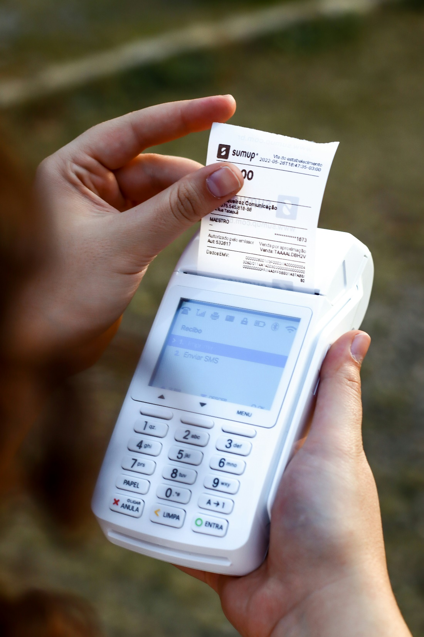
PDF to Text
LLM extraction
Streamlit GUI
Xero integration

