Slide 1

CreativeHUB
Make creative and do creative

Slide 2
Contents
Login/Register Page
Home Page
Art Page
Write Page
Music Page
Puzzle Page
Profile Page
Aboutus Page
Admin Page

Slide 3
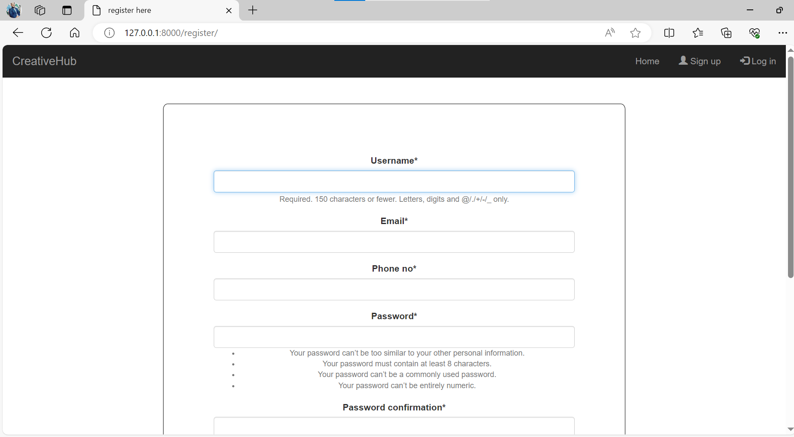
Register Page

Slide 4
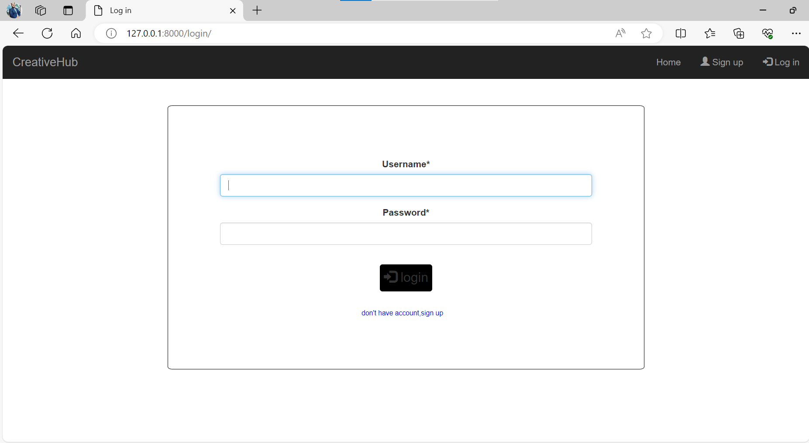
Login Page

Slide 5
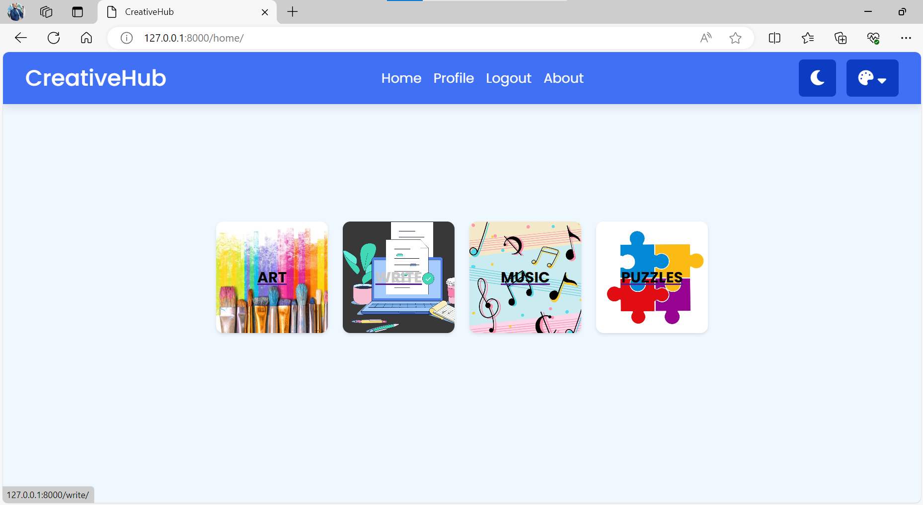
Home Page

Slide 6
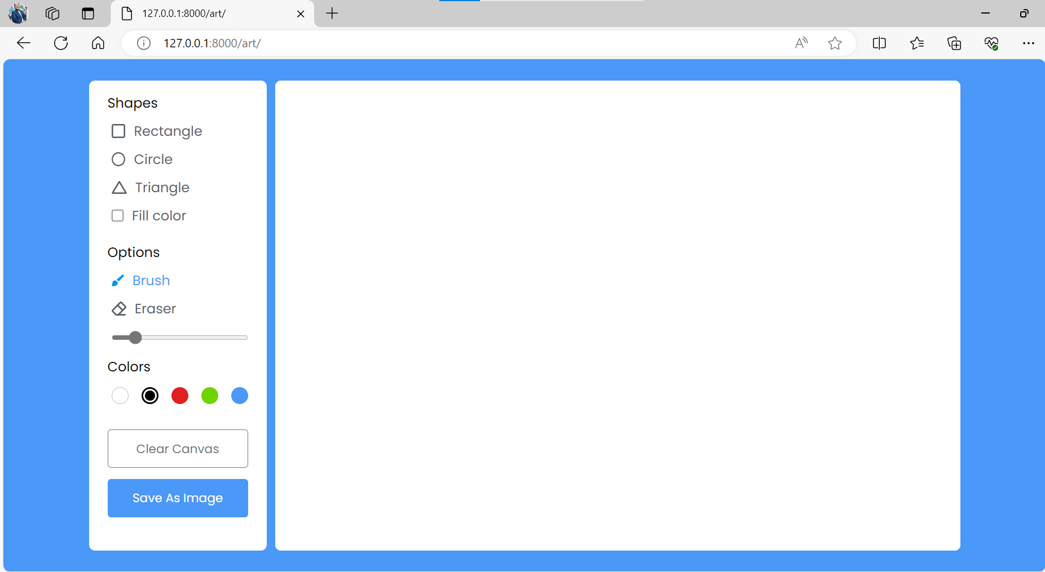
Art Page

Slide 7
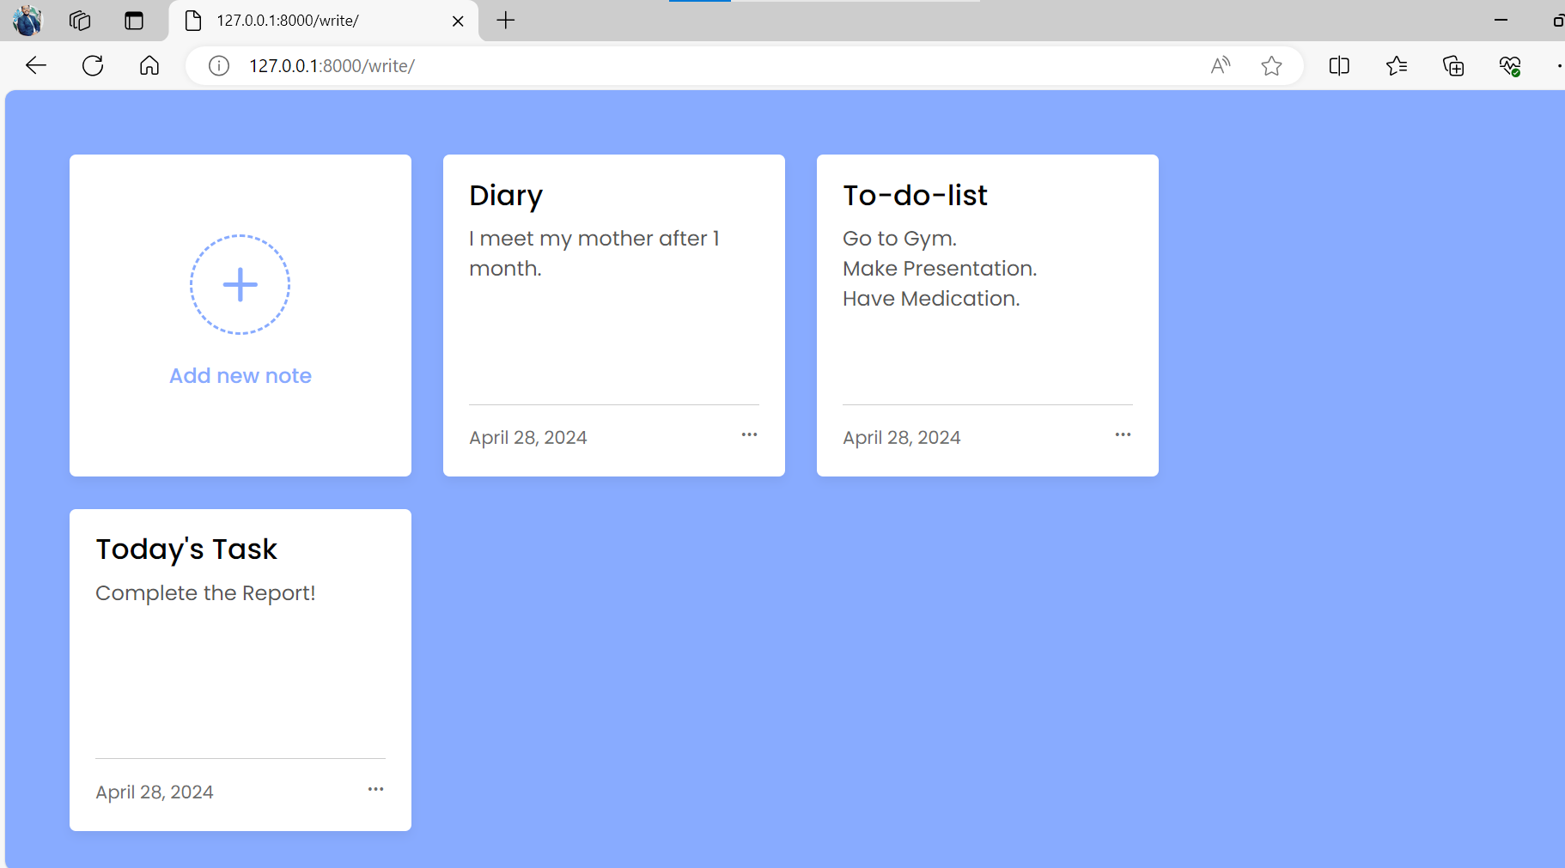
Write Page

Slide 8
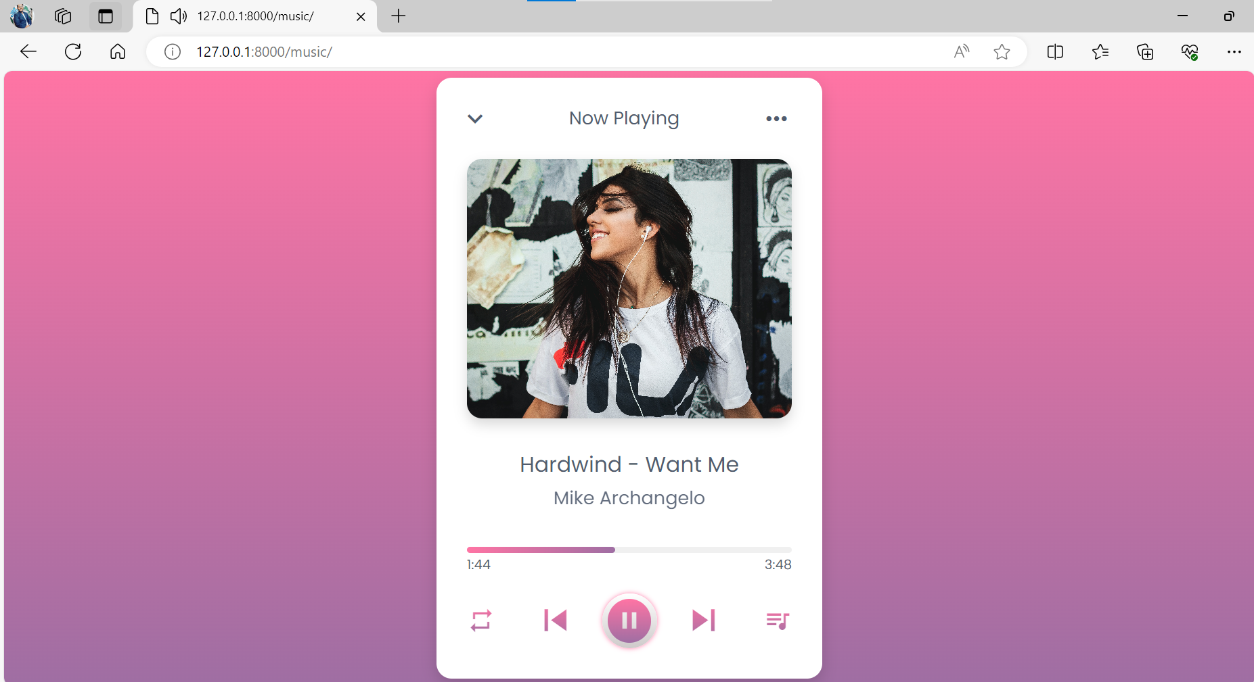
Music Page

Slide 9
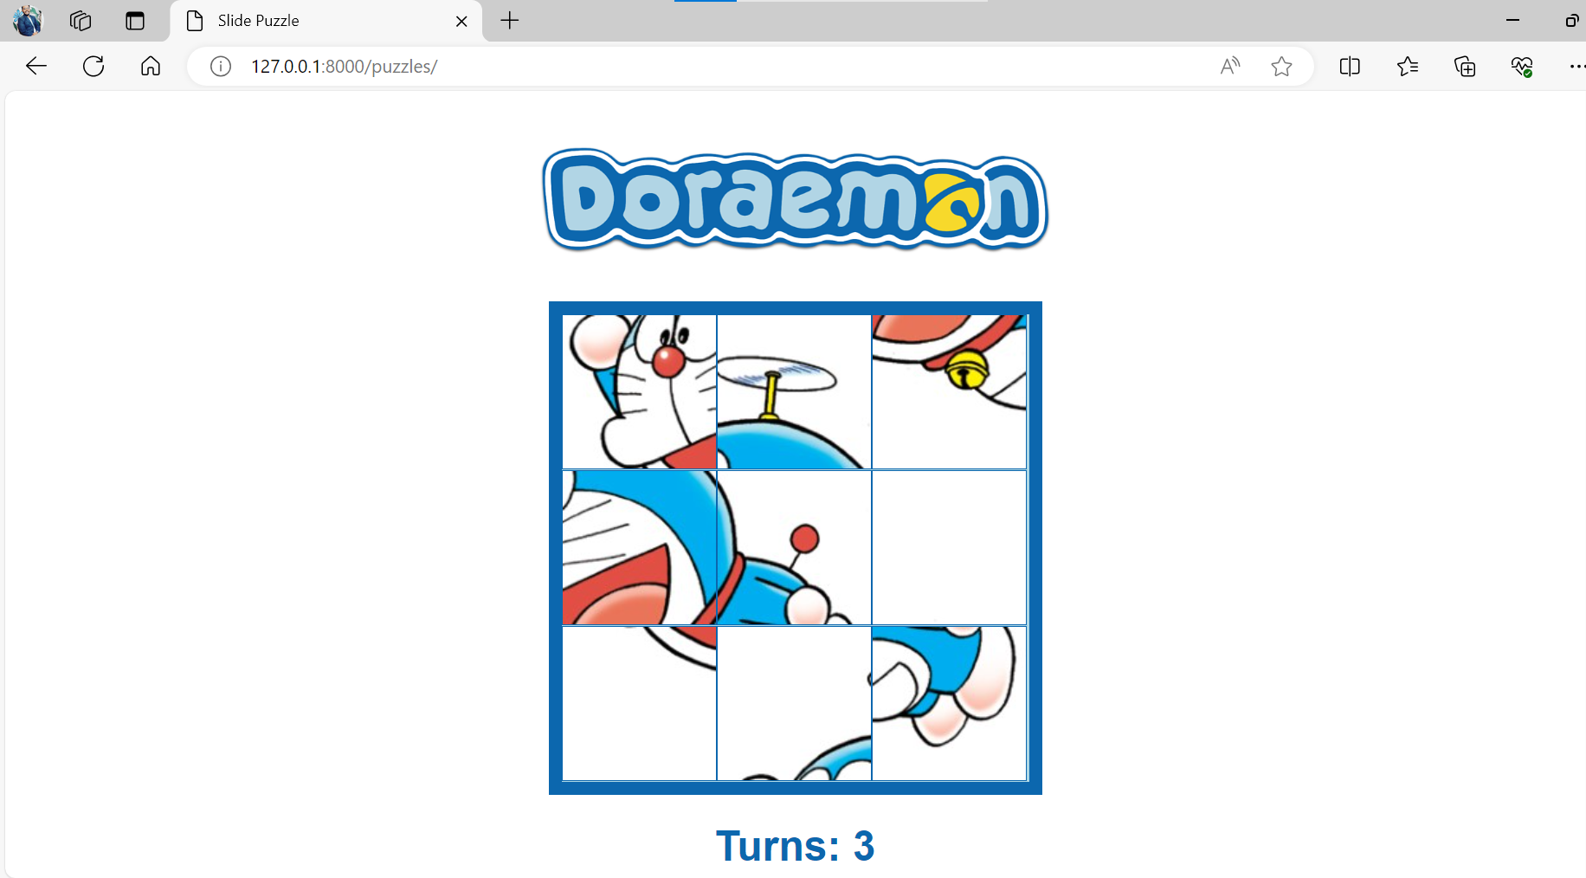
Puzzle Page

Slide 10
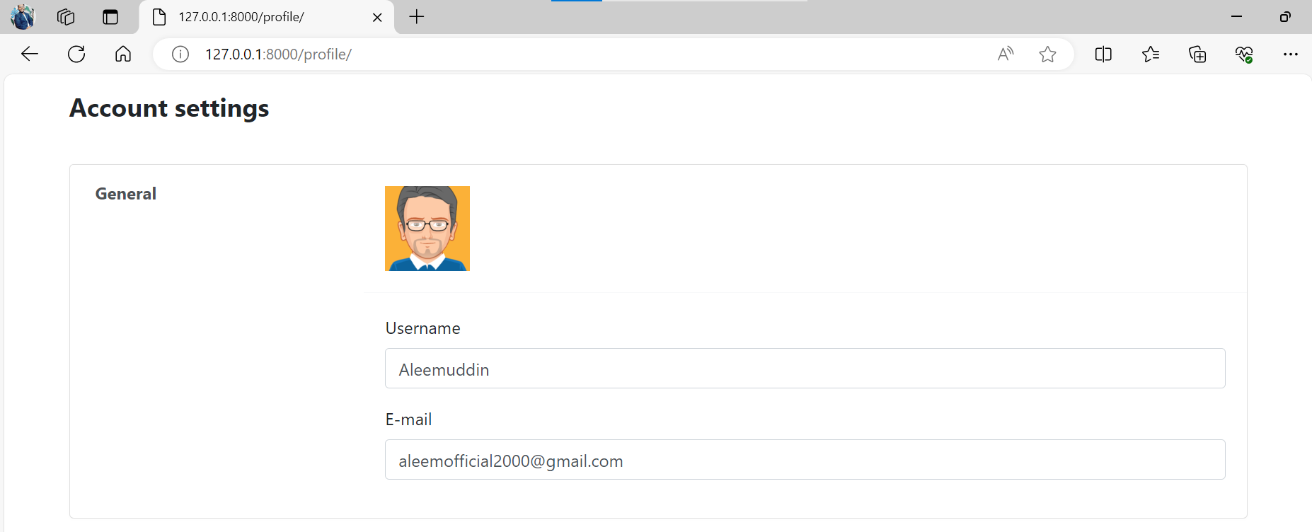
Profile Page

Slide 11
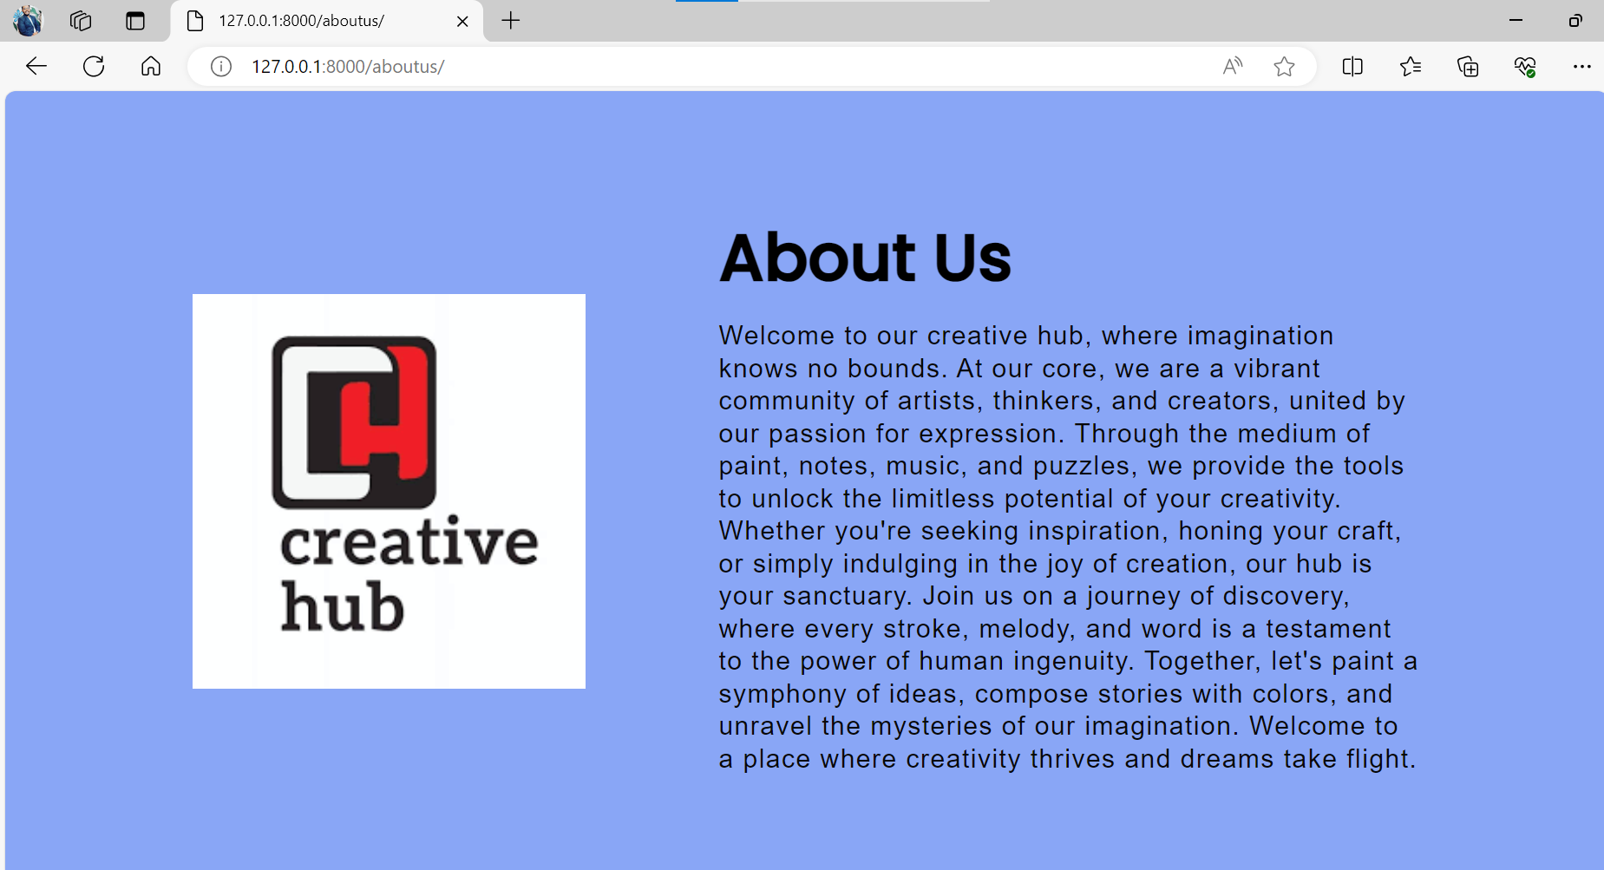
Aboutus Page

Slide 12
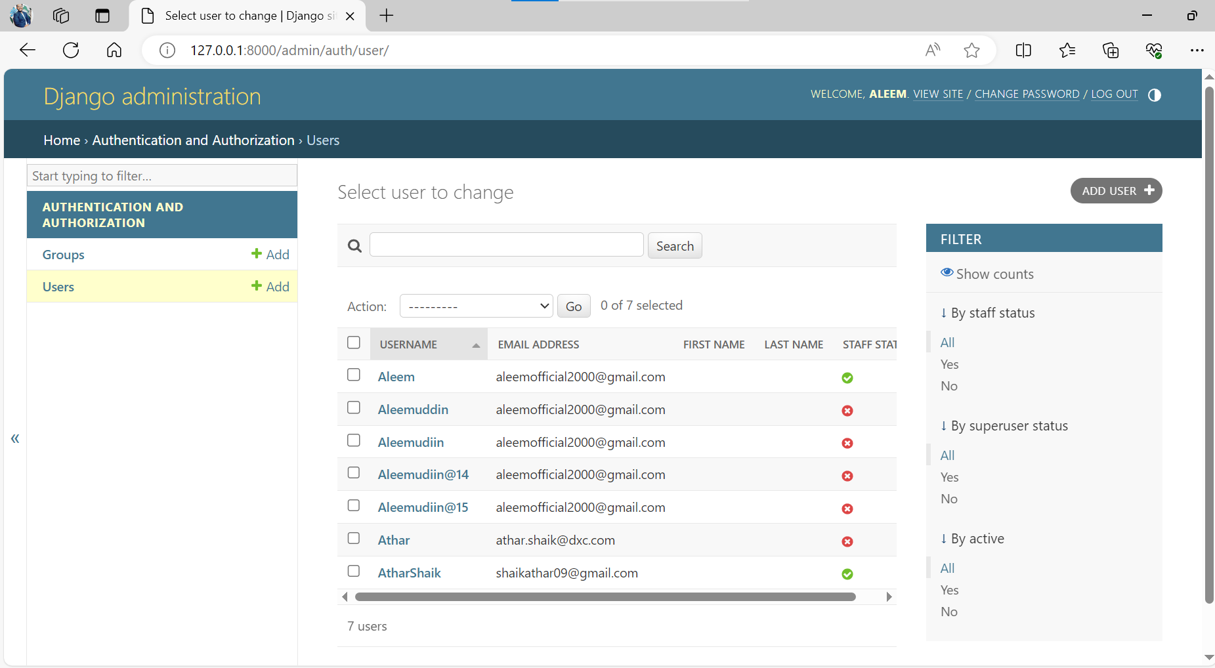
Admin Page

Slide 13
Thank You

