Slide 1
CoFFEE Bean Classification
Using deep learning
Presented By:
Aleena Thomas
Roll No: 08 |S9 INMCA

Slide 2
CONTENTS
INTRODUCTION
LITERATURE SURVEY
METHODOLOGY
IMPLEMENTATION
RESULTS
CONCLUSION
REFERENCES

Slide 3
INTRODUCTION
For ages, coffee's quality was manually assessed.The roasting process, a critical factor in flavor development, demands precise assessment.
with the assistance of deep learning, the classification of coffee bean roast levels is now automated.
The proposed method employs the ResNet model to enhance the accuracy and efficiency of coffee bean roast level classification.
The roast levels can be determined through image-based classification.

Slide 4
Literature Survey
[1] This paper explores the impact of time-temperature combinations during the coffee roasting process on the kinetics of aroma formation in coffee.
[2] Coffee roast level significantly impacts flavor, with factors like acidity and aroma being influenced by the degree of roasting, ranging from light to very dark.
Roasting entails the application of high temperatures, followed by cooling for the beans to be ready for brewing.

Slide 5
Literature Survey – (CNTD)
[3] This study developed a deep learning algorithm to effectively detect defects in coffee beans, also addressing issues related to feature extraction, image quality, and classification bias.
[4] Deep learning based coffee bean classification
[5] coffee bean quality classification based on color using the K-Nearest Neighbor method

Slide 6
Literature Survey – (CNTD)
[6] Focuses on a method to identify the roast levels of coffee beans through image processing and classification using neural networks.
[7]This study highlights how using advanced technology like deep learning is crucial to ensure the quality and origin of coffee products.
[8] This study centers on the application of machine learning methods to assess the quality of coffee beans using visual data.

Slide 7
Proposed system
This study proposes a deep learning-based approach to coffee bean classification using the ResNet50 model.
ResNet50 is a powerful deep learning architecture that has achieved state-of-the-art results in various image classification tasks.
The ResNet50 model will be fine-tuned on a dataset of coffee bean images to enable it to distinguish between different roast levels.

Slide 8
METHODOLOGY
Data Collection
Data Pre-processing
Transfer Learning
Model Training
Model Evaluation

Slide 9
METHODOLOGY
Data Collection
To train the model, Collect images of different coffee bean types, including different roast types.
The dataset was sourced from "Bona Coffee," a roastery located at JJ Mall Jatujak, and features four distinct roasting levels.

Slide 10
METHODOLOGY – (cntd)
2. Data Pre-processing
Preprocessing step include
Resize all images to a common size (224x224)
Adjust pixel values to a consistent scale between 0 and 1.

Slide 11
METHODOLOGY – (cntd)
Transfer learning
Transfer learning adapts a pre-trained ResNet50 model for a new task by fine-tuning its final layers.
Optimize the model for coffee bean classification without starting from scratch.

Slide 12
METHODOLOGY – (cntd)
4. Model Training
The complete model, consisting of both the pre-trained ResNet50 layers and the custom classification layers
Model learns from the coffee bean dataset and adjusts its parameters
The input image is mapped to the predicted class based on the class probabilities
assigned by the neural network

Slide 13
METHODOLOGY – (cntd)
5. Model Evaluation
Model evaluation is a vital step because it tells us how our model generalizes to real-world, unseen data.
Test Loss: Describe it as a measure of prediction error
Test Accuracy: Explain that it represents the model's correctness on the test data.

Slide 14
IMPLEMENTATION
Model Creation and Training
Train and fine-tune the coffee bean classification model using Google Colab.
Save the trained model as an .h5 file.

Slide 15
IMPLEMENTATION(CNTD)
2. Web Application Development
Download the model .h5 file.
Develop a web-based application for coffee bean classification.
Create function that accepts training data
The model provides instant results on the coffee bean type

Slide 16
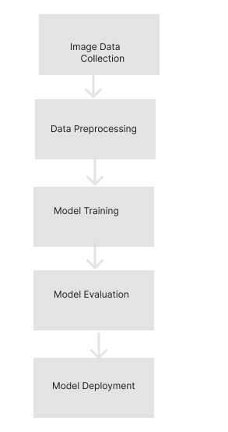
E CSCSC
WORKFLOW
DIAGRAM

Slide 17
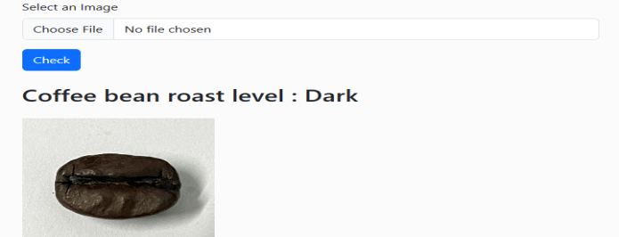
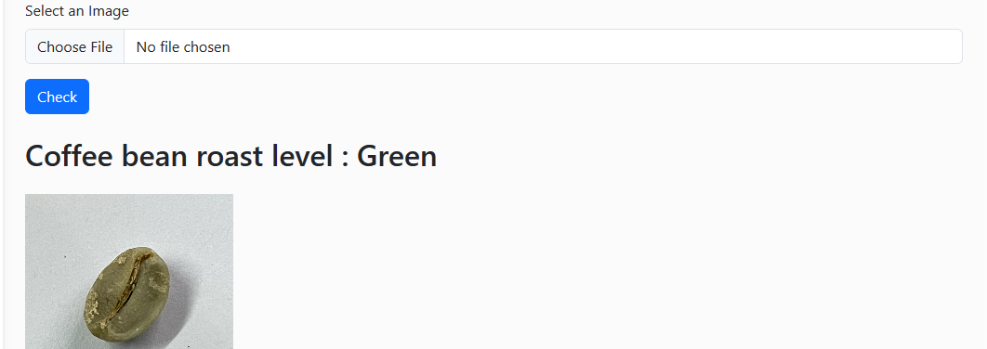
RESULTS
These sample prediction showcase the model's ability to accurately classify coffee beans into their respective roast levels.It's a powerful tool for quality control and ensuring consistent roast levels in the coffee production process.

Slide 18
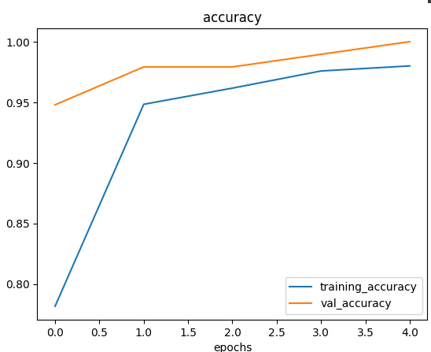
LINE GRAPH
This graph showcases the model's accuracy improvements over epochs.It shows a steady increase in accuracy during training.

Slide 19
CONCLUSION
Accurate coffee bean grading is crucial for quality control in the coffee industry.
Existing methods may lack precision and time consuming.
Our system leverages ResNet to classify coffee beans based on roast levels.

Slide 20
REFERENCES
J. U. B. Aggenstoss, L. U. P. Oisson, R. U. T. H. K. Aegi, R. A. P. Erren, and F. E. E. Scher, ―Coffee Roasting and Aroma Formation : Application of Different Time
Jokanović R. Marija(2020) “Changes of physical properties of coffee beans during roasting”
Micaraseth (2022): Automated Coffee Bean Grading
Chang, S. J. (2021). "Deep Learning Model for the Inspection of Coffee Bean Defects.
Nelly Oktavia (2022)”The quality of coffee bean classification systembased on color by using K-NN”
T H Nasution and U Andayani (2017), Recognition of Roasted Coffee Bean Levels using Image Processing and Neural Network
Muhammad Aji Alrasyid(2023),"ResNet-50 to classify the types of Indonesian local coffee beans"
Pragathi S P, Christ Deemed to be University, Puneand Lija JacobDepartment of Data Science, Christ Deemed To be University, Pune(2023), ”Review On Image based Coffee Bean Quality Classification: Machine Learning Approach”

Slide 21
Thank you!

