Slide 1
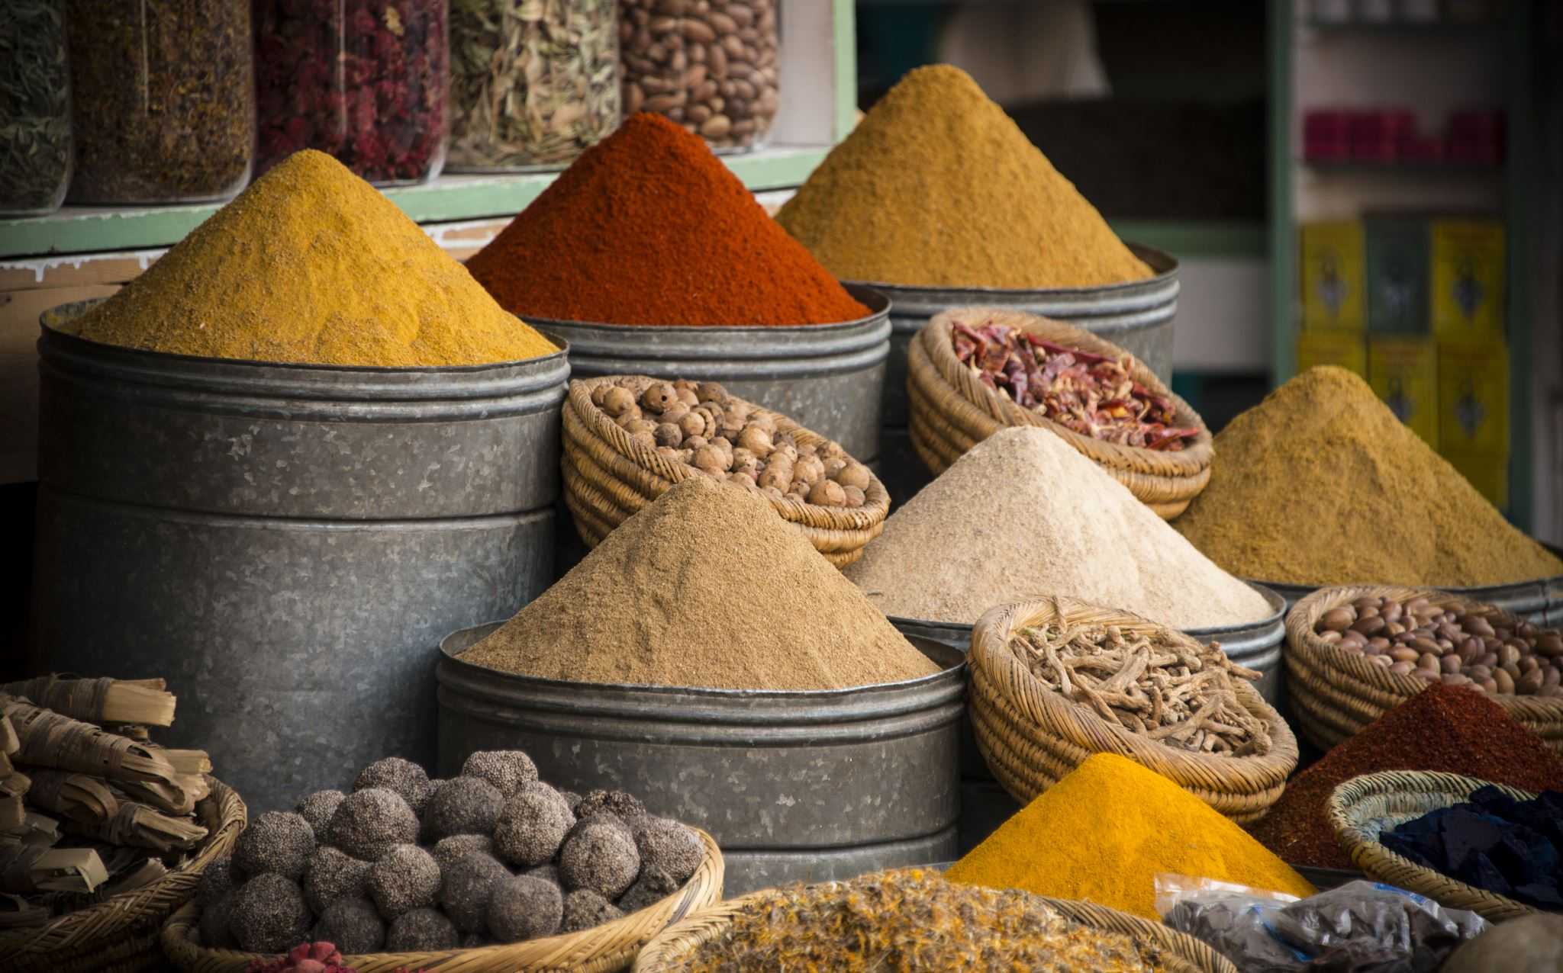
GustoGrove: Revolutionizing the Spice Shopping Experience

Slide 2

Introducing GustoGrove: Building a Comprehensive Spice Mart
A seamless fusion of flavor and convenience in the world of spices
Our mission: Providing a diverse range of high-quality spices through an immersive online platform

Slide 3

Users
Customer: Seamless browsing, personalized profiles, and comprehensive order history
Seller: Quality management and product maintenance for premium spice offerings
Admin: Administrative control and user role management for secure system operation

Slide 4

Functionalities
Customer: Empowering spice enthusiasts with personalized shopping experiences
Seller: Ensuring top-notch quality and efficient management of product inventory
Admin: Facilitating secure system operations and user management

Slide 5

Technologies
Creating an immersive and interactive user interface involves utilizing a combination of web development tools such as HTML, CSS, Bootstrap, JavaScript, jQuery, and AJAX
For handling server-side operations and ensuring effective communication between the front-end and back-end components, the use of the Django backend framework is essential
During the development phase, the focus is on leveraging the secure and efficient features of SQLite for local development and testing

Slide 6

Future Scope
GustoGrove: Redefining the Art of Spice Shopping

Slide 7
Thank You

