Slide 1

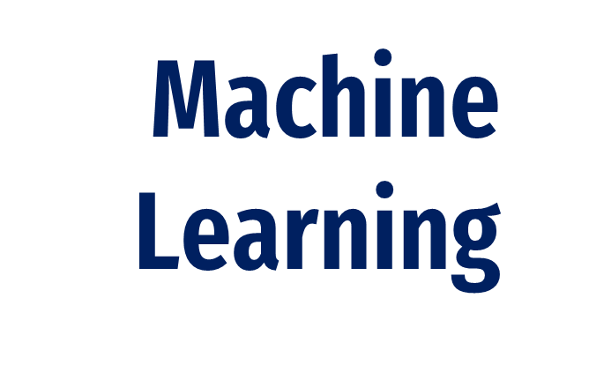
Aleena Varghese 2348503
Manu Martin 2348531
Ponwinsiya 2348539

Slide 2
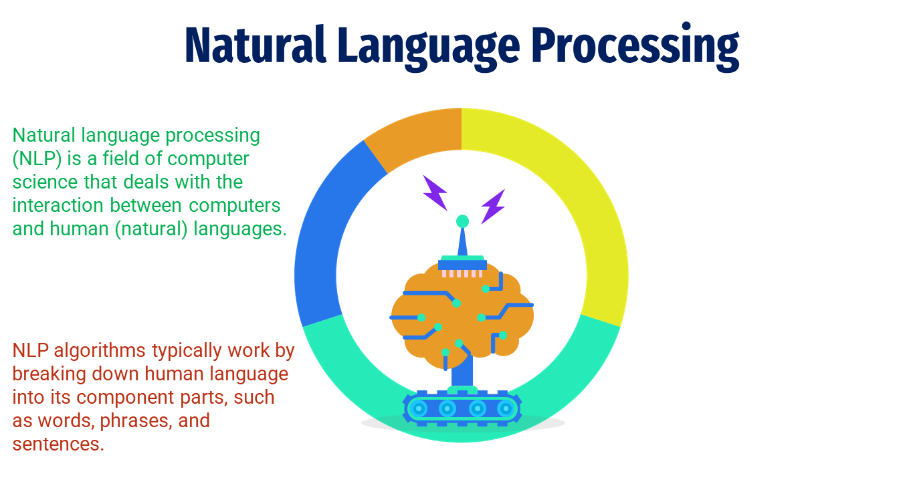
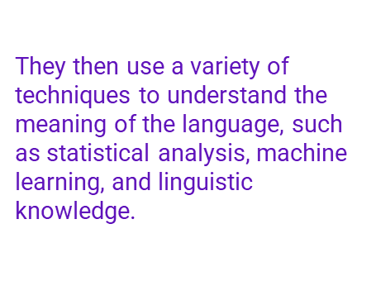
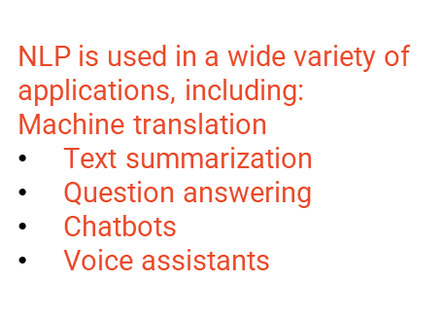

Slide 3
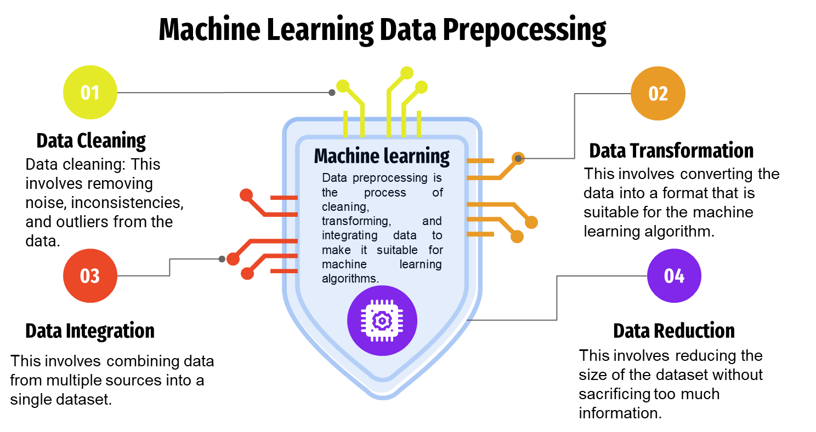

Slide 4
One-Hot Vector in Machine Learning
What ?
When ?
Applications
One-hot vector is a method of converting categorical variables into numerical vectors.
It works by creating a vector of the same size as the no. of unique values in the categorical variable, with a 1 in the position corresponding to the current value of the variable and 0s in all other positions
One-hot vector should be used whenever we have categorical variables that we want to use as inputs to machine learning algorithms.
This includes variables such as:
Country
City
State
Product category
Customer type
One-hot vector is used in a wide variety of machine learning applications, including:
Text classification
Image classification
Recommendation systems
Fraud detection
Medical diagnosis

Slide 5
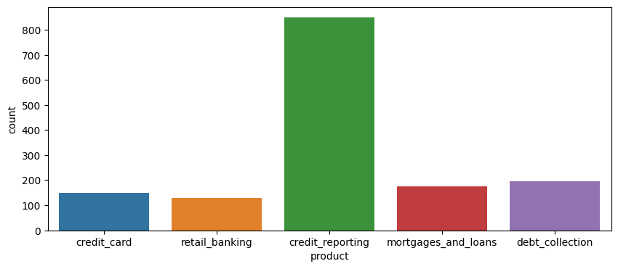
Types of Product
01
Credit Card
02
Retail Banking
03
Credit Reporting Product
04
Mortgages and Loans
05
Debt Collection
150
120
800
170
190

Slide 6
Deep Bidirectional Recurrent Neural Networks
What ?
How ?
Applications
Deep bidirectional RNNs work by using two separate RNNs, one that processes the sequence in the forward direction and one that processes the sequence in the backward direction.
The outputs of the two RNNs are then combined to produce a single output.
NLP tasks such as machine translation, text classification, and named entity recognition
Speech recognition tasks
Image classification and object detection tasks
Video analysis tasks
Time series forecasting tasks
Deep bidirectional RNNs are a type of recurrent neural network (RNN) that can process sequences of data in both forward and backward directions.
They can be used to learn long-range dependencies in the data and to process sequences of data in both forward and backward directions.

Slide 7
Spam Detection Models in Machine Learning
Spam detection models typically work by analyzing the features of messages to identify those that are likely to be spam.
Spam detection is important for complaints because it can help to reduce the workload on customer service teams and to improve the overall customer experience.
Spam
Spam is unsolicited electronic messages such as email, SMS, or social media messages.
Spam can be used to spread malware, phishing attacks, and other malicious content.
A spam detection model is a machine learning model that has been trained on a dataset of labeled examples of spam and non-spam complaints.
Deploying the model to a cloud-based platform such as AWS or Google Cloud Platform.
Deploying the model to an on-premises server.
There are a number of benefits to use a spam detection model for complaints, including:
Reduced workload on customer service teams
Improved customer experience
Faster resolution of legitimate complaints
Better understanding of spam trends

Slide 8
Machine Learning Algorithms
Models
LOGICAL REGRESSION | PROBABILITY
LINEAR REGRESSION | PREDICTION
Support-vector machines | MARGIN
KNN | SIMILARITY
RANDOM FOREST | TREES
DECISSION TREE | RULES

Slide 9
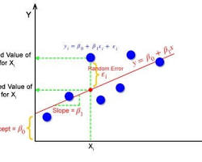
LINEAR REGRESSION :
-It is a supervised machine learning algorithm used to model the relationship between a dependent variable (target variable) and one or more independent variables (predictor variables).
-The goal of linear regression is to find a linear function that best predicts the dependent variable given the independent variables.

Slide 10
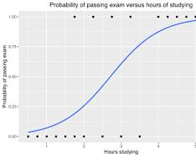
LOGISTIC REGRESSION :
- In this section, training a logistic regression model using the Logistic Regression class from scikit-learn.
- The model is trained on the training set (X_train, y_train).
- The accuracy of the logistic regression model is computed and printed.

Slide 11
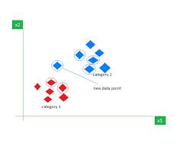
K-Nearest Neighbors (KNN)
- In this section, training a K-Nearest Neighbors (KNN) classifier using the KNeighborsClassifier class from scikit-learn.
- The model is trained with 5 neighbors on the training set (X_train, y_train).
- The accuracy of the KNN model is computed and printed.

Slide 12
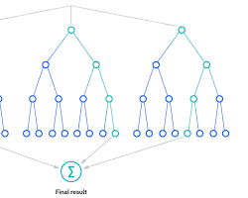
Random Forest Classifier
- In this section, training a Random Forest Classifier using the RandomForestClassifier class from scikit-learn.
- The classifier is trained on the TF-IDF vectorized text data (X_train, y_train).
- The accuracy of the Random Forest Classifier is computed and printed.

Slide 13
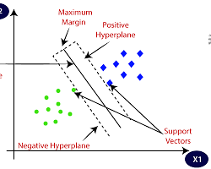
Support Vector Machines (SVM)
- In this section, training a Support Vector Machine (SVM) classifier with a linear kernel using the SVC class from scikit-learn.
- The SVM classifier is trained on the training set (X_train, y_train) with a linear kernel.
- The accuracy of the SVM classifier is computed and printed.

Slide 14
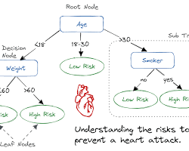
Decision Tree Classifier:
- In this section, train a Decision Tree Classifier using the Decision TreeClassifier class from scikit-learn.
- The classifier is trained on the training set (X_train, y_train).
- The accuracy of the Decision Tree Classifier is computed and printed.

Slide 15
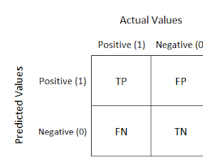
Confusion Matrix
- In this section, creating a confusion matrix for evaluating the performance of a classification model.
- By providing both the true labels (y_true) and predicted labels (y_pred) to compute the confusion matrix.
- The confusion matrix is visualized as a heatmap using Seaborn and Matplotlib. It shows the number of true positives, true negatives, false positives, and false negatives.

Slide 16
Random forests
Random forests are one of the most popular and versatile machine learning algorithms, used for both classification and regression tasks. They work by constructing a multitude of decision trees and then averaging their predictions to generate a final prediction.
Random forests are able to achieve high accuracy on a wide range of problems because they are able to reduce overfitting and learn complex relationships in the data. They are also relatively insensitive to noise and outliers in the data.
Advantages of Random Forests
High accuracy: Random forests are able to achieve high accuracy on a wide range of problems.
Robustness to overfitting: Random forests are less likely to overfit the training data than other machine learning algorithms, such as decision trees.
Versatility: Random forests can be used for both classification and regression tasks.
Interpretability: Random forests are relatively easy to interpret, which can be helpful for understanding the model's predictions.
Scalability: Random forests can be scaled to train on large datasets.
Disadvantages of Random Forests
Computational cost: Training a random forest can be computationally expensive, especially for large datasets.
Black box model: Random forests are a black box model, which means that it can be difficult to understand how the model makes its predictions.
Feature importance: Random forests can be used to identify the most important features for a given machine learning task, but the feature importance scores can be biased towards categorical features

Slide 17
Latent Dirichlet allocation
Latent Dirichlet allocation (LDA) is a generative probabilistic model for topic modeling. LDA assumes that each document is a mixture of topics, and each topic is a mixture of words. LDA can be used to extract topics from text data, identify the most important words and phrases in each topic, and visualize the topic structure of a text corpus.
LDA is used in a variety of applications, including:
Natural language processing: LDA can be used for a variety of NLP tasks, such as text classification, document summarization, and machine translation.
Information retrieval: LDA can be used to improve the performance of information retrieval systems by helping to identify the most relevant documents for a given query.
Marketing: LDA can be used for marketing tasks, such as customer segmentation, product recommendation, and sentiment analysis.
Social science research: LDA can be used for social science research tasks, such as identifying trends in public opinion and analyzing the content of social media posts.
Advantages:
LDA is a flexible model that can be used for a variety of tasks.
LDA can be used to extract topics from text data without the need for any labeled data.
LDA is a generative model, which means that it can be used to generate new text that is similar to the text that it was trained on.
Disadvantages:
LDA can be computationally expensive to train, especially on large datasets.
LDA can be sensitive to the hyperparameters that are used to train the model.
LDA can sometimes generate topics that are not interpretable

Slide 18
Non-negative matrix factorization
Non-negative matrix factorization (NMF) is a machine learning algorithm that decomposes a non-negative matrix into two non-negative matrices of lower dimensions. It is often used for dimensionality reduction and feature extraction tasks.
Uses
Dimensionality reduction
Feature extraction:
Image processing
Text analysis
Advantages
Interpretability: NMF-based features are often more interpretable than features extracted using other methods, such as principal component analysis (PCA).
Robustness to noise: NMF is relatively robust to noise in the data.
Versatility: NMF can be used for a variety of different machine learning tasks, including dimensionality reduction, feature extraction, image processing, and text analysis
Disadvantages
Computational cost: NMF can be computationally expensive to train, especially for large datasets.
Local minima: NMF algorithms are often prone to getting stuck in local minima.
Sensitivity to initialization: The performance of NMF algorithms can be sensitive to the initialization of the W and H matrices.

