Slide 1

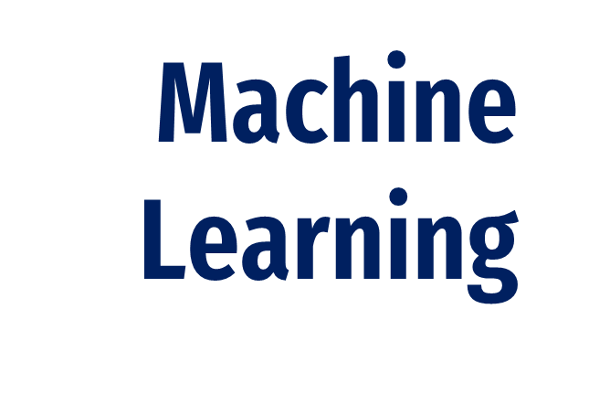
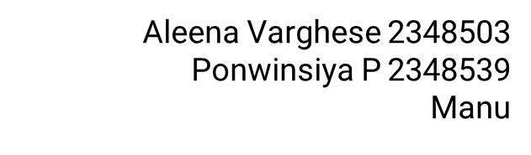

Slide 2
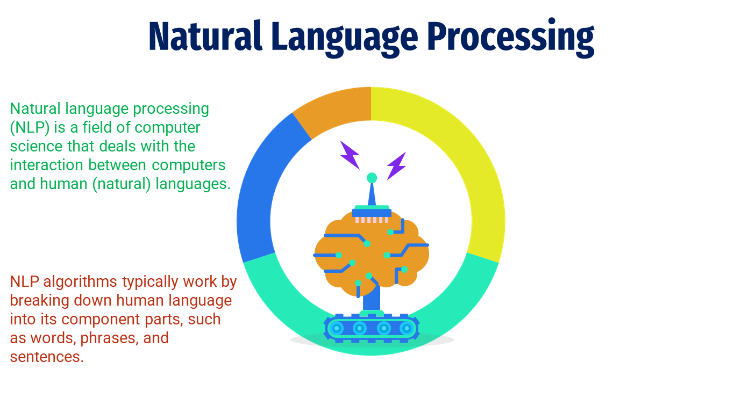
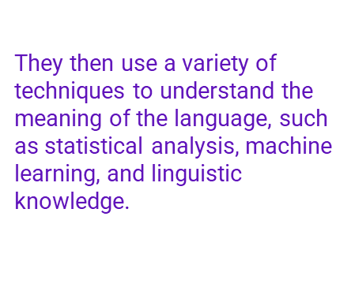
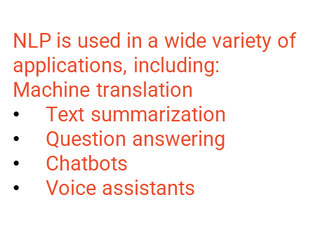

Slide 3
One-Hot Encoding in Machine Learning
What ?
One-hot encoding is a method of converting categorical variables into numerical vectors.
It works by creating a vector of the same size as the no. of unique values in the categorical variable, with a 1 in the position corresponding to the current value of the variable and 0s in all other positions
When ?
One-hot encoding should be used whenever we have categorical variables that we want to use as inputs to machine learning algorithms.
Applications
One-hot encoding is used in a wide variety of machine learning applications, including:
Country
This includes variables such as:
Product category
Customer type
City
State
Text classification
Image classification
Recommendation systems
Fraud detection
Medical diagnosis

Slide 4
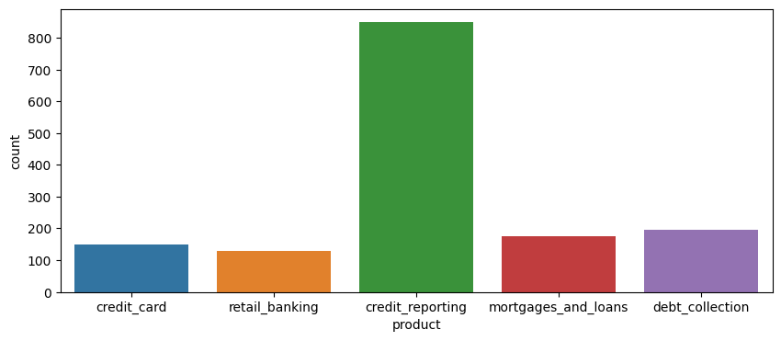
Types of Product
01
Credit Card
02
Retail Banking
03
Credit Reporting Product
04
Mortgages and Loans
05
Debt Collection
150
120
800
170
190

Slide 5
Deep Bidirectional Recurrent Neural Networks
What ?
How ?
Applications
Deep bidirectional RNNs work by using two separate RNNs, one that processes the sequence in the forward direction and one that processes the sequence in the backward direction.
The outputs of the two RNNs are then combined to produce a single output.
NLP tasks such as machine translation, text classification, and named entity recognition
Speech recognition tasks
Image classification and object detection tasks
Video analysis tasks
Time series forecasting tasks
Deep bidirectional RNNs are a type of recurrent neural network (RNN) that can process sequences of data in both forward and backward directions.
They can be used to learn long-range dependencies in the data and to process sequences of data in both forward and backward directions.

Slide 6
Spam Detection Models in Machine Learning
Spam detection models typically work by analyzing the features of messages to identify those that are likely to be spam.
Spam detection is important for complaints because it can help to reduce the workload on customer service teams and to improve the overall customer experience.
A spam detection model is a machine learning model that has been trained on a dataset of labeled examples of spam and non-spam complaints.
Deploying the model to a cloud-based platform such as AWS or Google Cloud Platform.
Deploying the model to an on-premises server.
There are a number of benefits to using a spam detection model for complaints, including:
Reduced workload on customer service teams
Improved customer experience
Faster resolution of legitimate complaints
Better understanding of spam trends
Spam
Spam is unsolicited electronic messages such as email, SMS, or social media messages.
Spam can be used to spread malware, phishing attacks, and other malicious content.

