Slide 1
GIT COMMANDS
By,
Aleena Joseph
UID : 166704
Trainer : Venkat

Slide 2
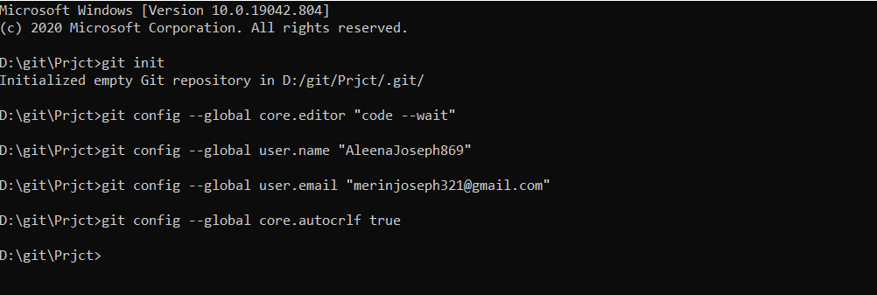
Git user configuration
git version : Git version check.
To initialize an empty repository : git init
To set up the editor : git config --global core.editor
To set up the username : git config --global user.name “Name”
To set up the email id : git config --global user.email “Emailid”
Final step : git config --global core.autocrlf true
AND WE ARE READY !!!

Slide 3
ADD & COMMIT
To stage a file : git add <filename>
To stage all files : git add .
To commit staged files : git commit –m “Message”
To add and commit files at a time : git commit –a -m “Message”
To unstage a staged file : git reset HEAD <filename>
To delete files and stage them : git rm <filename> , git rm –r <my folder>
To correct a commited message : git commit --amend –m “Message”
To check if there are any changes are yet to be commited : git status
To see a simplified list of commits : git log --oneline
To see list of commits with even more detail : git log

Slide 4
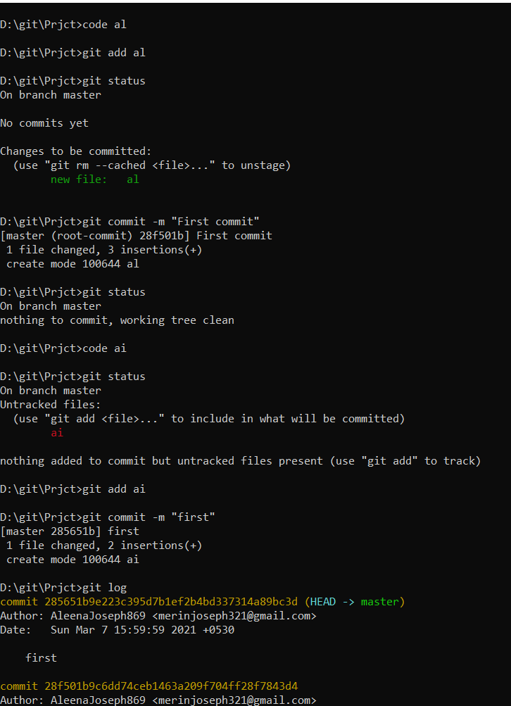
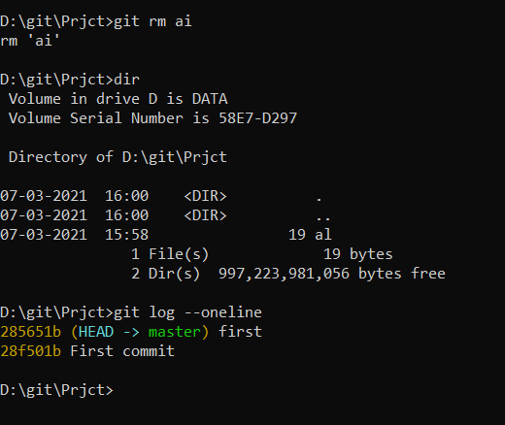

Slide 5
To add a remote repository link : git remote add origin <url>
To push commits to the remote repository in git hub : git push –u origin master
To create a pull request:
git push <url> master
git request-pull v1.0 <url> master
git diff <version1> <version2> - It takes two inputs and reflects the differences between them
git checkout – It navigate between the branches created by git branch . Checking out a branch updates the files in the working directory to match the version stored in that branch, and it tells Git to record all new commits on that branch.
git checkout –b <branchname> - Creates a new branch
eg: git checkout –b target1

Slide 6
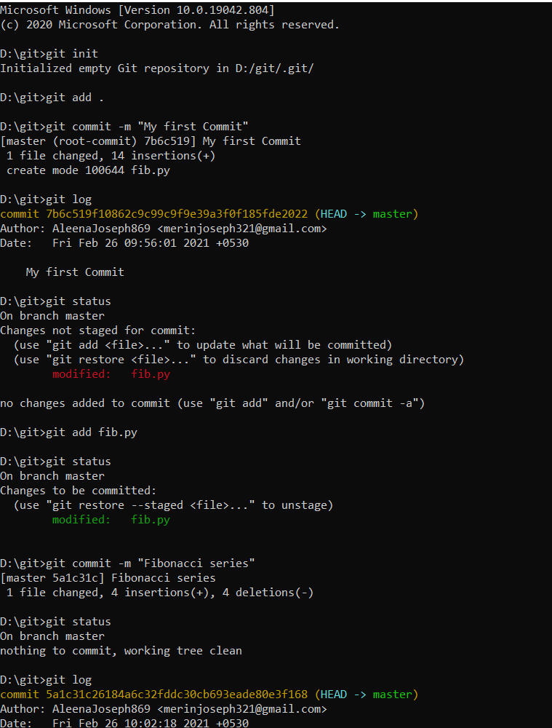
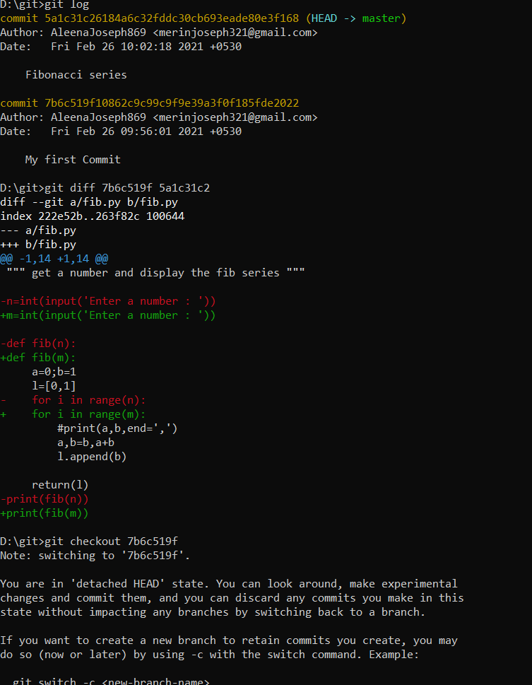

Slide 7
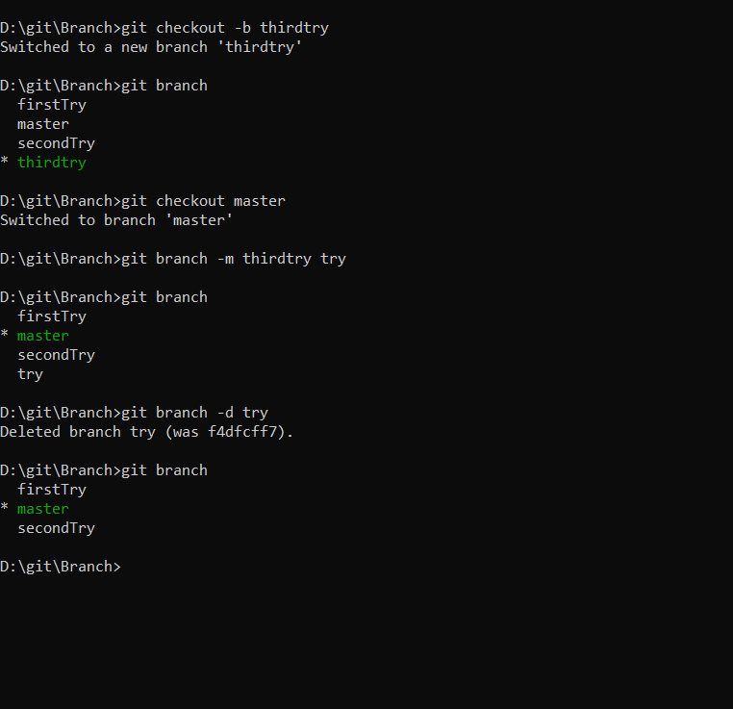
git checkout master – It navigates to the master.
git branch – It shows the total number of branches currently in the local repository
To rename a branch:
git branch –m <oldbranchname> <newbranchname>
To delete a branch:
git branch –d <branchname>

Slide 8
git merge – Usually used to merge two different branches and protects history of commits
eg: git merge <branchname> master
git checkout <target branch>
git merge <branch>
git merge-base : To find the best common ancestors between two commits to use in a merge.
To compare between branches:
git diff <branch1> <branch2>
git rebase - It integrates changes from one branch onto another and the history of commits will be rewritten. Rebasing can be used to change older and multiple commits, committed files, and multiple messages.
git stash - To save your un-committed changes in a "stash". This removes changes from working tree.
git stash list – list stashes, we can see something like this:
stash@{0}: WIP on {branch_name}: {SHA-1 of last commit} {last commit of you branch} stash@{0}: WIP on master: 085b095c6 modification for test

Slide 9
git stash apply – To apply stash to working tree in current branch.
git stash drop stash@{12} – To remove from stash list
git stash pop stash@{1} – To apply selected stash and drop it from stash list.
To copy an existing git repository onto your system : git clone <url>
To choose a commit from one branch and apply it onto another : git cherry-pick

Slide 10
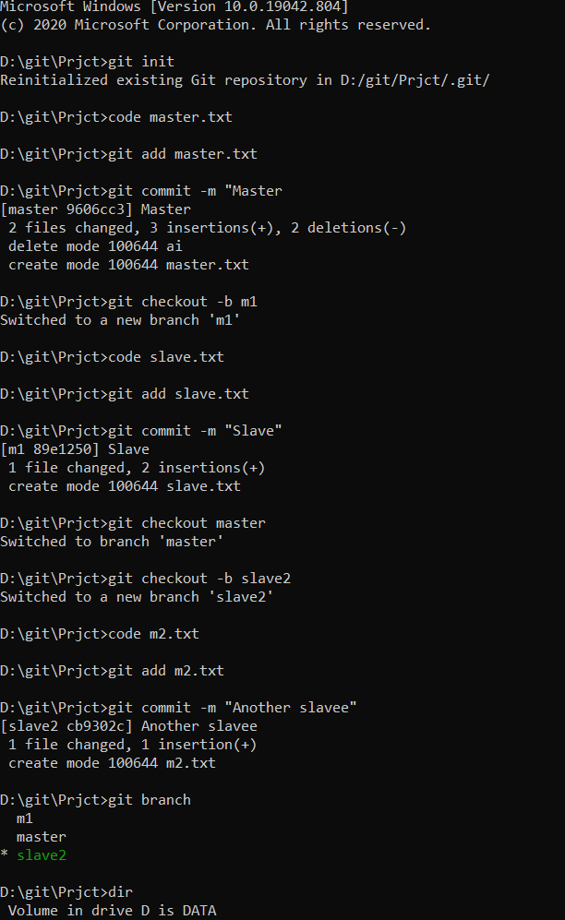
SAMPLE PROGRAM

Slide 11
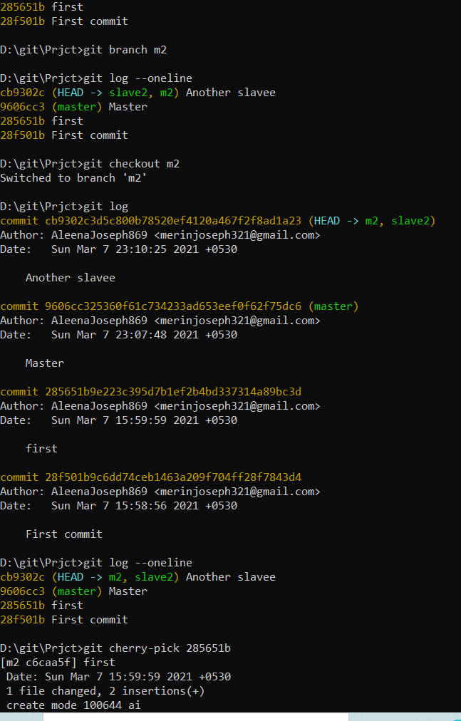
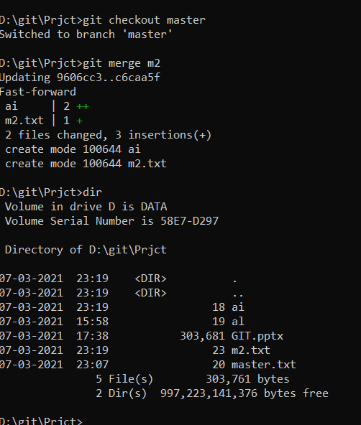

Slide 12
THANK YOU

