Slide 1
LINUX COMMANDS-2
By,
Aleena Joseph
166704

Slide 2
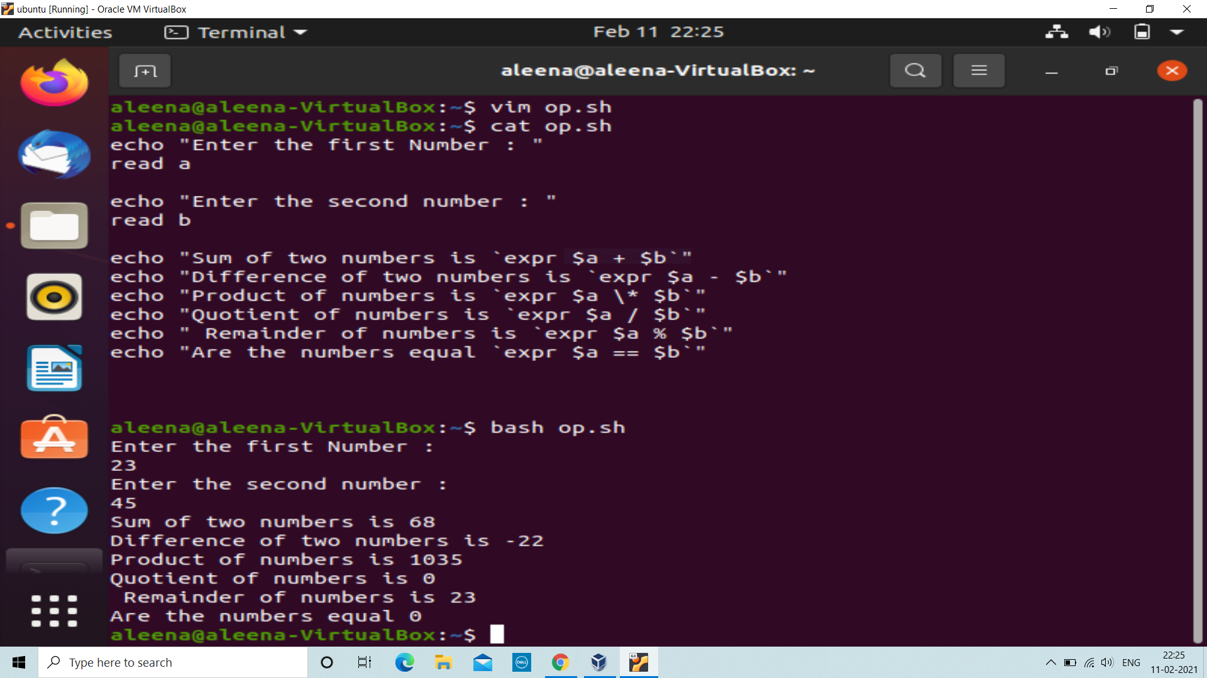
vim: Editor
echo: Displays string
read: Accepts input from the user.
Here different operators are used like ‘+’, ‘-’, ‘*’, ‘/’, ‘==‘, ‘%’…

Slide 3
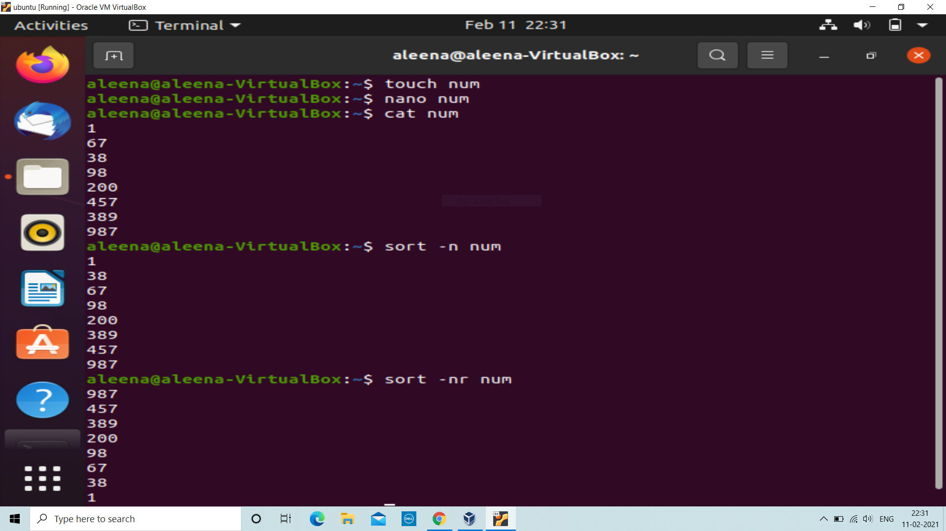
To Sort :
sort: Allows to sort in alphabetic order.
sort –nr numbers: Descending order

Slide 4
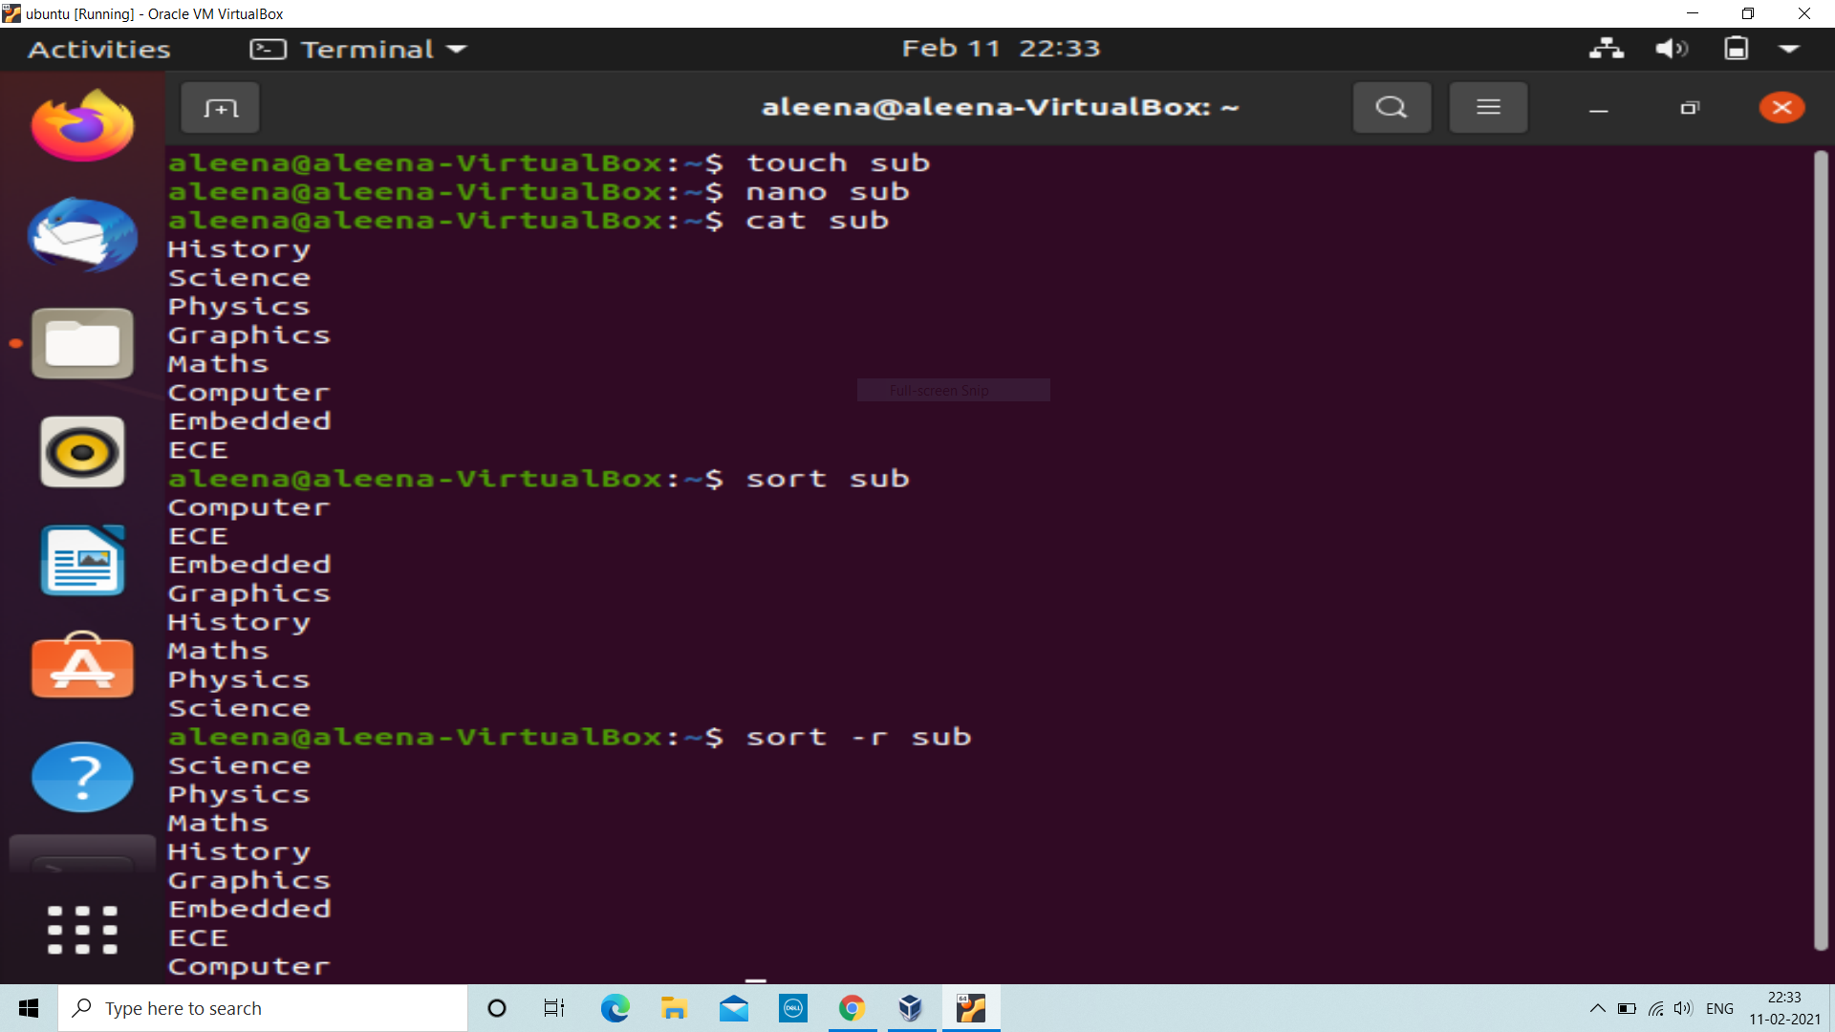
sort –n numbers : Ascending order
sort –r file: Reverse alphabetic order

Slide 5
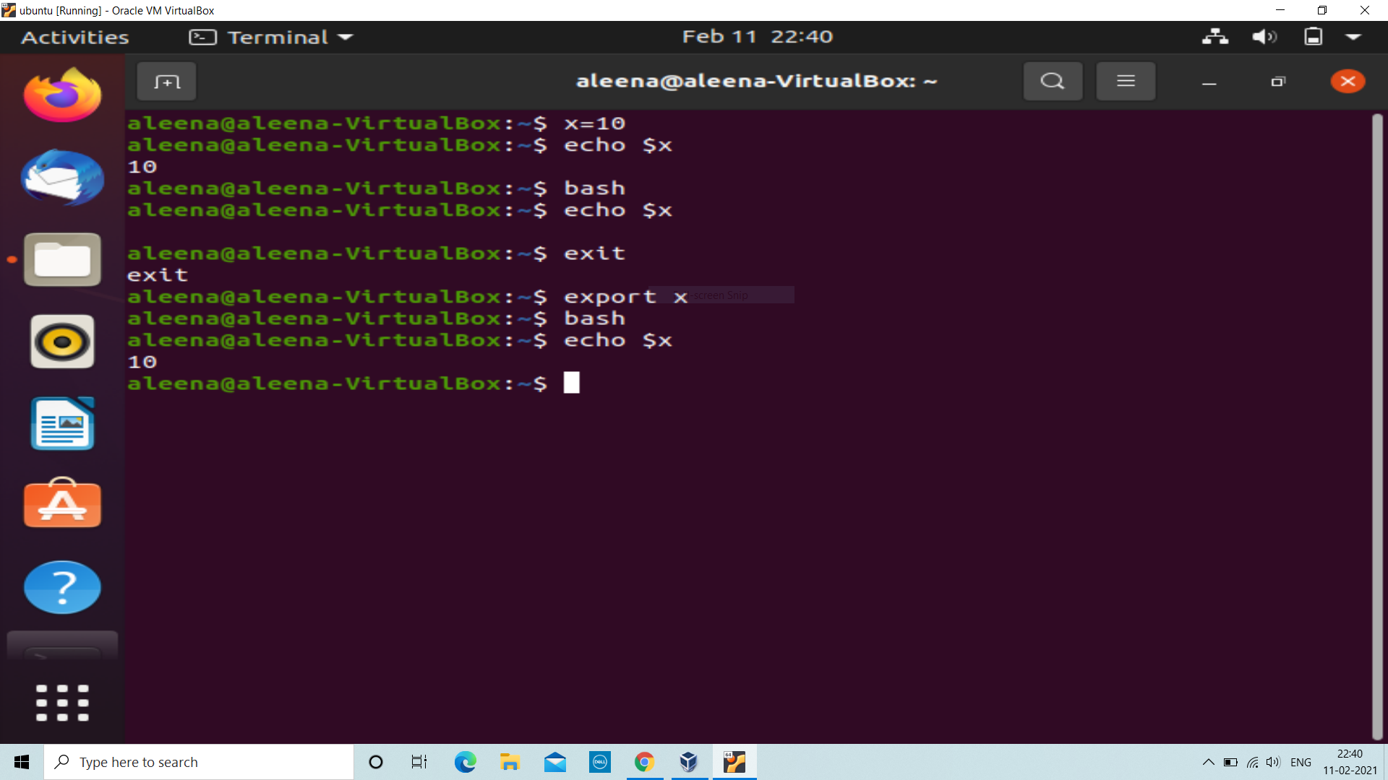
Shell to Shell Exchange
export: Exports the value from one shell to another shell.
exit: Exit from the current shell.
echo $x: Reads the value from x variable and displays it.
bash: Shell name

Slide 6
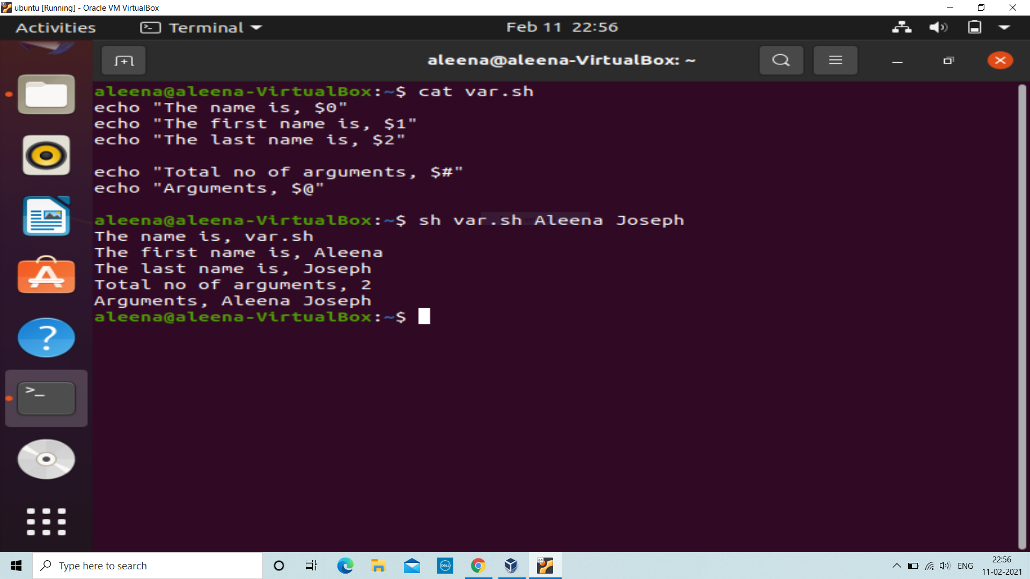
Special Variables
$0: Displays the file name of the current script.
$n: Displays the argument in the corresponding position.
$#: Shows the number of arguments in the script.
$@: Shows all the arguments individually double quoted.
$?: The exit status of the last command executed.

Slide 7
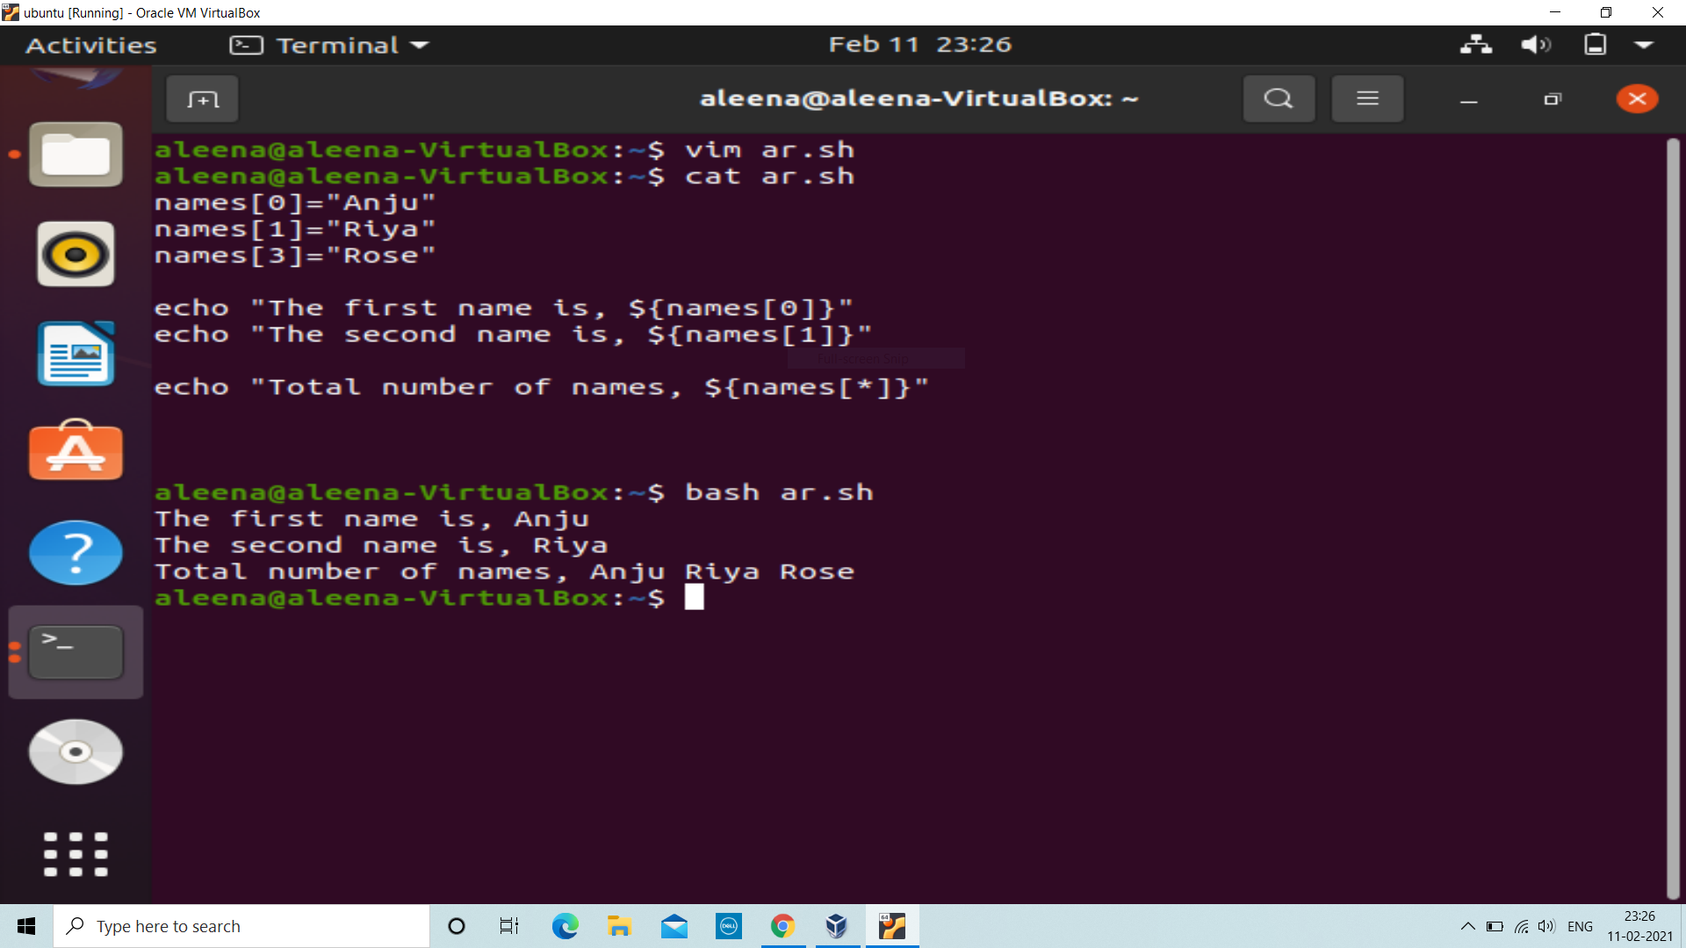
Use of array
Displaying names of users using array.
Here we can see the use of special variables.

Slide 8
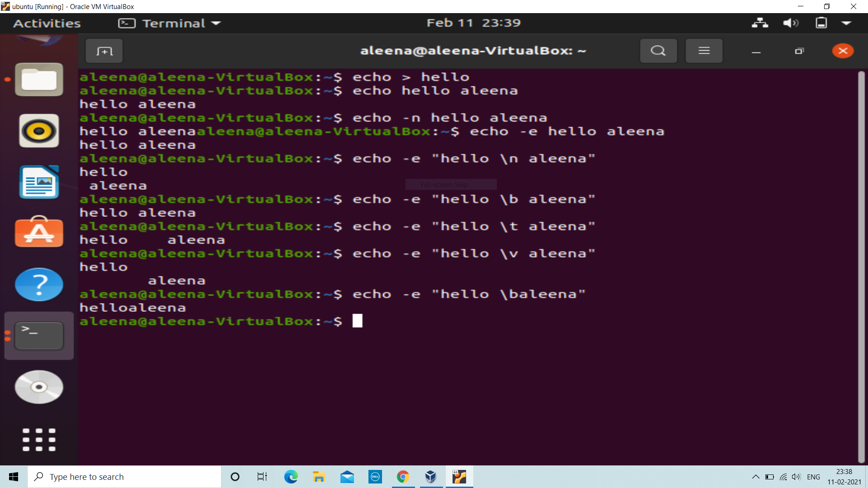
Options available
-n: Gives the output without a new line.
-e: Allows to use backslash escapes.
\b: Removes the space between text.
\n: Displays the text in different lines.
\t: Allows a horizontal tab.
\v: Allows a vertical tab.

Slide 9
VI / VIM EDITOR - Codes
i : Insert mode
k : Move cursor upwars
j : Move cursor downward
:q! : Quit the editor without editing
:wq : Quit with updated version
yy : Copy a single line
nyy : Copy n lines
p : Paste line
dd : Delete a single line
cc : Cut single line
/word : Search option

Slide 10
THANK YOU

