Slide 1
GIT COMMANDS

Slide 2
git init – Initializes git
git add . – This will add all the files present in the directory to the local repository
git commit –a –m “Commit line” – Add and commit files in a single line
git commit “Commit line” - This will save changes to the file in the repository
git status – This shows the status of the files in the repository. Generates an error if not commited.
git log - This tool allows to view information about previous commits that have occurred in a project.
Modify the file and save changes.
git status – Shows an error because the last changes are not saved.
git commit and add
git diff <version1> <version2> - It takes two inputs and reflects the differences between them

Slide 3
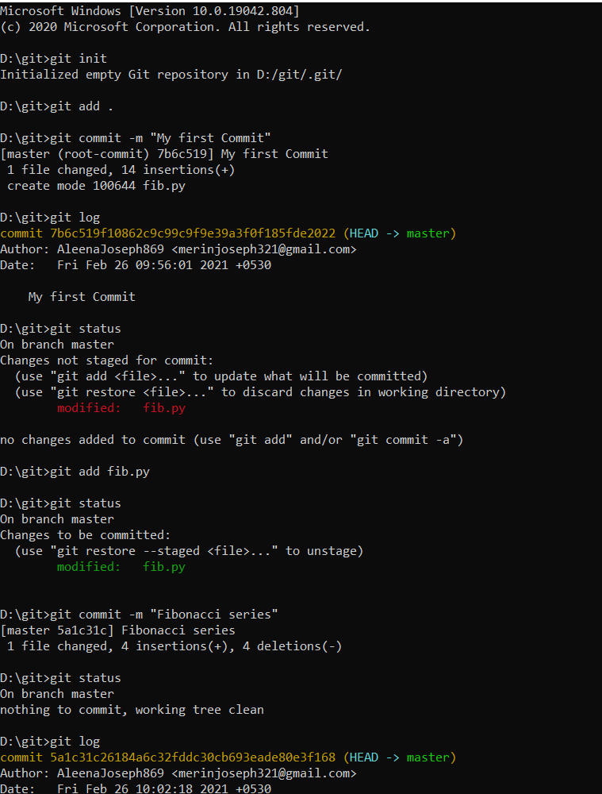
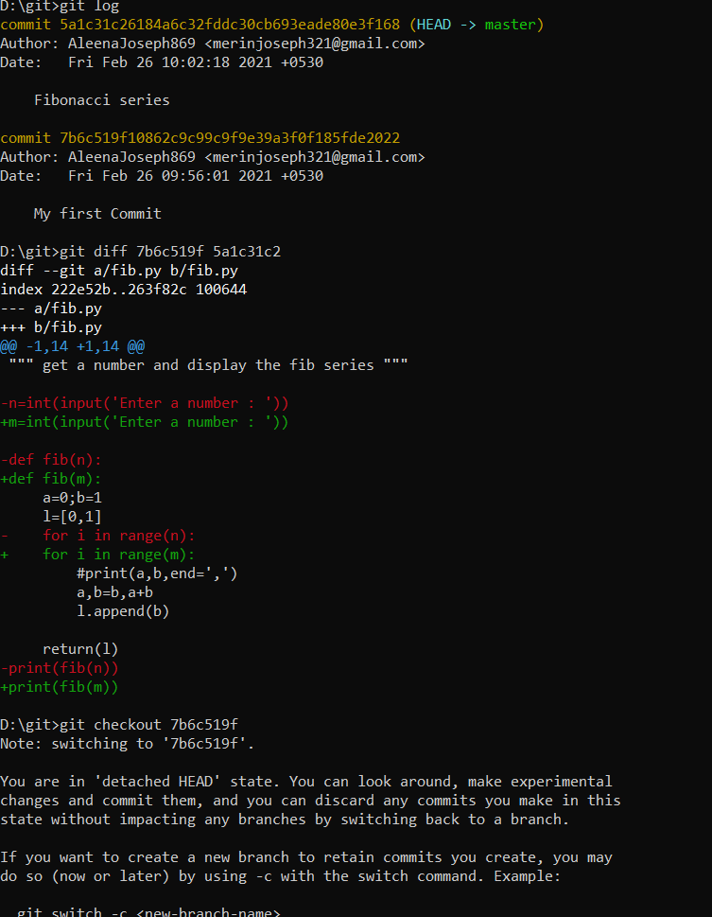

Slide 4
git checkout – It navigate between the branches created by git branch . Checking out a branch updates the files in the working directory to match the version stored in that branch, and it tells Git to record all new commits on that branch.
git checkout –b <branchname> - Creates a new branch
eg: git checkout –b target1
git checkout master – It navigates to the master.
git branch – It shows the total number of branches currently in the local repository
To rename a branch:
git branch –m <oldbranchname> <newbranchname>
To delete a branch:
git branch –d <branchname>

Slide 5
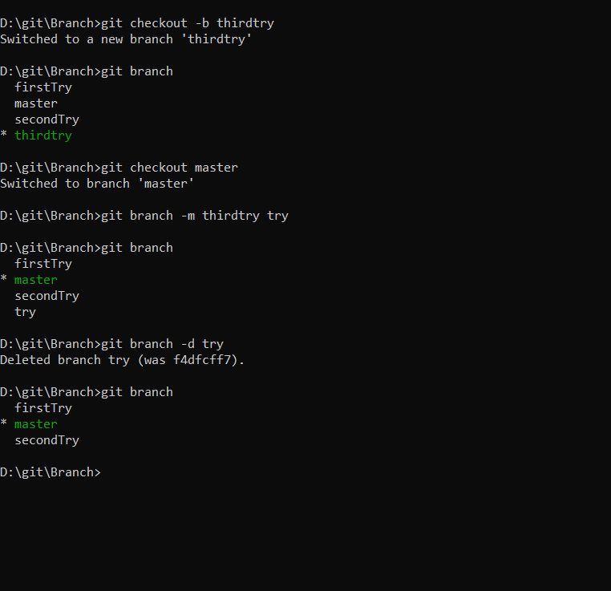

Slide 6
git merge – Usually used to merge two different branches
eg: git merge <branchname> master
git checkout <target branch>
git merge <branch>
To compare between branches:
git diff <branch1> <branch2>
git rebase - It integrates changes from one branch onto another and the history of commits will be rewritten. Rebasing can be used to change older and multiple commits, committed files, and multiple messages.
git stash - To save your un-committed changes in a "stash". This removes changes from working tree.
git stash list – list stashes, we can see something like this:
stash@{0}: WIP on {branch_name}: {SHA-1 of last commit} {last commit of you branch} stash@{0}: WIP on master: 085b095c6 modification for test

Slide 7
git stash apply – To apply stash to working tree in current branch.
git stash drop stash@{12} – To remove from stash list
git stash pop stash@{1} – To apply selected stash and drop it from stash list.
git log –oneline - The oneline option is used to display the output as one commit per line. It also shows the output in brief like the first seven characters of the commit SHA and the commit message.
git pull - The git pull command is used to fetch and download content from a remote repository and immediately update the local repository to match that content.
git pull origin master – It will pull changes from the origin remote, master branch and merge them to the local checked-out branch.
git push - It is used to upload local repository content to a remote repository.
git push –u origin master – It is used for pushing local content to GitHub.
git push –u origin <branchname> - Pushes the branch to the Github.
git clone <remote url> - Used to point to an existing repo and make a clone or copy of that repo at in a new directory, at another location. The original repository can be located on the local filesystem or on remote machine accessible supported protocols. The git clone command copies an existing Git repository.

