Slide 1
Crop yield prediction using decision Tree
Aleena Joseph
AJC19MCA-I007
INTMCA
Amal Jyothi College Of Engineering, Kanjirappally
Mr. Ajith G S
Assistant Professor
Department Of Computer Applications
Amal Jyothi College Of Engineering, Kanjirappally

Slide 2
Contents
Introduction
Literature survey
Methodology
Result and Discussion
Conclusion
References

Slide 3
Introduction
The proposed system mainly aims to predict the yield of a crop for a particular area based on certain criterias.
Here the data like the Year, Annual rainfall, Pesticides, Area and the crop is given then the system will predict the yield of that crop in the particular area in the given year
The prediction is done with the help of Decision tree algorithm.

Slide 4
Literature Survey
Crop Yield Prediction Based on Indian Agriculture Using Machine Learning
The paper uses advanced regression techniques like Kernel Ridge, Lasso and ENet algorithms to predict the yield and uses the concept of Stacking Regression for enhancing the algorithms to give a better prediction.

Slide 5
Literature Survey
Study on Machine Learning Algorithms in Crop Yield Predictions specific to Indian Agricultural Contexts.
This paper is a detailed study of various aspects of crop yielding in India using machine learning techniques and artificial intelligence.

Slide 6
Literature Survey
Crop Yield Prediction Using Machine Learning and Deep Learning Techniques
In this research work authors have implemented various machine learning techniques to estimate the crop yield in Rajasthan state of India on five identified crops.
The results indicate that among all the applied algorithms; Random Forest, SVM, Gradient Descent, long short-term memory, and Lasso regression techniques; the random forest performed better than others

Slide 7
Literature Survey
Design and Implementation of Crop Yield Prediction Model in Agriculture
The proposed machine learning approach aims at predicting the best yielded crop for a particular region by analyzing various atmospheric factors like rainfall, temperature, humidity etc., and land factors like soil pH, soil type including past records of crops grown.

Slide 8
Literature Survey
Predicting Yield of the Crop Yield Prediction Using Machine Learning Algorithm
It mainly describes that the farmer can utilize the prediction to determine the crop's yield prior to planting in an agricultural field.
Future crop yield is predicted with accuracy using Random Forest, one of the most potent and well-liked supervised machine learning algorithms.

Slide 9
Literature Survey
A hybrid approach for crop yield prediction using machine learning and deep learning algorithms.
In this paper, SVM is executed as Machine Learning algorithm while LSTM and RNN are used as Deep Learning algorithms.

Slide 10
Literature Survey
Crop Yield Prediction Using Machine Learning
This project will help the farmers to know the yield of their crop before cultivating onto the agricultural field and thus help them to make the appropriate decisions.

Slide 11
Literature Survey
Crop prediction using machine learning
The goal of the paper is to determine the best crop prediction model
The study uses two different criteria, entropy and gini, to evaluate a variety of algorithms for machine learning, including Random Forest Classifier, Decision Tree, and K-Nearest Neighbor (KNN).
The study's findings indicate that, of these algorithms, the Random Forest Classifier forecasts crop results with the highest degree of accuracy.

Slide 12

Methodology
A. Data Collection: This information include elements like the year, typical rainfall, use of pesticides, typical temperature, region (area), and the particular crop item. The dataset 'yield_df.csv' is loaded using Pandas.

Slide 13


Methodology
B. Data Preprocessing:
Data Cleaning: Unwanted columns are dropped
Handling Missing Values: Checking and handling any missing values that may exist.
Data Type Conversion: Ensure that the 'average_rain_fall_mm_per_year' column has the appropriate data type (float64).

Slide 14

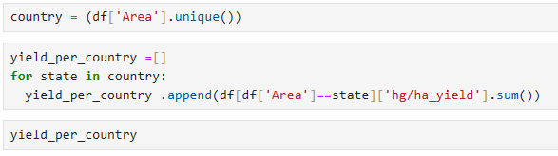

Methodology
C. Exploratory Data Analysis (EDA): Visualizing data using Seaborn and Matplotlib to gain insights into the dataset.

Slide 15
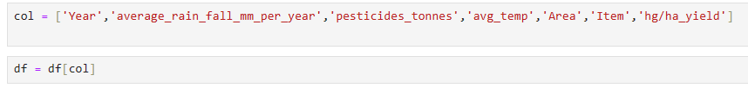

Methodology
D. Feature Selection: Selecting relevant features and creating a new DataFrame 'df' with the chosen columns.
E. Data splitting: Splitting the dataset into training and testing sets.

Slide 16

Methodology
F. Model Building: Train a Decision Tree Regressor model.

Slide 17
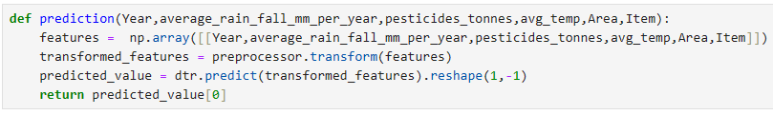
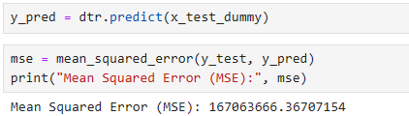

Methodology
G. Prediction Function: Create a function to make crop yield predictions.

Slide 18
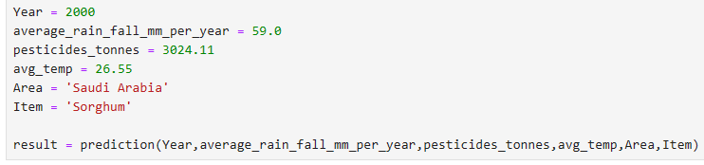
Result And Discussion
In this the 80 % of data is used for training and 20 % of data is used for testing.
This is the predicted value.

Slide 19
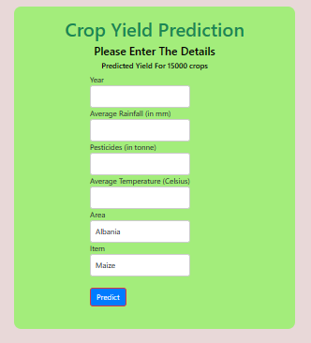
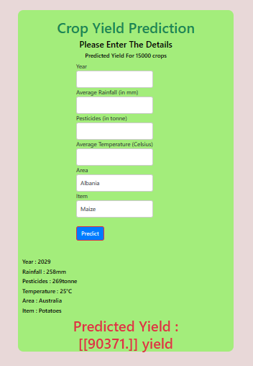
Result And Discussion
Output
Figure1 Figure2

Slide 20
Conclusion
In conclusion, utilizing decision trees for crop yield prediction is a valuable approach that offers several advantages. They provide insights into the factors that significantly influence crop yield and allow for data-driven decision-making.
Crop yield prediction using decision trees involves analyzing various factors such as weather conditions, pesticides etc. to make accurate predictions about the expected crop yield. Depending on the dataset, features, and particular decision tree algorithm used, the accuracy of crop yield prediction using decision tree models can vary. Based on our dataset the accuracy is 0.9769.

Slide 21
Conclusion
So, the crop yield prediction mainly help the farmers to take a decision on what crop to plant in their area based on the yield of the crop

Slide 22
Reference
Potnuru Sai Nishant, Pinapa Sai Venkat, Bollu Lakshmi Avinash, B. Jabber “Crop Yield Prediction Based on Indian Agriculture Using Machine Learning”2020 International Conference for Emerging Technology (INCET)
Suresh Kumar Sharma, Durga Prasad Sharma, Jitendra Kumar Verma “Study on Machine Learning Algorithms in Crop Yield Predictions specific to Indian Agricultural Contexts”2021 International Conference on Computational Performance Evaluvation (ComPE)
Kavita Jhajhariaa, Pratistha Mathura, Sanchit Jaina, Sukriti Nijhawan “Crop Yield Prediction Using Machine Learning and Deep Learning Techniques” International Conference on Machine Learning and Data Engineering
Sangeeta, Shruthi G “Design and Implementation of Crop Yield Prediction Model in Agriculture” International Journal of Scientific and Technology Research Volume 8, Issue 01, January 2020.

Slide 23
Reference
5. Priya P, U Muthaiah, M Balamurugan “Predicting Yield of the Crop Yield Prediction Using Machine Learning Algorithm” International Journal of Engineering Science and Research Technology
6. Sonal Agarwal and Sandhya Tarar” a hybrid approach for crop yield prediction using machine learning and deep learning algorithms” Journal of Physics: Conference Series
7. Mayank Champaneri, Darpan Chachpara, Chaitanya Chandvidkar, Mansing Rathod “Crop Yield Prediction Using Machine Learning” International Journal of Science and Research (IJSR)
8. Madhuri Shripathi Rao, Arushi Singh, N.V. Subba Reddy and Dinesh U Acharya” Crop prediction using machine learning” Journal of Physics: Conference Series

Slide 24
Thank You

