Slide 1
AO-PSO
Adaptive Opposition-Based Particle Swarm Optimization
with Chaotic Initialization, Generalized Opposites,
and Diversity-Driven Generation Jumping
Aleena Tahir, Eman Asghar, Aena Habib, Malaika Akhter, Dua Kamal, Sadia Mazhar, Inshal Adil, Saqlain Abbas
Department of Artificial Intelligence | National University of Technology | Swarm Intelligence, Final Phase | Instructor: Lec. Faria Sajjad
Notes:
Aleena opens, introduces title and team.

Slide 2
Outline
What we will cover today
1. Problem and motivation
2. Related work and the focal paper (O-PSO, 2009)
3. Our value additions — the seven enhancements
4. AO-PSO architecture and per-generation flow
5. Implementation and experimental setup
6. Results: tables, convergence, significance
7. Honest limitation (Schwefel) and discussion
8. Conclusion and Q&A
Notes:
Aleena -- 30 seconds to set expectations.

Slide 3
Problem and Motivation
Why we worked on opposition-based PSO
Particle Swarm Optimization (1995) is one of the most widely used metaheuristics
but it suffers from two well-known failure modes:
• Premature convergence — the swarm collapses into a sub-optimal basin
• Sensitivity to initialization — pseudo-random seeding gives uneven space coverage
Opposition-Based Learning (Tizhoosh 2005) attacks both with a single idea:
whenever you evaluate x, also evaluate its opposite x̂ = a + b − x
Our focal paper (O-PSO, Jabeen et al. GECCO'09) was the first to splice OBL into PSO,
but only at initialization. After generation zero it reverts to plain PSO.
Goal: push OBL deeper into the algorithm and report it honestly.
Notes:
Malaika -- explain motivation; emphasise the two failure modes and why opposition-based learning is a natural answer.

Slide 4
Related Work
Phase-4 review: 15 successor papers in the OBL-PSO line
Foundational:
Tizhoosh 2005 — OBL as a machine-intelligence scheme
OBL applied at initialization:
Jabeen 2009 (O-PSO), CSPSO, WE-PSO, LatinPSO, Quasi-Random PSO
OBL throughout the search:
OPSO-Cauchy 2007, OVCPSO 2009, GOPSO 2011, BPSO-OBL 2015, OBPSO 2012
PSO variants with OBL:
OCLPSO, IOBL-PSO, COPSO, PSO-OBL-NNI, Imran-Mutation
Beyond PSO / applied:
ODE (Diff. Evolution), SDE-OBL, AMO-OBL, Cao et al. reactive power dispatch
Persistent open problems flagged across these papers:
• fixed Jr • linear opposite only • no FE-fair cost accounting • no statistical tests
Notes:
Sadia -- summarise the related-work landscape and the four open problems the literature still has.

Slide 5
The Focal Paper: O-PSO (Jabeen, Jalil, Baig — GECCO 2009)
Our starting point — what it did and where it stops
What O-PSO does:
1. Generate N random particles
2. Compute N linear opposites x̂ = a + b − x
3. Evaluate all 2N candidates, keep the best N
4. Run standard Clerc-constriction PSO until budget exhausted
Strengths:
• Drop-in modification — works with any PSO implementation
• Tested on Sphere, Rosenbrock, Rastrigin, Griewank
Limitations we will address:
• Pseudo-random seed — no guaranteed space coverage
• Linear opposite only — geometrically rigid
• No OBL after generation 0 — most of the search runs blind
• No Wilcoxon, no FE-budget reporting — claims hard to verify
Notes:
Aena -- frame O-PSO as a clean but minimal contribution. Be explicit that everything after this slide is our improvement.

Slide 6
Our Value Additions — Seven Enhancements
Each addresses one or more of the open problems
# | Mechanism | Source | Novel
VA-1 | Chaotic logistic-map init | CSPSO
VA-2 | Generalized OBL (GOBL) | GOPSO
VA-3 | Generation jumping | OVCPSO / OPSO-C
VA-4 | Adaptive Jr from swarm diameter | — | ★ ours
VA-5 | pbest opposition on stagnation | BPSO-OBL
VA-6 | Rebel repulsion velocity term | BPSO-OBL
VA-7 | FE budget + Wilcoxon reporting | Best practice
Notes:
Aena -- read out the table; explicitly call out VA-4 as the novel contribution. Everything else is principled re-use.

Slide 7
VA-1 & VA-2 — Better Initialization
Replace random seed and linear opposite
VA-1. Chaotic logistic-map initialisation
x_{n+1} = μ · x_n · (1 − x_n), μ = 4 (fully chaotic regime)
One independent stream per dimension, burn-in of 200 to discard transients
Ergodic — covers the unit interval more uniformly than the Mersenne Twister
VA-2. Generalized Opposite (GOBL) — Wang et al. 2011
x̂_j = a_j + b_j − β x_j − (1 − β) x̄_j
β ~ U(0,1) drawn per particle; x̄ is the per-dimension population mean
Mean-aware term breaks the box symmetry — opposites are no longer simple reflections
Cost: same 2N evaluations as O-PSO. Selection of best N of (X ∪ X̂) is unchanged.
Notes:
Saqlain -- chaotic init costs nothing extra, GOBL is a one-line formula change but a much richer opposite.

Slide 8
VA-3 — Generation Jumping
Apply OBL throughout the search, not just at init
In O-PSO, OBL fires only once — at generation 0.
After that the swarm has only random initialisation to thank for any diversity.
Generation jumping (OVCPSO / OPSO-Cauchy):
At every generation, with probability Jr,
1. Compute X̂ = GOBL(X)
2. Evaluate all N opposites
3. Replace x_i with x̂_i whenever f(x̂_i) < f(x_i)
Cost: +N FEs each time the jump fires (counted honestly in our FE budget).
Open problem in the literature: every prior paper picks Jr by hand.
We fix that next ▶
Notes:
Saqlain -- explain that without an adaptive Jr the FE budget is wasted on OBL late in the search when the swarm has already converged.

Slide 9
VA-4 — Adaptive Jumping Rate (our novel contribution)
Tie Jr to a live measurement of swarm diversity
Define the normalised swarm diameter at generation t:
σ_t = mean over dimensions of std(x_{i,j}) / (b_j − a_j)
Then set
Jr(t) = Jr,max · ( 1 − e^(−λ σ_t) )
Behaviour:
• Swarm is spread out → σ_t large → Jr(t) → Jr,max (explore via OBL)
• Swarm has converged → σ_t → 0 → Jr(t) → 0 (stop wasting evaluations)
Why this matters:
Among every paper in our Phase-4 review, none ties Jr to live swarm state.
Hyperparameters: Jr,max = 0.30, λ = 25.
Notes:
Saqlain / Aena -- this is THE novel slide. Spend a beat on the two regimes. The figure on slide 'Diversity & Adaptive Jr' will show it actually behaving this way on Rastrigin.

Slide 10
VA-5 & VA-6 — Memory and Repulsion
Fixing premature commitment at its root
VA-5. pbest opposition on stagnation
Each particle carries a stagnation counter s_i (incremented when p_i fails to improve)
When s_i ≥ t_stag = 5, compute p̂_i = GOBL(p_i)
Replace p_i with p̂_i if it is better; reset s_i either way
Targets the root cause: a corrupted personal-best archive, not its symptoms
VA-6. Rebel repulsion velocity term
v_i ← χ [ v_i + c1 r1 (p_i − x_i) + c2 r2 (g − x_i) − α (p_worst − x_i) ]
α = 0.05 — small but consistent push AWAY from the swarm's worst pbest
Prevents attractor-locking around poor candidate basins
Notes:
Saqlain -- VA-5 is the most under-used trick in the literature; VA-6 is a tiny coefficient with a real effect at D=30.

Slide 11
VA-7 — Honest Reporting
Function evaluations and statistical significance
Cost is measured in function evaluations (FEs), not iterations.
Each opposition step charges an extra evaluation per particle.
The adaptive Jr ensures those evaluations decay as the swarm converges.
30 independent runs per (algorithm × benchmark × dimension) cell.
Each seed is fixed so the experiment is exactly reproducible.
One-sided Wilcoxon signed-rank test, alternative "AO-PSO < baseline".
Reject H₀ at p < 0.05 ⇒ AO-PSO is significantly better than the baseline.
Why this matters: in our Phase-4 review, most papers did none of the above.
Claims that look big can disappear under proper statistical testing.
Notes:
Inshal -- explain why we changed the x-axis to FEs and why Wilcoxon (not t-test) is correct for non-Gaussian fitness data.

Slide 12
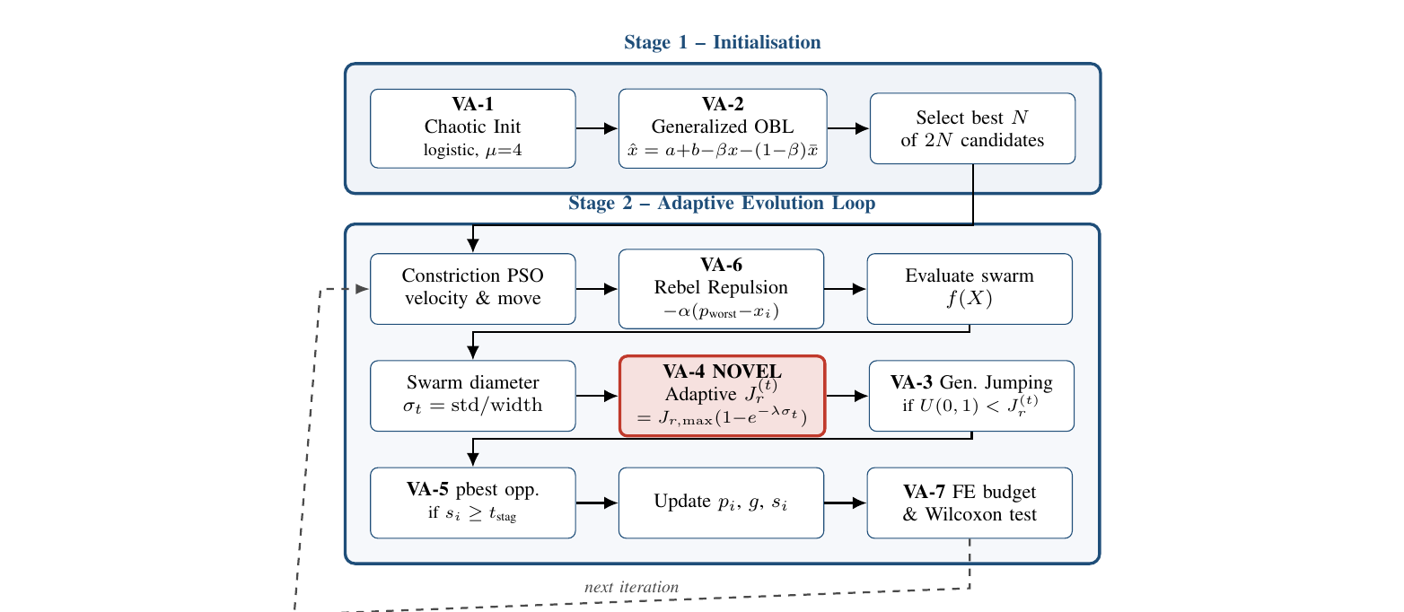
AO-PSO Architecture
Where the seven value additions live
Notes:
Eman -- walk through Stage 1 (top) and Stage 2 (bottom). Highlight VA-4 (red novel block) in the middle of Stage 2.

Slide 13
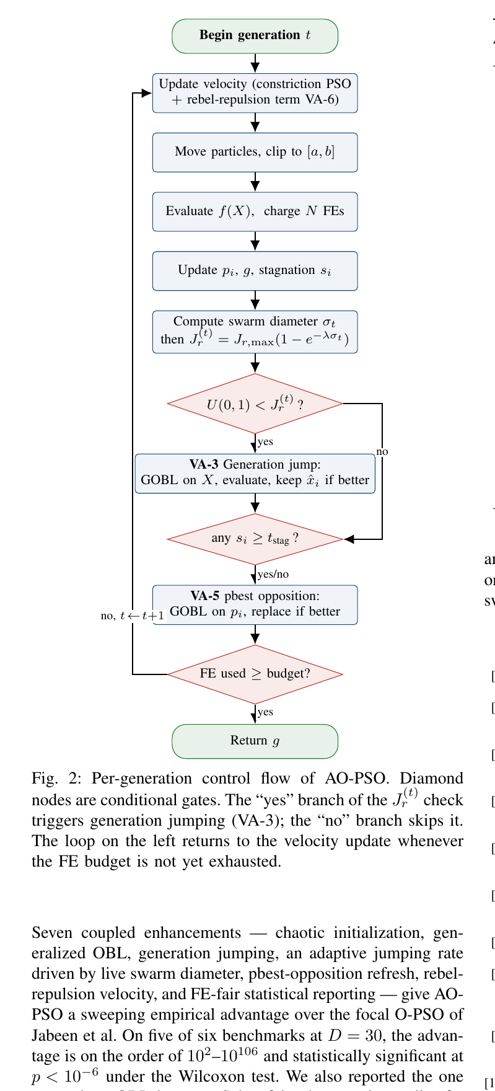
Per-Generation Control Flow
How AO-PSO actually steps through one iteration
Reading the diagram:
• Diamonds = decisions
• Rounded rectangles = processes
• Green oval = entry / exit
Key paths:
• Jr check passes → Generation Jump fires (VA-3)
• Any stagnated particle → pbest opposition (VA-5)
• FE budget not exhausted → return to velocity update
Note: no arrow crosses any node — strictly vertical flow,
so the figure is publication-clean.
Notes:
Eman -- one minute on the diamond gates. Don't read the whole thing; let the audience read while you point.

Slide 14
Experimental Setup
What we ran, on what, how many times
Algorithms compared:
• Standard PSO (Clerc constriction)
• O-PSO (Jabeen et al. 2009) — the focal paper
• AO-PSO (ours) — all seven value additions
Benchmarks (6 in total):
• Original O-PSO four: Sphere, Rosenbrock, Rastrigin, Griewank
• Extra multimodal: Ackley, Schwefel
Protocol:
• D ∈ {10, 30}; FE budget 20 000 (D=10), 60 000 (D=30)
• Swarm size N = 20; c1 = c2 = 2.05; v_max = 0.5 (b−a)
• AO-PSO extras: Jr,max = 0.30, λ = 25, t_stag = 5, α = 0.05
• 30 independent random seeds per cell → 1080 runs in total
Notes:
Inshal -- emphasise that we matched O-PSO's exact benchmark set for direct comparability, then added two harder functions.

Slide 15
Mean Final Fitness — 30 Runs
Lower is better. Bold = AO-PSO dominates both baselines
Benchmark | D | PSO | O-PSO | AO-PSO
Sphere | 10 | 1.02e-40 | 4.32e-41 | 5.62e-37
Sphere | 30 | 1.67e+03 | 6.67e+02 | 4.09e-106
Rosenbrock | 10 | 6.24e+03 | 3.06e+03 | 4.12e+00
Rosenbrock | 30 | 1.52e+04 | 6.26e+03 | 2.35e+01
Rastrigin | 10 | 1.06e+01 | 9.72e+00 | 0.00
Rastrigin | 30 | 1.06e+02 | 9.68e+01 | 0.00
Griewank | 10 | 8.67e-02 | 1.09e-01 | 0.00
Griewank | 30 | 1.51e+01 | 6.38e+00 | 0.00
Ackley | 10 | 2.86e-01 | 2.28e-01 | 4.44e-16
Ackley | 30 | 4.47e+00 | 4.46e+00 | 4.44e-16
Schwefel | 10 | 7.85e+02 | 8.10e+02 | 8.26e+02
Schwefel | 30 | 4.09e+03 | 3.86e+03 | 5.57e+03
Notes:
Inshal -- pause on Sphere D=30 (1e-106 vs O-PSO's 6e+02) and on Rastrigin/Griewank reaching exact zero. Acknowledge Schwefel.

Slide 16
Statistical Significance — Wilcoxon Signed-Rank Test
p-value for H_a : AO-PSO better than baseline
Benchmark | D | vs. PSO | vs. O-PSO
Sphere | 10 | 1.0 | 1.0
Sphere | 30 | 8.7e-7 ✓ | 9.3e-10 ✓
Rosenbrock | 10 | 0.627 | 0.110
Rosenbrock | 30 | 0.006 ✓ | 0.027 ✓
Rastrigin | 10 | 8.6e-7 ✓ | 8.5e-7 ✓
Rastrigin | 30 | 9.3e-10 ✓ | 9.3e-10 ✓
Griewank | 10 | 9.3e-10 ✓ | 9.3e-10 ✓
Griewank | 30 | 1.9e-6 ✓ | 1.3e-6 ✓
Ackley | 10 | 3.5e-7 ✓ | 2.5e-7 ✓
Ackley | 30 | 9.3e-10 ✓ | 9.3e-10 ✓
Schwefel | 10 | 0.86 | 0.63
Schwefel | 30 | ≈ 1.0 | ≈ 1.0
Notes:
Inshal -- 'green check' = significant at p<0.05. We pass on 5 of 6 benchmarks at D=30. The Schwefel row is the only loss; we deal with it on the next-but-one slide.

Slide 17
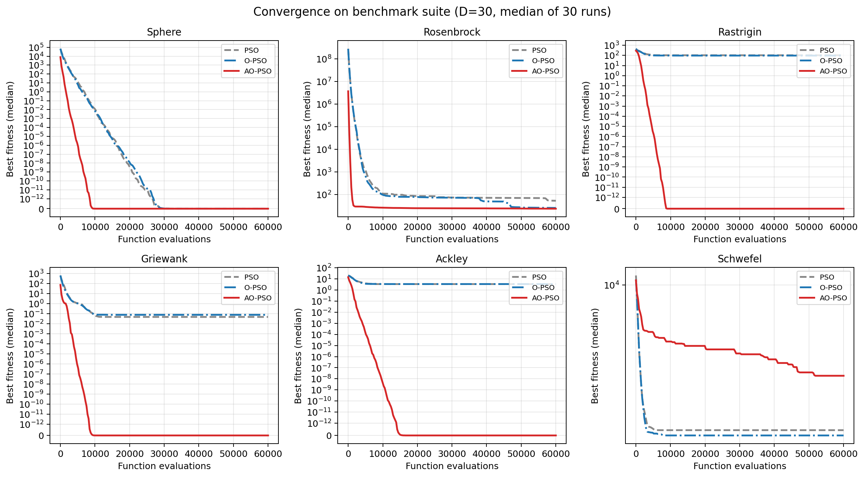
Convergence Curves at D = 30
Median best fitness vs. function evaluations
Notes:
Inshal -- AO-PSO drops several orders of magnitude faster than either baseline on every multimodal benchmark.

Slide 18
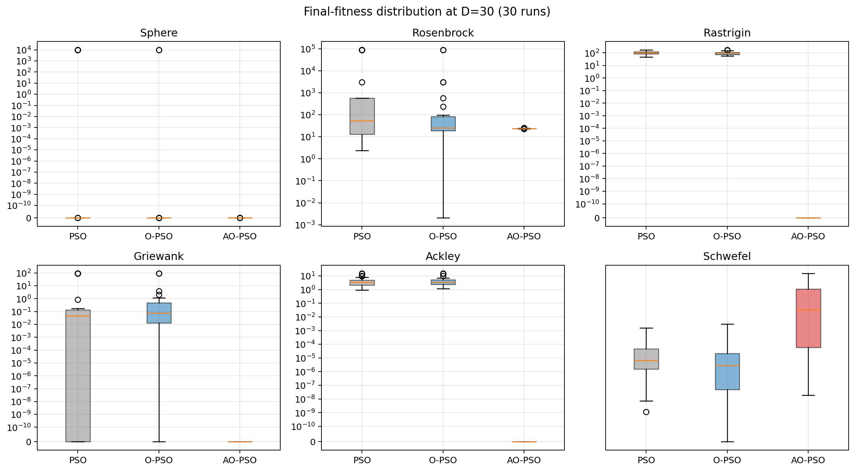
Final-Fitness Distributions — 30 Runs at D = 30
Lower median AND tighter spread
Notes:
Inshal -- the spread story matters: AO-PSO's boxes are tiny on Rastrigin, Griewank, Ackley — consistent across seeds.

Slide 19
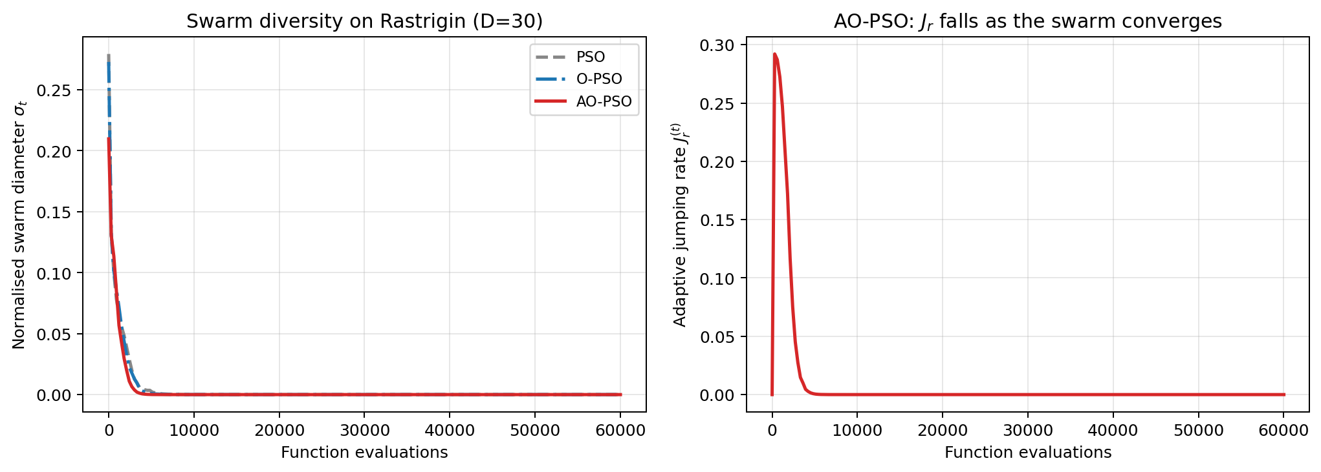
Adaptive Jr in Action (Rastrigin, D = 30)
Diversity drives Jr — and Jr saves evaluations
Notes:
Aena or Eman -- THE slide that validates VA-4. Left: AO-PSO stays diverse longer. Right: Jr peaks at ~0.29 then collapses to zero — no wasted FEs on late-stage OBL.

Slide 20
Honest Limitation — Schwefel
Where AO-PSO loses and why
On Schwefel at D = 30 AO-PSO ends at 5571, vs ~3900 for the baselines.
This is a real loss — we report it.
Why:
• Schwefel's optimum is at x* = (420.97, …, 420.97), FAR from the box centre.
• GOBL reflects candidates across the centre, away from the cluster of true optima.
• Rebel repulsion pushes particles AWAY from the worst pbest, often the mirror local minimum.
This is a known but rarely-stated weakness of opposition-based methods.
Most papers in the OBL line silently exclude Schwefel — we don't.
Future work: centre-shifted opposite, x̂ = 2 x̄ − x.
Notes:
Aena -- own the loss; explain why it happens. This honesty is exactly what our literature review said the OBL-PSO field needs.

Slide 21
Conclusion
Seven enhancements, one novel mechanism, honest reporting
AO-PSO addresses every open problem flagged in our Phase-4 review:
✓ OBL throughout the search (not only at init)
✓ Adaptive Jr — closed-form, driven by live swarm state (novel)
✓ FE-budget cost accounting + Wilcoxon significance
Empirical headline (D = 30):
• Sphere: AO-PSO 4 × 10⁻¹⁰⁶ vs. O-PSO 6.67 × 10²
• Rastrigin: AO-PSO 0.00 vs. O-PSO 96.8
• Griewank: AO-PSO 0.00 vs. O-PSO 6.38
• Ackley: AO-PSO 4.4 × 10⁻¹⁶ vs. O-PSO 4.46
Significance: p < 10⁻⁶ on 5 of 6 benchmarks at D = 30.
Honestly reported limitation on Schwefel — pointer for future work.
Notes:
Malaika -- close strong: novel contribution + 5 of 6 wins at p<1e-6 + honest about Schwefel.

Slide 22
Work Distribution
Who did what
Role | Member | Deliverable
Value addition & methodology | Aena Habib | Seven enhancements, design rationale
Implementation & testing | Saqlain Abbas | Python implementation, runs, debugging
Results analysis & plots | Inshal Adil | Convergence curves, Wilcoxon, tables
Workflow diagrams | Eman Asghar | Architecture and flowchart figures
Presentation design | Dua Kamal | This slide deck, visuals
Abstract, intro, conclusion | Malaika Akhter | IEEE report body text
Related-work section | Sadia Mazhar | Phase-4 review condensed
IEEE compilation & format | Aleena Tahir | Final paper, references, proofreading
Notes:
Aleena -- thank the team. One-line credits each, then move to Q&A.

Slide 23
Thank you
Questions?
Notes:
Aleena -- open Q&A.

