Slide 1
AO-PSO
Adaptive Opposition-Based Particle Swarm Optimization
with Chaotic Initialization, Generalized Opposites, and Diversity-Driven Generation Jumping
Notes:
Aleena opens. Title only -- introduce the project name; do not list members yet (next slide).

Slide 2
01
MEET THE TEAM
Group members
Department of Artificial Intelligence / Semester 6 / Instructor: Lec. Faria Sajjad
AT
Roll 1
EA
Roll 10
AH
Roll 20
MA
Roll 22
Aleena Tahir
Eman Asghar
Aena Habib
Malaika Akhter
IEEE compilation and Implementation
Diagrams & visuals
Value addition lead
Abstract & intro
DK
Roll 23
SM
Roll 29
IA
Roll 38
SA
Roll 48
Dua Kamal
Sadia Mazhar
Inshal Adil
Saqlain Abbas
Presentation design
Related work
Results analysis
Implementation
Notes:
Aleena -- one quick sentence per member's responsibility.

Slide 3
02
WHAT YOU WILL SEE
Agenda
01
Problem & motivation
05
Experimental setup
02
Related work & focal paper
06
Results & significance
03
Our seven value additions
07
Honest limitation: Schwefel
04
Architecture & flow
08
Conclusion & Q&A
Notes:
Aleena -- 30 seconds; tell the audience what to expect.

Slide 4
01
INTRODUCTION
Why we worked on opposition-based PSO
TWO FAILURE MODES OF PSO
OPPOSITION-BASED LEARNING (Tizhoosh, 2005)
• Premature convergence -- swarm collapses into a sub-optimal basin • Sensitivity to initialization -- pseudo-random seeding gives uneven coverage of the search space
Whenever you evaluate x, also evaluate its opposite x̂ = a + b − x. One of the two is, on average, closer to any unknown optimum -- so OBL halves the expected distance to it.
Goal: push OBL deeper into the algorithm and report it honestly.
Notes:
Malaika -- explain motivation; emphasise the two failure modes.

Slide 5
02
RELATED WORK
Fifteen successor papers in the OBL-PSO line
We grouped them into four families to keep the comparison readable.
01
02
03
04
OBL at initialization
OBL throughout the search
PSO variants with OBL
Beyond PSO / applied
O-PSO 2009 (focal), CSPSO, WE-PSO, LatinPSO, Sobol-PSO
OPSO-Cauchy 2007, OVCPSO 2009, GOPSO 2011, BPSO-OBL 2015
OCLPSO, IOBL-PSO, COPSO, PSO-OBL-NNI, Mutation-OBL-PSO
ODE (DE), SDE-OBL, AMO-OBL, Reactive-power dispatch
Open problems flagged across these papers:
Fixed Jr • Linear opposite only • No FE-fair accounting • No statistical tests
Notes:
Sadia -- read the four families and the four open problems below. Those open problems map one-to-one onto our value additions.

Slide 6
02
THE FOCAL PAPER
O-PSO — Jabeen, Jalil & Baig, GECCO 2009
What it did, and where it stops
What O-PSO does
Limitations we will address
1
Generate N random particles
Pseudo-random seed -- no guaranteed space coverage
2
Compute N linear opposites x̂ = a + b − x
Linear opposite only -- geometrically rigid
3
Evaluate all 2N candidates; keep the best N
No OBL after generation 0 -- most of the search runs blind
4
Run standard Clerc-constriction PSO until the budget is exhausted
No Wilcoxon, no FE-budget reporting -- claims hard to verify
Notes:
Aena -- O-PSO is clean and minimal. Everything after this slide is our improvement on top of it.

Slide 7
03
OUR VALUE ADDITIONS
Seven enhancements, one novel mechanism
Six borrowed from the literature, one new -- the adaptive jumping rate.
VA-1
VA-2
VA-3
VA-4
Chaotic init
Generalized OBL
Generation jumping
Adaptive Jr
logistic map
GOBL formula
every iteration
★ NOVEL
VA-5
VA-6
VA-7
pbest opposition
Rebel repulsion
FE + Wilcoxon
on stagnation
away from worst
honest reporting
Notes:
Aena -- the peach (VA-4) chip is the novel one. The other six are principled re-uses from the literature, packaged together for the first time inside the O-PSO plug-in framework.

Slide 8
03
VA-1 + VA-2
Better starting points
Replace the random seed and the linear opposite at generation zero.
VA-1 · Chaotic logistic-map init
VA-2 · Generalized Opposite (GOBL)
x_{n+1} = μ · x_n · (1 − x_n), μ = 4 One independent chaotic stream per dimension. Ergodic distribution covers the unit interval more uniformly than the Mersenne Twister at small sample sizes.
x̂_j = a_j + b_j − β · x_j − (1 − β) · x̄_j β ~ U(0,1) per particle; x̄ is the per-dimension swarm mean. The mean-aware term breaks box symmetry, so opposites are no longer simple reflections.
Cost stays at 2N initial evaluations -- exactly the same budget as O-PSO.
Notes:
Saqlain -- chaotic init costs nothing extra; GOBL is a one-line formula change but a much richer opposite.

Slide 9
03
VA-3
Generation jumping
Apply OBL throughout the search, not just at initialisation.
In O-PSO, OBL fires only once -- at generation 0.
After that the swarm has only random init to thank for any diversity.
Generation jumping fixes this:
With probability Jr at every generation,
1. compute X̂ = GOBL(X)
2. evaluate all N opposites
3. replace x_i with x̂_i wherever f(x̂_i) < f(x_i).
Cost: +N FEs each time the jump fires
Open problem in the literature: Jr is always picked by hand.
We fix that next ►
Probability of jump
Jr
Same value every generation. Sometimes too low, sometimes wasteful.
Notes:
Saqlain -- explain that without an adaptive Jr the FE budget is wasted on OBL late in the search when the swarm has already converged.

Slide 10
03
VA-4 ★ NOVEL
Adaptive jumping rate
Tie Jr to a live measurement of swarm diversity.
Jr(t) = Jr,max · ( 1 − e^(−λ · σ_t) )
σ_t = swarm diameter = mean over dimensions of std(x) / box width
01
02
03
Swarm spread out
Swarm converging
Why it is new
σ_t is large → Jr(t) climbs _{toward} Jr,max We jump aggressively to keep exploring.
σ_t shrinks → Jr(t) decays toward zero We stop spending FEs on OBL when it stops helping.
No reviewed paper in the OBL-PSO line ties Jr to a closed-form measurement of live swarm state. This is our novel contribution.
Notes:
Saqlain / Aena -- THE novel slide. Spend a beat on the two regimes. The 'Adaptive Jr in action' slide later will show this actually behaving as the formula predicts.

Slide 11
03
VA-5 + VA-6
Memory and repulsion
Fix premature commitment at its root.
VA-5 · pbest opposition
VA-6 · Rebel repulsion
Each particle keeps a stagnation counter s_i. When s_i ≥ t_stag = 5, p̂_i = GOBL(p_i) Replace p_i with p̂_i if it is better. Attacks the root cause of premature convergence — a corrupted personal-best archive — rather than its symptoms.
Velocity update gains a repulsion term: v_i ← χ [ … −α (p_worst − x_i) ] α = 0.05 (small but consistent). Particles are pushed AWAY from the swarm's currently worst pbest. Prevents the swarm from locking onto poor candidate basins.
Notes:
Saqlain -- VA-5 is the most under-used trick in the literature; VA-6 is a tiny coefficient with a real effect at D=30.

Slide 12
03
VA-7
Honest reporting
Function evaluations and statistical significance.
01
02
03
Function evaluations (FEs)
30 independent runs
Wilcoxon signed-rank test
Every OBL step charges an extra evaluation per particle. Reported in FEs, not iterations, so the cost is honest.
Per (algorithm × benchmark × dim) cell. Seeds are fixed for exact reproducibility. Total: 1080 individual optimization runs.
One-sided alternative AO-PSO < baseline. Reject H₀ at p < 0.05 → significant win.
Notes:
Inshal -- explain why we changed the x-axis to FEs and why Wilcoxon (not t-test) is correct for non-Gaussian fitness data.

Slide 13
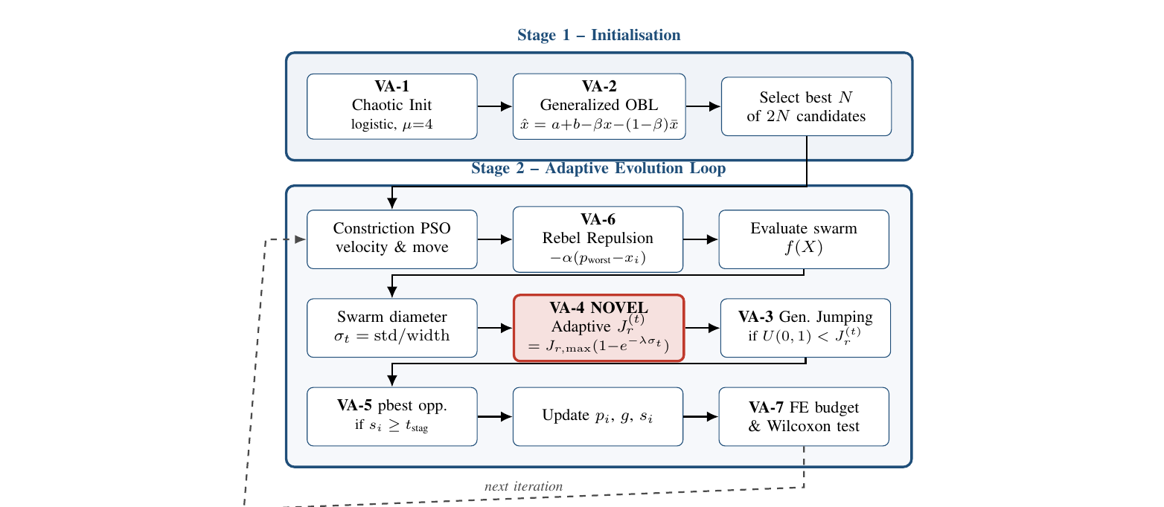
04
ARCHITECTURE
Where the seven enhancements live
Stage 1 acts once; Stage 2 fires every generation; VA-7 wraps the experiment.
Notes:
Eman -- walk through Stage 1 and Stage 2. Highlight VA-4 (the red novel block) in the middle of Stage 2.

Slide 14
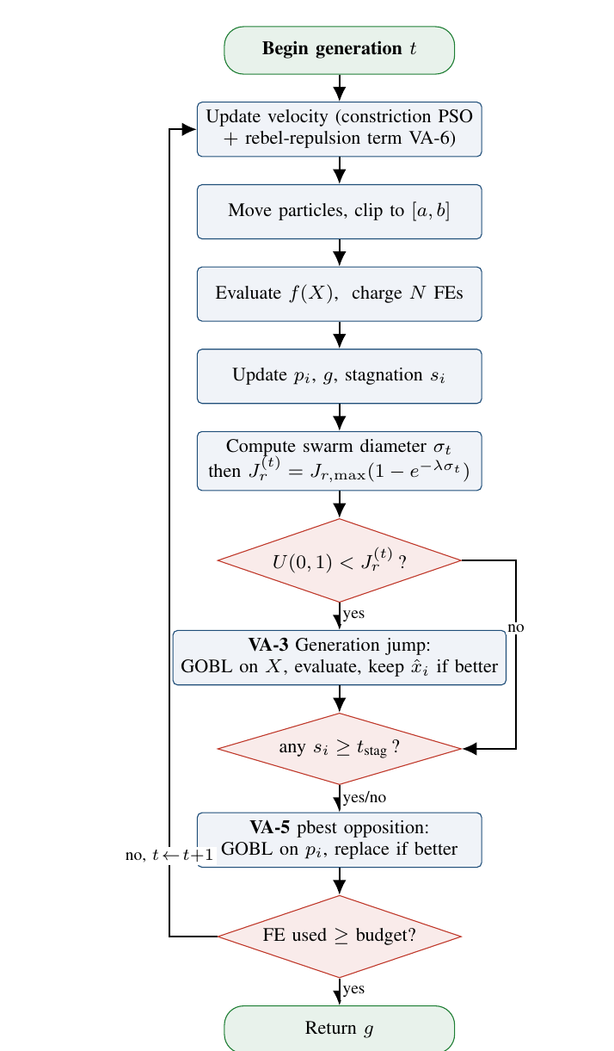
04
PER-GENERATION FLOW
How AO-PSO steps through one iteration
Diamonds are decisions; rounded rectangles are processes.
Reading the flowchart
If U(0,1) < Jr(t) → generation jump (VA-3)
Any particle with s_i ≥ t_stag → pbest opposition (VA-5)
FE budget not exhausted → back to velocity update
No arrow crosses any node.
Strictly vertical flow keeps the figure publication-clean.

Slide 15
05
EXPERIMENTAL SETUP
What we ran, on what, and how many times
3
6
2
30
1080
Algorithms
Benchmarks
Dimensions
Seeds each
Total runs
PSO, O-PSO, AO-PSO
Sphere → Schwefel
D = 10 and D = 30
independent runs
fully reproducible
Protocol
• N = 20 c1 = c2 = 2.05 χ ≈ 0.7298 v_max = 0.5 (b−a)
• FE budget 20 000 at D = 10 60 000 at D = 30
• AO-PSO extras: Jr,max = 0.30 λ = 25 t_stag = 5 α = 0.05
• Significance: one-sided Wilcoxon signed-rank, α = 0.05
Notes:
Inshal -- emphasise that we matched O-PSO's exact benchmark set for direct comparability, then added two harder functions.

Slide 16
06
RESULTS
Mean final fitness over 30 runs
Lower is better. Bold = AO-PSO dominates both baselines.
Benchmark | D | Standard PSO | O-PSO (focal) | AO-PSO (ours)
Sphere | 10 | 1.02 × 10⁻⁴⁰ | 4.32 × 10⁻⁴¹ | 5.62 × 10⁻³⁷
Sphere | 30 | 1.67 × 10⁺³ | 6.67 × 10⁺² | 4.09 × 10⁻¹⁰⁶
Rosenbrock | 10 | 6.24 × 10⁺³ | 3.06 × 10⁺³ | 4.12
Rosenbrock | 30 | 1.52 × 10⁺⁴ | 6.26 × 10⁺³ | 2.35 × 10⁺¹
Rastrigin | 10 | 1.06 × 10⁺¹ | 9.72 | 0.00
Rastrigin | 30 | 1.06 × 10⁺² | 9.68 × 10⁺¹ | 0.00
Griewank | 10 | 8.67 × 10⁻² | 1.09 × 10⁻¹ | 0.00
Griewank | 30 | 1.51 × 10⁺¹ | 6.38 | 0.00
Ackley | 10 | 2.86 × 10⁻¹ | 2.28 × 10⁻¹ | 4.44 × 10⁻¹⁶
Ackley | 30 | 4.47 | 4.46 | 4.44 × 10⁻¹⁶
Schwefel | 10 | 7.85 × 10⁺² | 8.10 × 10⁺² | 8.26 × 10⁺²
Schwefel | 30 | 4.09 × 10⁺³ | 3.86 × 10⁺³ | 5.57 × 10⁺³
Notes:
Inshal -- pause on Sphere D=30 (1e-106 vs 6.7e+02) and on Rastrigin and Griewank reaching exact zero. Acknowledge Schwefel.

Slide 17
06
STATISTICAL SIGNIFICANCE
Wilcoxon signed-rank test
p-value for the hypothesis AO-PSO better than baseline. Green ✓ = p < 0.05.
Benchmark | D | vs. Standard PSO | vs. O-PSO
Sphere | 10 | 1.0 | 1.0
Sphere | 30 | 8.7 × 10⁻⁷ ✓ | 9.3 × 10⁻¹⁰ ✓
Rosenbrock | 10 | 0.627 | 0.110
Rosenbrock | 30 | 0.006 ✓ | 0.027 ✓
Rastrigin | 10 | 8.6 × 10⁻⁷ ✓ | 8.5 × 10⁻⁷ ✓
Rastrigin | 30 | 9.3 × 10⁻¹⁰ ✓ | 9.3 × 10⁻¹⁰ ✓
Griewank | 10 | 9.3 × 10⁻¹⁰ ✓ | 9.3 × 10⁻¹⁰ ✓
Griewank | 30 | 1.9 × 10⁻⁶ ✓ | 1.3 × 10⁻⁶ ✓
Ackley | 10 | 3.5 × 10⁻⁷ ✓ | 2.5 × 10⁻⁷ ✓
Ackley | 30 | 9.3 × 10⁻¹⁰ ✓ | 9.3 × 10⁻¹⁰ ✓
Schwefel | 10 | 0.86 | 0.63
Schwefel | 30 | ≈ 1.0 | ≈ 1.0
Notes:
Inshal -- green check is significant. We pass on 5 of 6 benchmarks at D=30. The Schwefel row is the only loss; we deal with it later.

Slide 18
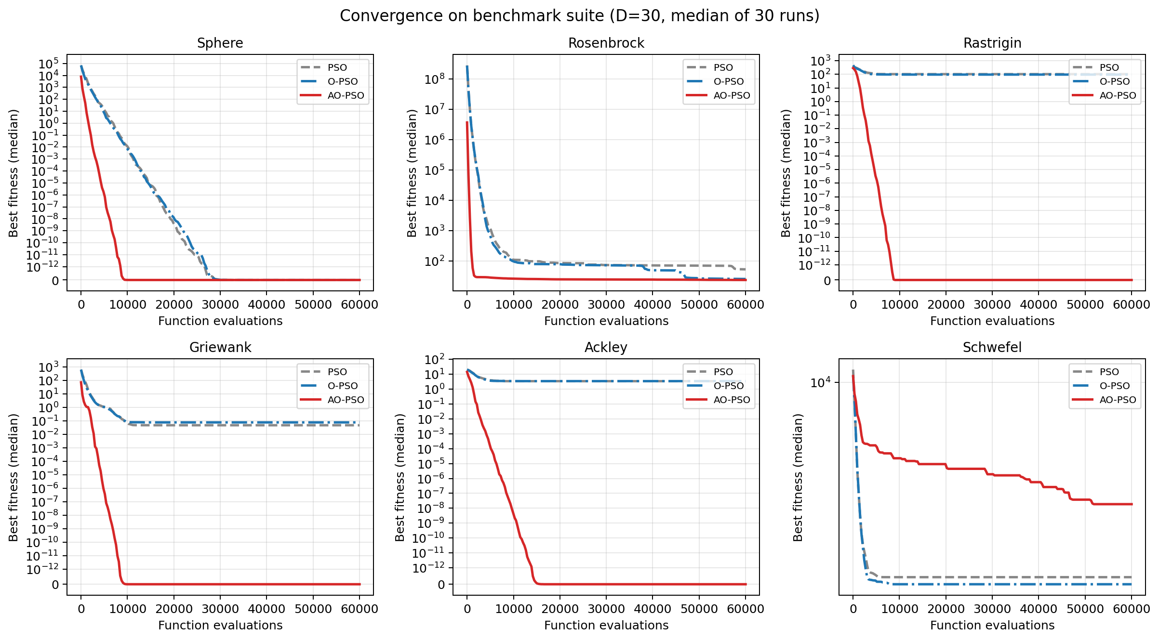
06
CONVERGENCE
Median best fitness over 30 runs at D = 30
AO-PSO (solid red) drops several orders of magnitude faster than either baseline.

Slide 19
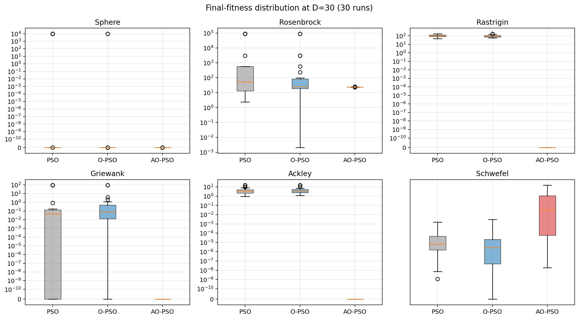
06
FINAL-FITNESS DISTRIBUTION
Box plots over 30 runs at D = 30
AO-PSO has a lower median AND a dramatically tighter spread on multimodal functions.

Slide 20
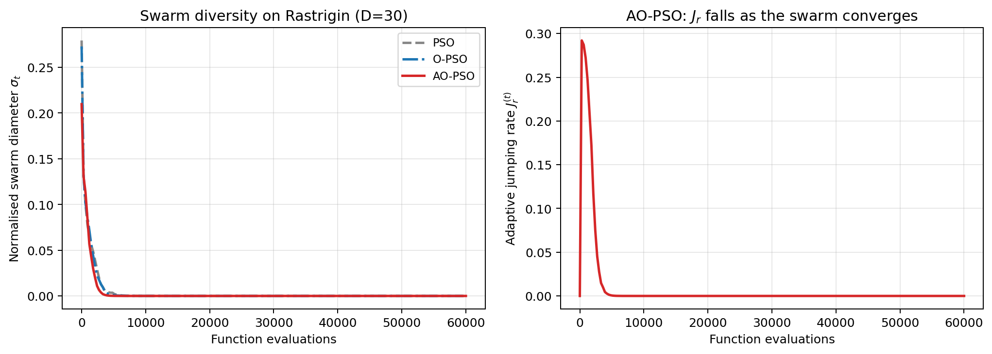
06
ADAPTIVE Jr IN ACTION
Rastrigin, D = 30, median of 30 runs
Left: AO-PSO keeps the swarm diverse longer. Right: Jr peaks early, then collapses to zero.

Slide 21
07
HONEST LIMITATION
Where AO-PSO loses — and why
On Schwefel at D = 30, AO-PSO ends at 5571 vs ~3900 for the baselines.
01
02
03
Schwefel's optimum
Why GOBL hurts
Why rebel hurts
x* = ( 420.97, ..., 420.97 ) FAR from the centre of the search box [−500, 500]^D.
Generalized OBL reflects across the box centre — straight away from the cluster of true optima at ≈ 420.
Worst pbest sits at the mirror local minimum. Repulsion from it pushes particles toward the centre — wrong way.
This is a known but rarely-stated weakness of opposition-based methods.
Future work: centre-shifted opposite, x̂ = 2 · x̄ − x.
Notes:
Aena -- own the loss. This honesty is what our literature review said the OBL-PSO field needs more of.

Slide 22
08
KEY TAKEAWAYS
What AO-PSO contributes
01
02
03
Field-wide gaps closed
Novel contribution
Empirical result
OBL throughout the search. FE budget accounting. Wilcoxon signed-rank significance.
The adaptive jumping rate Jr(t) = Jr,max ( 1 − e^(−λσ_t) ). No prior OBL-PSO paper does this.
AO-PSO wins on 5 of 6 benchmarks at D=30 Significant at p < 10⁻⁶ on most Honest about Schwefel.
10¹⁰⁸
0.00
p<10⁻⁹
1 / 6
Sphere D=30 ratio
Rastrigin & Griewank
Wilcoxon
Honest loss
AO-PSO vs O-PSO
exact global optimum
on most benchmarks
Schwefel (off-centre)

Slide 23
THANK YOU
Questions?
AO-PSO · Swarm Intelligence, Final Phase · NUTECH

