Slide 1
01 TOPIC
Adaptive Water Extraction
with Q Learning under Climate Stress
An agent based model in Python. Mesa framework.

Slide 2
TEAM
Group Members
01
Saqlain Abbas
02
Aleena Tahir
03
Aena Habib
04
Eman Asghar
05
Dua Kamal

Slide 3
AGENDA
Contents
01
The Problem and the Research Question
02
How the Model Works
03
Climate Scenarios and Experimental Design
04
Result 1. Tragedy Baseline
05
Result 2. Enforcement Saves the Stable Climate
06
Result 3. Why Enforcement Fails Under Stress
07
Primary RQ. Effect of Discount Factor
08
Sensitivity and Validation
09
Conclusions and Future Work

Slide 4
01 . CONTEXT
The Problem
Tragedy of the Commons meets a changing climate
• Twenty farmers share one river. Each season every farmer decides how much water to extract.
• If everyone extracts heavily, the resource collapses and everyone loses. Hardin (1968) called this the Tragedy of the Commons.
• Pakistan's Indus Basin supports over 90 percent of national agriculture and is one of the world's most water stressed basins.
• By 2030 nearly half the global population will live in regions of high water stress (UN World Water Development Report).
• Real farmers learn, observe neighbors, and adapt. Existing agent based models do not capture this learning.

Slide 5
01 . FOCUS
Research Question
PRIMARY QUESTION
How does the discount factor gamma in Q learning agents affect the emergence of sustainable water extraction strategies under varying climate stress scenarios?
SUB QUESTIONS
• Can Q learning agents discover cooperative strategies without external enforcement?
• How do learned strategies break down under sudden drought shocks, and how fast do agents re adapt?
• At what monitoring intensity does enforcement become unnecessary?

Slide 6
02 . MODEL
How the Model Works
Three stage step. Act, monitor, regenerate, finalize.
• Each irrigator chooses one of five extraction levels: 0, 25, 50, 75, 100 percent of max.
• Observed state. Water level bin, own previous action, neighbors average action, climate stress flag.
• Reward equals log utility of water extracted minus a sustainability penalty minus any fine.
• Shared resource follows logistic regeneration with a baseline inflow modulated by climate factor.
• Monitor agent catches over extractors with probability p detect and issues a fine.
• Social network is a random k regular graph. Each farmer observes k neighbors.
• Implemented in Python 3.12 with Mesa 2.3.4. About 700 lines of clear code.

Slide 7
02 . MATH
The Q Learning Update Rule
Watkins and Dayan, 1992. Tabular and interpretable.
Q(s, a) = Q(s, a) + alpha [ r + gamma . max Q(s', a') minus Q(s, a) ]
alpha is the learning rate. gamma is the discount factor. s' is the post regen state.
• Exploration uses epsilon greedy with exponential decay. Epsilon starts at 0.30, decays at rate 0.010.
• State space is small. About 150 unique state action pairs. Fits in a tabular Q table.
• Action 2 equals each agent's fair share of total sustainable yield. Auto scaled with N.
• Heterogeneity. Each agent has its own RNG and its own initial Q table noise.

Slide 8
03 . SCENARIOS
Climate Scenarios
Four climate factor profiles test resilience.
Scenario | Climate factor profile
Stable | c_f = 1.0 forever. Baseline. No climate change.
Gradual | c_f declines linearly from 1.0 to 0.5 over 400 steps.
Shock | c_f = 1.0 normally. Drops to 0.3 between steps 200 and 300.
Stochastic | c_f is gaussian noise around 0.85, clipped to [0.3, 1.0].
c_f multiplies BOTH logistic regeneration AND baseline inflow.
Lower c_f means less water replenished each season.

Slide 9
03 . EXPERIMENTS
Experimental Design
Three batch experiments totaling 340 runs.
Experiment | Variables | Runs
A. Tragedy baseline | 4 climates x 30 seeds. No monitor. | 120
B. With enforcement | 4 climates x 30 seeds. p detect = 0.3 | 120
C. Gamma sweep | stable and shock x 5 gamma x 10 seeds | 100
• Each run is 500 simulation steps. About 125 seasons if one step is one quarter year.
• Sensitivity analysis varies alpha, gamma, epsilon, regeneration rate, p detect, N by plus or minus 20 percent.
• Validation. Three sanity checks against Hardin 1968, Perolat 2017, Indus Basin 2022.

Slide 10
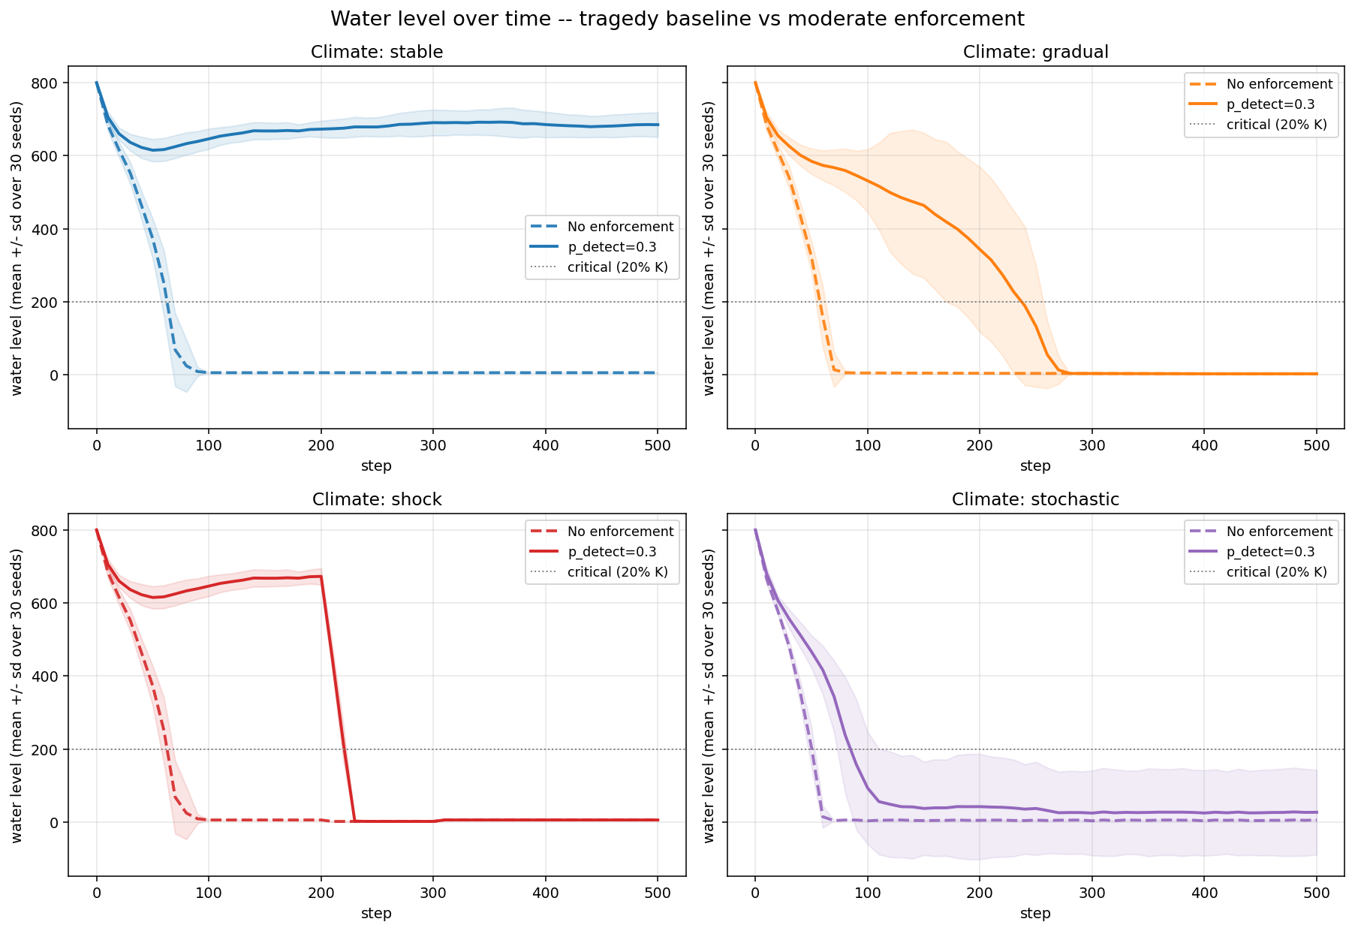
04 . RESULT 1
Tragedy Baseline
Without enforcement every climate collapses.
WHAT IT MEANS
• All four scenarios collapse to roughly 5 units of water within 80 steps.
• Mean payoff falls to between minus 755 and minus 804 per agent.
• Standard deviation across 30 seeds is effectively zero. Tragedy is deterministic.
• Reproduces Hardin (1968) at the population level.

Slide 11
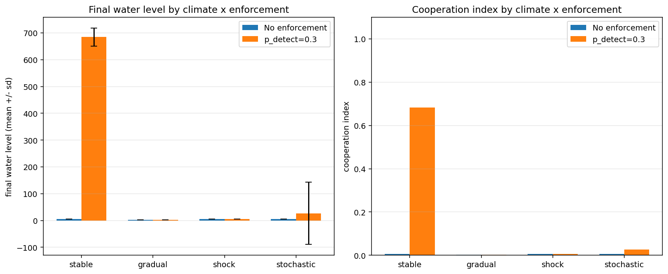
05 . RESULT 2
Enforcement Saves the Stable Climate
Moderate monitoring flips the dynamics.
WHAT IT MEANS
• Stable scenario. Water rises from 5 to 685. A 125 times improvement.
• Mean payoff turns positive. Minus 756 becomes plus 222 per agent.
• Eighty six percent of agents choose cooperative actions.
• Three other scenarios still collapse. See next slide for why.

Slide 12
06 . KEY FINDING
Why Enforcement Fails Under Stress
The fixed quota policy breaks when climate changes.
Even p detect = 0.9 cannot save the drought shock scenario.
p detect | stable. final water | shock. final water
0.3 | 700 | 5.6 (collapsed)
0.6 | 777 | 5.6 (collapsed)
0.9 | 787 | 5.6 (collapsed)
WHY IT HAPPENS (structural, not a tuning issue)
• Agents' five action grid is calibrated to baseline climate where c f = 1.0
• When c f drops to 0.3 during the shock, even the cooperative fair share action is over extraction.
• Sixty eight percent of agents are STILL choosing cooperative actions during failure. Not selfish.
• Implication. Real regulators need adaptive (climate aware) quotas. Fixed quotas are not enough.

Slide 13
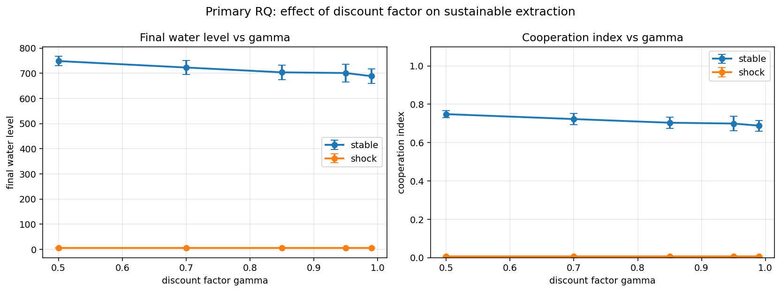
07 . PRIMARY RQ
Effect of the Discount Factor
Gamma sweep over stable and shock scenarios.
WHAT IT MEANS
• Stable scenario. Final water mildly DECREASES with gamma. From 748 down to 688.
• Shock scenario. Final water is identical at 5.55 across all gamma values.
• Surprising direction. Lower gamma is slightly better in stable climate.
• Refines the answer. Gamma is not the resilience knob. Action space matters more.

Slide 14
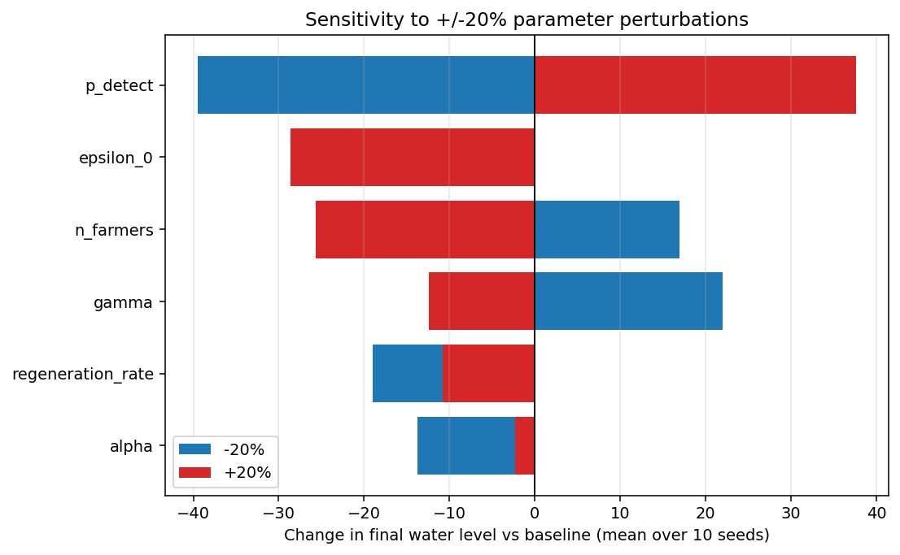
08 . SENSITIVITY
Sensitivity Analysis
Plus or minus 20 percent on six parameters.
WHAT IT MEANS
• p detect dominates. Plus or minus 38 units of final water.
• Epsilon zero and alpha are non monotonic. Baseline near local optimum.
• Gamma effect moderate. Regeneration rate small.
• Validates that p detect = 0.3 is a fair choice for headline runs.

Slide 15
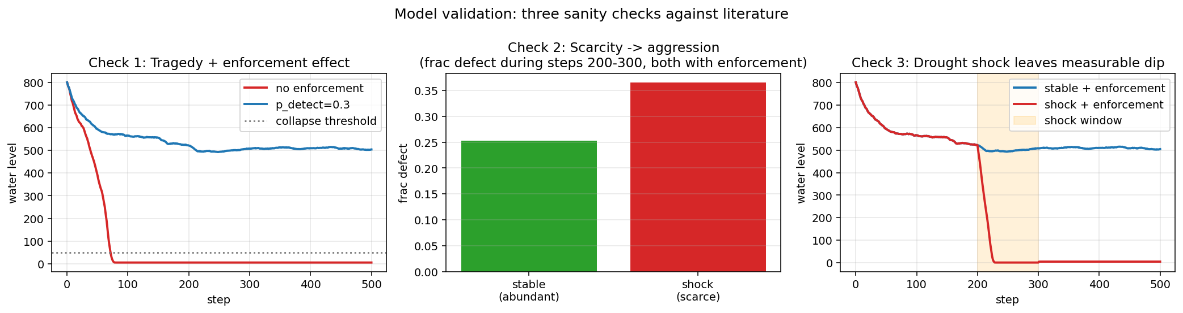
08 . VALIDATION
Validation Against Literature
Three sanity checks. All three pass.
# | Source | Test | Result
1 | Hardin 1968 | No enforcement should collapse. With enforcement under stable climate it should sustain. | PASS 5.6 vs 504
2 | Perolat et al 2017 | Scarcity should drive aggression. Compare frac defect steps 200-300, stable vs shock with enforcement. | PASS 25.3% vs 36.5%
3 | Indus Basin 2022 | A 70% drop in c f should leave a measurable dip in water level at step 300. | PASS 507 vs 1.5

Slide 16
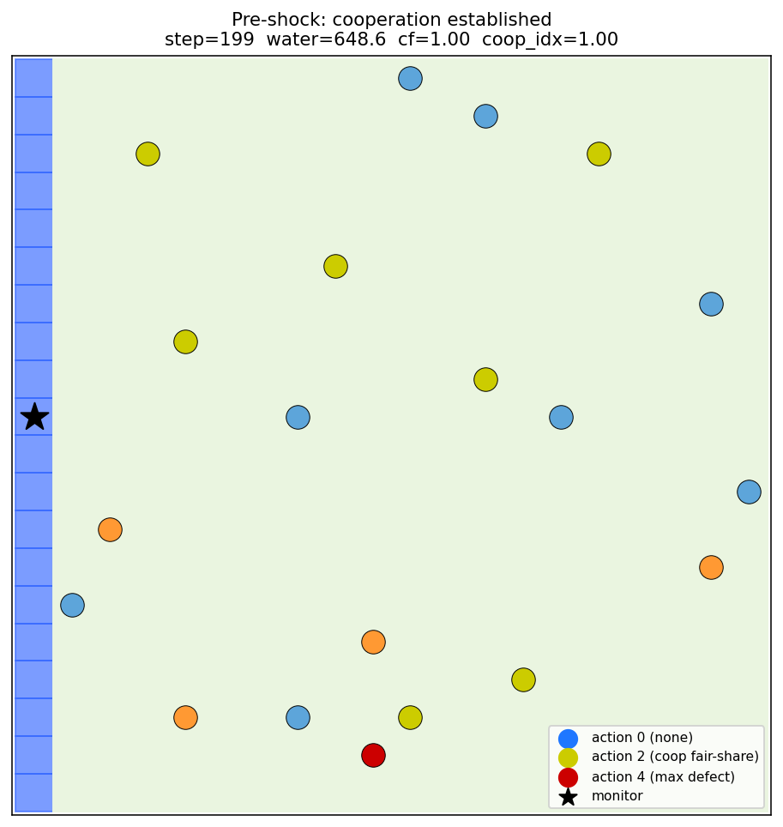
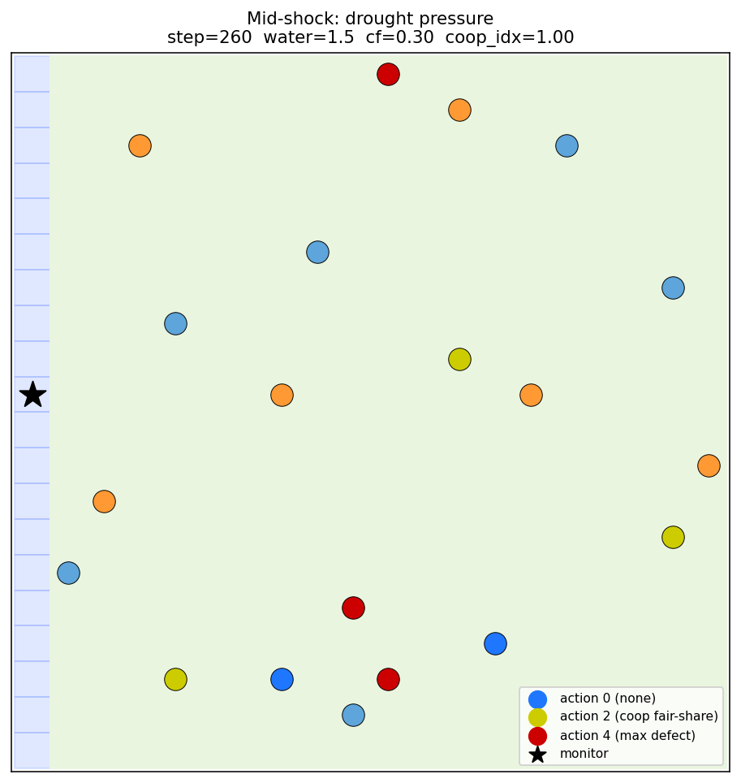
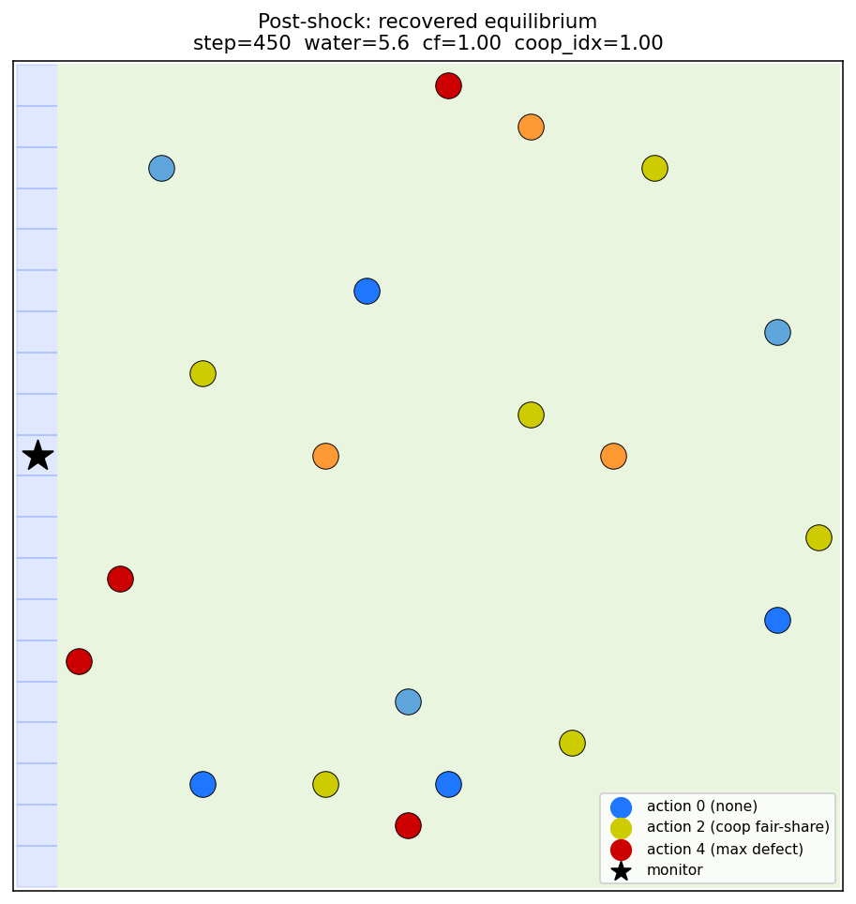
08 . EVIDENCE
Emergent Spatial Dynamics
Three snapshots from one shock scenario run.
Step 199. Pre shock cooperation
Step 260. Mid shock pressure
Step 450. Post shock equilibrium

Slide 17
09 . WRAP UP
Conclusions and Future Work
What we learned. What comes next.
FINDINGS
• Pure Q learners reproduce the tragedy of the commons in every climate scenario.
• Moderate enforcement at p detect = 0.3 saves cooperation under stable climate. Water rises from 5 to 685.
• The SAME enforcement fails under any climate stress. Even p detect = 0.9 cannot rescue shock.
• Gamma matters at the margins under stable climate but is dominated by climate dynamics under stress.
FUTURE WORK
• Continuous or adaptive action space so agents can scale extraction with current regeneration.
• Climate aware monitor that tightens the fair share threshold during droughts.
• Deep reinforcement learning extension. Comparison with human commons experiments.

Slide 18
Thank you

