Slide 1
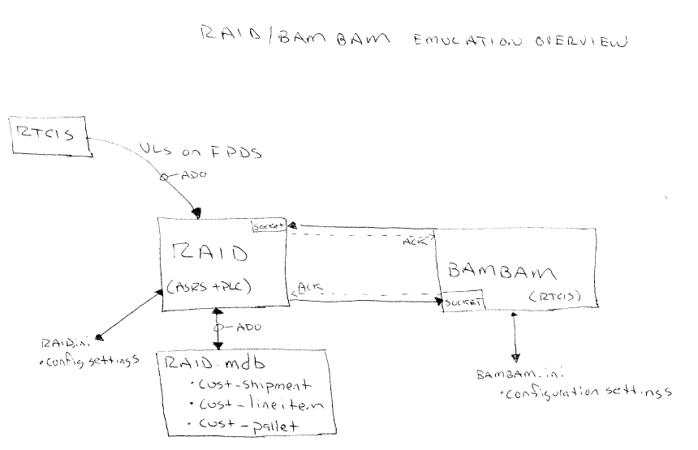

Slide 2
The Presentation

