Slide 1



“Quad-sched: A short-term CPU Schedular”

Slide 2

Introduction
The short-term scheduler picks ready processes for CPU execution.
MLFQ improves this by using multiple queues with different algorithms.
This report analyzes three different implementations of an MLFQ scheduler, each using a unique combination of algorithms

Slide 3


Goals
Design and implement a Multi-Level Feedback Queue (MLFQ) scheduler using different combinations of scheduling algorithms.
Evaluate and compare the performance of each implementation based on responsiveness, average wait time , turnaround time and CPU efficiency.

Slide 4
Scheduling Algorithms
RR - Round Robin
PS – Priority Scheduling
SRTF – Shortest Remaining Time first
SJF - Shortest Job First

Slide 5
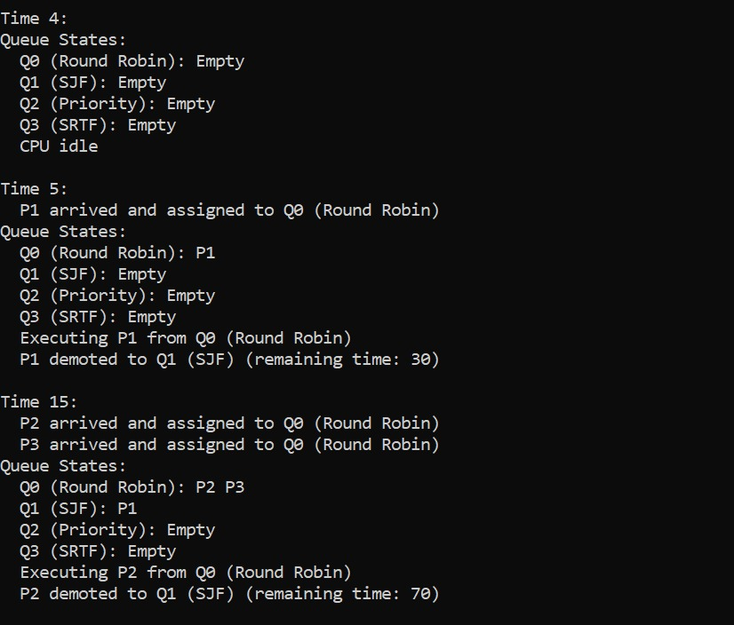
Methodology-I
Q0: Round Robin
Q1: SJF
Q2: Priority
Q3: SRTF

Slide 6
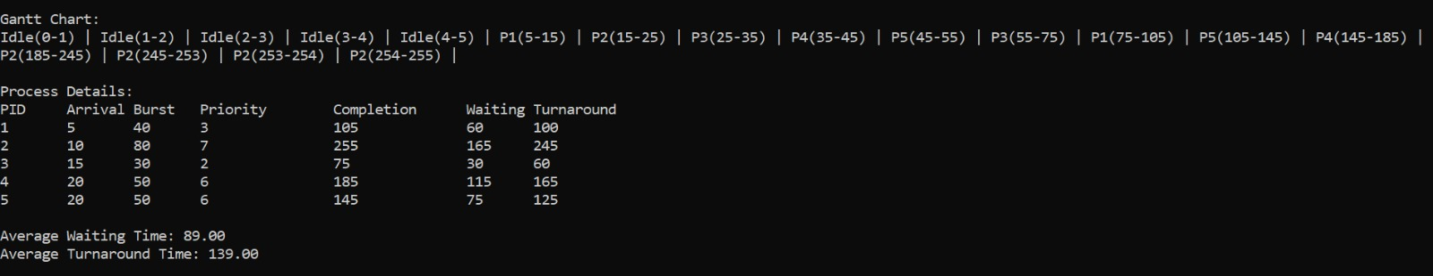
Gantt Chart for the approach - I

Slide 7
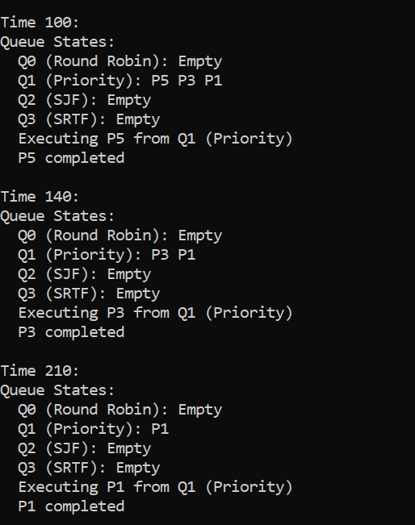
Methodology-II
Q0: Round Robin
Q1: Priority
(non-preemptive)
Q2: SJF
Q3: SRTF

Slide 8
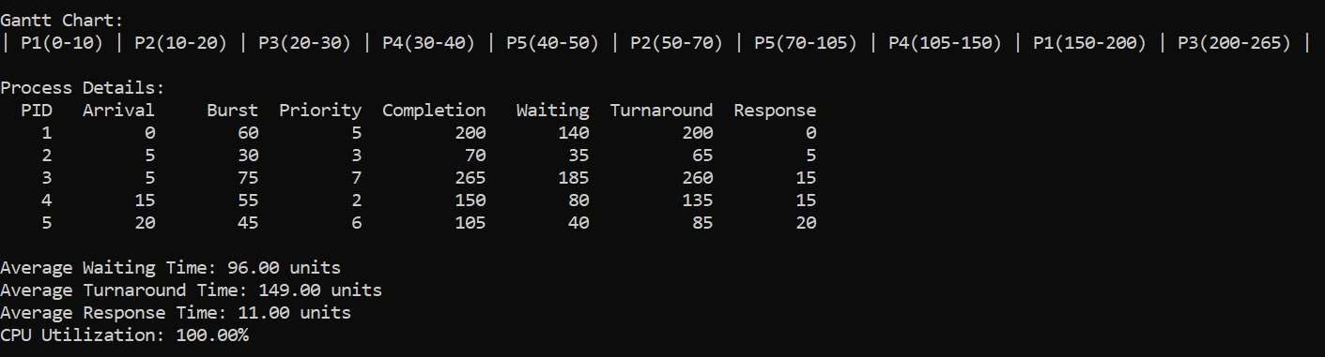
Gantt Chart for the approach - II

Slide 9
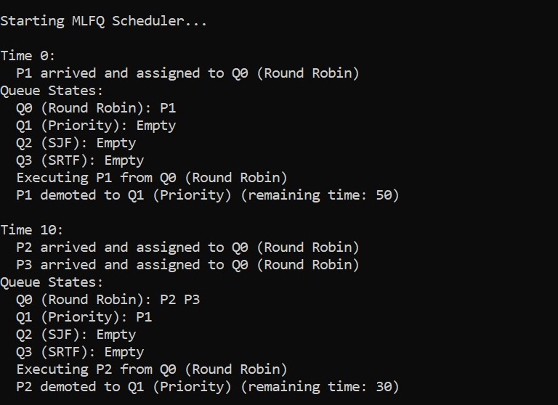
Methodology-III
Q0: Round Robin
Q1: Priority
(preemptive)
Q2: SJF
Q3: SRTF

Slide 10
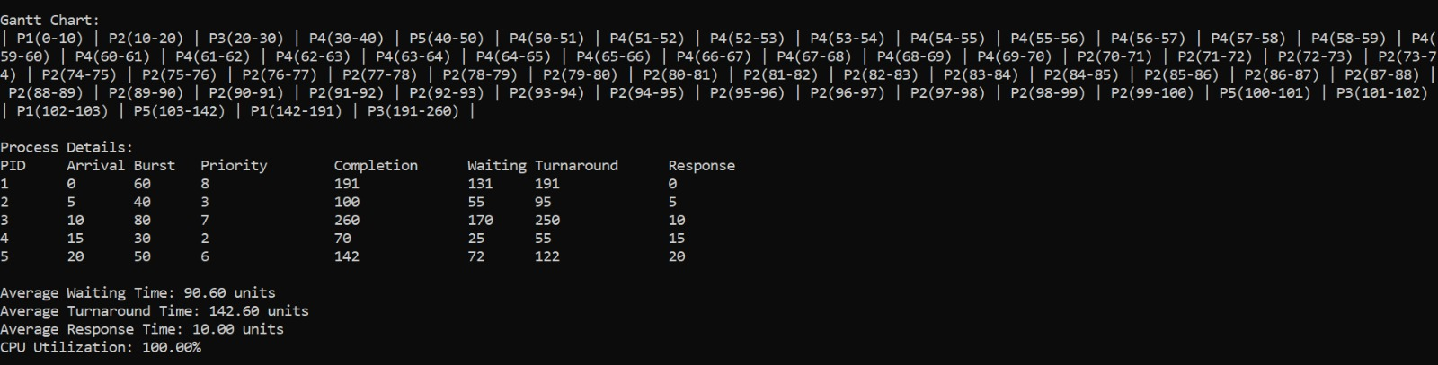
Gantt Chart for the approach - III

Slide 11
Results
Metric | Approach 1 | Approach 2 | Approach 3
Avg. Waiting Time | 89 units | 96 units | 90 units
Avg. Turnaround Time | 139 units | 149 units | 142 units
CPU Utilization | < 100% | 100% | 100%
Queue Utilization | Low Q2/Q3 use | Low Q2/Q3 use | Balanced

Slide 12
Conclusions
Among the three MLFQ implementations, Approach 3 proved to be the most balanced and effective.
It used preemptive Priority Scheduling in Q1, allowing dynamic handling of high-priority tasks while still making use of Q2 (SJF) and Q3 (SRTF).
This approach ensured better queue utilization, fairness, and responsiveness across all types of processes.

Slide 13
Thank you ☺

