Slide 1
CSE/MB620 · DEEP LEARNING WITH PYTORCH · COURSE PROJECT
Ask the model to write a digit
Digits on Demand: a class-conditional diffusion model, built and trained from scratch on MNIST — small on purpose.
Aleh Haiko · October 24, 2026 · submitted in absentia: this deck carries the full talk; the attached screen recording (2:12) shows the live run.
sample(label=3) → 3
WHAT I WOULD SAY
“Hi, I'm Aleh. My project is a small AI model that draws handwritten digits — and it draws the digit you ask for. You say 'seven', it draws a seven. Not from memory: a new seven every time, one that never existed before. Everything lives in one notebook and one Python file, and the recording shows it running live.”
Notes:
Hi, I'm Aleh. My project is called Digits on Demand. It's a small AI model that draws handwritten digits — and it draws the digit you ask for. You say 'seven', it draws a seven. Not from memory — it draws a new seven every time, one that never existed before. Everything you'll see is in this one notebook, and I'll run it live.

Slide 2
How I got to this idea
LoRA fine-tune of ViT
Char-level transformer
U-Net segmentation
Conditional diffusion · CHOSEN
Plant-disease classifier on a downloaded 86M-param backbone. Rejected: shows adaptation, not mechanism.
Train a tiny text model on my own corpus. Rejected: not visual enough for a live demo.
Oxford-IIIT Pet with a skip-connection ablation. Rejected: heaviest training of the four.
Small enough to build, train and understand end to end — and to run live without fear.
The deciding vote
The professor suggested this exact demo in class: “train a toy diffusion model, ask it to write a 3.” Diffusion is also the biggest single topic on the final — and the grading logic from the lectures: download-only earns a B, building your own earns more.
WHAT I WOULD SAY
“The project rules were short: the code must run — live. I looked at four ideas, and three of them lost to one question: what can I build end to end, understand completely, and run without fear? The professor had already suggested the answer in class. The choice made itself.”
Notes:
Origin story: rules (live code, grading logic download=B / build=more), four candidates, three rejections, professor’s in-class suggestion, diffusion = biggest final-exam topic.

Slide 3
One model, one narrow job
The task
Why small
The data
Generate handwritten digits on request: ask for a 3, get a 3. Diffusion — the course’s 20-point model — plus class conditioning.
A narrow-domain model trained end to end beats a grand plan that does not run. Under a quarter-million parameters; trains on a free Colab GPU in six minutes.
MNIST: 60,000 labeled digits, 28 × 28 grayscale. Labels come free — they become the condition, not a classification target.
Downloaded vs built
Downloaded: the dataset and a reference repo for comparison (TeaPearce/Conditional_Diffusion_MNIST). Built: AI-assisted code — read, verified, and edited by me; every design decision is mine to defend.
WHAT I WOULD SAY
“Plain diffusion generates an image; I needed the image you asked for — control, not just generation. That's the same problem Stable Diffusion solves with text prompts, scaled down to ten digit classes so one person can own the whole thing.”
Notes:
Problem = controllable generation, not MNIST. An image vs the image. Downloaded vs built and the AI-assisted formula are mandatory.

Slide 4
How it works
3
3·
···
noise
Add noise for T = 400 steps by a fixed schedule. No training here — the data labels itself.
Forward
noise
denoiser
predicts noise
3
The network’s only job: estimate the noise at step t, so it can be subtracted — step by step, 400 times.
Reverse
The digit label rides into every denoising step as an embedding — the same move that lets Stable Diffusion follow a text prompt, at 1/1000 the size.
Condition
WHAT I WOULD SAY
“In plain words: think of milk stirred into coffee — easy to mix, impossible to un-mix. Mixing here is adding noise to a picture until only static is left; that part is fixed. The network learns the way back — and at every cleaning step the label rides along, like a passenger telling the driver where to go. That's conditioning.”
Notes:
Forward is fixed, learning lives in the denoiser, conditioning = label embedding in every step.

Slide 5
What I built on top of the baseline
1 · Own denoiser
2 · Class conditioning
A compact U-Net written from the course material — downsampling, bottleneck, horizontal skip connections. 228,897 parameters.
nn.Embedding(10, d) for the digit label plus a sinusoidal timestep embedding, both injected into every U-Net stage.
3 · Guidance knob
4 · Measured, not estimated
Classifier-free guidance: labels are dropped 10% of the time in training; one slider at sampling trades variety for legibility.
Every number in this deck comes from the real run committed to the repo: training time, loss endpoints, sampling speed. No borrowed figures.
WHAT I WOULD SAY
“Four pieces: my own compact U-Net denoiser; the conditioning — a label embedding plus a timestep embedding, injected into every stage; classifier-free guidance, which buys me one knob at sampling; and honest numbers — everything here is measured on the real run, nothing borrowed.”
Notes:
Grade slide. From the downloaded repo: only a comparison baseline, none of its code.

Slide 6
Training: one line of loss
t = randint(0, T, (batch,))
x_t, noise = forward(x0, t)
loss = mse(model(x_t, t, label), noise)
loss, measured
1.105 → 0.040
Random timestep per image — the model sees every corruption level
The noisy input comes from a closed-form jump, not a 400-step loop
Adam, lr 1e-3, batch 256, 30 epochs on a free Colab T4
30 epochs · 348 seconds · T4
The start is no accident: predicting unit Gaussian noise blindly costs exactly 1.0 of MSE — everything below is learned signal.
WHAT I WOULD SAY
“Training is three lines: random timestep per image, noise it with the closed-form jump, mean squared error between predicted and true noise. The loss starts at exactly one — that's what blind guessing of unit noise costs — and landed at 0.040. Three hundred forty-eight seconds on a free Colab T4.”
Notes:
Q prep: closed-form forward jump via alpha-bar; no closed form for the reverse — hence iterative sampling.

Slide 7
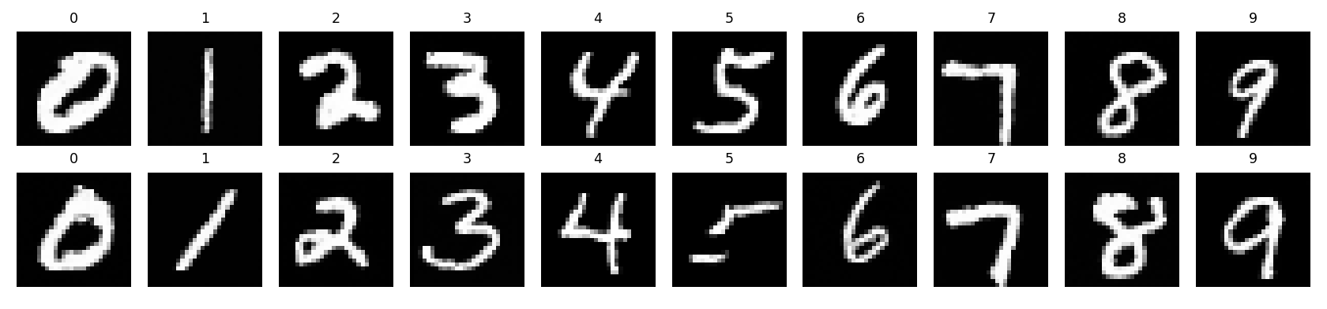
Results 1 of 3 — breadth: every class on request
samples_mnist.png, committed to the repo · generated right after training · every column is a requested class
10 / 10 classes render legibly
2 samples per class, no cherry-picking
0.23M parameters end to end
WHAT I WOULD SAY
“The model's own final exam: the moment training ends, the script asks it to draw two of every digit, zero through nine. Every column is a requested class — ordering works across the board.”
Notes:
Breadth. Grid committed to the repo; same file the README shows.

Slide 8
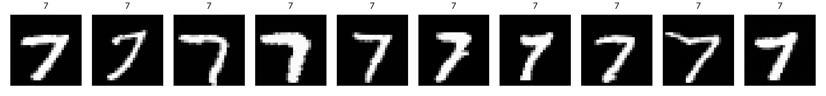
Results 2 of 3 — precision: one class, ten takes
sample(label=7) × 10 · default guidance · ≈ 5 s on the T4, ≈ 20 s on CPU
Ten different sevens — different slant, thickness, handwriting — because each one starts from its own random noise. None of them exists in MNIST.
WHAT I WOULD SAY
“One class, ten takes. They're all different — slant, thickness, handwriting — because each one started from its own random static. The model didn't memorize a seven; it learned what seven-ness looks like.”
Notes:
Precision. Generated from the committed checkpoint with the same one-file script.

Slide 9
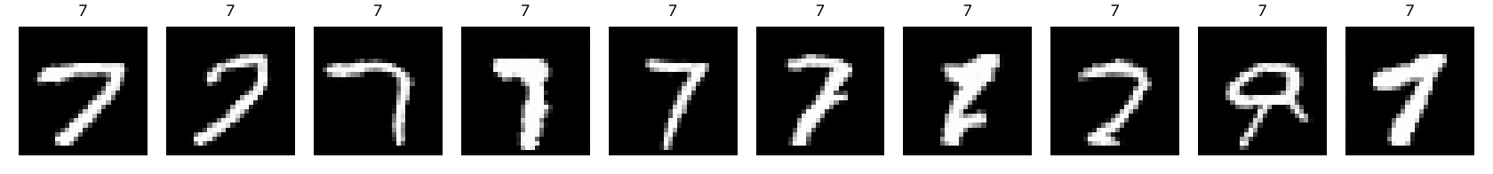
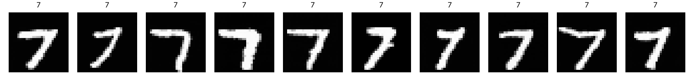
Results 3 of 3 — control: the guidance knob
guidance = 0 · variety (some barely readable)
guidance = 4 · legibility (textbook sevens, less variety)
WHAT I WOULD SAY
“In training I sometimes hid the label, so the model learned two skills: drawing what you ordered, and drawing something. Mixing them at sampling is the knob: zero — freedom; four — discipline. Variety versus legibility, the same trade-off Stable Diffusion exposes to its users.”
Notes:
Control. Same order (label=7), same checkpoint; only the guidance scale differs: eps = (1+w)*cond - w*uncond.

Slide 10
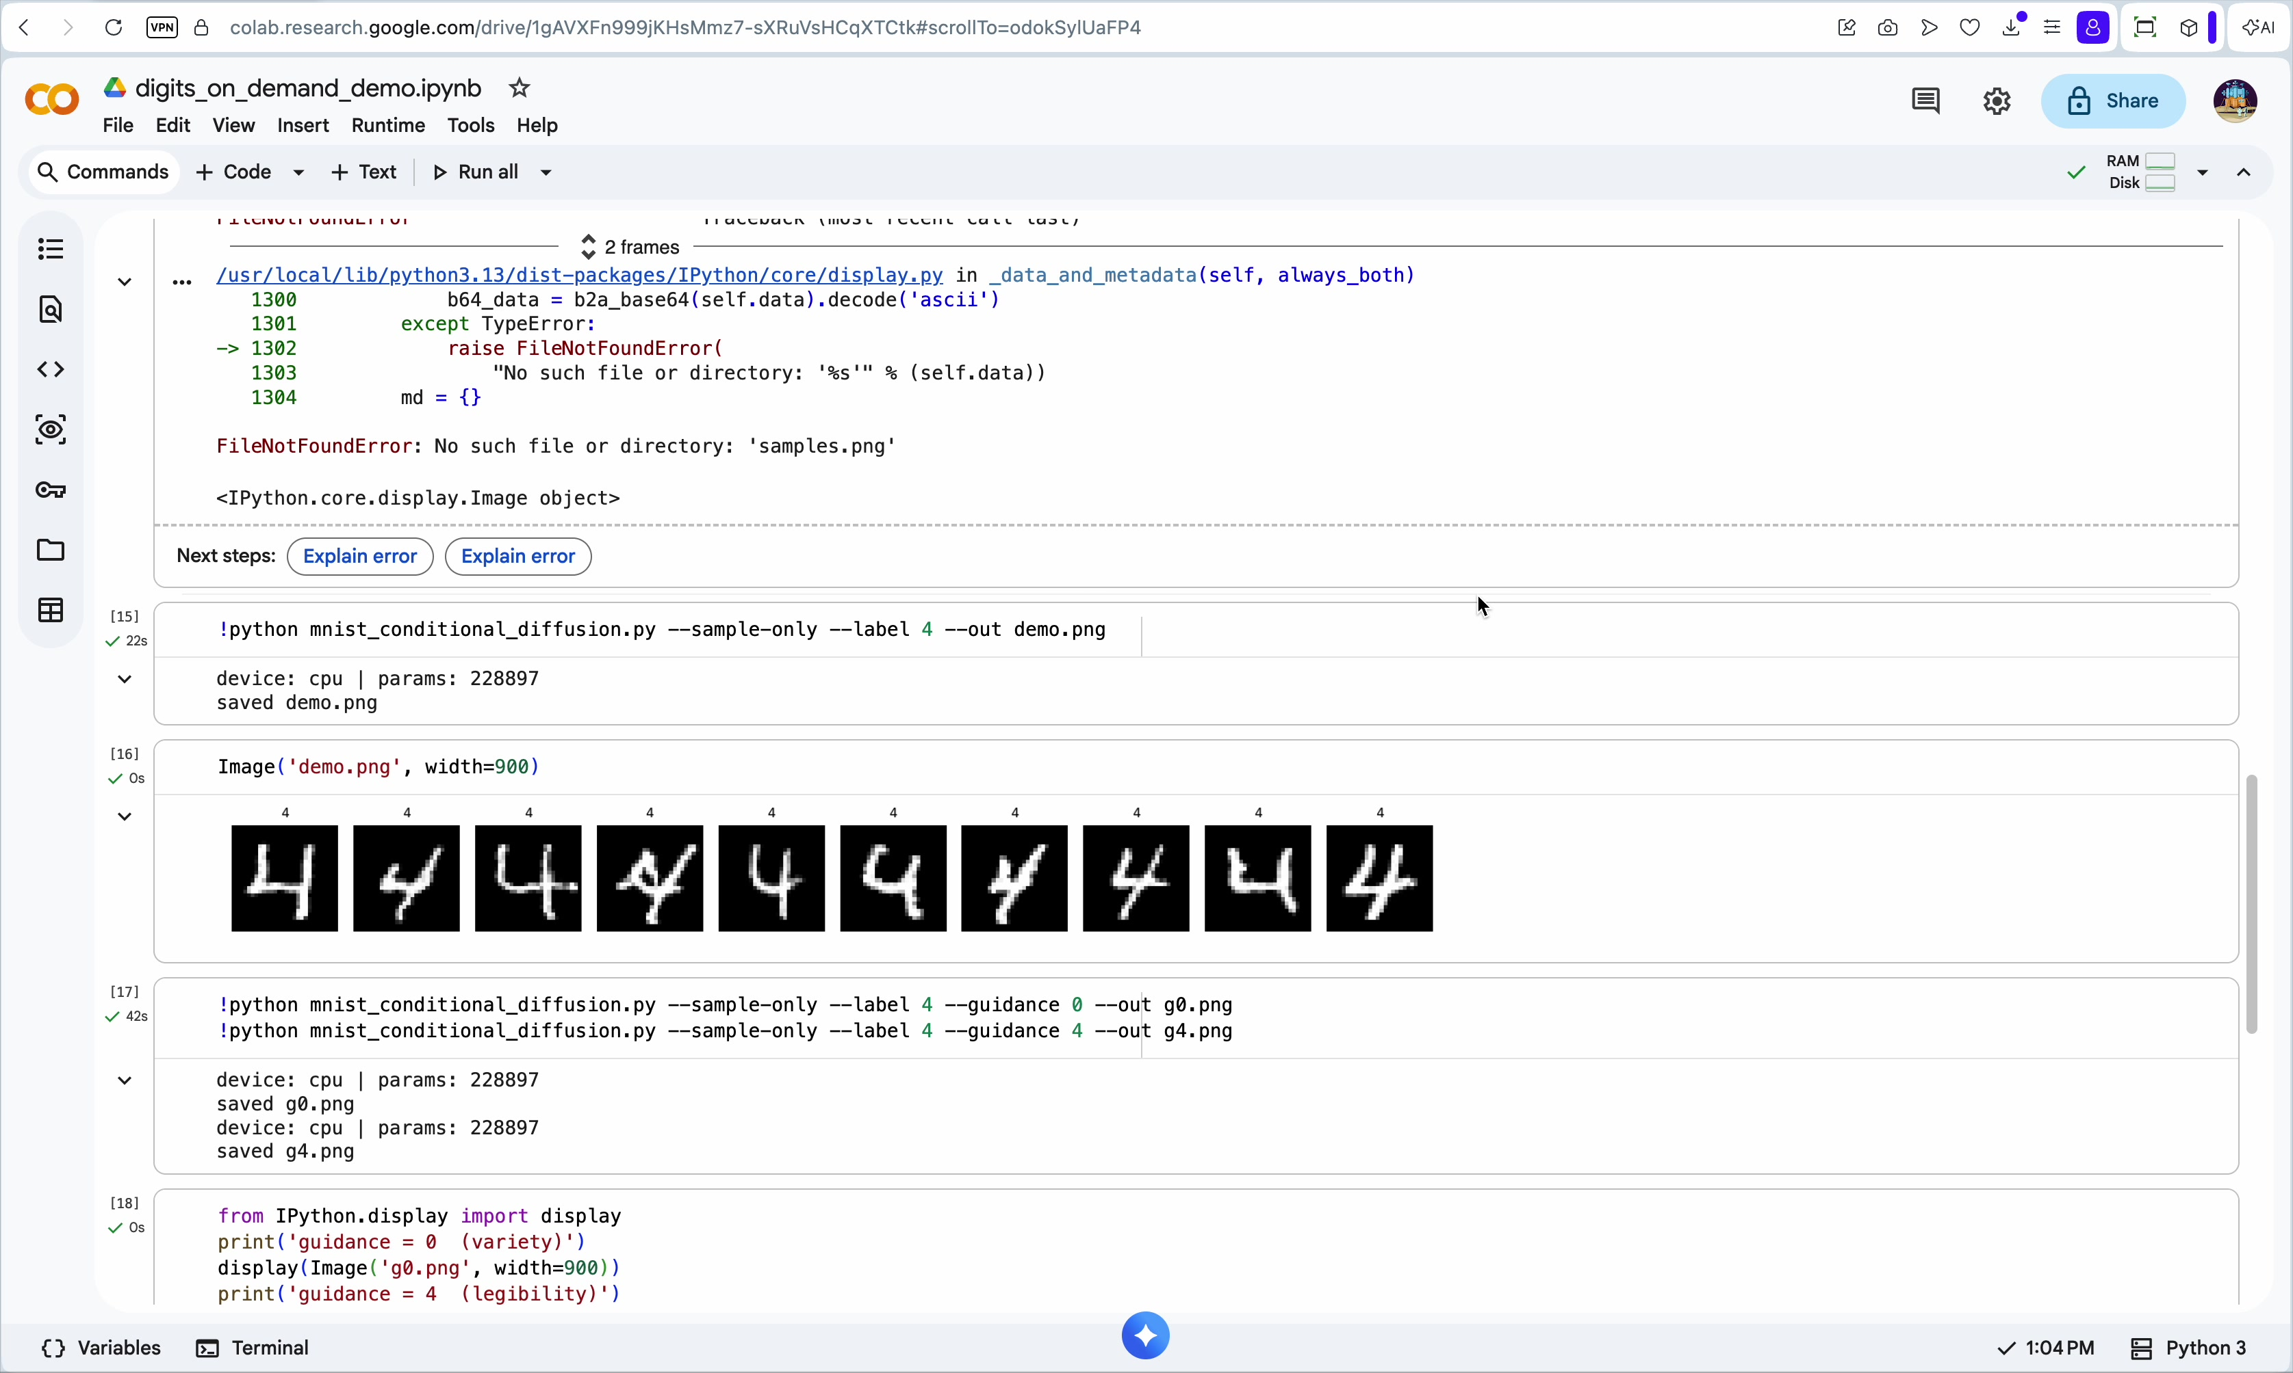
THE LIVE RUN, RECORDED
Screen Recording
2026-10-24 at 13.02.24.mov
2:12 · what it shows:
• label edited live to the requested 4
• ten fours generated ≈ 20 s (CPU)
• guidance 0 vs 4, same order
• full repeat path: clone → sample
CPU, not GPU: the free quota was spent training the model twice that morning — the 6-minute GPU training log is saved in the notebook.
Frame from the attached recording: the requested 4, generated and displayed in Colab.
WHAT I WOULD SAY
“This recording is the live part of the talk. A digit is requested — a four — I type it into the command, and the model draws ten new fours from pure noise. It runs on CPU here, about twenty seconds a batch instead of five: I burned through my free GPU quota training the model twice that morning. The run is fully repeatable from a fresh clone.”
Notes:
Demo evidence. Video attached in Classroom next to this deck; repeat path = clone, sample-only (checkpoint is committed).

Slide 11
Takeaways
What worked
Measured results
Next step
The whole diffusion recipe fits in one notebook: fixed forward process, noise-predicting U-Net, iterative sampling. Conditioning is one embedding away.
Loss 1.105 → 0.040 in 348 seconds; all ten classes render on request; 228,897 parameters end to end.
Swap the U-Net denoiser for a small transformer — the DiT move from class — and compare at equal parameter count.
Code, checkpoint and samples: github.com/AlehHaiko/digits-on-demand
Thank you
WHAT I WOULD SAY
“The whole recipe of modern image generators — noise it, learn to un-noise it, steer it with a label — fits in one file and trains on a free GPU in six minutes. Making it draw what you ask took exactly one extra ingredient: an embedding for the label. Thank you.”
Notes:
Close. Full spoken script also attached as colab_talk_en.md; Q&A answers are in it.

