Slide 1

Hello Again
Company Name
Date

Slide 2



The
Problem
Company Name
Date
Many isolated elders
Technology serves old, not young
Rural lag

Slide 3
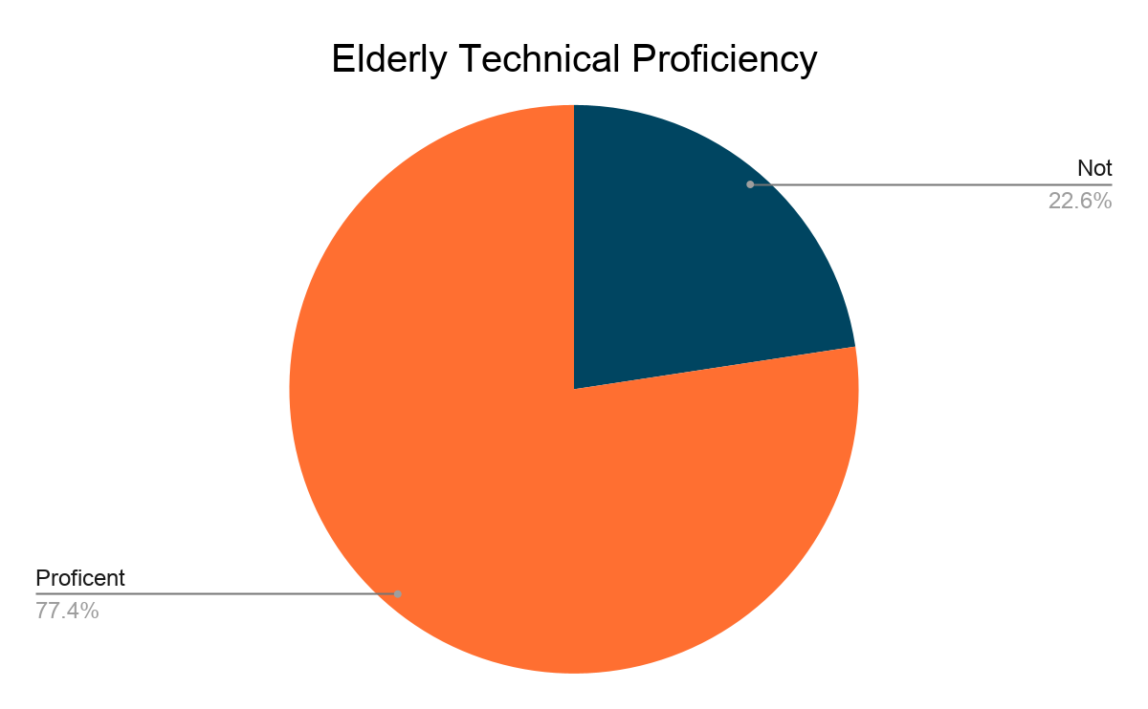
Why
Company Name
Date
Around 20% of Bulgaria's population lives in villages around the country.
5000
340–350
Villages
Average Population
1.7 million in rural areas

Slide 4
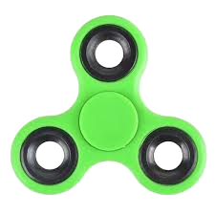
The Goal
Company Name
Date
Help old people connect
Bridge modern tech with seniors
Provide easier accessibility to applications

Slide 5
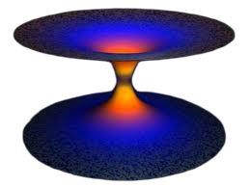
Solution
Date
Voice instead of movement
Complete control over application via audio
Networking
Personality and interest based connections
Intuitive UI
Fluid interface adapted to personal desire
Tailored for elders
Multiple specialized features made for seniors

Slide 6
DEMONSTRATION

Slide 7
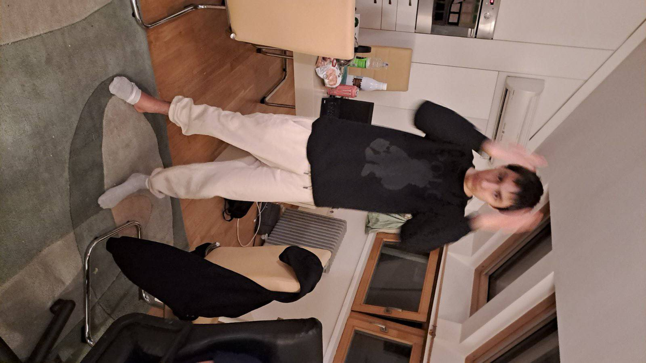
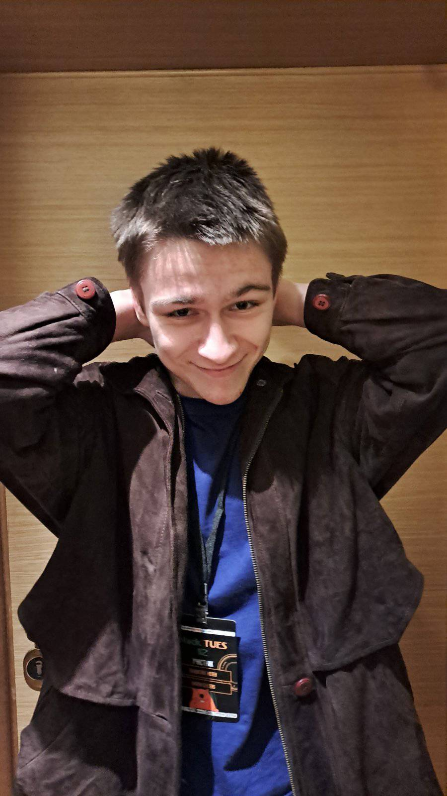
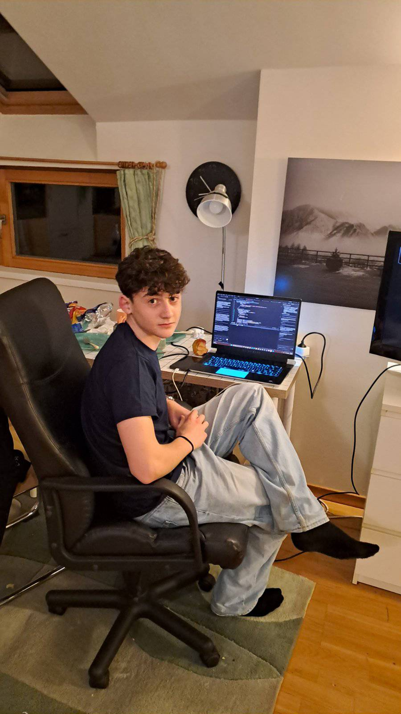
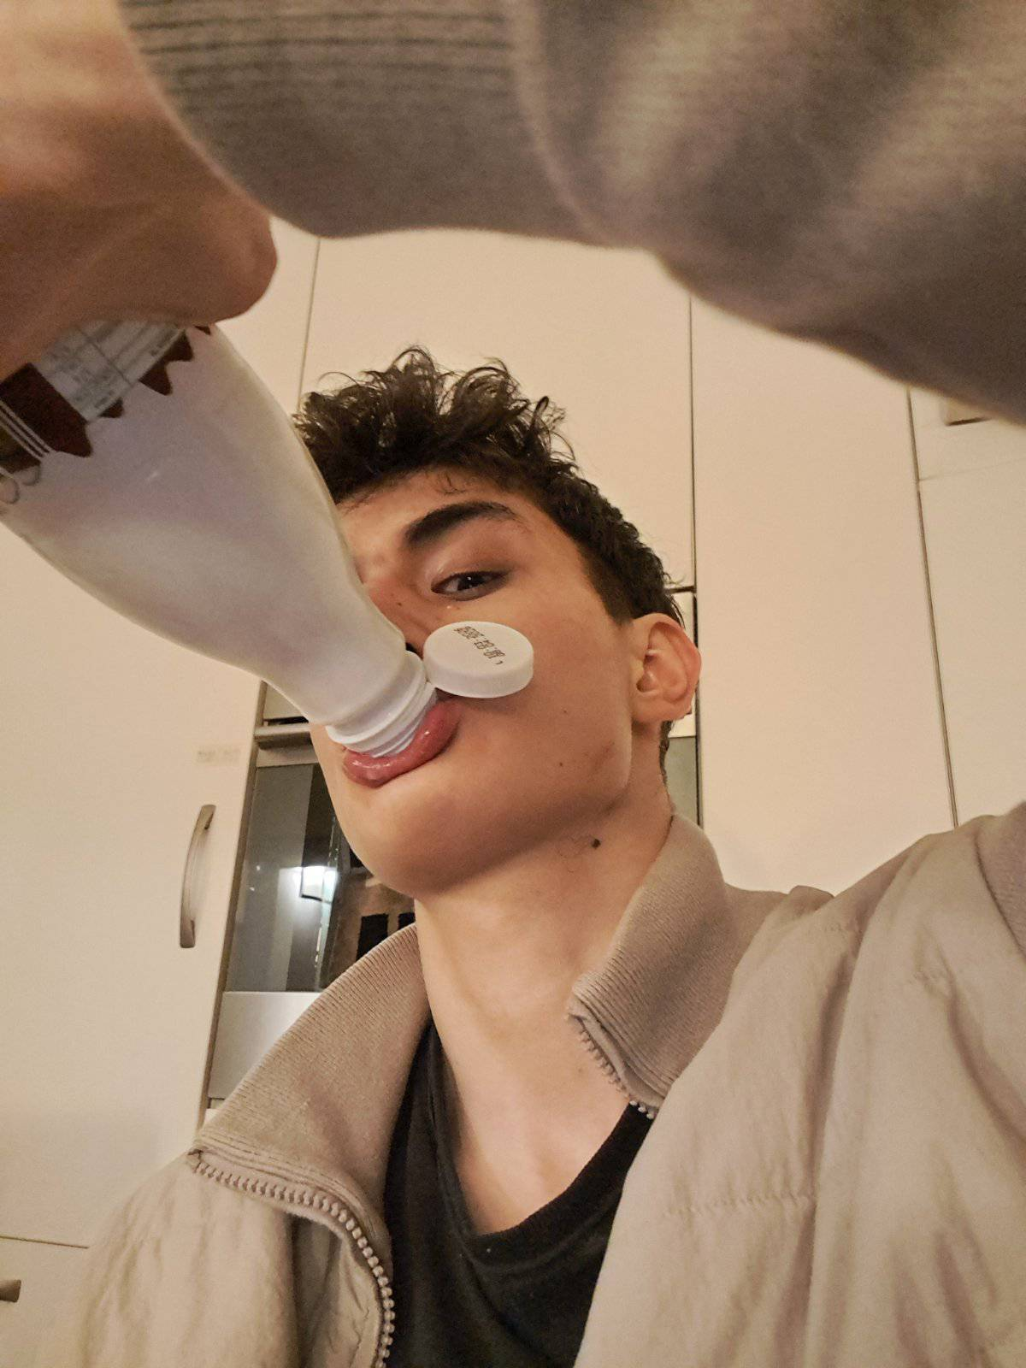
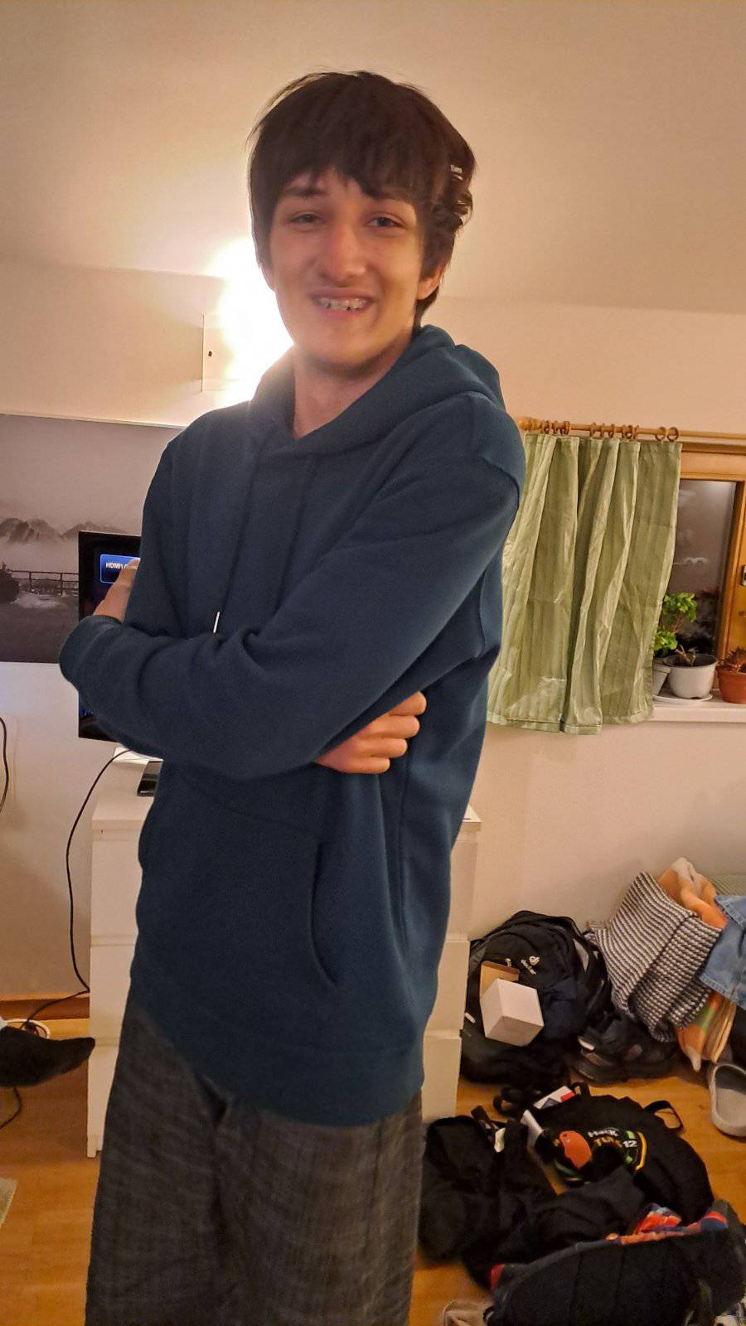
Ekipa
Company Name
Date
Ekipa
Full Name
Title
Full Name
Title
Full Name
Title
Full Name
Title
Full Name
Title
Full Name
Title

Slide 8



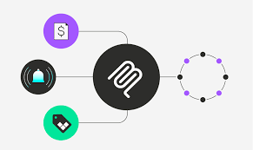

AI Stack
Date
Torch
PostGRE
ChatGPT
Google Cloud
Slide 00

Slide 9



Tech Stack
Date
Django
Flutter
Kotlin
Cloud Console

Slide 10
Thank you

