Slide 1
Fraud Alert
Vulnerability
Analytical dataset quality, coverage, and modeling readiness
Exploratory Data Analysis
Polished report — version 2
Scope
Validate analytical population, outcome integrity, and temporal coverage
Review source history, credit exposure, missingness, raw distributions, and point-in-time controls
Do not assess model performance or feature importance in this report
READY FOR FEATURE VALIDATION
Prepared for Data Science review

Slide 2
Analytical Dataset at a Glance
One-party analytical population with complete 12-month behavioral panels.
688,589
62,599
625,990
48
Unique analytical parties
Positive observations
Negative observations
Consecutive observation months
12
8.26M
98.05M
0
Analytical behavior months / party
Party-month observations
Underlying trade records
Point-in-time violations
Interpretation note: the 9.09% sample event rate reflects the analytical sampling design and should not be interpreted as population prevalence.
Dataset is large enough for robust descriptive review and subsequent modeling work.
Behavioral history has exactly 12 analytical months per party.
Underlying trade extraction passed point-in-time validation.
EDA Report · Version 2 polished · 1
Sample event rate reflects analytical sampling; not population prevalence.

Slide 3
Cohort and Outcome Integrity
The analytical unit and label definition pass basic and temporal consistency controls.
COHORT UNIT
OUTCOME INTEGRITY
Unique party = analytical row
PASS
Positive without qualifying alert
0
Duplicate party rows
0
Positive alert ≤ observation date
0
Null party IDs
0
Positive alert outside 3m horizon
0
Null observation dates
0
Negative with alert inside horizon
0
Null labels
0
Outcome horizon violations
0
Invalid labels
0
Takeaway: the cohort has a clean one-party/one-observation structure and the target respects the future 3-month horizon for every observation.
EDA Report · Version 2 polished · 2
Sample event rate reflects analytical sampling; not population prevalence.

Slide 4
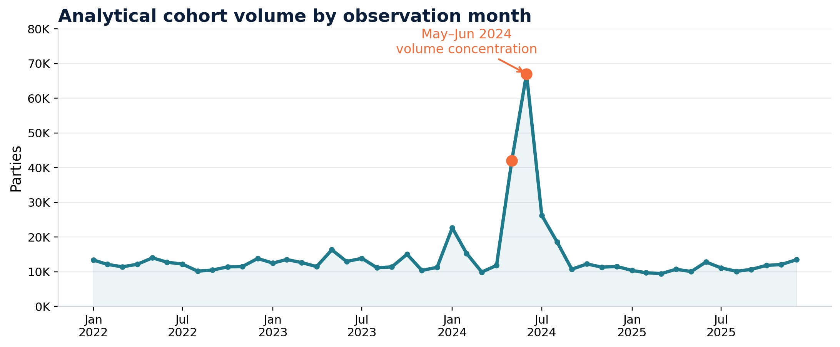
Continuous Calendar Coverage
48 consecutive month-end observation dates with no calendar gaps.
Key point: cohort volume is not uniform over time. May–June 2024 is a material concentration and should be considered when interpreting aggregate statistics.
EDA Report · Version 2 polished · 3
Sample event rate reflects analytical sampling; not population prevalence.

Slide 5
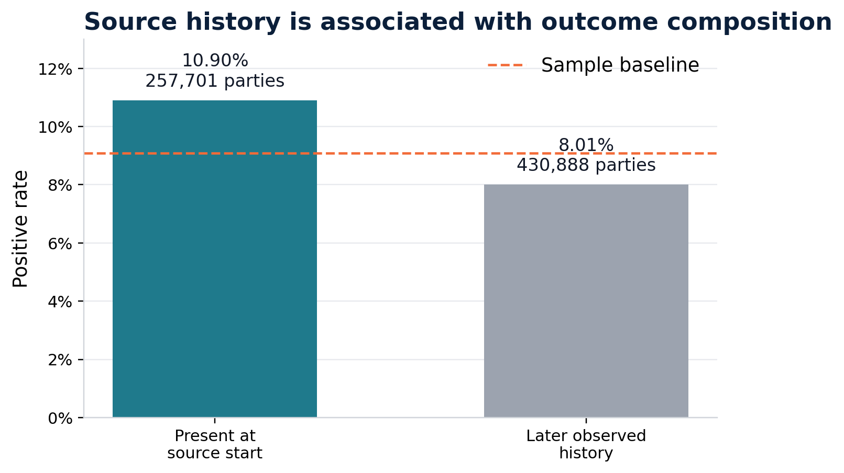
Source History and Left-Censoring
Available data history is not the same as true customer tenure.
37.43%
257,701
present at source inception
source-start parties
10.91%
8.01%
source-start positive rate
later-history positive rate
Caution: person_restricted.data_date reflects source availability / loading history, not customer relationship start date. True tenure is not directly available from this source.
EDA Report · Version 2 polished · 4
Sample event rate reflects analytical sampling; not population prevalence.

Slide 6
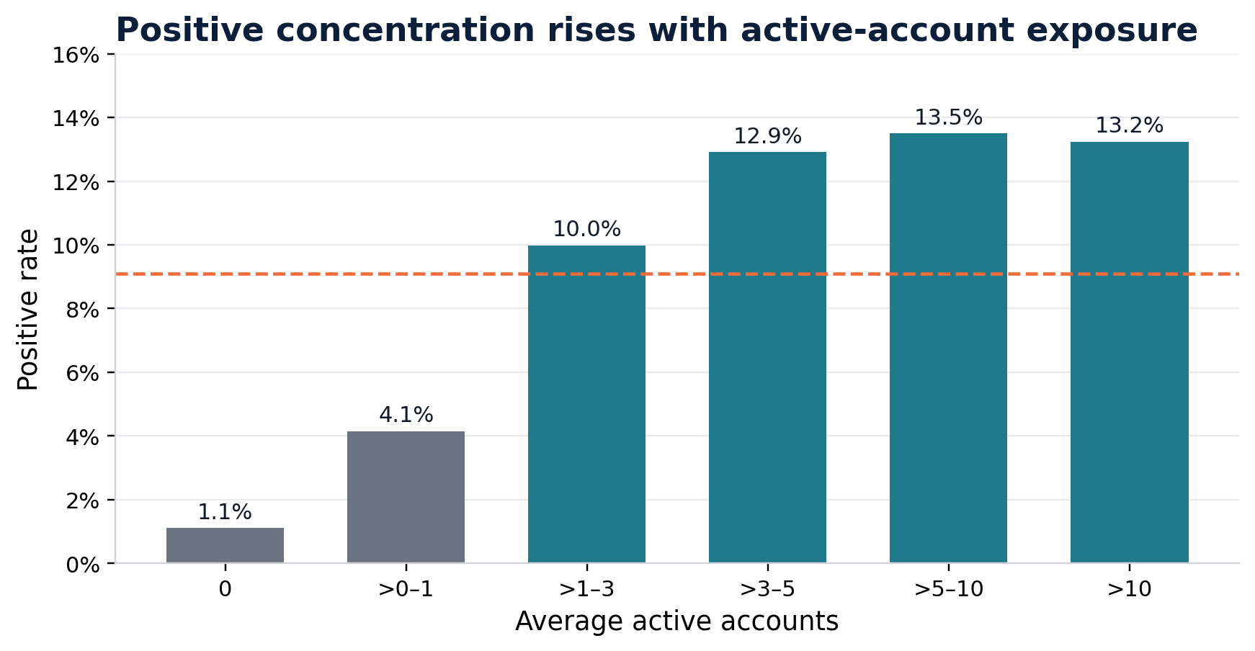
Credit Exposure Differs Materially Across Groups
Positive observations have deeper observable credit files.
3.53
5.04
avg active accounts · Negative
avg active accounts · Positive
16.09%
1.80%
zero active all months · Negative
zero active all months · Positive
Interpretation: positive concentration increases quickly from thin/no-active-file groups and then plateaus around 3+ active accounts.
EDA Report · Version 2 polished · 5
Sample event rate reflects analytical sampling; not population prevalence.

Slide 7
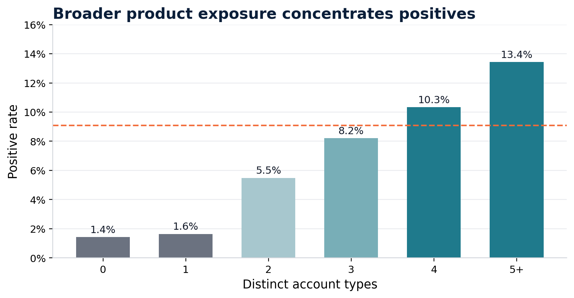
Broader Product Exposure Is Concentrated Among Positive Observations
Distinct account-type breadth is an important structural difference.
40.0%
59.0%
population with 5+ account types
positives in 5+ account-type group
Product labels are retained at code level unless an authoritative account-type mapping is available. Low-volume account codes should not be interpreted individually.
Breadth is descriptive of credit-file structure.
This is not yet model feature importance.
EDA Report · Version 2 polished · 6
Sample event rate reflects analytical sampling; not population prevalence.

Slide 8
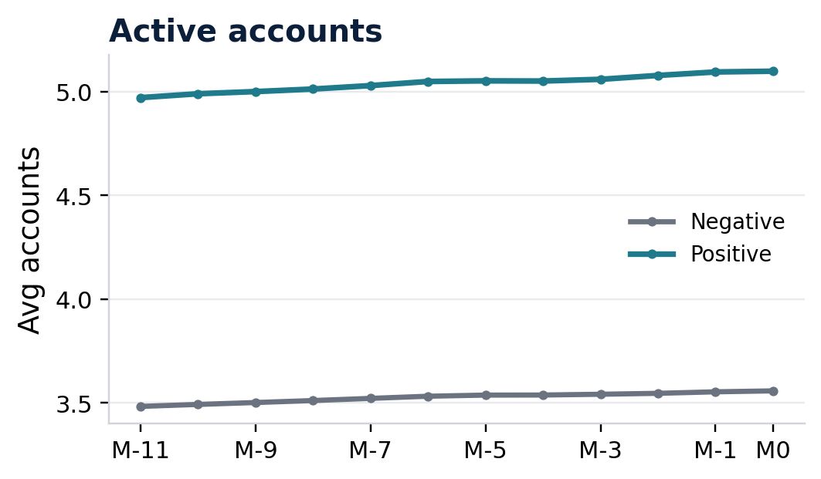
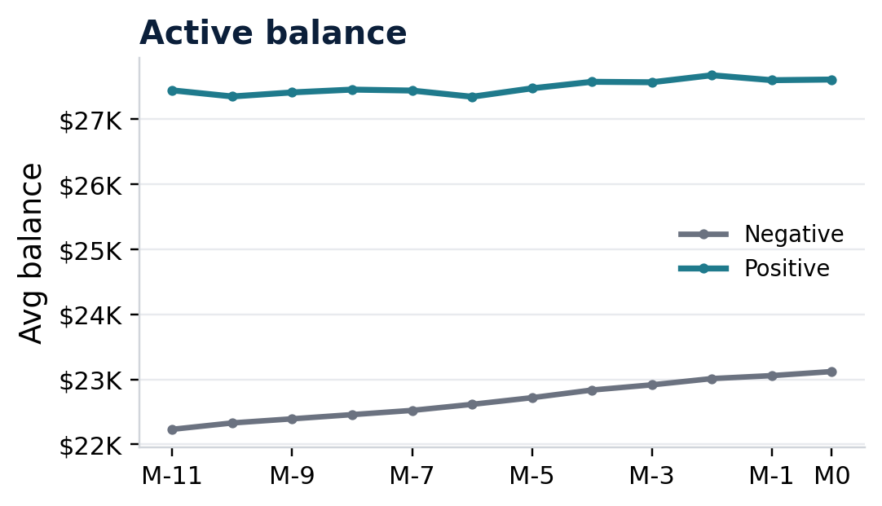
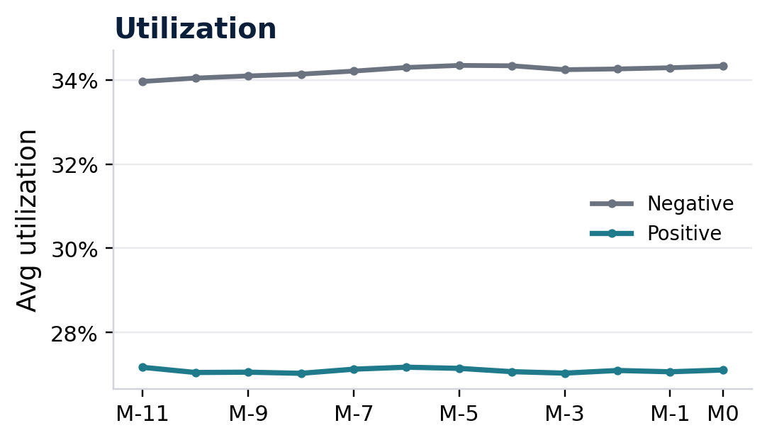
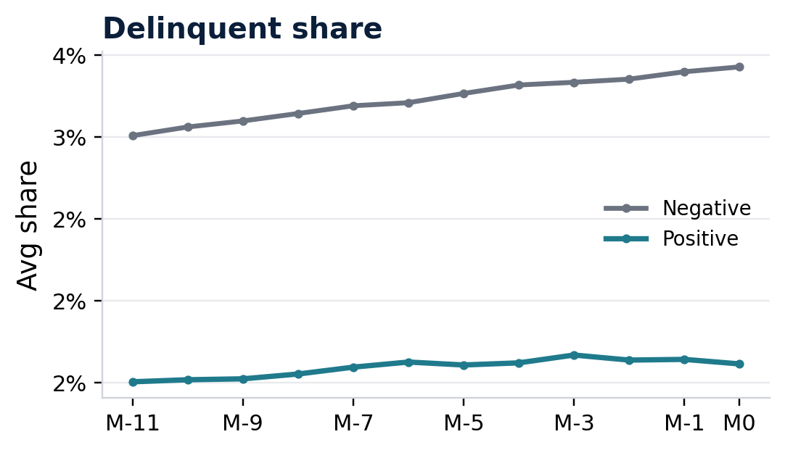
Behavioral Profiles Are Stable but Structurally Different
Population-level averages show persistent exposure differences rather than a sharp pre-event ramp.
Key reading: positives maintain higher exposure and balance, but do not exhibit higher traditional credit distress. The target is future qualifying alert placement, not default.
EDA Report · Version 2 polished · 7
Sample event rate reflects analytical sampling; not population prevalence.

Slide 9
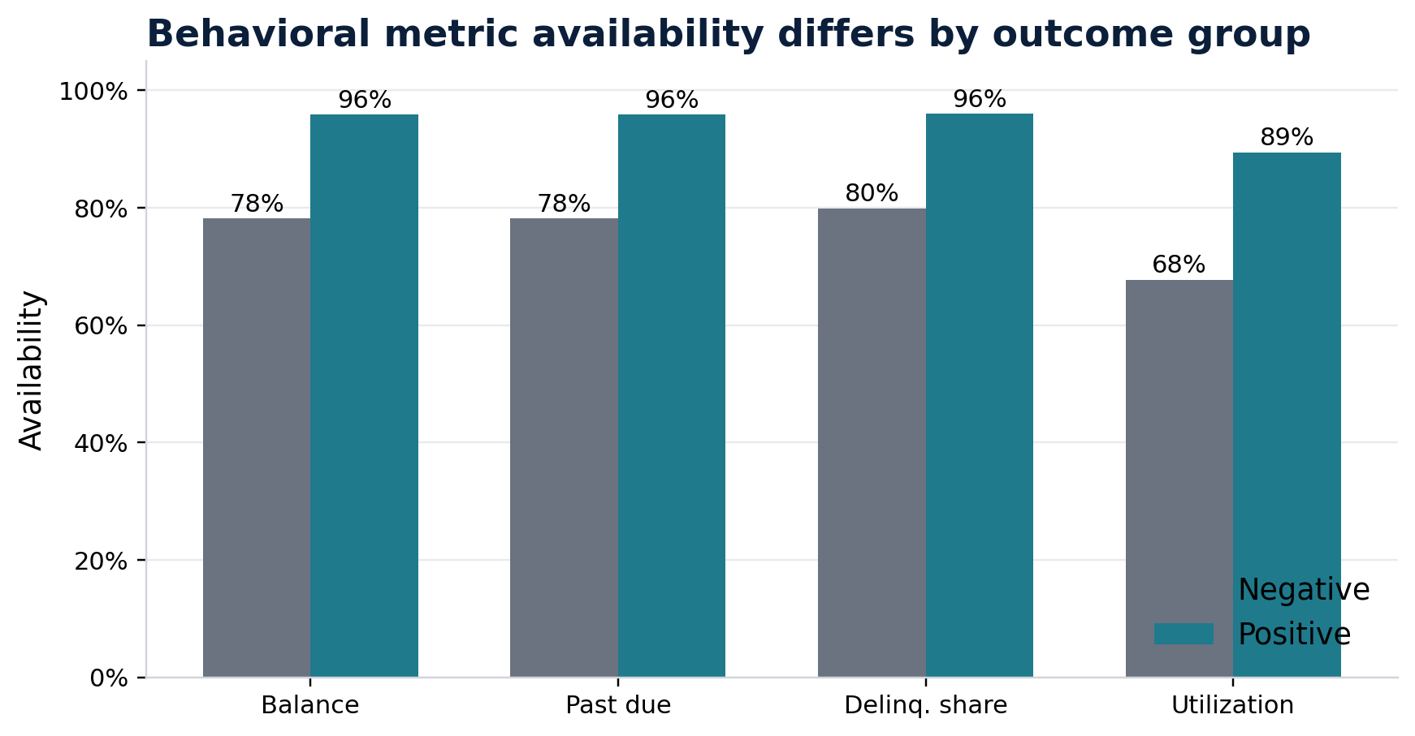
Missingness Is Structural, Not Random
Availability of behavior measures differs materially by outcome group.
21.7pp
17.7pp
utilization availability gap
balance availability gap
Implication: availability flags are necessary because zero-valued behavior and non-computable behavior are not equivalent.
Reported accounts and active accounts are 100% available.
Balance, past due, delinquency share, and utilization are structurally missing for many thin-file observations.
EDA Report · Version 2 polished · 8
Sample event rate reflects analytical sampling; not population prevalence.

Slide 10
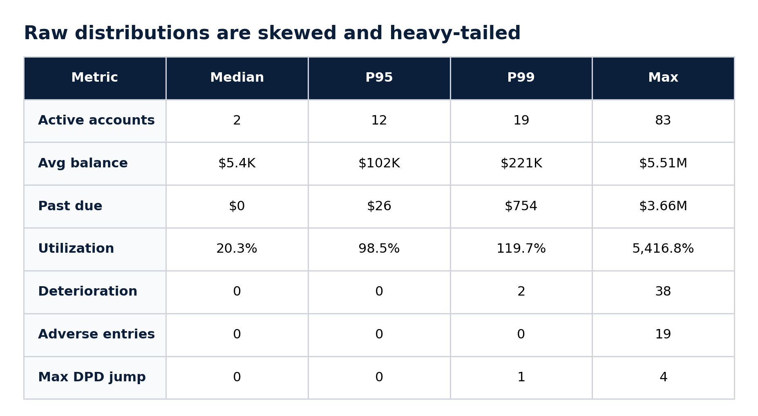
Raw Distributions Are Skewed and Heavy-Tailed
Extreme values exist, but logical rules show no invalid data patterns.
0
54.17
logical violations across 8.26M rows
max avg utilization
$3.66M
83
max past due
max active accounts
Recommendation: handle long tails through robust transformations / outlier treatment during feature engineering rather than automatically removing records.
EDA Report · Version 2 polished · 9
Sample event rate reflects analytical sampling; not population prevalence.

Slide 11
Point-in-Time and Panel Integrity
The behavioral construction is complete, temporally aligned, and free of observable leakage.
12-MONTH ANALYTICAL PANEL
UNDERLYING TRADE EXTRACTION
Parties
688,589
Trade rows
98,051,779
Party-month rows
8,263,068
data_date > observation
0
Parties not 12 months
0
feature_month > observation
0
Missing / duplicate offsets
0
eff_dte > data_date
0
Future feature months
0
eff_dte > observation
0
Invalid window mapping
0
data month misaligned
0
Offsets 0–11 represent the analytical history. Offset 12 exists only as the technical seed used for transition calculations.
POINT-IN-TIME INTEGRITY: PASS
EDA Report · Version 2 polished · 10
Sample event rate reflects analytical sampling; not population prevalence.

Slide 12
EDA Readiness Assessment
The dataset is ready for feature validation and model development with documented limitations.
Dimension
Assessment
Comment
Analytical cohort
PASS
One party / one observation
Outcome integrity
PASS
0 label violations
Calendar completeness
PASS
48 consecutive months
Behavioral panel
PASS
Complete 12-month history
Point-in-time integrity
PASS
0 future-data violations
Logical consistency
PASS
0 violations across 8.26M rows
Missingness
DOCUMENTED
Structural, not random
Outliers
MANAGEABLE
Long tails require robust handling
True tenure
LIMITATION
Not available from current source
Source left-censoring
LIMITATION
Material source-boundary effect
Executive conclusion: no blocking cohort, label, temporal, or logical data-quality issues were identified. Remaining considerations are methodological and should be carried into feature validation and model development.
EDA Report · Version 2 polished · 11
Sample event rate reflects analytical sampling; not population prevalence.

