Slide 1
DATA ENGINEERING PORTFOLIO
Financial Market
Data Pipeline
Financial ETL • PostgreSQL • Apache Airflow • CI/CD
Alejandra G. Mejía
Data Analyst | Aspiring Data Engineer
ALEJANDRA G. MEJÍA / PROJECT 02
01 • INTRODUCTION

Slide 2
CONTEXT
From fragmented market data to reliable records
Analytics requires consistent, traceable, reproducible historical data.
Inconsistency
Manual effort
API constraints
Mixed formats, invalid observations, and duplicate records.
Repetitive extraction and workflows that are hard to reproduce.
Limited quotas and the need to avoid redundant requests.
Goal: a modular ETL with operational controls and verifiable quality.
ALEJANDRA G. MEJÍA / PROJECT 02
02 • THE PROBLEM

Slide 3
DESIGN
Layered system architecture
ETL handles data; Airflow orchestrates; GitHub Actions validates the code.
Alpha Vantage
/ Local JSON
Python ETL
OHLCV
Validation
PostgreSQL
18
Apache Airflow
GitHub Actions
Manual local replay, task status, and execution logs.
CI: code quality, ETL tests, PostgreSQL, and DAG tests.
ALEJANDRA G. MEJÍA / PROJECT 02
03 • ARCHITECTURE

Slide 4
PIPELINE
ETL flow with data quality gates
The same application supports API data and saved JSON replay.
1. Extract
2. Preserve
3. Transform
4. Validate
5. Load
API or local JSON
Original response
OHLCV time series
Financial checks
Transactional UPSERT
Offline replay
Ingestion controls
Repeatable tests without Alpha Vantage calls.
Freshness, daily budget, and provider rate limits.
ALEJANDRA G. MEJÍA / PROJECT 02
04 • ETL

Slide 5
POSTGRESQL
Reliable and idempotent persistence
Composite primary key (symbol, date); updates only when values differ.
daily_prices
ingestion_state
api_request_usage
OHLCV prices, volume, and update timestamp.
Last successful fetch to avoid redundant API calls.
Atomic reservations against the daily request budget.
Verified replay: 100 AAPL observations → 0 modified rows
ALEJANDRA G. MEJÍA / PROJECT 02
05 • DATA

Slide 6
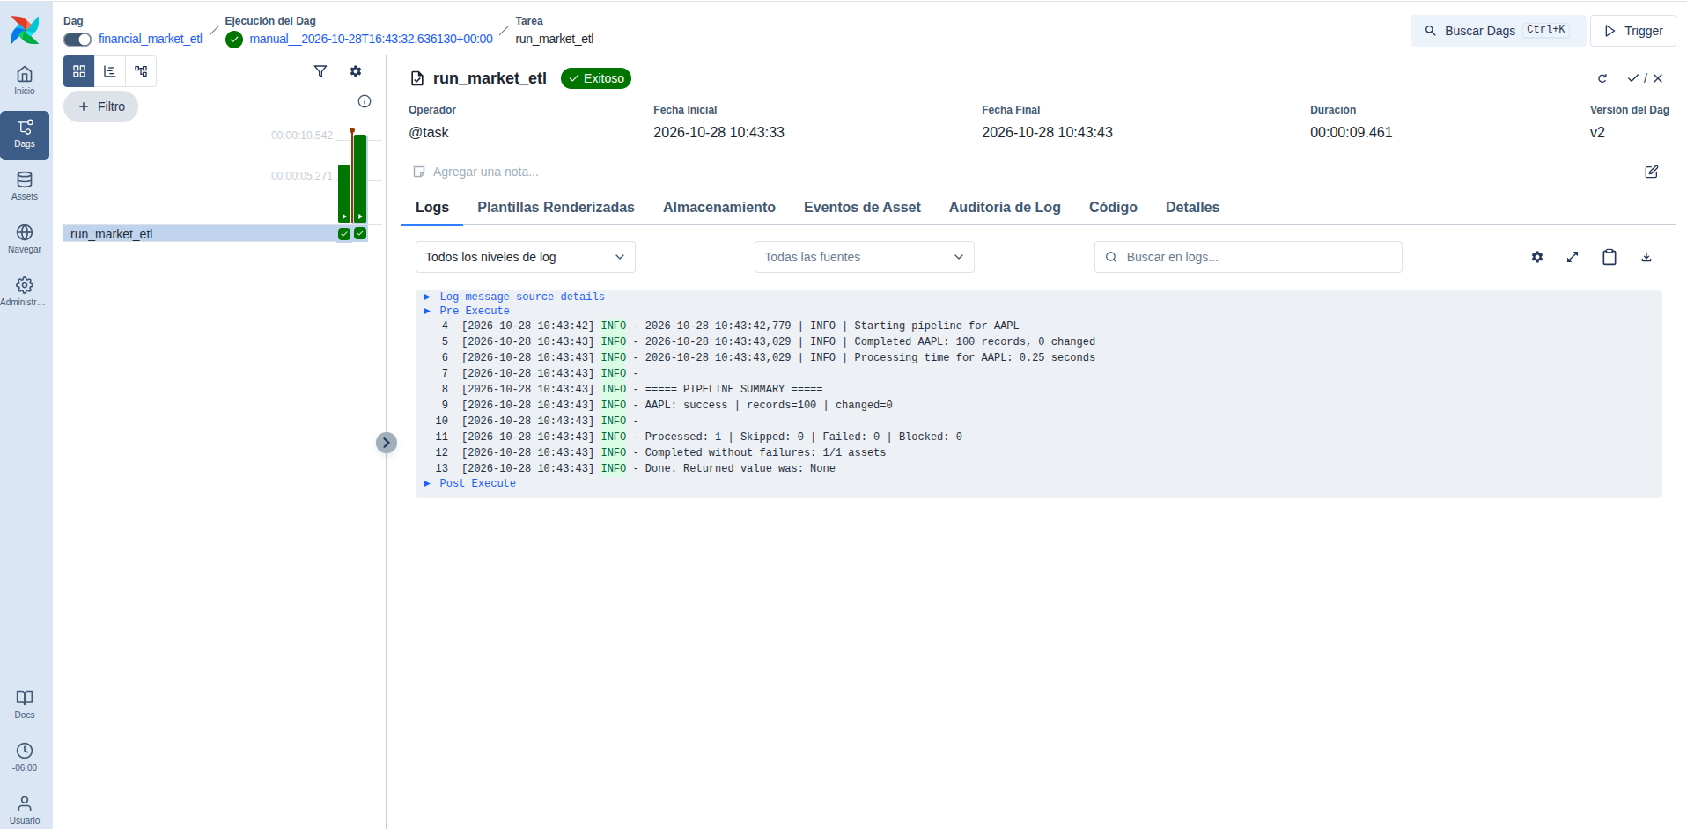
APACHE AIRFLOW
Orchestration and observability
Manual DAG, one task, offline replay, and inspectable task logs.
Verified execution
DAG: financial_market_etl
Task: run_market_etl
100 records processed
0 modified rows
Status: Success
Source: successful execution screenshot, Oct 28, 2026.
ALEJANDRA G. MEJÍA / PROJECT 02
06 • AIRFLOW

Slide 7
QUALITY
65 automated tests
Local and CI validation; results apply to the tested environments.
61
4
4/4
ETL tests
Airflow tests
CI jobs passing
CI: Ruff + Bash • unit tests • PostgreSQL integration • Airflow DAG tests
ALEJANDRA G. MEJÍA / PROJECT 02
07 • TESTING

Slide 8
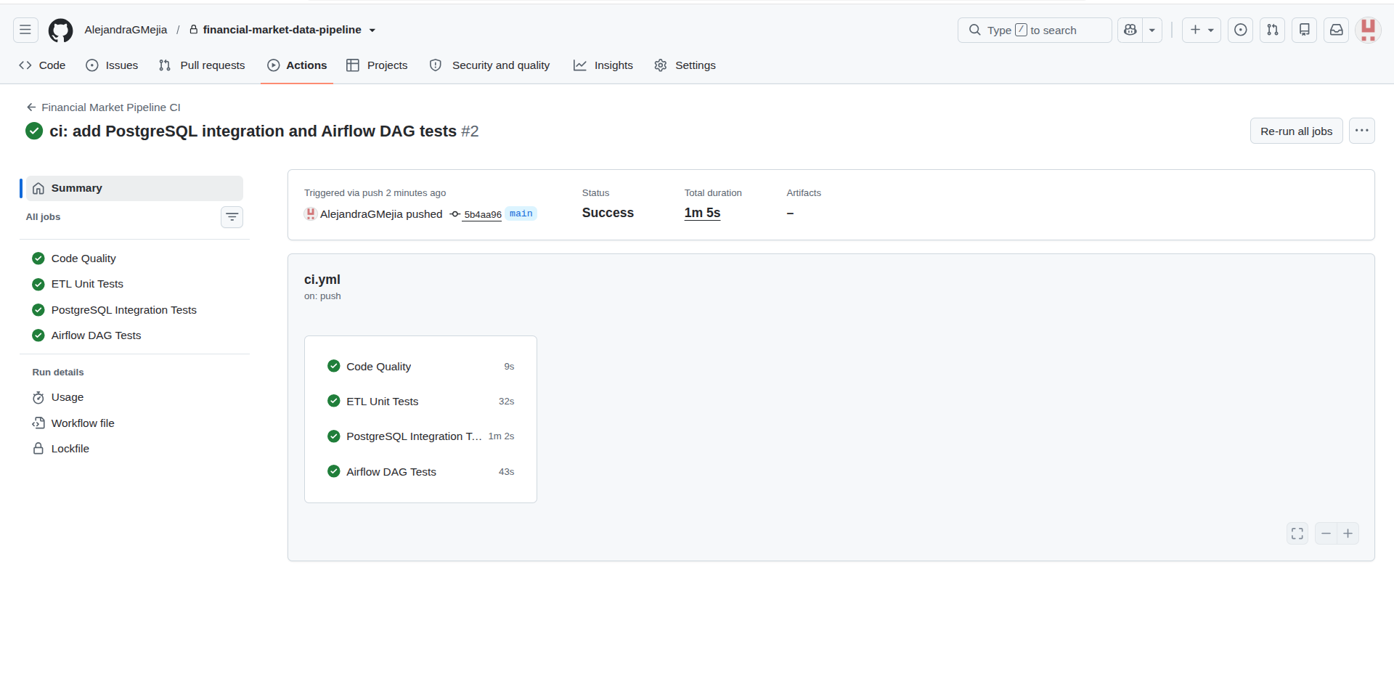
GITHUB ACTIONS
Verified continuous integration
Four independent jobs completed successfully on Oct 28, 2026.
Workflow results
Code Quality: passed
ETL Unit Tests: passed
PostgreSQL Integration: passed
Airflow DAG Tests: passed
Total duration: 1m 5s
Commit 5b4aa96 • main
ALEJANDRA G. MEJÍA / PROJECT 02
08 • CI/CD

Slide 9
TAKEAWAY
A verifiable pipeline, not just a running script
Scope: local demonstration and CI; not a production deployment.
What was demonstrated
Potential next steps
Modular ETL; idempotent UPSERT; quota controls; Airflow execution; independent testing and CI.
Quota-aware scheduling, alerts, cloud storage, and production deployment.
Alejandra G. Mejía
github.com/AlejandraGMejia/financial-market-data-pipeline
ALEJANDRA G. MEJÍA / PROJECT 02
09 • CONCLUSION

