Slide 1
Supervised Learning Assignment
Exploring Machine Learning: Theory, Practice, and Performance Analysis.
By Alejandro Gonçalves (202205564), Francisca Mihalache (202206022) and Pedro Fernandes (202208347)

Slide 2
Synopsis
Our presentation consists in:
Understanding and testing the Knn algorithm and its limitations;
Theorizing on how to solve such limitations;
Tackle those disadvantages using bagging and feature subsets;
Summarising of results;

Slide 3
Selected Algorithm-KNN
KNN (K-nearest Neighbor) is a non-parametric supervised learning method used for classification and regression.
In this case (classification), the object is classified by the vote of its neighbors, with the object being assigned to the most common class among its k nearest neighbors.

Slide 4
KNN-Advantages
Simple to implement;
Inherently incremental: If new objects are added to the training set, the algorithm will automatically take them into account when predicting the class of a new object;

Slide 5
KNN-Disadvantages
Slow classification for bigger datasets (has to deal with every line individually);
Sensitive to irrelevant attributes;
Sensitive to outliers and noisy data;

Slide 6
Limitations
Overfitting can occur when the model memorizes the training data and fails to generalize well to unseen data. This can happen especially in scenarios where the dataset contains noisy data/outliers.
If the data has irrelevant features, they will induce incorrect classification decisions based on unimportant information.

Slide 7
Motivation
Our motivation for this work comes from the need to understand how machine learning algorithms, particularly K-Nearest Neighbors (KNN), handle noisy data and irrelevant features.
In real-world applications, datasets often contain imperfections such as noisy observations and irrelevant attributes. These imperfections can cause overfitting, where the model memorizes training data and fails to generalize to new data, and can lead to incorrect classification decisions.

Slide 8
Empirical Study
To address the challenge of noisy data, we hypothesized that adjusting both the k value and the distance measures, tested with different test splits, could help prevent overfitting, and also reduce variance
To target the irrelevant features, we simply need to find which features are more relevant in each dataset, considering metrics like accuracy and recall as measurements.

Slide 9
Features
Due to lack of time, we couldn’t work out the code for the features part, mostly since we only managed to pick one random set of attributes one single time, and didn’t run the test more times for consistency.
However, it is worth mentioning that probably, as the number of cycles tended to infinity, the classification metrics for this part would improve, since it’s more likely to find the correct attributes for the classification.
(we will talk about the methodology, but no results will be presented)

Slide 10
Experimental Setup
To begin with, we implemented the KNN algorithm given in this GitHub repository: https://github.com/rushter/MLAlgorithms.
That includes the import all of the knn logic, base and metrics.
We then proceeded to build the notebook:
imported and fitted the csvs;
defined the functions that test our hypothesis. That includes the definition of the distance functions, the cycles for it, and the features part;

Slide 11
CSV Details
Datasets | Size | Number of attributes
df1 | 700 | 10
df2 | 3524 | 6
df3 | 768 | 9
df4 | 900 | 8
df5 | 1190 | 12
df6 | 59 | 7
df7 | 2500 | 13
df8 | 178 | 14
df9 | 10000 | 6
df10 | 3276 | 10
Note that all of the target classes are binary.

Slide 12
Hyperparameters
The hyperparameters we manipulated were:
k values: We experimented with various values of k in the range of 3 to 11.
Distance metrics: We tested different distance metrics to evaluate their impact on model performance.
For consistency and robustness, we tuned the model using different test splits, in this case, 0.2, 0.3, and 0.4.

Slide 13
Performance Estimation Methodology
When testing the metrics for the base case initially, we got around 90% on them (accuracy, recall…).
We estimated that with the use of bagging, we could improve those statistics by a lot, hopefully 95%

Slide 14
Performance Estimation Methodology
Different k Values: Varying k helps balance model complexity. Larger k values reduce overfitting by smoothing decision boundaries, while smaller ones capture more intricate patterns but risk overfitting.
Different Distance Metrics: Each distance metric captures different aspects of data similarity. Using multiple metrics introduces diversity, reducing overfitting by ensuring robustness across various data characteristics.

Slide 15
Bagging
By using bagging with KNN, where multiple instances of the algorithm are trained on different distance measures (Euclidean, Cosine, Manhattan, Jaccard, Mahalanobis), the resulting ensemble model improves generalization performance and reduces the influence of any single metric.
This approach reduces the risk of overfitting and mitigates the impact of outliers, as individual KNN models are trained on different distance measures.
Therefore, outliers have less influence on the overall prediction, leading to more reliable and stable performance.

Slide 16
Features
This methodology involves selecting random subsets of features from the entire set of attributes for the classification task.
This randomness helps to choose the best attributes and therefore it reduces the risk of overfitting, ensuring that the model does not rely too heavily on any single subset of features.
We can mitigate the classification errors caused by irrelevant features.

Slide 17
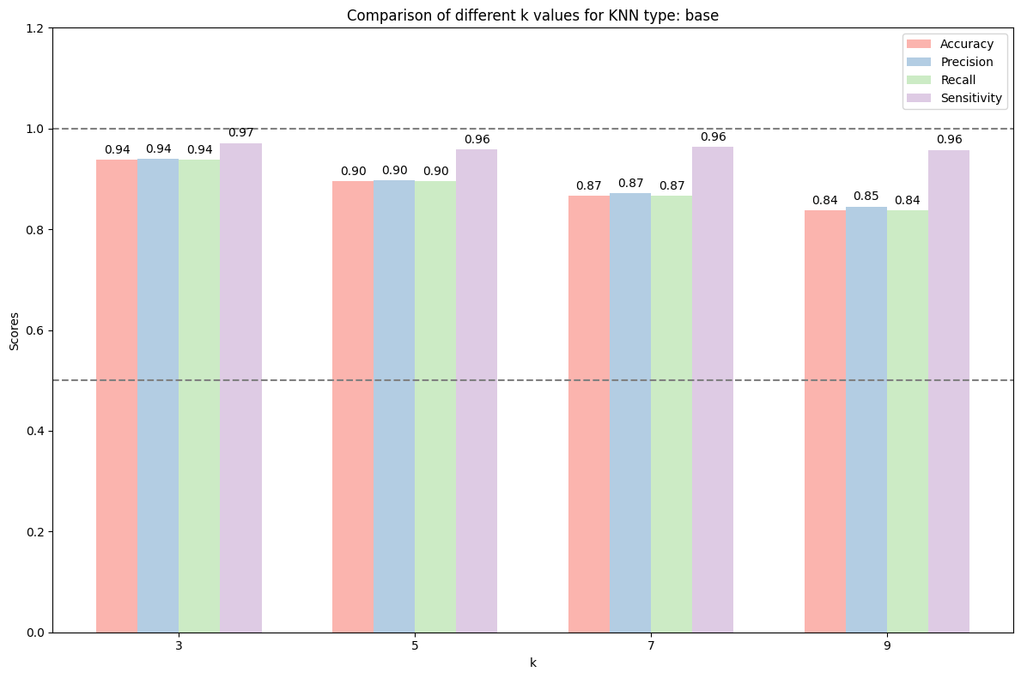
Different k values for base distance
This graph serves as a control, displaying the performance of the original KNN algorithm (distance = Euclidean) across different values of k.
Notes:
num dado csv, dataset 1

Slide 18
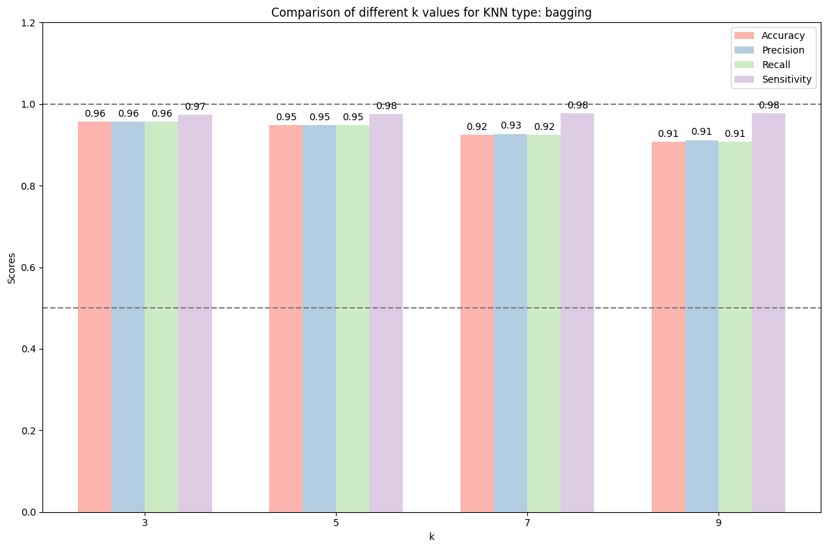
Different k values for bagging distance
This graph shows KNN with bagging's performance across various k values. .Bagging slightly outperforms baseline KNN, indicating effectiveness on this method.
The selected distance metric for each K is the one yielding the optimal results.
For smaller datasets, we observed an inverse relationship between the value of k and the algorithm's performance. However, considering the limited dataset sizes, it's important to note that this observation might not hold true for larger datasets.
We speculate that for larger datasets, increasing k could potentially lead to better performance in a proportional manner.

Slide 19
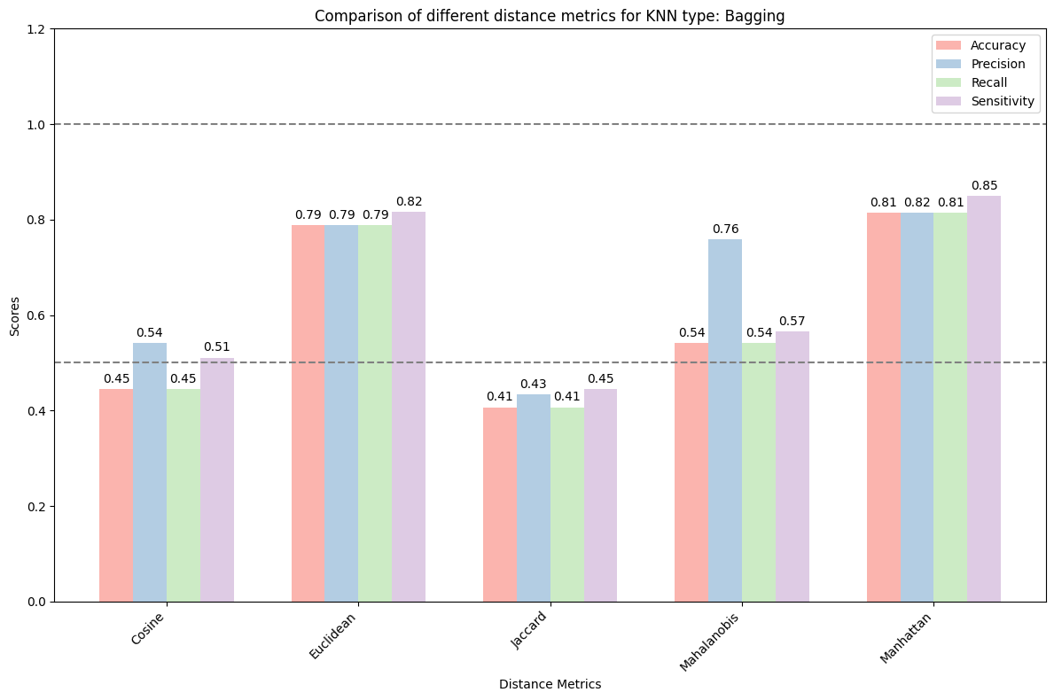
Different distance metrics
This graph compares different distance metrics in a KNN classifier with bagging. While Euclidean is the default, our results highlight Manhattan’s effectiveness. The graph is generated by iterating over all datasets and calculating the scores for each metric. This shows the importance of exploring different metrics for optimal results.

Slide 20
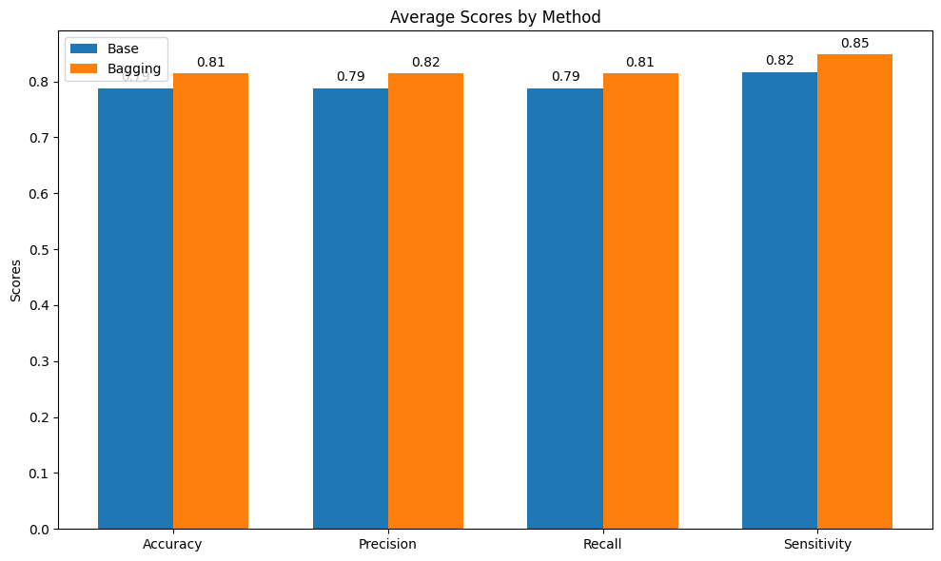
Average Scores by method
This bar chart illustrates the average performance scores of the "Base" and "Bagging" methods across four metrics: Accuracy, Precision, Recall, and Sensitivity.
Each column represents the best case scenario for each method, considering the optimal number of neighbors (K) for the "Base" method and for the “Bagging” method, the optimal combination of K and distance metric.
As shown on the graph, "Bagging" clearly demonstrates better performance across most metrics

Slide 21
Discussion
Although it didn’t improve as much as we expected it to, bagging improved the metrics (generally speaking), which confirms our null hypothesis.
We couldn’t confirm the features part, for the reasons mentioned before, but we hope that during summer vacations we find the time to actually complete that part.

Slide 22
Conclusion
We proved that the use of KNN, although not commonly, can still be justified, if the hyperparameters are correctly tuned.
We hope that during the ML II class, in the 3rd year of out bachelor degree, we dive even deeper on the nuances of the ML algorithms, and hopefully can and try to improve the KNN even more.
This work was very pertinent, and we believe we learnt a lot.

