Slide 1
CityMeet Presentation &
Demo
Group 5/Team CityMeet
CS 3337 Spring 2025
5/9/2025
A look at our team’s social media web application.

Slide 2
Meet the Team
Group 5/Team CityMeet
Elliot Gong
Product Manager,
Frontend Developer,
UX Designer
Vivian Casas
Frontend Developer,
UX Designer
Alan Mai
Frontend Developer,
UX Designer
Siying Chen
UX Designer
Darshan Patel
Backend Developer
Alejandro Vargas
Backend Developer
Designed the software architecture and Implemented the Profile Page.
Designed and Implemented the Messaging Page
Designed and Implemented the Landing Page.
Designed the Profile Page
Implemented the Accounts Feature
Implemented Content Uploading
Isidoro Flores
Full-Stack Developer
Deion Stapleton
Full-Stack Developer
Product link: https://citymeet-test.vercel.app/
Github: https://github.com/Alejandro-50X/citymeet-test
Implemented Geospatial Mapping
Implemented City Welfare Services

Slide 3




Vision
Group 5/Team CityMeet
Customer
Problem
Solution
Social media users that desire a platform that’s driven by communities in the local region. These people seek content and information that is more relevant to their lives given their location.
There isn’t a platform that’s driven by communities in the local region. People have trouble finding content and information that is more relevant to their lives given their location.
A social media platform centered around regional activities/content can help provide a platform that is both authentic and practical.

Slide 4


Introducing CityMeet Social Media Website
Group 5/Team CityMeet
City Meet is a Social Media website that specializes in content driven by local areas/communities. It also partners with the Los Angeles City Government to provide resources and a hotline for requesting welfare or tracking current events.

Slide 5
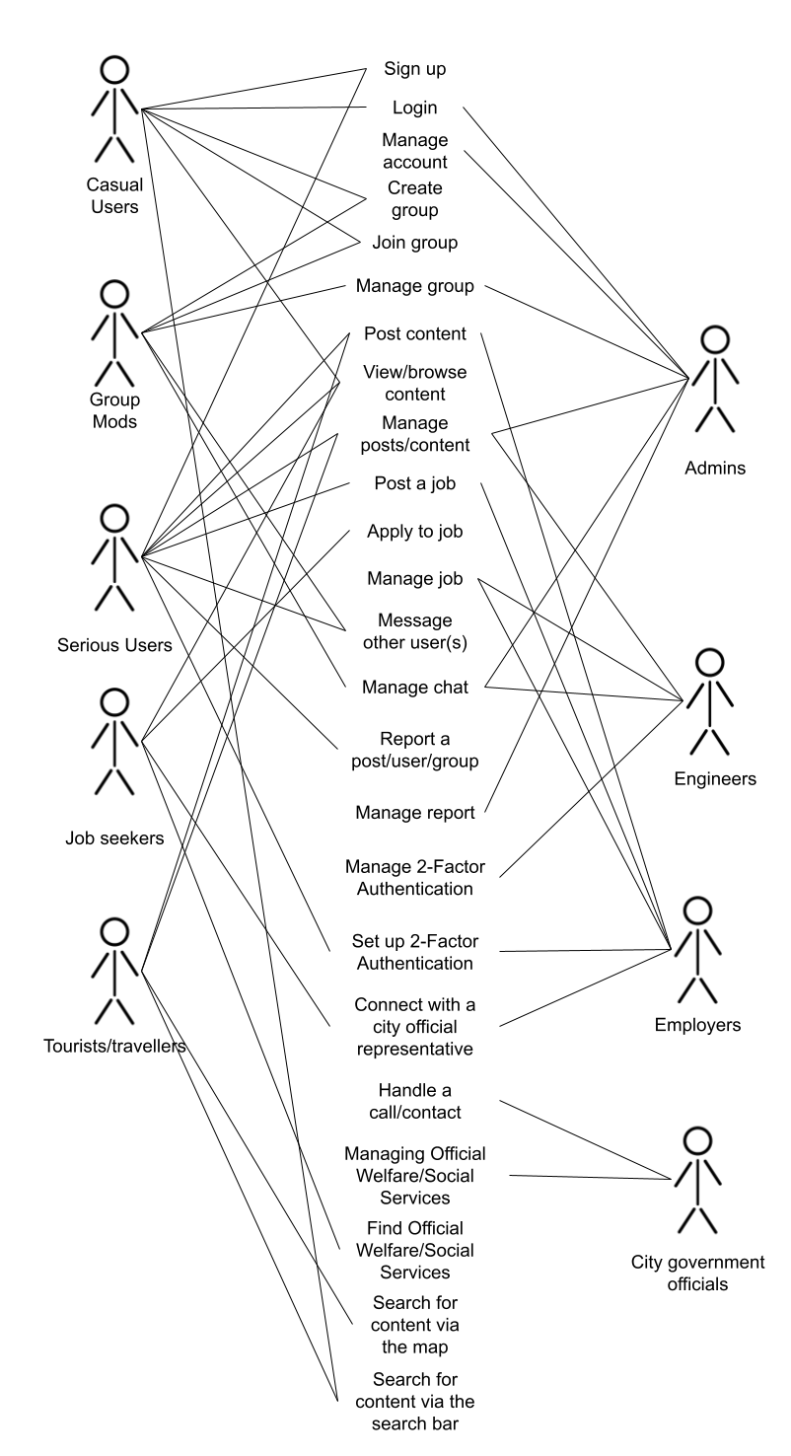
Requirements
Group 5/Team CityMeet
User Stories
Here, we see CityMeet’s various users and how they use the features provided by the product.

Slide 6
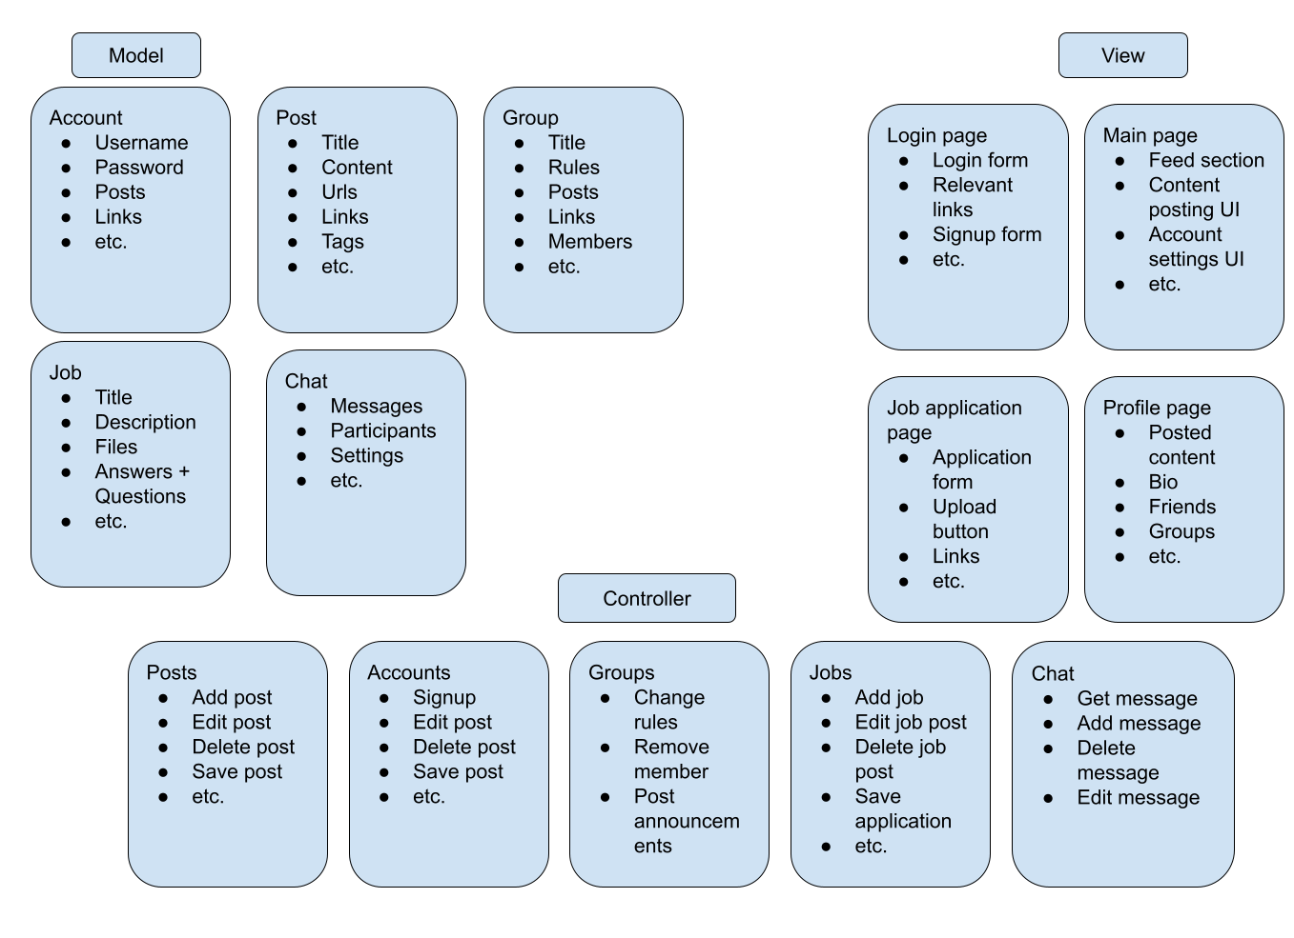
Architectural Design
Group 5/Team CityMeet
Model-View-Controller
CityMeet follows the Model-View Controller architecture pattern.
Non-Functional Requirements
We want the product to be intuitive for both users and developers.
We chose the MVC model provides increased scalability, maintainability, security, reusability, and testability.

Slide 7
Detailed Design: Technologies
Group 5/Team CityMeet
Technologies used by the Software
Technologies used by for Development
React.js
Generate page components
Tailwind CSS
Provide convenient styling
Next.js
Manage system logic
Supabase
Store user and content data
Google Maps
Showcase locations of interest
Vercel
Host the live website.
Visual Studio Code
Served as the IDE.
Next.js
Developed system logic
Supabase
Configured the database
Vercel
Configured the product’s deployment
Github
Provided project management
Figma/UX Pilot
Generated design materials.

Slide 8
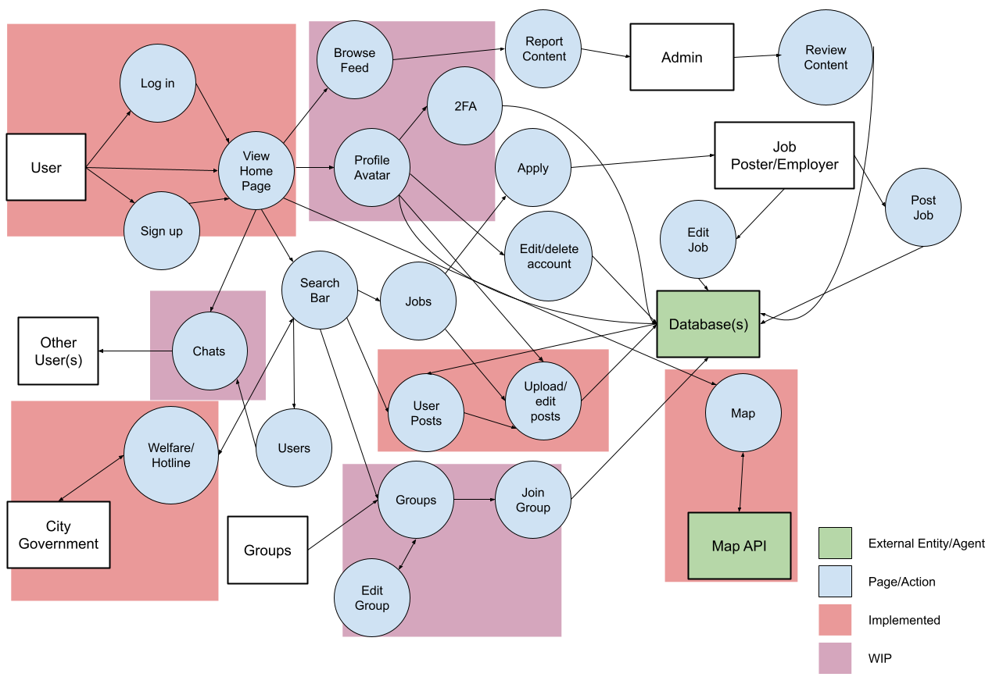
Detailed Design: Processes
Group 5/Team CityMeet
Level 1 Logical Data Flow Diagram

Slide 9
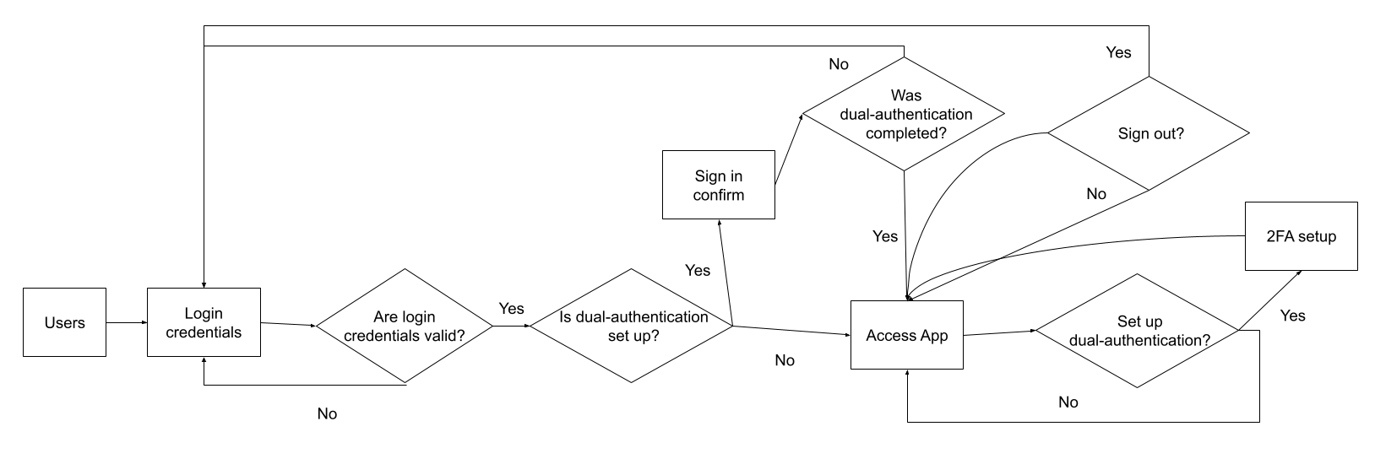
Detailed Design: Sample Behavior Diagram
Group 5/Team CityMeet
Control Flow/Behavioral Diagram for User Accounts(Login, Sign Up, 2FA)

Slide 10
Lessons Learned
Group 5/Team CityMeet
Exposure to New Technologies
Working in Larger Teams
Time Management
Using Scrum and Agile
Working with a larger group taught us communication, collaboration, and leadership.
Since everyone had other obligations and responsibilities, we learned how to best manage our time given our schedules.
Following the Scrum/Agile workflow helped prepare us for real-world work conditions.
Everyone got to learn and use new softwares and techniques.

Slide 11
Project Roadmap
Group 5/Team CityMeet
24.0
24.1
24.2
Future
Design + Research
System configuration and setup
Geospatial Mapping
User Accounts
Content Filtering
User Content
City Government Outreach/Hotlines
Groups
Messaging
Content Moderation
Jobs

Slide 12

Ask us anything!

