Slide 1

Análisis de Sentimientos en Reddit
Alejandro Casanova Martín

Slide 2

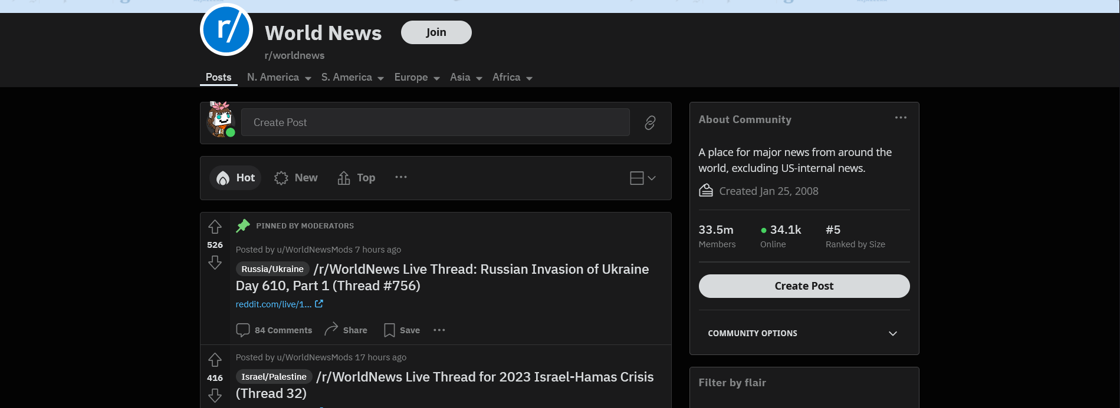

Slide 3



Tecnologías Utilizadas

Slide 4





Reddit API
Last Comments Table
comments
Sentiment History
comments, posts...
Sentiment Analysis
sentiment
Average Sentiment
Count Words
Count Biased Words
Most Commented Words
words
biased_words
Most Relevant Words

Slide 5
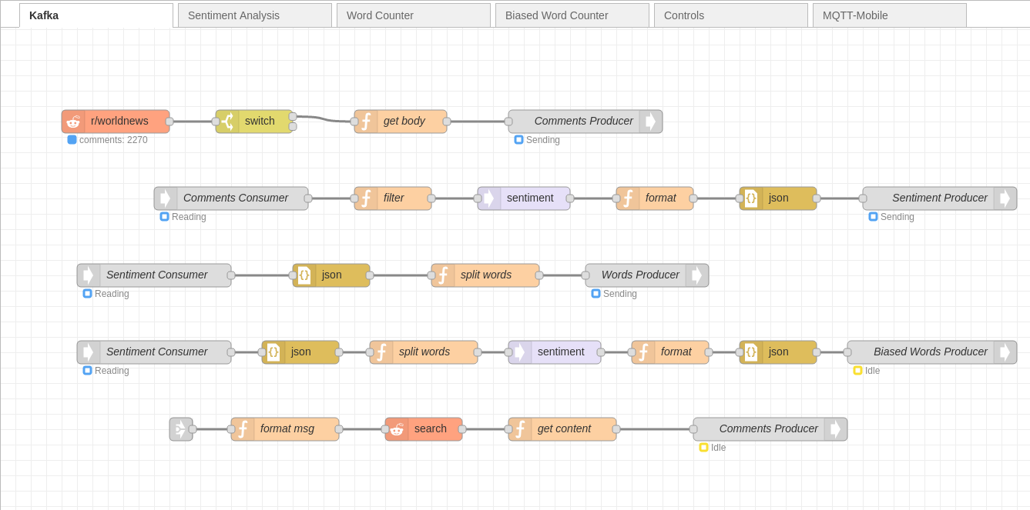

Slide 6
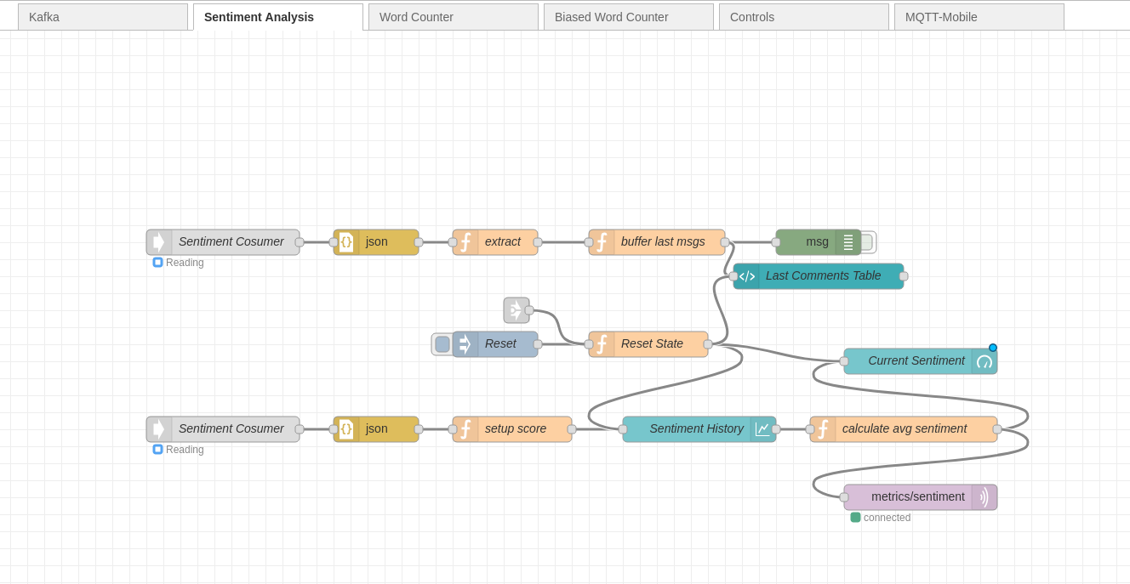

Slide 7
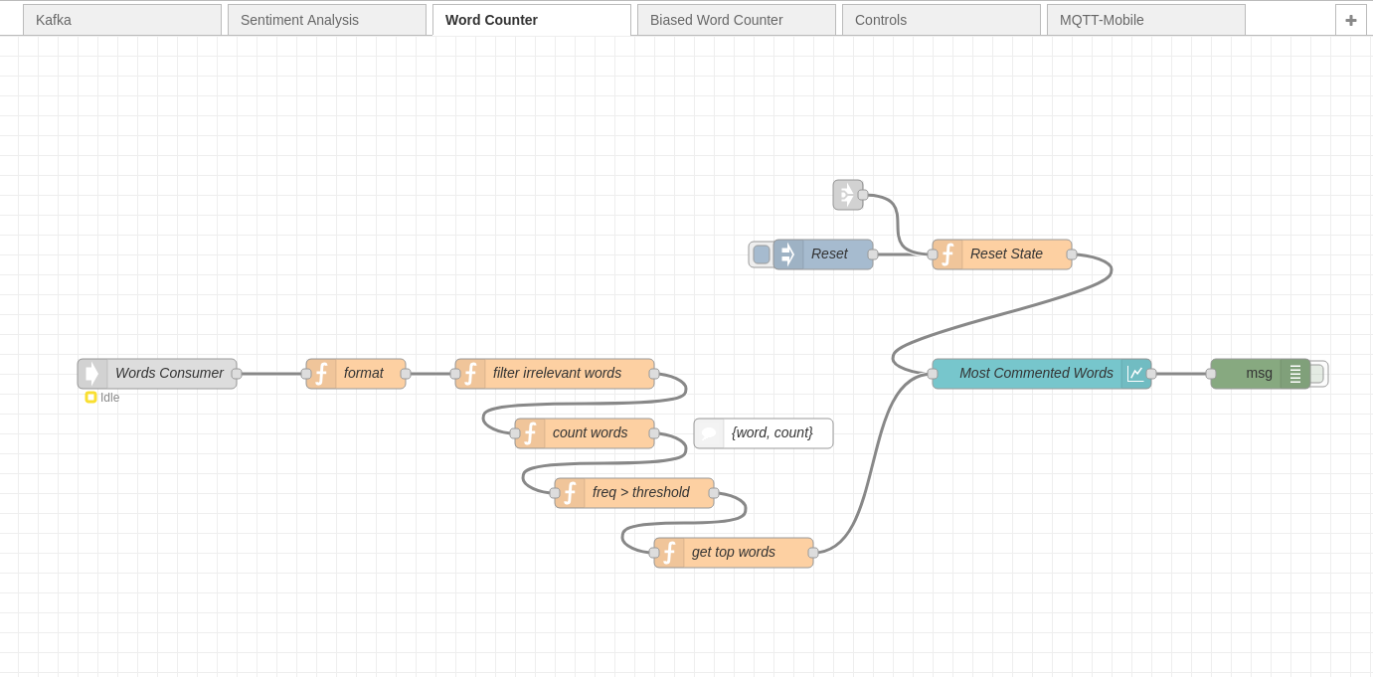

Slide 8
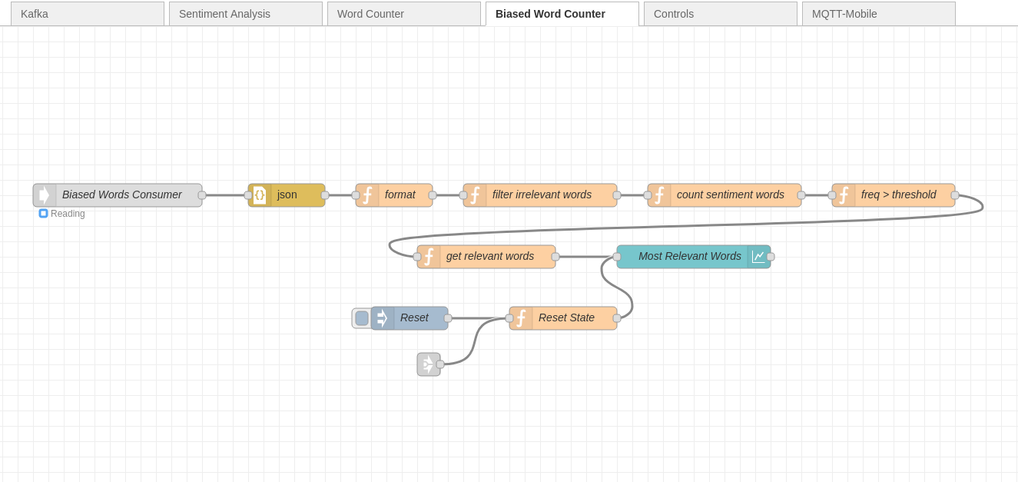

Slide 9
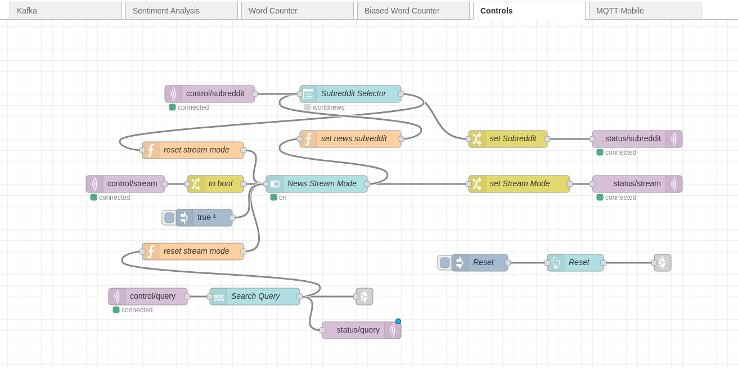

Slide 10
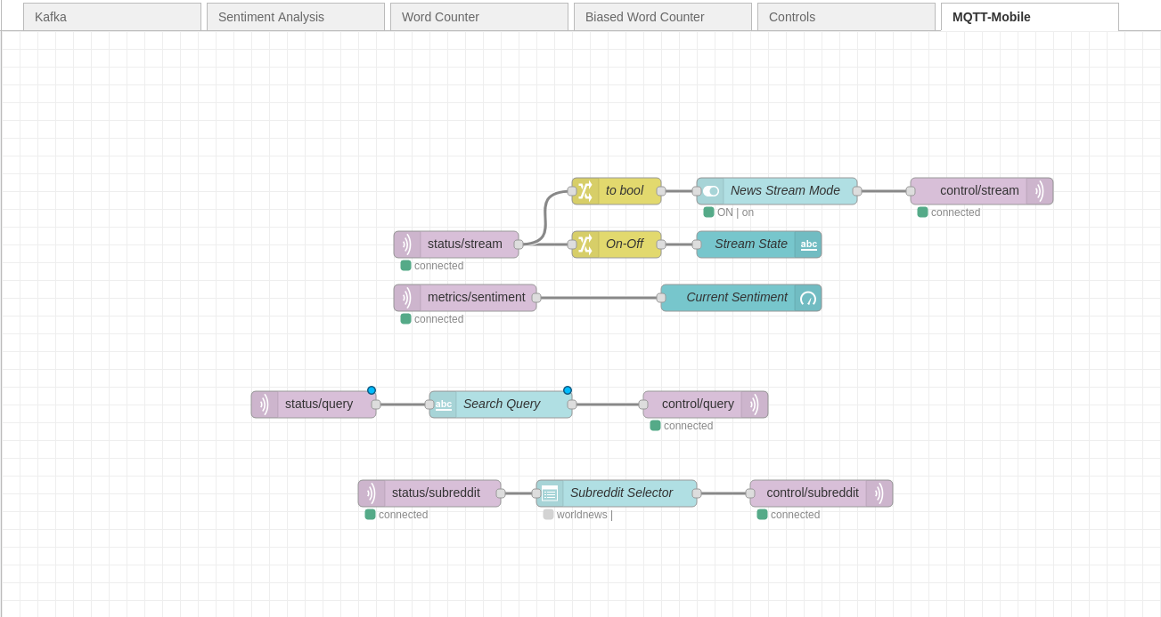

Slide 11
Semántica de MQTT
control/stream: QoS:1, retain: false.
control/query: QoS: 2, retain: false.
control/subreddit: QoS:1, retain: false.
status/stream: QoS:1, retain: true.
status/query: QoS:1, retain: true.
status/subreddit: QoS:1, retain: true.
metrics/sentiment:QoS: 0, retain: false.

Slide 12
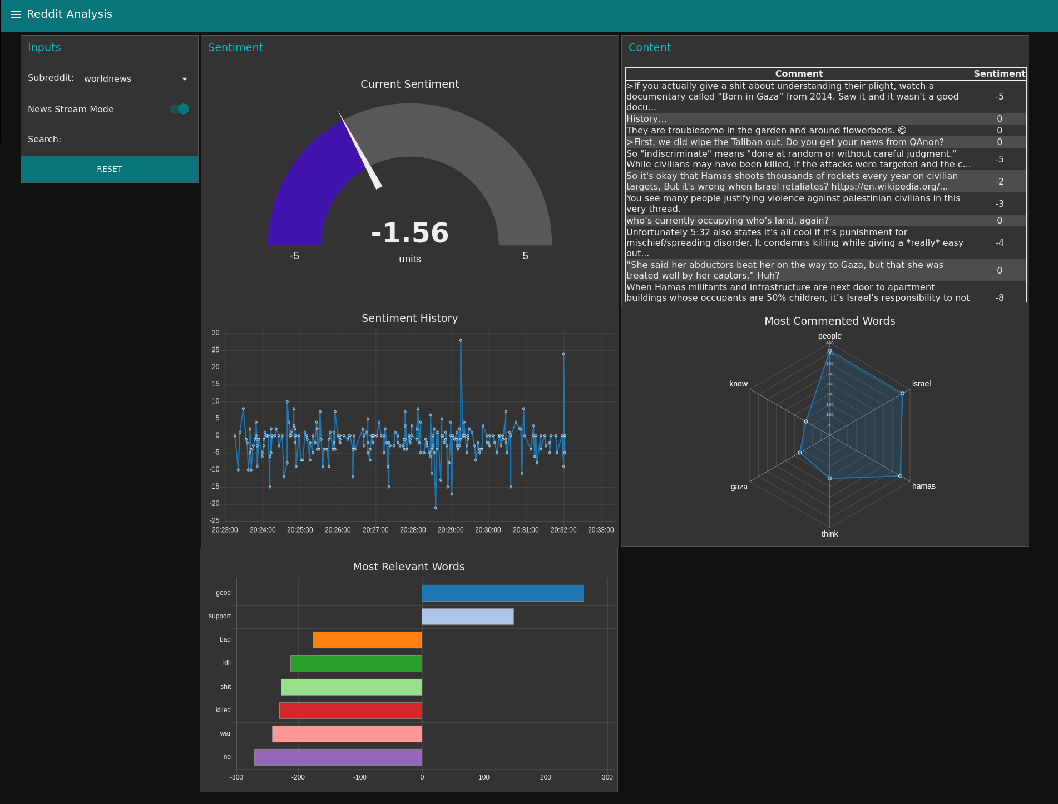

Slide 13
