Slide 1
Attrition is not a pay problem everywhere
A blanket 6 % across LATAM would cost $5.38M and leave the worst-paid segment where it is. $1.15M, targeted, does more.
MPG People & Corporate Services · Executive Committee
4,500 employees · 9 cities · 24 months · 746 segments scanned
Built on synthetic data, generated to a documented specification. Real compensation data is confidential — and because the anomalies were designed in advance, the analysis can be scored rather than asserted.
github.com/Alejandro-Tarazona/01_PeopleAnalytics
Notes:
The recommendation is not to spend less for its own sake. It is that the blanket proposal spends where the evidence is not.

Slide 2
What was asked
HR has proposed a blanket 6 % salary adjustment across the LATAM hub. Before approving it, the CEO asked three questions.
1
Are we losing people everywhere, or in specific places?
Company attrition is 13.5 %. LATAM is at 16.4 %. Neither number says where.
2
Is this actually a money problem?
Low pay and high attrition in the same place is a correlation, not a cause. Three different problems can produce the same symptom.
3
What is the smallest number that fixes most of it?
A blanket rate large enough to fix the worst segment overpays everyone else.
This deck answers them in that order. Every figure is reproducible from the repository.

Slide 3
The answer, in one slide
The proposal on the table
What we recommend instead
Exposure it addresses
$5.38M
$1.15M
$5.76M
blanket 6 % across LATAM
two segments, targeted
1 : 5 against the spend
95 % of the blanket money lands on people already paid at or above their band minimum.
It is spread evenly across a problem that is not.
23 people in LATAM would still be below band minimum after it.
The rate large enough to fix them is not a rate the budget can carry.
The targeted adjustment pays for itself in under five months.
And still covers three times its cost under the most conservative assumption we tested.

Slide 4
Specific places
746 segments were scanned. Eleven are large enough to judge. Four carry a signal.
Segments scanned
Large enough to judge
Carrying a signal
Twelve-month exposure
746
11
4
$83.3M
city × job × level
thirty or more people
across three different rules
599 voluntary exits
Why the middle number matters
735 segments were set aside on size, not on judgement. Below thirty people an attrition rate is arithmetic on too few lives to act on — a single resignation moves it by three points. Reporting on them would not be conservative, it would be noise presented as findings.

Slide 5
Heads and dollars point at different cities
Exposure, $M
Voluntary exits
Bogotá lost 148 people, two and a half times more than any other city, and ranks fourth in exposure. Dublin lost 79 and ranks first: LATAM salaries are lower, so the same resignation costs less.

Slide 6
What the rule declines to flag
Three tests, applied identically to all 746 segments, written before the data was looked at.
A materiality floor
Thirty people. A rule that cannot act below thirty has no business reporting below thirty.
A significance test
The exact Poisson probability of the observed exits at the company rate. Below 0.05, or it does not fire.
Three separate rules
Pay, internal equity, and organizational. Three problems that look identical in an attrition report.
Two segments, identical numbers, neither fires
Bogotá Operations IC3 and São Paulo Sales IC3: 35 people each, 8 voluntary exits against 4.7 expected, 1.69× the company baseline, p = 0.107. At that population an elevated reading has close to a one-in-nine chance of being chance alone.
Under the “1.5× the baseline” rule of thumb this replaced, both would have been recommended for a raise.

Slide 7
Bogotá · Data & Analytics IC3–IC4
PAY ADJUSTMENT
Compa-ratio
Attrition vs baseline
Significance
0.85
2.42×
p < 0.0002
Cost to lift to 0.95
Exposure carried
Payback
$811K
$3.43M
4.8 months
The one segment where money is both the cause and the fix. 150 people paid at 85 % of market midpoint, losing a third of themselves a year. The pay gap is not in a tail: only 15 % sit below band minimum, because the band floor is 80 % of midpoint. The whole distribution has drifted.

Slide 8
Dublin · Engineering IC5
INTERNAL EQUITY
Compa-ratio
Attrition vs baseline
Incumbents vs recent hires
0.99
0.74×
p25 → p74
Cost to close the gap
Exposure carried
Payback
$342K
$2.33M
no attrition yet
Invisible in the segment average, which is healthy. Long-tenured engineers sit at the 25th percentile of their own peer group while recent hires enter at the 74th. Attrition has not reacted — this is the only finding made before it did, and the only time an equity correction is cheap.

Slide 9
Singapore · Risk & Compliance IC2
ORGANIZATIONAL
Compa-ratio
Attrition vs baseline
Span of control
1.01
2.07×
15.1 vs 6.7
Cost of a pay rise
Exposure carried
A supervisory layer
not the lever
$2.18M
$0.5M – $1.2M / yr
Attrition twice the baseline and pay at market. One manager for every fifteen people against a company norm of one in seven. The lever is supervision, and it is not free: closing the span to 10 needs three more managers, to 7 needs eight.

Slide 10
The smallest number that fixes most of it
Where a blanket 6 % across LATAM goes
The comparison
Blanket 6 % across LATAM
$5.38M
23 people still below minimum after it
Targeted, two segments
$1.15M
covers $5.76M of exposure, 1 : 5
95 % of $5.38M reaches people the argument does not describe.

Slide 11
The assumption it all rests on
Every payback here depends on what replacing someone costs. That figure is declared, not measured — so here is the recommendation at the whole range.
Payback on the pay adjustment, months
The spend does not move
$1.15M at every assumption. The replacement factor prices the benefit, never the intervention — lifting a salary costs what it costs regardless of what replacing that person would have cost.
There is no breaking point in the range
At the most conservative assumption anyone defends — 1.0× salary, the bottom of the published range — the recommendation still covers 3.3 times its cost and pays back inside eight months.
HR literature puts replacement cost between 0.5× and 2× annual salary, rising with specialization and ramp time. The model applies 0.5× to Operations through 2.0× to managers.

Slide 12
The raise we did not recommend
São Paulo Sales, 122 people, is the most under-paid population in the company on base salary. It is not on the action list.
Base compa-ratio
Total target cash
Attrition vs baseline
0.88
0.99
1.17×
lowest of any segment
41 % variable against a 25 % norm
inside the noise, p = 0.49
Sales people in São Paulo are paid through variable compensation, and the market there expects it. Reading base salary alone would have recommended a raise for 122 people who were never underpaid — the single most expensive mistake available in this dataset, and the reason the rule reads total target cash rather than base.

Slide 13
What could make this wrong
Attrition may not be caused by pay
Bogotá shows low pay and high attrition together. That is a correlation. If people are leaving for managers, workload or career path, $811K buys nothing.
Fixing IC3–IC4 alone inverts the ladder
IC5 sits at 0.887 and IC6 at 0.928. Lift IC3–IC4 to 0.95 and the levels above them are paid less than the levels below.
Mitigation:
Pilot it. Treat one half, hold the other.
Mitigation:
Extend to the whole family: $194K more.
Singapore's fix is priced at zero here
A supervisory layer is a salary budget too. Three to eight managers, depending on the span targeted.
The market survey is a point in time
Every compa-ratio is measured against one survey year. If the market moved, the gap is measured against a stale midpoint.
Mitigation:
Price it before committing: $0.5M – $1.2M.
Mitigation:
Re-run at the next survey before extending.

Slide 14
The pilot the data already designed
Bogotá Data & Analytics splits into two levels that are statistical twins. Treat one, hold the other — a controlled comparison, not a before-and-after.
IC3 — treated
74 people · compa-ratio 0.853 · attrition 34.0 % · 24 exits Lift to 0.95 of market: $349K
IC4 — control
76 people · compa-ratio 0.851 · attrition 31.5 % · 25 exits No change until the pilot reads out
When it can answer
3 months · p = 0.09 · cannot tell 6 months · p = 0.07 · suggestive 9 months · p = 0.01 · conclusive
But it can fail fast
Six or more exits from IC3 in the first three months would be unlikely if the adjustment were working. That is the stop-loss: killing a failure is quicker than proving a success.

Slide 15
What happens next
Now
Month 1
Month 3
Month 9
Approve $349K
Adjustments effective
Stop-loss review
Read the pilot
Bogotá DAT IC3 only. Dublin's $342K equity correction runs in parallel — it needs no pilot, the gap is measured, not inferred.
Communicated as a market correction, not as a retention payment. IC4 unchanged and unaware.
Six or more exits from IC3 and the pay hypothesis is wrong. Stop, and re-open the segment as an organizational question.
Conclusive at p = 0.01 if it worked. Extend to IC4 and the rest of the ladder: $462K plus $194K.
Total committed today: $691K. The remaining $656K is contingent on a result.

Slide 16
What this proves, and what it does not
It was scored, not asserted
The rule was run against an answer key written before the data existed: four anomalies built in, two of them designed to be dismissed.
Precision 100 % · Recall 100 %
Every figure is computed twice — once in DAX inside the model, once in Python from the warehouse — and the two are reconciled cell by cell. 77 automated tests. A wrong number fails a build, not a meeting.
The limits, stated
The thresholds are calibrated on this organization. A company with a different baseline needs them re-derived, not copied.
A perfect score on data built to be found is not a perfect score on real data. What this demonstrates is that the logic separates a real signal from two plausible decoys.
And it is why the recommendation is a pilot rather than a rollout.

Slide 17
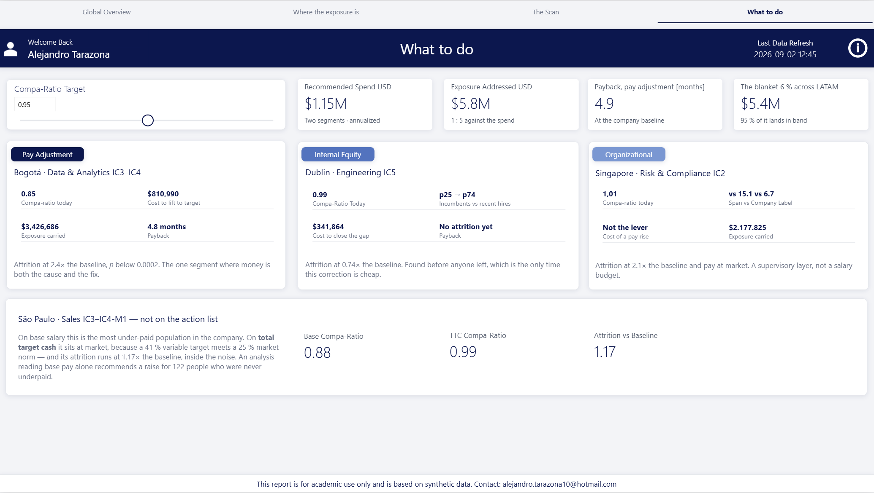
Annex — the report this came from
Four pages
Global Overview · Where the exposure is · The Scan · What to do.
Each carries an information panel stating what the page is for, which figures it shows, and what is deliberately left off it. The export page behind them is the contract a test suite reads.
The screen shown is What to do — the fourth page, and the one this deck's recommendation is drawn from.
The repository
All four pages, with their panels (PDF)
Notes:
Annex. Not part of the argument - it exists so anyone who wants to see the tool behind the numbers can reach it.

