Slide 1
MASTER THESIS DEFENSE · MSC IN QUANTITATIVE ECONOMIC ANALYSIS
Oil-at-Risk
A Framework for Studying Oil Price Vulnerabilities
J. Alejandro Rodríguez Garrido
Supervised by Pilar Poncela Blanco · Diego Eduardo Fresoli
Universidad Autónoma de Madrid · June 2026
Notes:
Hello, my name is Alejandro and I am going to present a framework for studying oil price vulnerabilities and exposure to geopolitical risk. Acknowledgement: many thanks to my professors in the master, especially my supervisors Diego Fresoli and Pilar Poncela for their continuous support in the development of this thesis.

Slide 2
01 · MOTIVATION
Why oil prices?
An old macroeconomic debate
1
Exogenous shocks that cause recessions — Hamilton (1983) shows oil shocks Granger-cause downturns — versus endogenous responses to global demand (Barsky & Kilian, 2004).
Either way, oil is first-order
2
An essential input for strategic sectors and a primary driver of inflation: a concern for producers, investors and economists alike.
And the spotlight is back
3
Recent tensions in the Middle East have once again made crude the barometer of global stress.
Oil-at-Risk · J. A. Rodríguez Garrido — UAM
2
Notes:
Why study this? The exogeneity debate — Hamilton showed oil shocks Granger-caused downturns; Kilian and Barsky argued endogenous responses to global demand. Either way oil is essential for strategic sectors and a primary inflation driver, and the Middle East has put it back in the spotlight.

Slide 3
01 · MOTIVATION
Why a new framework
Asymmetries
1
Vast literature shows the response to oil shocks is asymmetric and time varying (Brignone, Gambetti and Ricci, 2025)
Importance of the tails
2
Volatility clustering, influential outliers and heavy tails distort linear estimates. The tails carry the signal.
So, we adapt the Growth-at-Risk Framework
3
(Adrian et al., 2019) to study the vulnerability of daily oil prices
Oil-at-Risk · J. A. Rodríguez Garrido — UAM
4
Notes:
Why traditional frameworks fail: asymmetric responses (linear models understate downside risk) and the data itself — near-zero average daily returns, volatility clustering, influential outliers, heavy tails. Hence GaR adapted to daily oil prices. And beyond measurement: we show one vulnerability indicator carries predictive power over oil market shakes.

Slide 4
02 · INTRODUCTION
The framework, step by step
1
Quantile regression
Define a specification for the quantile regression of Oil returns.
2
Direct forecasting
Forecast the quantiles of oil returns at a chosen horizon h
3
Distribution fitting
Fit a parametric distribution to the discrete forecasts.
4
Vulnerability metrics
Compute risk metrics from the fitted distribution.
5
Early warning test
Test whether a selected risk metric carries predictive power over oil shocks.
Oil-at-Risk · J. A. Rodríguez Garrido — UAM
5
Notes:
The steps of the framework: a specification for the quantile regression; direct forecasting at horizon h; fit a parametric distribution to the discrete forecasts; compute vulnerability metrics; and test whether a selected risk metric predicts oil shocks.

Slide 5
AGENDA
Roadmap of the defense
1
Literature review
2
Contribution
Where this thesis fit
One main contribution, five components
3
Data & specification
4
Direct forecasting
Regressors as sources of risk
Setting, breach indicators, competing models
5
Distribution fitting
6
Risk metrics
The Johnson SU, MDE, and diagnostics
VaR, ES, skewness — and relative entropy
7
Early warning system
8
Conclusions
Hypothesis, tests, Iran War eve case
And the open-source module
Oil-at-Risk · J. A. Rodríguez Garrido — UAM
6
Notes:
For the presentation as a whole: literature and where the thesis fits; the contribution; data and specification; then the pipeline — direct forecasting, distribution fitting, risk metrics, EWS diagnostics; conclusions and time for questions.

Slide 6
03 · LITERATURE
The Growth-at-Risk paradigm
Adrian, Boyarchenko & Giannone (2019), American Economic Review — “Vulnerable Growth”
The finding
1
The conditional distribution of GDP growth depends on financial conditions: adverse conditions greatly deteriorate the lower quantiles while the upper quantiles barely move.
The original architecture
2
Quantile regression at 5 distinct quantiles → a skewed-t distribution fitted to those quantiles → risk metrics extracted from the density to study vulnerability.
Our adaptation
3
The original setup was meant for quarterly data and well-known macro indicators. We adapt it to exploit high-frequency financial data — and a familiar but different problem.
Oil-at-Risk · J. A. Rodríguez Garrido — UAM
7
Notes:
The main research behind this thesis: Adrian, Boyarchenko & Giannone 2019 — conditional distribution of GDP as a function of financial conditions; adverse conditions crush the lower quantiles while upper ones barely move. Original setup: QR at 5 quantiles, skewed-t fit, risk metrics. Meant for quarterly data and familiar indicators — we adapt it to high-frequency financial data.

Slide 7
03 · LITERATURE
The five pillars of the adapted methodology
Koenker & Bassett (1978)
Formalised quantile regression and its main diagnostic tools — the same QR core used by the original authors.
Engle & Manganelli (2004)
CAViaR: formalised the contestant models proposed in this thesis — alternative specifications for the QR.
Johnson (1949)
The SU family: a flexible transformation of the Gaussian capturing skewness and heavy tails — our departure from the skewed-t.
Kullback & Leibler (1951)
Relative entropy: the divergence measure behind the main vulnerability metric of this thesis.
Diebold & Mariano (1995) · Diebold, Gunther & Tay (1998)
The backtesting toolkit used to compare forecasts and assess the calibration of the fitted densities.
Oil-at-Risk · J. A. Rodríguez Garrido — UAM
8
Notes:
Five pillars: Koenker & Bassett 1978 (QR and diagnostics — unchanged from the original); Engle & Manganelli 2004 (CAViaR — our contestant models); Johnson 1949 (the SU family — a transformation of the Gaussian, our departure from the skewed-t); Kullback & Leibler 1951 (relative entropy — the main metric); Diebold & Mariano 1995 and Diebold, Gunther & Tay 1998 (backtesting toolkit). And FYI: the framework is used at the IMF for house prices at risk and surveillance, and adapted to inflation at central banks.

Slide 8
04 · CONTRIBUTION
The contribution
MAIN CONTRIBUTION Adapting a novel methodology to study the vulnerabilities of oil prices, this which includes:
1
Familiar quantile models inside the architecture: the CAViaR-inspired contestants.
2
A departure from the canonical skewed-t to a financial-friendly density: the Johnson SU.
3
An early warning system built on one of the risk metrics.
4
An open-source Python module to replicate the full pipeline or extend it to other research.
4
Beyond the application itself: this presentation also aims to explain the framework, in case you find it useful for studying other phenomena — as other authors have done.
Oil-at-Risk · J. A. Rodríguez Garrido — UAM
9
Notes:
One main contribution — adapting a novel framework to study oil price vulnerability — with five components: familiar quantile models inside the architecture; the JSU replacing the skewed-t; the backtesting battery; the EWS built on a risk metric; and the open-source module. And the broader aim: explaining the framework so others can reuse it.

Slide 9
05 · DATA
A specification built on risk
We want to study vulnerabilities related to specific risk sources.
Risk moves oil prices
1
Kilian (2009): precautionary demand, the fear of future supply disruptions drives agents to buy early, altering prices before any physical shortfall.
And it moves them asymmetrically
2
Brignone, Gambetti & Ricci (2025): geopolitical shocks in the oil market are highly asymmetrical, motivating a flexible, distribution-aware framework.
Oil-at-Risk · J. A. Rodríguez Garrido — UAM
10
Notes:
Why the specification is built on risk metrics: the EMH — prices reflect all available information and expected returns are a function of risk; so we condition on sources of risk. Supporting literature: Kilian's precautionary demand and Brignone et al.'s asymmetry. Each regressor will capture a distinct source of risk: geopolitical, exchange, logistical, speculative.

Slide 10
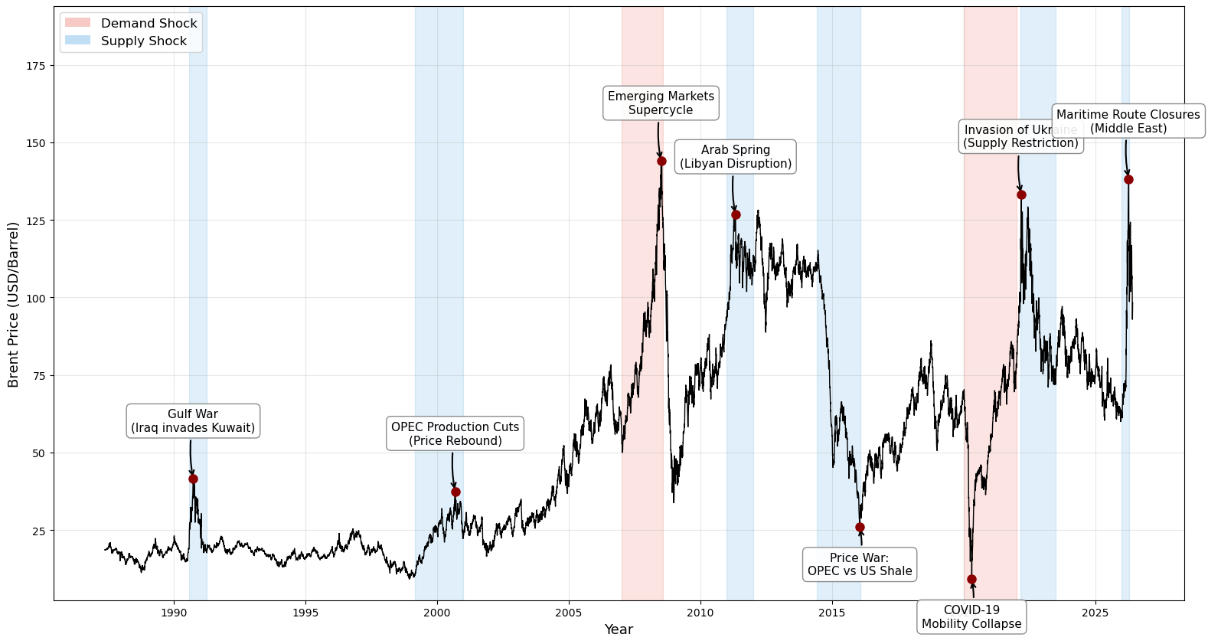
05 · DATA
The dependent variable: Brent crude log-returns
Brent spot price, 1990–2026, with its structural supply and demand episodes
Daily frequency, January 1990 to April 2026, via FRED (EIA). We work with the log-returns of the spot price.
Oil-at-Risk · J. A. Rodríguez Garrido — UAM
11
Notes:
The dependent variable: Brent crude, daily from 1990 to April 2026 via FRED. We work with log-returns. The chart shows the price history and the structural episodes the sample spans — Gulf wars, 2008, the 2014 glut, COVID, Ukraine, Iran.

Slide 11
05 · DATA
Why Brent and not WTI?
Preferred in the literature
Waterborne, not landlocked
Brent is the standard choice for studying world oil prices: it better reflects international market conditions. WTI is too tied to U.S. domestic conditions.
Extracted in the North Sea and loaded directly onto ships: tradable across Europe, Asia, Africa and the Americas.
Global market dominance
Sensitivity to global geopolitics
Roughly two-thirds of globally traded crude is priced relative to Brent — the benchmark for Europe, Africa and the Middle East.
As a maritime crude, Brent reacts immediately to chokepoint disruptions — Hormuz, the Red Sea — OPEC+ decisions, and tensions across three continents.
WTI is technically lighter and sweeter — but in a global benchmark, logistics and liquidity beat chemistry.
Oil-at-Risk · J. A. Rodríguez Garrido — UAM
12
Notes:
Why Brent over WTI: the literature's standard choice because it reflects international conditions — WTI is too tied to the US; waterborne and internationally accessible; two-thirds of world crude priced off Brent; and maritime exposure means geopolitics shows up in Brent first.

Slide 12
05 · DATA
The regressors: three sources of risk
GEOPOLITICAL RISK
EXCHANGE RISK
LOGISTICAL RISK
Geopolitical Risk Index (MA-7)
U.S. Dollar Index
Baltic Dry Index
Caldara & Iacoviello (2022)
Chen, Rogoff & Rossi (2010)
Bakshi, Panayotov & Skoulakis (2011)
Seven-day moving average of the daily GPR index: geopolitical risk as perceived by the media. The main regressor and the main source of risk in this thesis.
Oil is traded mostly in dollars: the index captures the exchange-rate component of price movements — and exchange rates have been shown to forecast commodity prices.
Bulk-shipping freight rates: captures logistical disruptions in the oil distribution chain. The BDI predicts commodity returns and global economic activity.
Oil-at-Risk · J. A. Rodríguez Garrido — UAM
13
Notes:
Each regressor captures a distinct source of risk. GPR (MA-7 of the daily index by Caldara & Iacoviello): geopolitical risk as perceived by the media — the main regressor. The US Dollar Index: exchange risk — oil trades in dollars, and Chen, Rogoff & Rossi show exchange rates can forecast commodity prices. The Baltic Dry Index: logistical risk in the distribution chain — Bakshi, Panayotov & Skoulakis show it predicts commodity returns and global activity.

Slide 13
05 · DATA
The fourth source: realized volatility
SPECULATIVE / VOLATILITY RISK
What it captures
Why it adds predictive power
Volatility clustering and sudden changes in speculation — the market-turbulence component of oil price risk, kept separate from the structural pricing of geopolitical threat.
Cenesizoglu & Timmermann: the distribution of returns is predictable using volatility-type state variables. Andersen, Bollerslev, Diebold & Labys (2003): modelling realized volatility directly outperforms latent-variance models.
A model-free, observable measure — unlike the latent variance of GARCH-type models.
Oil-at-Risk · J. A. Rodríguez Garrido — UAM
14
Notes:
The fourth risk source: speculation and volatility. RV captures volatility clustering and sudden changes in speculation. Literature: Cenesizoglu & Timmermann on return-distribution predictability; Andersen, Bollerslev, Diebold & Labys 2003 on RV-based forecasting beating latent-variance models. It is observable and model-free.

Slide 14
06 · SPECIFICATION
The specification
τ ∈ {0.01, 0.05, 0.25, 0.50, 0.75, 0.95, 0.99} — one specification preserved across all quantiles, for simplicity
Why no more variables? To prevent multicollinearity and keep parsimony: a compact regressor set protects the tails from overfitting and keeps the quantiles comparable. (Correlation matrix of the regressors in the backup slides.)
Oil-at-Risk · J. A. Rodríguez Garrido — UAM
15
Notes:
The specification, preserved across all quantiles for simplicity. Why no more variables: to prevent multicollinearity and keep some parsimony. The correlation matrix is in the backup slides, as is the detailed rationale for the 7-day moving average.

Slide 15
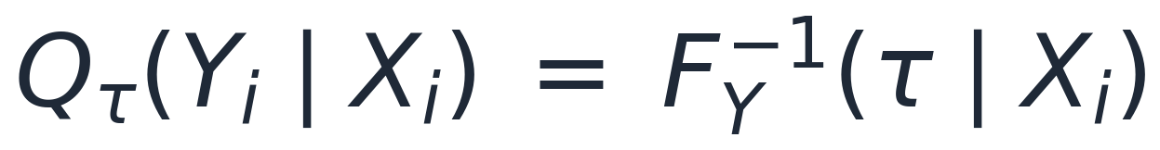
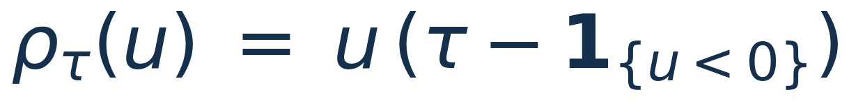
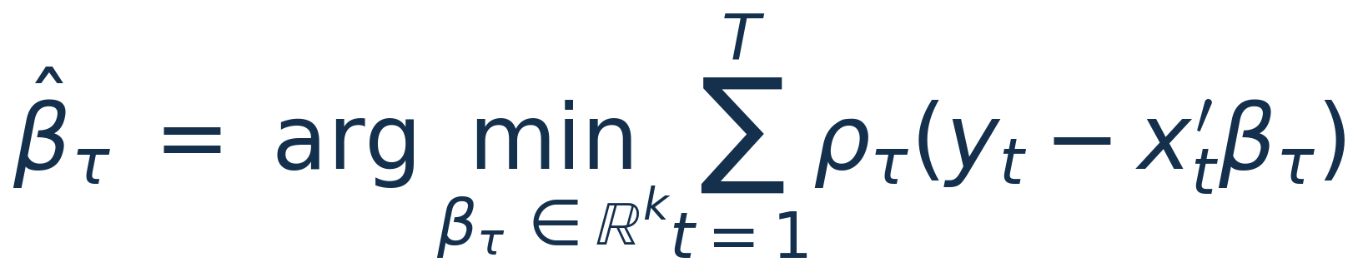
07 · QUANTILE REGRESSION
The quantile regression estimator
The conditional quantile function
The asymmetric check loss
The estimator (Koenker & Bassett, 1978)
Oil-at-Risk · J. A. Rodríguez Garrido — UAM
16
Notes:
The estimator itself: the conditional quantile function as the inverse conditional CDF; the asymmetric check loss that traces out percentiles; and the Koenker-Bassett estimator, solved as a linear programme. The optimisation details are in the backup slides.

Slide 16
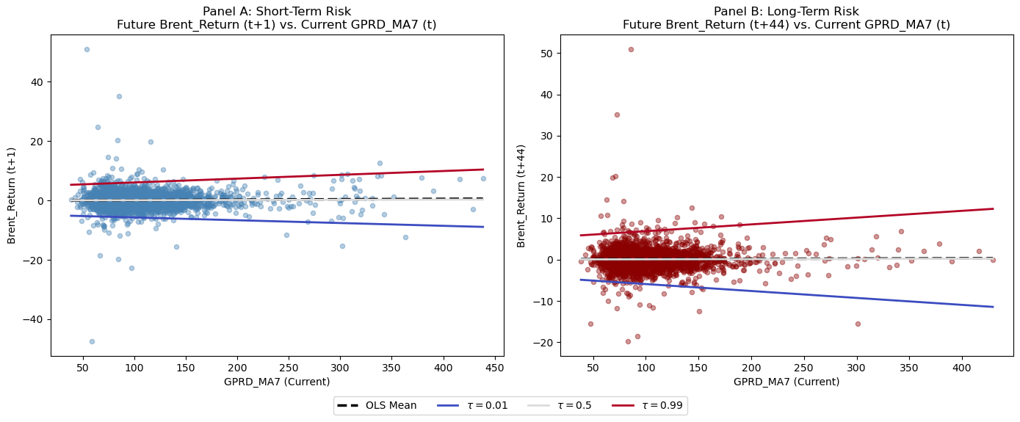
07 · QUANTILE REGRESSION
In-sample estimates
Fitted quantiles against realised returns
Oil-at-Risk · J. A. Rodríguez Garrido — UAM
17
Notes:
In-sample estimates: the coefficient dashboard (paths across quantiles, controls, pseudo R-squared, residuals) and the fitted scatter plots. Next slide: the coefficients side by side at the three key quantiles.

Slide 17
07 · QUANTILE REGRESSION
What the estimates say
Great explanatory power in the tails, little at the median
1
R¹ ≈ 0.53 and 0.56 at the 5th and 95th percentiles against 0.03 at the median. Expected, since the median daily return carries almost no signal.
Asymmetric GPR effect
2
The sign of the GPR coefficient flips between the lower and the upper tail: geopolitical stress deepens downside risk and stretches the upside simultaneously.
But no causal conclusions
3
A quantile regression alone does not identify causal effects — that requires pairing it with valid techniques such as instrumental-variable QR (Chernozhukov & Hansen).
Oil-at-Risk · J. A. Rodríguez Garrido — UAM
19
Notes:
Main in-sample results: explainability concentrated in the tails (expected — the median return carries no signal); asymmetric GPR effect through the sign flip; and the honest caveat — no causal conclusions from QR alone, it would need IV-QR à la Chernozhukov & Hansen. More on this in the backup slides.

Slide 18
08 · DIRECT FORECASTING
The direct forecasting problem
We cannot iterate the expected value as in other well-known time-series models: conditional quantiles obey no law of iterated expectations. Each forecast horizon therefore gets its own dedicated regression.
Training
Evaluation
A 1,000-observation rolling window — around 4 years of trading data.
Independently evaluated on the last 3 years of data, through recursive out-of-sample estimation.
Oil-at-Risk · J. A. Rodríguez Garrido — UAM
20
Notes:
Direct forecasting: quantiles cannot be iterated like conditional means, so each horizon gets its own regression. Setting: 1,000-observation rolling window (~4 years) for training, independent evaluation on the last 3 years of data through recursive out-of-sample estimation. Why the iteration fails is expanded in the backup slides.

Slide 19
08 · DIRECT FORECASTING
The horizon: h = 5 trading days
One trading week
1
Not too short, not too long: the natural cadence for hedge and margin decisions, and short enough for the quantile signal to stay sharp.
One horizon for the whole pipeline
2
Applied consistently across forecasting, risk metrics and the early-warning step, so every output speaks about the same object.
A convention, stated openly
3
Other horizons may be tried, and in a more rigorous approach, the model may be calibrated.
Oil-at-Risk · J. A. Rodríguez Garrido — UAM
21
Notes:
The horizon: 5 periods, one full trading week. Not too short, not too long. Uniform across the pipeline. The rigorous alternative — selecting h where the regressor-target dynamics are best captured — is discussed in the backup slides.

Slide 20
08 · DIRECT FORECASTING
Focusing on the tails: the breach indicator
We want a model that captures extreme tail events, so we build a proper diagnostic tool.
One flag for upside breaches, one for downside — asymmetric effects stay visible.
Breaches cluster around market shakes: the standard model systematically fails to capture tail events exactly when it matters.
Oil-at-Risk · J. A. Rodríguez Garrido — UAM
22
Notes:
Since the object is extreme tail events, we build a breach indicator: 1 when the realised value lands outside the forecast quantile range, split by side for asymmetry. The figure shows the standard model's breaches: they cluster around market shakes — the model systematically fails during exactly those periods.

Slide 21
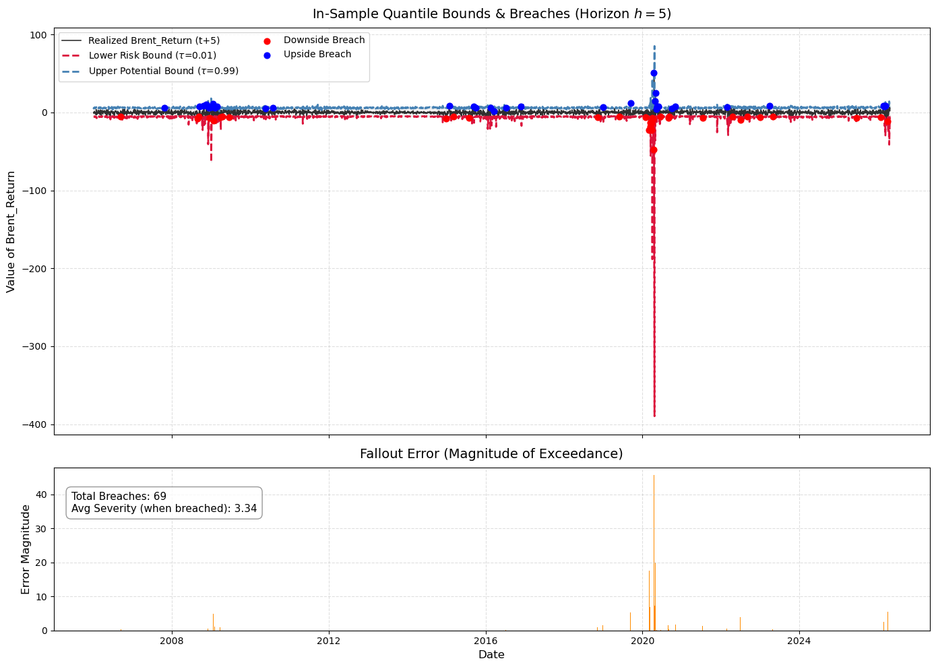
08 · DIRECT FORECASTING
Focusing on the tails: the breach indicator
Breaches of the standard model across the evaluation window
Oil-at-Risk · J. A. Rodríguez Garrido — UAM
22
Notes:
Since the object is extreme tail events, we build a breach indicator: 1 when the realised value lands outside the forecast quantile range, split by side for asymmetry. The figure shows the standard model's breaches: they cluster around market shakes — the model systematically fails during exactly those periods.

Slide 22
08 · DIRECT FORECASTING
The fix: giving the model memory of its failures
We import the CAViaR models of Engle & Manganelli (2004) — originally built for Value-at-Risk — into our framework: two contestants that include the breach indicator among their regressors, so they can react to extreme events.
Model 2 · binary indicator
Model 3 · breach severity
The breach enters as a binary variable: one flag for upside, one for downside, to control for asymmetric effects. Any breach weighs the same: size is not considered.
The breach enters as a continuous variable: the distance from the realised value to the closest quantile. Larger breaches get larger weight: the model adjusts for size.
Oil-at-Risk · J. A. Rodríguez Garrido — UAM
23
Notes:
The fix: give the model memory of its own failures. Two CAViaR-inspired contestants, differing only in how the breach enters: Model 2 as binary flags (any breach weighs the same); Model 3 as the severity — distance from the realised value to the closest quantile, weighting large breaches more.

Slide 23
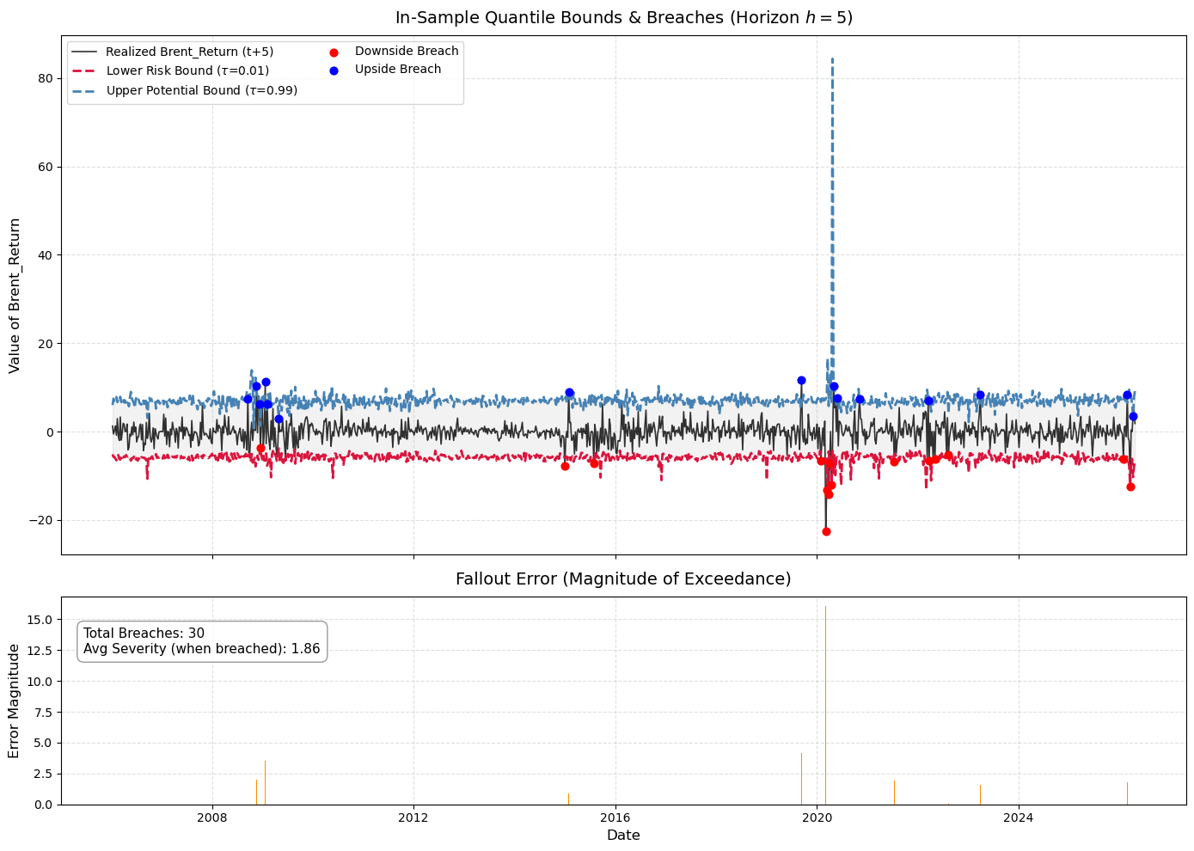
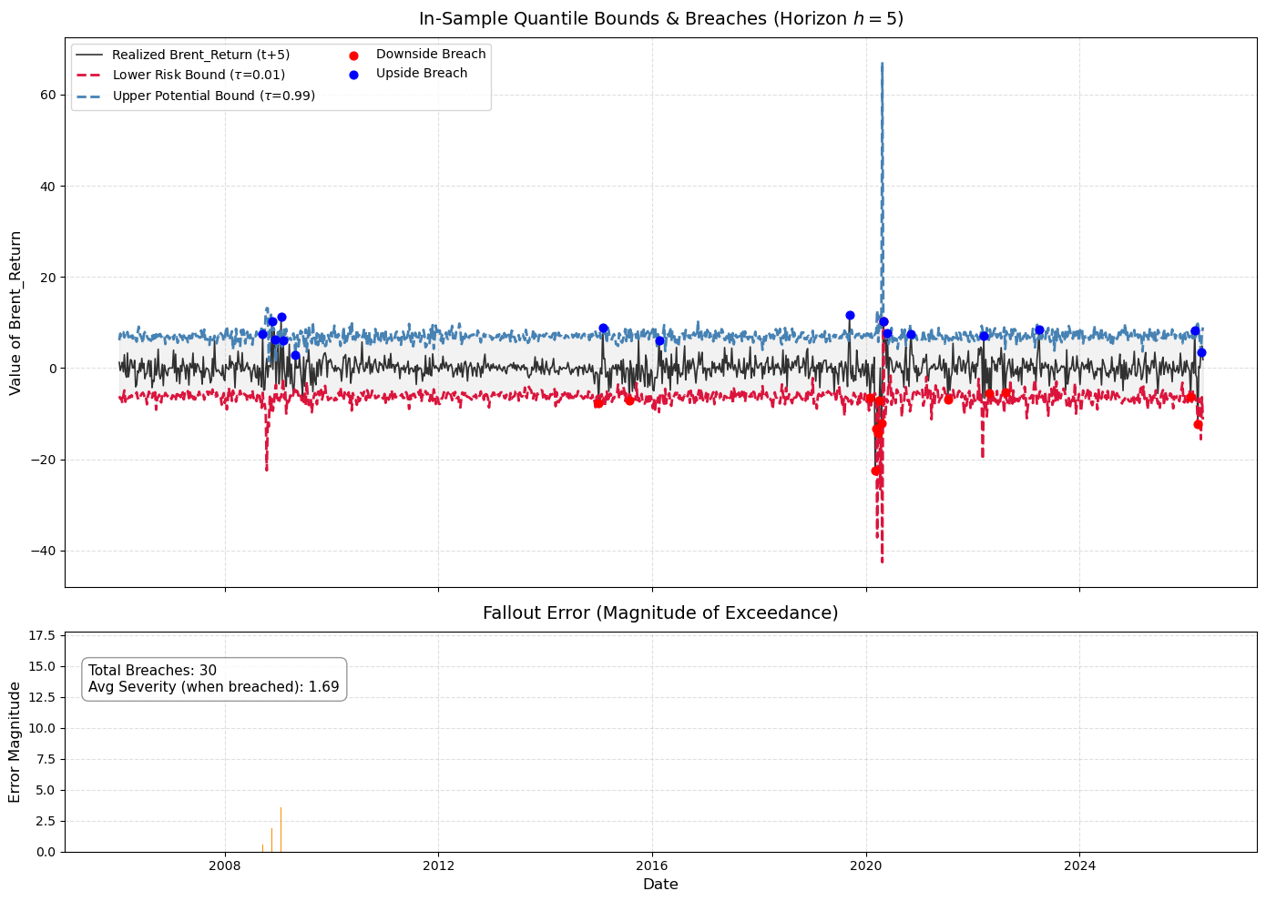
08 · DIRECT FORECASTING
The fallout audit: the contestants react
CAViaR indicator: breaches
CAViaR severity: breaches
The augmented models cut the number of breaches more than twice: they capture tail events far better.
But…
Oil-at-Risk · J. A. Rodríguez Garrido — UAM
24
Notes:
The fallout audit: the breach paths of the two augmented models. They cut the number of breaches roughly by three — much better tail capture. But... (next slide: does that translate into predictive power?)

Slide 24
08 · DIRECT FORECASTING
The comparison: does memory add predictive power?
Diebold–Mariano on the tick loss (τ = 0.95, h = 5)
Comparison | p-value | Verdict
Standard vs CAViaR-i | 0.364 | no difference
Standard vs CAViaR-s | 0.280 | no difference
CAViaR-i vs CAViaR-s | 0.237 | no difference
At this horizon and quantile, the breach indicator adds no significant predictive power: the signal probably arrives too late.
Disclaimer: at shorter horizons, these models may improve predictive power significantly. Pending for future steps.
Oil-at-Risk · J. A. Rodríguez Garrido — UAM
25
Notes:
The comparison: Diebold-Mariano on tick-loss error series — no model dominates at h=5; the breach signal probably comes too late. The OOS loss profiles at the main quantiles tell the same story. Disclaimer: at shorter horizons other results may be observed — expanded in the backup slides.

Slide 25
09 · DISTRIBUTION FITTING
The Johnson SU distribution
A flexible transformation of the standard normal (this is the reduce expression):
ξ
λ
γ
δ
Location
Scale
Skewness
Tail weight
Centres the distribution
Stretches the distribution (proxy for std.)
Tilts the distribution
Governs the heaviness of the tails
Oil-at-Risk · J. A. Rodríguez Garrido — UAM
26
Notes:
The Johnson SU: a transformation of the standard normal through the inverse hyperbolic sine. Four parameters: xi location (anchored at the median forecast), lambda scale, gamma skewness, delta tail weight. The two shape parameters are what let it track asymmetric, heavy-tailed oil returns.

Slide 26
09 · DISTRIBUTION FITTING
Why the Johnson SU?
Independent shape control
1
γ drives skewness and δ drives tail weight, independently: the family tracks the asymmetric tail rotations of oil — right tail fattening under supply threats, left under demand collapses — and nests the Gaussian as a limit.
Versatile and field-tested for asset returns
2
One of the most used distributions for modelling financial returns, precisely because it accounts for skewness and tail weight. The canonical skewed-t is not estimated here — no head-to-head is claimed.
Oil-at-Risk · J. A. Rodríguez Garrido — UAM
27
Notes:
Why the JSU: independent control of skewness and tail weight — it tracks the tail rotations of oil and nests the Gaussian; and it is versatile, battle-tested for asset returns. Honesty point: we do not estimate the skewed-t, so no superiority claim.

Slide 27
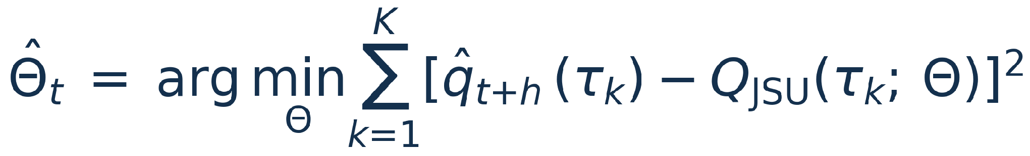
09 · DISTRIBUTION FITTING
Fitting with seven points: Minimum Distance Estimation
Why not Maximum Likelihood? At each origin we observe only K = 7 predicted quantiles — not a sample of future returns. MDE fits the theoretical quantile function to that forecast skeleton instead.
Configuration
Training & refresh
ξ starts at the median forecast, λ at the IQR, γ = 0, δ = 1 — a symmetric prior the optimiser refines. Equal weights; tolerance 10⁻¹⁰.
Same 1,000-day rolling training window as the forecasting step; the quantile coefficients are retrained every 30 out-of-sample days.
Oil-at-Risk · J. A. Rodríguez Garrido — UAM
28
Notes:
Why not MLE: seven quantiles, not seven thousand observations. MDE minimises the squared distance between the JSU quantile function and the forecast skeleton. Configuration: median/IQR initialisation, symmetric shape prior, equal weights, tight tolerance. Training: the same 1,000-day rolling window, coefficients retrained every 30 OOS days.

Slide 28
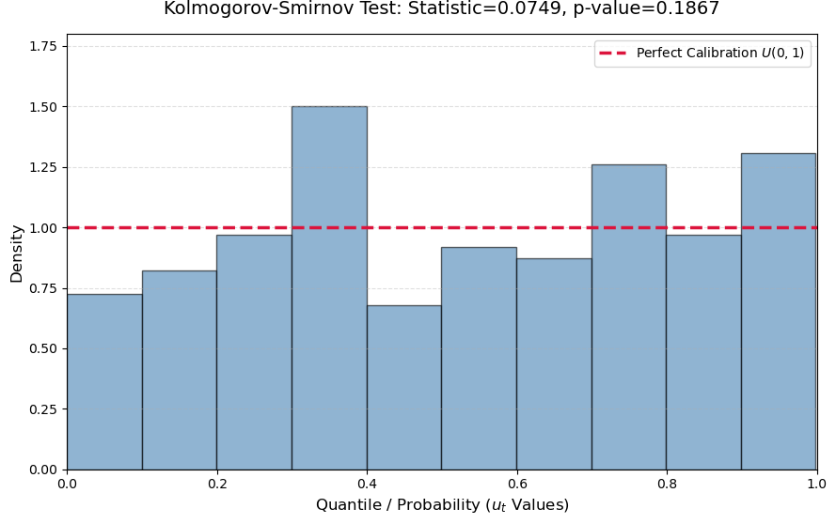
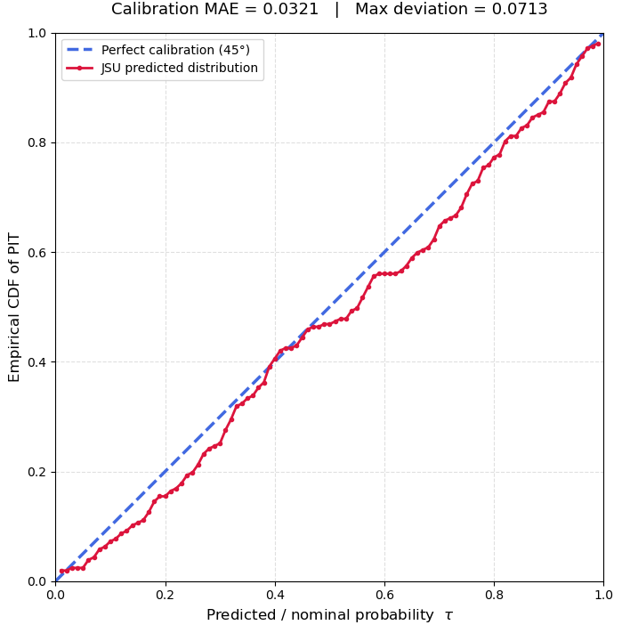
09 · DISTRIBUTION FITTING
Is the fit any good? The PIT test
The PIT measures where each realised return lands within the forecast distribution (Diebold, Gunther & Tay, 1998). Under a perfectly calibrated model, the PIT sequence behaves as a Uniform(0,1) — tested with a Kolmogorov–Smirnov test on the out-of-sample PITs.
PIT histogram vs U(0,1)
Empirical vs theoretical CDF
Oil-at-Risk · J. A. Rodríguez Garrido — UAM
29
Notes:
The PIT: where did each realised return land within our forecast distribution? Under a perfectly calibrated model the PIT sequence is Uniform(0,1). We run a KS test on the OOS PITs — and pass. (Say the pass verbally; it is deliberately not printed on the slide.)

Slide 29
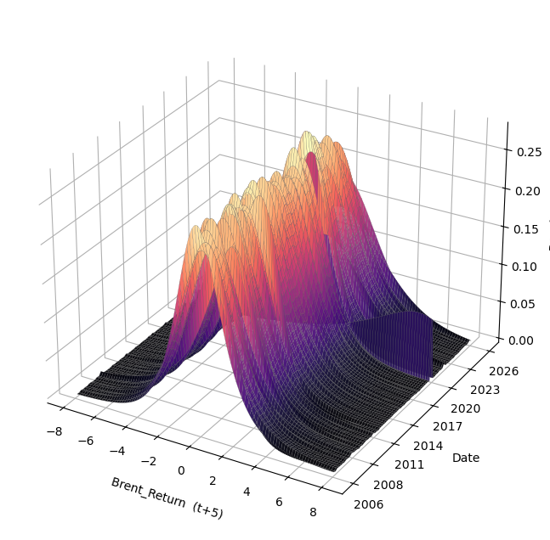
09 · DISTRIBUTION FITTING
The result: a full forecasted density, every day
Twenty years of daily conditional densities for Brent returns at h = 5
Oil-at-Risk · J. A. Rodríguez Garrido — UAM
30
Notes:
The payoff of the fitting step: a full forecasted density at every trading day. The tails visibly fatten under stress episodes. Everything that follows — VaR, ES, skewness, entropy — is read from this surface.

Slide 30
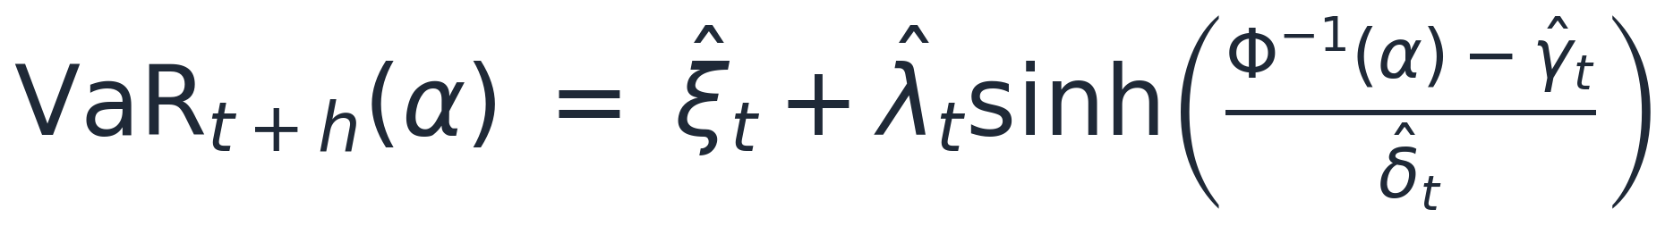
10 · RISK METRICS
Reading risk off the density: VaR, ES, skewness
Value-at-Risk
Expected Shortfall
Skewness
The α-quantile of the fitted JSU, computed for both tails, they need not move together. Already an h-day VaR: no √t scaling.
The average loss beyond VaR, coherent (sub-additive) and the Basel III FRTB standard; quoted at 97.5% confidence.
Closed-form Fisher skewness of the JSU: which way is the balance of risks tilted, supply-threat upside or demand-collapse downside?
Benchmarked against a rolling 1,000-day historical simulation: divergence means the model sees a shift that recent history has not yet absorbed.
Oil-at-Risk · J. A. Rodríguez Garrido — UAM
31
Notes:
Four vulnerability metrics from the fitted distribution; here the first three. VaR from the closed-form JSU quantile, both tails, no time-scaling. ES: coherent, Basel III at 97.5%. Skewness: closed-form, tracks the direction of the risk balance.

Slide 31
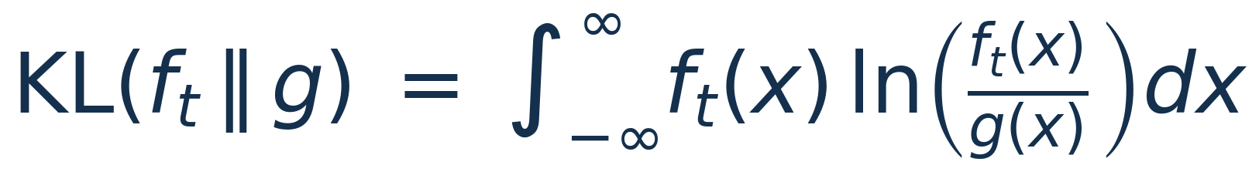
10 · RISK METRICS
The main metric: relative entropy (KL divergence)
Kullback & Leibler (1951): how far a density has moved from a reference state, the whole shape, not a single point on it.
Computed over three regions of the distribution:
Full divergence
Right-tail divergence
Left-tail divergence
The entire distribution: the aggregate shift of the forecast density away from the reference.
Computed over the 0.90 – 0.99 quantile region: upside stress — supply threats and geopolitical escalation.
Computed over the 0.01 – 0.10 quantile region: downside stress — demand collapses and risk-off episodes.
Disclaimer: the tail intervals are a convention — a more robust approach would test which intervals yield the best results.
Oil-at-Risk · J. A. Rodríguez Garrido — UAM
32
Notes:
The main metric: relative entropy — the expected log-likelihood ratio between the forecast density f and the reference g. Computed three ways: over the full distribution, over the right tail (0.90-0.99 region, upside stress) and over the left tail (0.01-0.10 region, downside stress). Disclaimer in small print: the intervals are a convention; a more robust approach would calibrate them.

Slide 32
10 · RISK METRICS
Two candidate reference states
The unconditional density
The Normal density
A Johnson SU fitted by Maximum Likelihood to the historical returns in the rolling window: the market's long-run distribution, as the data describe it.
The distribution usually assumed to produce fan charts and density forecasts — and the JSU's own parent: the SU family collapses to the Gaussian in the limit.
Divergence reads as: how far are current conditions from the historical norm?
Divergence reads as: how non-Gaussian — how fat-tailed and tilted — have the forecast densities become?
Oil-at-Risk · J. A. Rodríguez Garrido — UAM
33
Notes:
Two candidate references: the unconditional density (JSU fitted by MLE to history) and the Normal (the classical fan-chart assumption and the JSU's parent). Which to choose? Look at the data first.

Slide 33
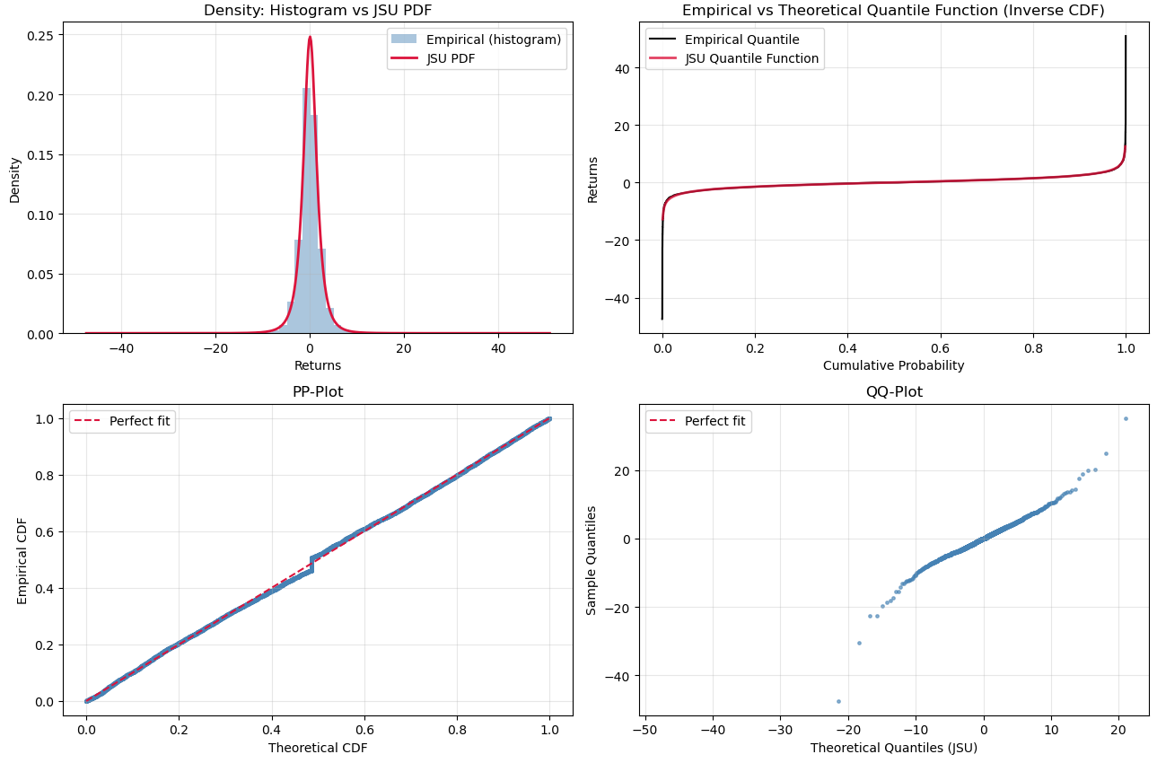
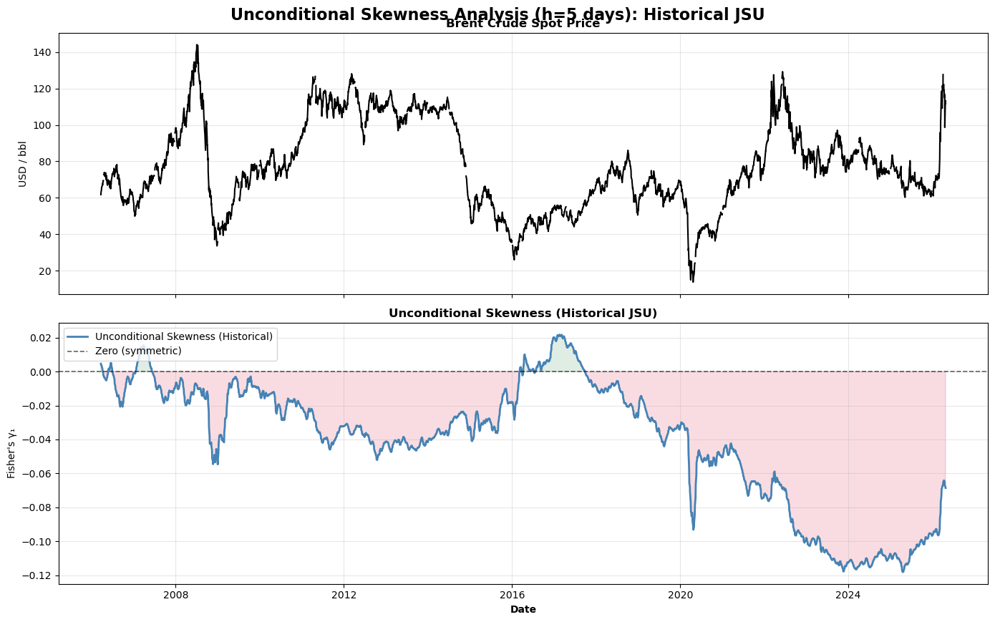
10 · RISK METRICS
What the unconditional distribution looks like
The unconditional JSU, fitted by MLE: heavy-tailed, near-symmetric centre
Rolling skewness of the unconditional JSU: negative and drifting
The unconditional fit is strongly heavy-tailed — and its skewness is not constant: it drifts with the market regime.
Oil-at-Risk · J. A. Rodríguez Garrido — UAM
34
Notes:
The evidence: left, the unconditional JSU fitted by MLE — strongly heavy-tailed. Right, its rolling skewness — persistently negative and drifting with the regime. The unconditional reference is itself absorbing skewness changes.

Slide 34
10 · RISK METRICS
The verdict: use the Normal as baseline
The natural baseline
1
The Johnson SU nests the Normal, and the Normal is the distribution usually assumed when producing fan charts and density forecasts, a natural reference state.
The unconditional density embeds risk
2
It absorbs skewness and heavy tails, which are risks in themselves, so measuring divergence against it may understate the risk metrics.
So divergence from the Normal reads cleanly
3
Tail fattening and tilt: exactly the risks a vulnerability metric should detect, not absorb into its reference.
Oil-at-Risk · J. A. Rodríguez Garrido — UAM
35
Notes:
Why the Normal: first, the JSU nests it and it is the usual fan-chart assumption — a natural baseline. Second, the unconditional density already embeds skewness and heavy tails, which are risks in themselves, so measuring against it may understate risk.

Slide 35
11 · EARLY WARNING SYSTEM
Does the entropy predict? The hypothesis and the tests
HYPOTHESIS The entropy, computed from the forecasted distribution, carries predictive power over oil prices. Since we forecast five days ahead, we should expect at least five days of lead.
Test 1 · Cross-Correlation Function
Test 2 · Granger causality
The correlation between returns and the entropy — first-differenced to make it stationary. If the entropy warns early, it should correlate more with future returns than with the past or the present.
The second opinion: does the entropy help predict oil returns beyond what their own history already provides?.
Oil-at-Risk · J. A. Rodríguez Garrido — UAM
36
Notes:
Most GaR frameworks stop at the metrics — we test whether the entropy predicts. Hypothesis: at least 5 days of lead, since the forecast is 5-ahead. Two tests: the CCF (entropy first-differenced for stationarity; expect higher correlation with future returns) and Granger causality as a second opinion (beyond the returns' own history). DISCLAIMER for questions — what these tests do and do not establish: they certify predictive content in the forecasting sense (lead-lag correlation; incremental information beyond the returns' own lags). They do NOT establish structural or economic causation, the CCF is bivariate (cannot exclude a common third factor), and the Granger F conditions only on the returns' own history — not on other predictors like volatility.

Slide 36
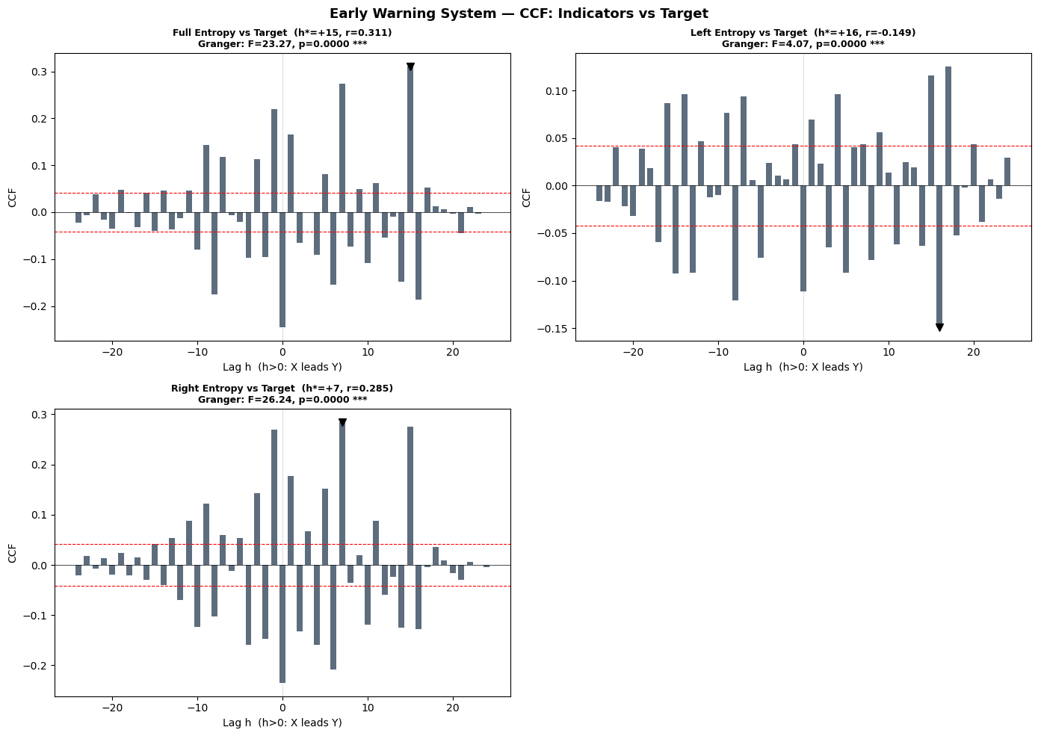
11 · EARLY WARNING SYSTEM
Results: the entropy leads Brent returns
Indicator | CCF peak | r at peak | Granger F | p
Right-tail entropy | +6 days | −0.250 | ≈ 29.6 | < 0.001
Full entropy | +14 days | −0.229 | ≈ 29.4 | < 0.001
Left-tail entropy | +16 days | −0.110 | ≈ 5.2 | < 0.001
The entropy leads Brent returns by 6 to 16 days, depending on the metric; all Granger-significant at the 1% level.
CCF: all peaks at strictly positive lags
Part of the lead is expected; the entropy comes from a 5-step-ahead forecast. But the lead exceeds it: the forecast is truly forecasting.
Oil-at-Risk · J. A. Rodríguez Garrido — UAM
37
Notes:
The results: leads of 6-16 days depending on the entropy metric, all Granger-significant at 1% (sample: 2,167 daily observations, June 2012 - April 2026; AIC lags 16-22). DISCLAIMER — what is and is not being tested: these are tests of predictive content in the forecasting sense. The CCF is a bivariate lead-lag correlation — it cannot exclude a common third factor. Granger conditions on the returns' own history only — it certifies incremental information, not structural causation. Effect sizes are modest (squared peak correlations of roughly 1-6%): a signal to combine with others, not a standalone trigger. And part of the measured lead is mechanical, since the entropy is built from a 5-day-ahead forecast — the finding is that the lead exceeds that horizon.

Slide 37
12 · CONCLUSIONS
Conclusions
The methodology travels
1
It can measure the vulnerability of many indicators to different sources of risk, this thesis is one application, and within it many possibilities remain to be explored.
Forecast-based entropy carries predictive power
2
KL divergence computed from forecasted quantiles leads the target variable — with a lead longer than the forecast horizon — even in high-frequency, volatile markets.
The scope is bounded by the regressors
3
Ours capture geopolitical and market risks, so the entropy reacts early to those: it may have no predictive power over other kinds of events. Other risk sources can be added to the specification.
Oil-at-Risk · J. A. Rodríguez Garrido — UAM
38
Notes:
Three conclusions: the methodology is general — one application among many possible; forecast-based KL divergence carries predictive power with a lead longer than the forecast horizon, even at daily frequency in a volatile market; and the scope is bounded by the risk sources in the specification — geopolitical and market risks here, other sources can be added. The punchline: high-frequency data lets GaR become an early warning system.

Slide 38
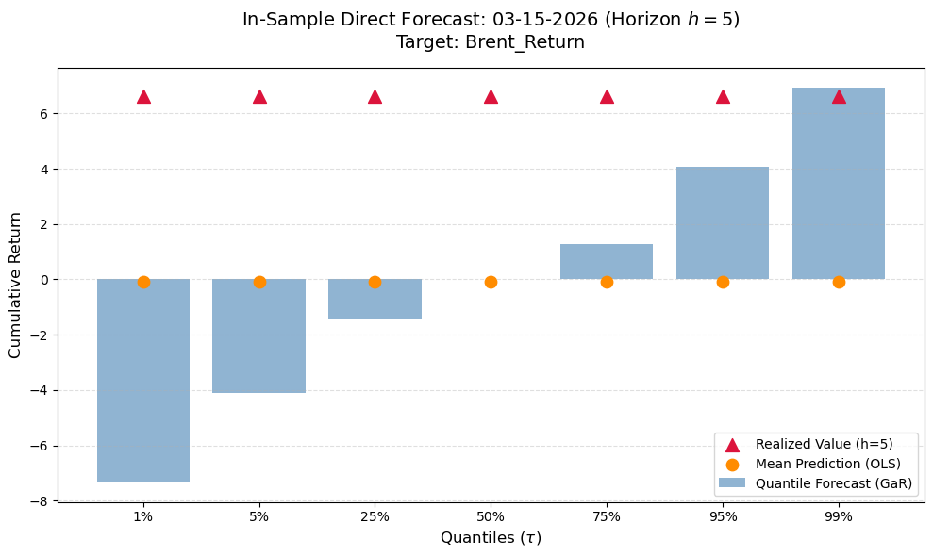
EXAMPLE 1
The quantile forecast at the eve of the Iran war
Realised Brent returns against the forecast quantile envelope around the escalation
Oil-at-Risk · J. A. Rodríguez Garrido — UAM
39
Notes:
Example one: the quantile forecast around the eve of the Iran war. The corridor visibly widens ahead of the largest moves as the conditioning variables absorb the threat.

Slide 39
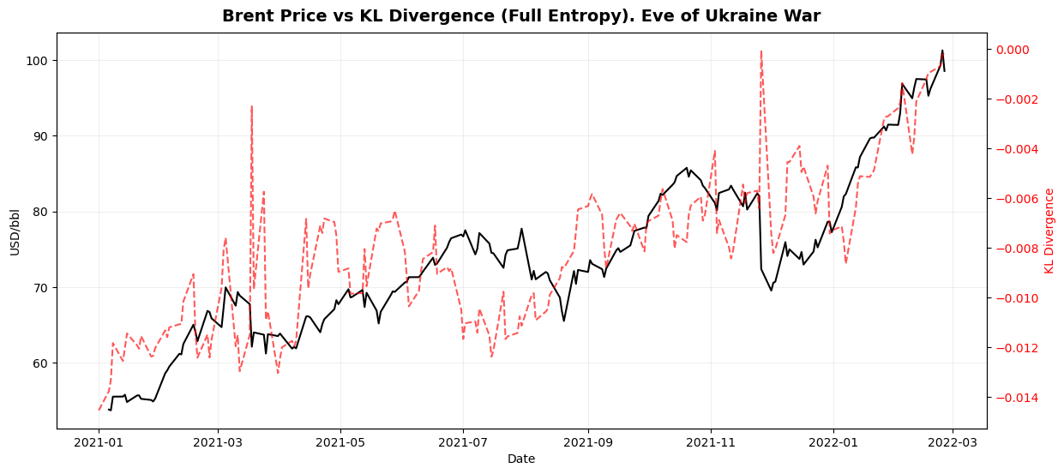
EXAMPLE 2
KL divergence vs Brent at the eve of the Ukraine war
KL divergence against Brent prices, zoomed on the eve of the Ukraine war (early 2022)
Oil-at-Risk · J. A. Rodríguez Garrido — UAM
40
Notes:
Example two: the KL divergence against Brent at the eve of the Ukraine war — the entropy spiking ahead of the price break. Figure placeholder: export the zoomed plot to results/plots and drop it in.

Slide 40
13 · SOFTWARE
The Python module: architecture
data & preprocessing
quantile engine
direct forecasting
→
→
alignment, returns, MA construction
standard + CAViaR-augmented specifications
rolling windows, horizon grid, recursive OOS
↓
distribution
risk metrics
backtesting
→
→
Johnson SU fitting by MDE
VaR · ES · skewness · KL divergence
Kupiec · DM · PIT · DQ · fallout
Six modules, one pipeline: each step consumes the previous step's output — and each can be swapped without touching the rest.
Oil-at-Risk · J. A. Rodríguez Garrido — UAM
41
Notes:
The architecture: six modules mirroring the methodology one-to-one — data, quantile engine, direct forecasting, distribution, risk metrics, backtesting. Modular by design: each stage can be swapped independently.

Slide 41
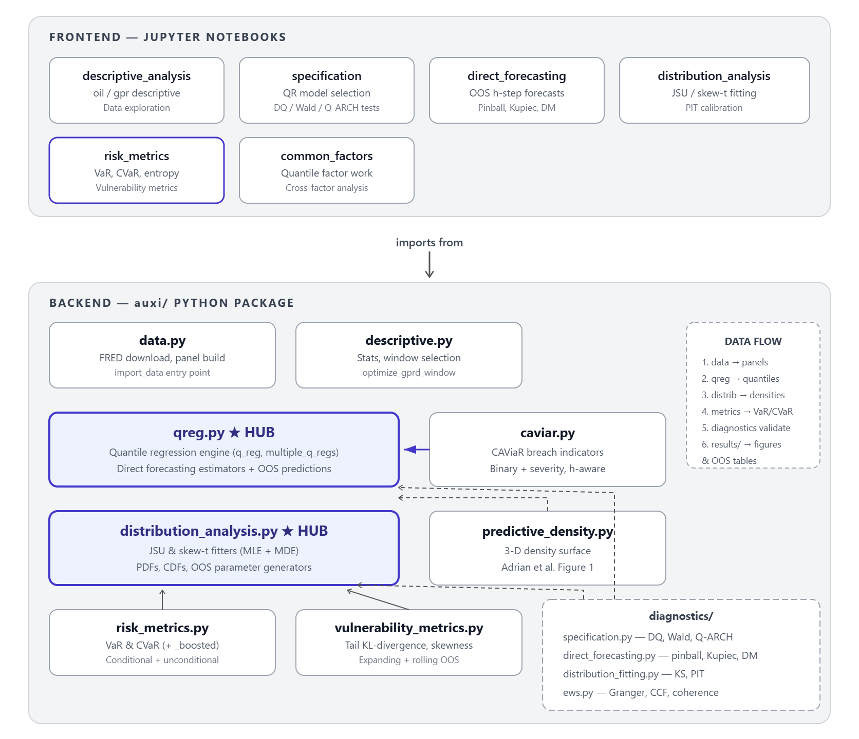
13 · SOFTWARE
The Python module: architecture
Oil-at-Risk · J. A. Rodríguez Garrido — UAM
41
Notes:
The architecture: six modules mirroring the methodology one-to-one — data, quantile engine, direct forecasting, distribution, risk metrics, backtesting. Modular by design: each stage can be swapped independently.

Slide 42

13 · SOFTWARE
Open source, ready to replicate
Few ready-to-use tools existed for this pipeline — so most were designed from scratch for this thesis.
Notebook-driven analysis on top of a tested package core (unit tests included).
Every figure and table in the thesis is reproducible from the repository.
Modular: swap the distribution family, the regressors, or the horizon grid without touching the evaluation layer.
Available for replication — and for extending the framework to other research.
github.com/Alejandro-bot-one/
Oil-at-Risk
scan to visit the repository
Oil-at-Risk · J. A. Rodríguez Garrido — UAM
42
Notes:
While doing this project I found few ready-to-use software tools, so I had to design most of them myself. All the code and modules are available on GitHub for replication and for other researchers. The QR code links directly to the repository.

Slide 43
14 · NEXT STEPS
Where this goes next
From predictive to causal
1
With some changes the framework can take a causal orientation — generalised quantile regression (Powell, 2020) or quantile local projections (Wojciechowski, 2025). A completely different thesis, deserving its own research.
More specifications
2
This is one of many configurations to try. The CAViaR models remain to be explored at shorter horizons — they may not forecast better, yet still yield a better early warning system.
Calibration of arbitrary decisions
3
Choices such as the tail-entropy intervals or the 7-day moving-average window can be calibrated to obtain even better results.
Oil-at-Risk · J. A. Rodríguez Garrido — UAM
43
Notes:
Next steps, as in the script: a causal orientation via generalised QR (Powell 2020) or quantile local projections (Wojciechowski 2025) — a different thesis of its own; more specifications, with CAViaR at shorter horizons possibly yielding a better EWS even without better point forecasts; and calibrating the arbitrary choices — tail intervals, MA window.

Slide 44
OIL-AT-RISK · MASTER THESIS DEFENSE
Thank you.
Any advice is more than welcome — and I will be really glad to hear your questions.
J. Alejandro Rodríguez Garrido
Universidad Autónoma de Madrid · MSc in Quantitative Economic Analysis
github.com/Alejandro-bot-one/Oil-at-Risk

Slide 45
Backup slides
The MA-7 window · collinearity · QR optimisation, hypotheses & diagnostics · causality · iteration & horizons · thresholds and ROC · breach-model disclaimer · Kupiec · DQ · entropy internals — followed by the math annex with every test statistic

Slide 46
BACKUP · THE MA-7 WINDOW
The 7-day moving average, in detail
Two goals
1
Smooth the raw daily indicator, and capture the time structure of risk transmission through the news cycle — stress builds over days, not in one session.
The window trade-off
2
Large enough to smooth the indicator; short enough not to induce excessive autocorrelation — we do not want to carry too much memory into the future in such a volatile index.
How the length was chosen
3
Candidate windows were assessed through the loss function at the operative horizon, giving an interval of near-optimal lengths. Among them, we chose the one matching a natural trading week — 7 calendar days ≈ 5 trading days.
Oil-at-Risk · J. A. Rodríguez Garrido — UAM
46
Notes:
The MA-7 rationale in full: smoothing plus news-cycle time structure; the trade-off between smoothing and induced autocorrelation; and the selection — loss-function assessment across candidate windows produced an optimal interval, from which the natural trading-week length was picked.

Slide 47
07 · QUANTILE REGRESSION
The coefficients across quantiles
τ = 0.05 · R¹ = 0.531
τ = 0.50 · R¹ = 0.034
τ = 0.95 · R¹ = 0.559
Regressor | Coefficient
GPRD_MA7 | −0.00028 | ***
Realized Vol. | −0.18722 | ***
Δ BDI | +0.00126 | *
Δ USD Index | −0.09284 | ***
Regressor | Coefficient
GPRD_MA7 | −0.00020
Realized Vol. | +0.01963 | ***
Δ BDI | +0.01535
Δ USD Index | −1.67430 | ***
Regressor | Coefficient
GPRD_MA7 | +0.00016 | ***
Realized Vol. | +0.18713 | ***
Δ BDI | +0.00010 | **
Δ USD Index | −0.06602 | **
Signs flip and magnitudes rotate across the distribution: volatility loads negatively on the left tail and positively on the right; the dollar bites hardest at the median; GPR reverses sign between the tails.
Oil-at-Risk · J. A. Rodríguez Garrido — UAM
18
Notes:
The coefficients at the three key quantiles, side by side. Read the rotation: RV negative in the left tail, positive in the right (it widens the distribution); the dollar strongest at the median; GPR flips sign from negative (lower tail) to positive (upper tail). Significance stars: *** 1%, ** 5%.

Slide 48
BACKUP · COLLINEARITY
Correlation matrix of the regressors
 | Δ USDI | RV | Δ BDI | Δ Brent
Δ USDI | 1.000 | 0.015 | −0.013 | −0.229
RV | 0.015 | 1.000 | −0.018 | 0.082
Δ BDI | −0.013 | −0.018 | 1.000 | 0.012
Δ Brent | −0.229 | 0.082 | 0.012 | 1.000
All pairwise correlations among the regressors are below 0.02 in absolute value — no evidence of problematic multicollinearity in the retained set.
Oil-at-Risk · J. A. Rodríguez Garrido — UAM
47
Notes:
The screening for multicollinearity: contemporaneous Pearson correlations over the estimation sample. Regressor-to-regressor correlations are tiny; the only sizable entry is USDI against the dependent variable itself, which is the effect we control for, not collinearity.

Slide 49
BACKUP · QR OPTIMISATION
How the quantile regression is solved
The problem
1
The check function has a non-differentiable corner at zero: standard first-order conditions do not apply, so the optimisation becomes problematic. Solution: LP transformation
The transformation
2
Each residual is split into two non-negative buckets, u⁺ (under-prediction) and u⁻ (over-prediction), with u = u⁺ − u⁻. The objective becomes min Σ [τ·u⁺ + (1−τ)·u⁻] subject to x′β + u⁺ − u⁻ = y.
The algorithms
3
Barrodale–Roberts modified simplex for smaller datasets — searching along the geometric edges of the data — or Frisch–Newton interior-point methods for large ones.
Oil-at-Risk · J. A. Rodríguez Garrido — UAM
48
Notes:
QR optimisation as in the thesis appendix: the absolute-value corner rules out closed-form FOCs; split residuals into positive parts to linearise; solve by Barrodale-Roberts simplex or Frisch-Newton interior point.

Slide 50
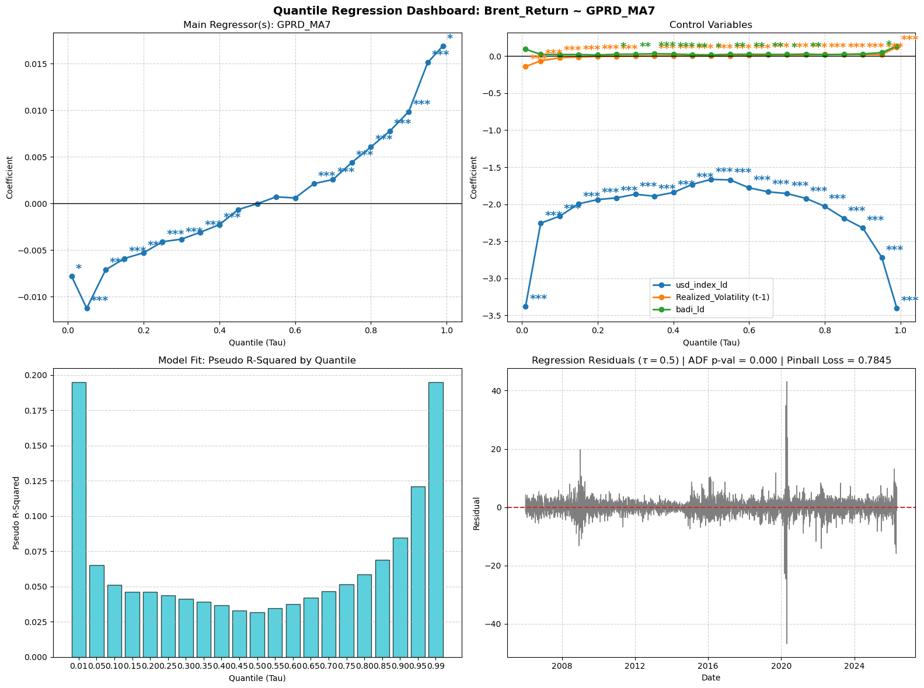
BACKUP · ESTIMATES
The estimated coefficients, in full
Coefficient paths across all quantiles, with significance marks and the OLS benchmark
Oil-at-Risk · J. A. Rodríguez Garrido — UAM
49
Notes:
The full coefficient dashboard for reference during questions: paths across all estimated quantiles with significance, controls, pseudo R-squared and residuals.

Slide 51
BACKUP · HYPOTHESES
What the estimator requires
Linearity of conditional quantiles
1
Q_τ(Y | X) = X′β(τ): each targeted quantile is a linear function of the regressors.
Strict quantile exogeneity
2
The conditional τ-quantile of the error, given X, is zero: Q_τ(u | X) = 0.
No perfect multicollinearity
3
E[XX′] finite, positive-definite and invertible — checked via the correlation matrix.
Positive density at the quantile
4
The error density around the fitted quantile must be strictly positive: precision depends on how dense the data are near the quantile — tails are estimated with more noise.
Oil-at-Risk · J. A. Rodríguez Garrido — UAM
50
Notes:
The four consistency hypotheses: linearity of the CQF, strict exogeneity at the quantile, no perfect collinearity, positive density near the quantile (sparsity governs precision).

Slide 52
BACKUP · DIAGNOSTICS
Quantile-regression diagnostic battery
Koenker–Machado R¹(τ)
Wald slope-equality test
Pseudo-R² as the proportional reduction in check loss vs the intercept-only model (the unconditional quantile). Explanatory power concentrates in the tails — expected: the median return carries no directional signal.
H₀: identical slopes across all τ — under it, QR collapses to a shifted OLS. Rejected. Covariance of the stacked system estimated by moving-block bootstrap to preserve serial dependence.
QAR unit-root test (Koenker & Xiao)
Quantile crossing inspection
Quantile-specific stationarity: H₀ of a unit root rejected at every targeted τ — Brent returns mean-revert throughout the conditional distribution. Simulated critical values.
Monotonicity of the fitted quantile function in τ checked at every observation: no crossings detected — a necessary condition for a valid conditional distribution.
Oil-at-Risk · J. A. Rodríguez Garrido — UAM
51
Notes:
The four in-sample diagnostics with their nulls and mechanics, ready for questions.

Slide 53
BACKUP · CAUSALITY
Why no causal conclusions from this regression
Quantile regression measures conditional association
1
β₁(τ) describes how quantiles co-move with GPR given the controls — it does not identify what would happen to Brent if GPR were exogenously moved.
The regressor is not 100% exogenous
2
GPR is built from news coverage, and newspapers react to markets and to the same world events that move oil: reverse causality and common drivers are plausible.
What identification would take
3
Pairing QR with valid identification techniques — instrumental-variable quantile regression (Chernozhukov & Hansen) or high-frequency instruments for geopolitical shocks.
Oil-at-Risk · J. A. Rodríguez Garrido — UAM
52
Notes:
Why no causal reading: QR gives conditional association; GPR is news-based and endogenous to markets and world events; identification would require IV-QR (Chernozhukov & Hansen) or high-frequency instruments. The thesis is deliberately predictive.

Slide 54
BACKUP · DIRECT FORECASTING
Why quantiles cannot be iterated
Means iterate; quantiles do not
1
The conditional mean obeys the law of iterated expectations: E[Y(t+2)|t] = E[E[Y(t+2)|t+1]|t], so one-step models can be chained forward. No analogous law exists for quantiles.
The quantile of a composition is not the composition of quantiles
2
The τ-quantile of Y(t+h) given today is not reachable by feeding the one-step τ-quantile into itself h times — quantiles are not linear operators, and each chaining step distorts the target probability.
Hence direct forecasting
3
A separate regression per horizon pairs today's information directly with the value realised h days ahead — targeting the h-step quantile without composition bias.
Oil-at-Risk · J. A. Rodríguez Garrido — UAM
53
Notes:
Why iteration fails: LIE holds for means, not quantiles; composing one-step quantile forecasts does not deliver the multi-step quantile. Direct forecasting targets each horizon explicitly.

Slide 55
BACKUP · HORIZON SELECTION
A more rigorous horizon selection
Error growth in direct forecasting is different
1
Because nothing is iterated, the variance is not recursively compounded over time as in traditional time-series models. The error grows instead because information decays: today's covariates say less and less about returns further away.
The rigorous criterion
2
Select the horizon at which the dynamics between the regressors and the dependent variable are best captured — the loss-minimising h, per model and per quantile.
What that grid shows here
3
Loss-minimising horizons scatter between h = 2 and h = 20 across models and quantiles: no single h dominates, which is why the transparent trading-week convention was retained.
Oil-at-Risk · J. A. Rodríguez Garrido — UAM
54
Notes:
The rigorous alternative to h=5: in direct forecasting the error grows through information decay, not variance compounding; the criterion is the loss-minimising horizon where regressor-target dynamics are best captured; the grid scatters 2-20, so the convention stands.

Slide 56
BACKUP · THRESHOLDS
The 0.95 boundary — and how it should be chosen
The honest admission
1
The 0.95 mark defining the breach boundary was chosen arbitrarily, as a conventional tail marker.
Why a threshold is a trade-off
2
Lower the boundary and breaches fire earlier and more often — more sensitivity, more false alarms. Raise it and alarms become rare but late — fewer false triggers, more missed events. Every threshold buys one error type with the other.
The rigorous approach: ROC analysis
3
Sweep the threshold, plot the true-positive rate against the false-positive rate (ROC curve), summarise discrimination with the AUC, and pick the operating point matching the user's cost of a missed crisis versus a false alarm.
Oil-at-Risk · J. A. Rodríguez Garrido — UAM
55
Notes:
Deductive chain: the 0.95 boundary is a convention; any threshold trades early detection against false alarms; the rigorous selection sweeps thresholds through a ROC curve, summarises with AUC, and picks the point matching the asymmetric cost of errors. This is exactly the proposed next step.

Slide 57
BACKUP · BREACH MODELS
When would the breach models win?
The breach signal is short-lived
1
A violation today says a lot about tomorrow and little about three weeks ahead: tail stress clusters at short range, so the information content of a breach decays quickly with the horizon.
So the augmentations shine at short horizons
2
At h = 5 the signal has already gone stale — which is what the Diebold–Mariano tie shows. At shorter horizons (h = 1–3) the breach regressors carry their sharpest information and may significantly improve predictive power.
Oil-at-Risk · J. A. Rodríguez Garrido — UAM
56
Notes:
The disclaimer expanded: breach information decays fast, so the CAViaR-inspired models are strongest at very short horizons; at the operative h=5 they tie with the standard model.

Slide 58
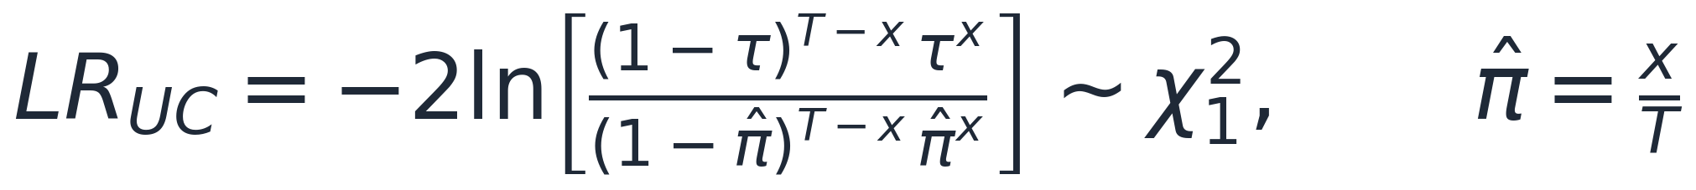
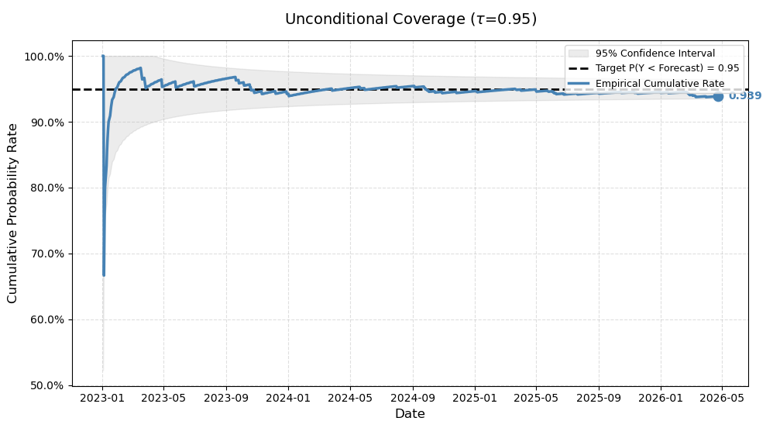
BACKUP · COVERAGE
The Kupiec coverage test
A τ-quantile forecast promises breaches at rate 1−τ. Kupiec (1995) tests whether the realised breach frequency matches that promise:
Model | N | π̂ | LR (p-value)
Standard QReg | 864 | 0.9387 | 2.189 (0.139)
CAViaR-indicator | 864 | 0.9381 | 1.437 (0.231)
CAViaR-severity | 864 | 0.9342 | 2.471 (0.116)
Only unconditional coverage is tested: overlapping h-step forecasts make hits serially dependent, distorting independence-based tests but not the breach count.
Coverage convergence, main model
Oil-at-Risk · J. A. Rodríguez Garrido — UAM
57
Notes:
Kupiec: likelihood-ratio test on the breach frequency against the nominal rate; all three models pass. Only unconditional coverage by design — the overlap makes hits MA(h−1)-dependent, which distorts independence tests but leaves the count assessment intact.

Slide 59
BACKUP · MODEL COMPARISON
Loss-minimising horizons and the evidence summary
Loss-minimising horizon per model and quantile (h* → pinball loss)
Model | τ = 0.05 | τ = 0.50 | τ = 0.95
Standard QReg | h = 2 → 0.3017 | h = 4 → 0.9375 | h = 3 → 0.2856
CAViaR-indicator | h = 9 → 0.2960 | h = 6 → 0.9742 | h = 7 → 0.2806
CAViaR-severity | h = 20 → 0.3397 | h = 6 → 0.9573 | h = 16 → 0.3810
Realised returns vs the forecast quantile envelope, out-of-sample
Evidence summary across the three models (τ = 0.95, h = 5)
Test | Standard | CAViaR-i | CAViaR-s
Pinball / generalisation gap | Pass | Pass | Pass
Fallout audit (inside tunnel) | 97.83% | 97.17% | 97.26%
Kupiec PoF (p-value) | Pass (0.139) | Pass (0.231) | Pass (0.116)
Diebold–Mariano | baseline | n.s. | n.s.
Oil-at-Risk · J. A. Rodríguez Garrido — UAM
58
Notes:
The per-quantile optimal horizons scatter (2 to 20). Evidence summary: all pass everything; average tick losses 0.2380 / 0.2290 / 0.3317 — the tie is the point.

Slide 60
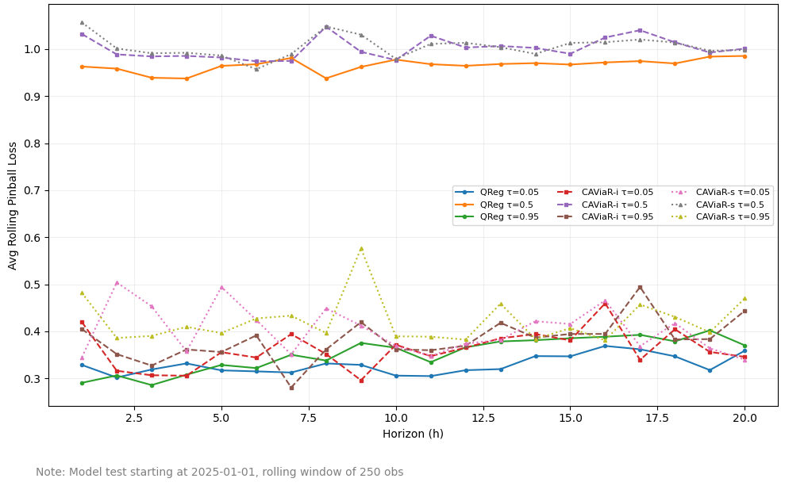
BACKUP · MODEL COMPARISON
OOS Loss-function at different horizons
Oil-at-Risk · J. A. Rodríguez Garrido — UAM
58
Notes:
The per-quantile optimal horizons scatter (2 to 20). Evidence summary: all pass everything; average tick losses 0.2380 / 0.2290 / 0.3317 — the tie is the point.

Slide 61
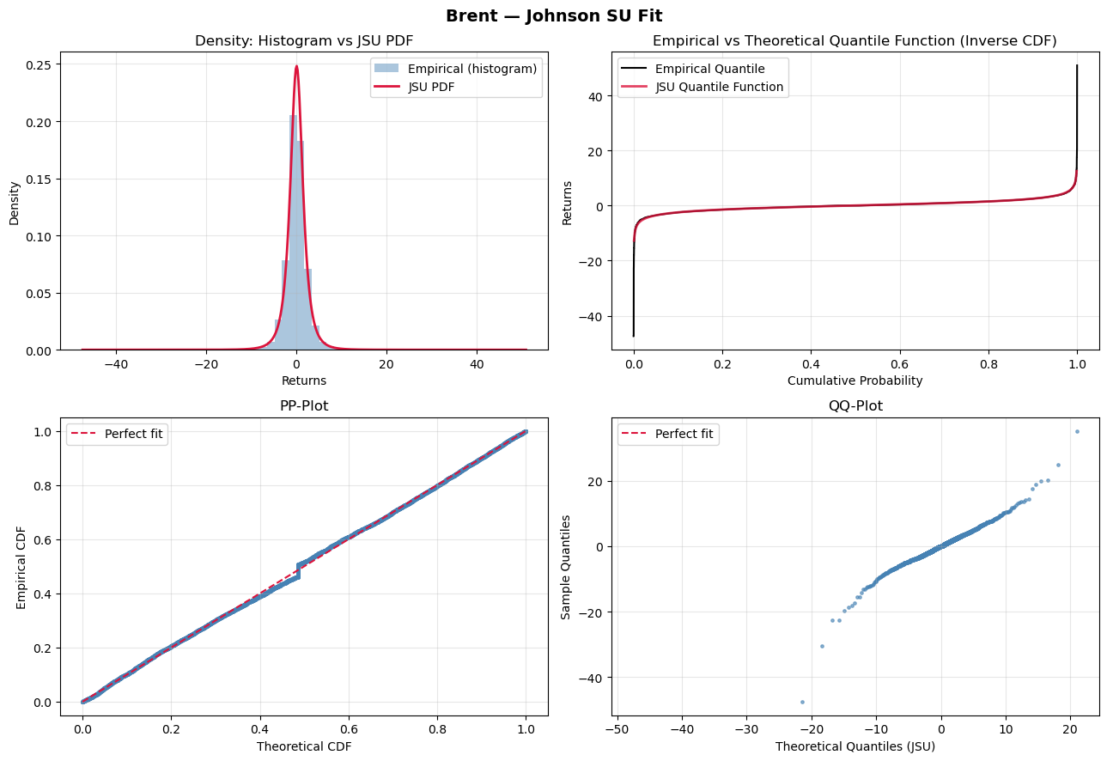
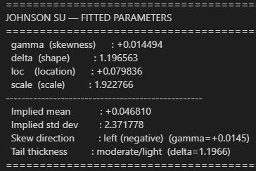
BACKUP · UNCONDITIONAL DISTRIBUTION
Unconditional distribution fitted through MLE
Oil-at-Risk · J. A. Rodríguez Garrido — UAM
58
Notes:
The per-quantile optimal horizons scatter (2 to 20). Evidence summary: all pass everything; average tick losses 0.2380 / 0.2290 / 0.3317 — the tie is the point.

Slide 62
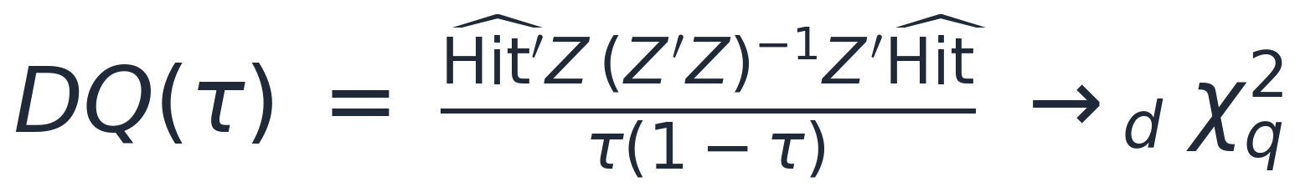
BACKUP · DYNAMIC QUANTILE TEST
The DQ test — and why CAViaR passes it by construction
Centre the hit sequence; correct dynamic specification demands breaches be unpredictable from anything known yesterday (martingale difference):
Project hits on a constant, L lagged hits and the lagged fitted quantile; test joint significance:
Rejection = the violation process is still predictable — the model is caught off guard by clustered tail events.
The CAViaR augmentations feed the model's own lagged breach information back into the forecast: they internalise precisely the lagged-hit dependence the DQ statistic interrogates, so they pass the test by construction.
Oil-at-Risk · J. A. Rodríguez Garrido — UAM
59
Notes:
DQ mechanics: centred hits, instrument projection, Wald form chi-squared. The motivation for the CAViaR augmentations is exactly the term this test interrogates.

Slide 63
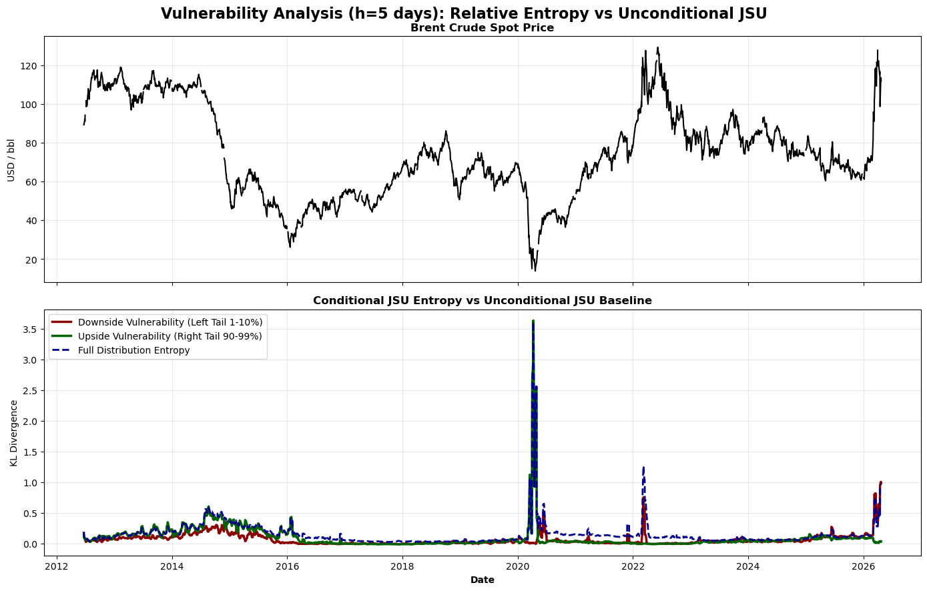
BACKUP · ENTROPY INTERNALS
Internal coherence and the unconditional benchmark
Pairwise CCF among the entropy components
X | Y | h* | r at h* | Significant
Full | Left | 0 | +0.748 | Yes
Full | Right | 0 | +0.631 | Yes
Left | Right | 0 | −0.036 | No
The two tails are uncorrelated (r = −0.036, n.s.). A supply-disruption shock fattens the right tail without touching the left; a demand contraction does the reverse. The tail components carry largely independent information — monitoring both separately gives a richer warning profile than the aggregate alone.
KL divergence vs the unconditional JSU (MLE): high divergence = genuine conditional shift, not mere non-normality
Oil-at-Risk · J. A. Rodríguez Garrido — UAM
60
Notes:
Coherence: full entropy correlates with each tail contemporaneously; the tails are mutually uncorrelated — independent information. The unconditional-JSU divergence series is also computed and shown here for completeness.

Slide 64
Math annex
Every test statistic used in the thesis, ordered by pipeline stage: in-sample diagnostics · forecast evaluation · density evaluation · risk metrics · early-warning tests

Slide 65
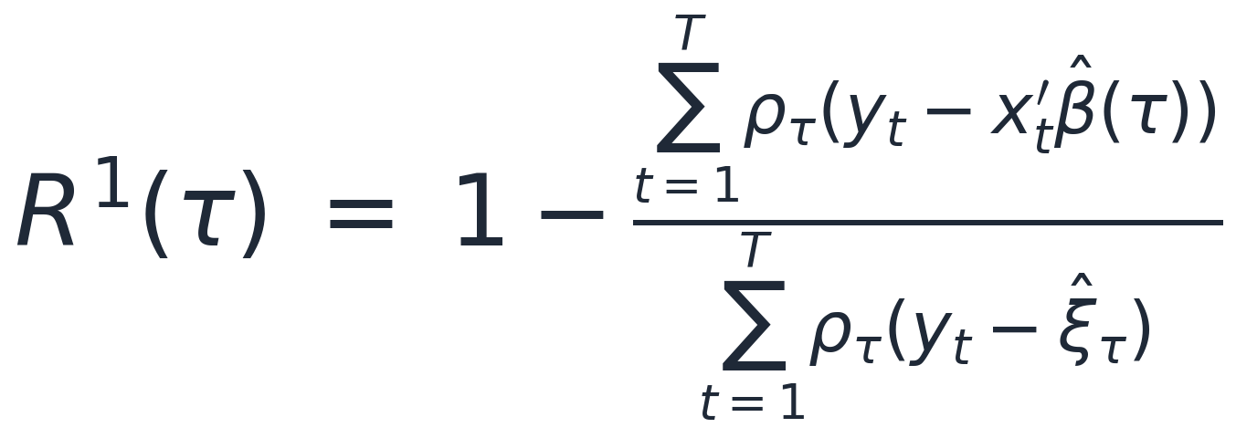
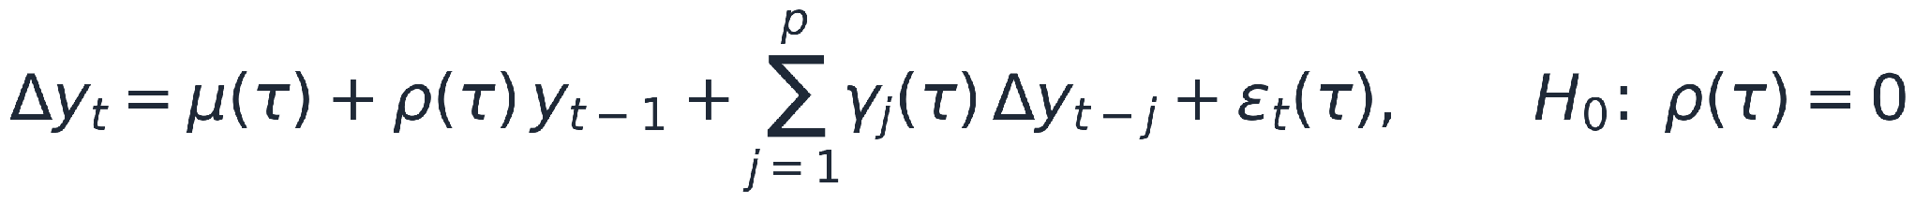
MATH ANNEX · IN-SAMPLE DIAGNOSTICS
Goodness of fit, slope equality, stationarity
Koenker–Machado R¹(τ) — proportional reduction in check loss vs the intercept-only model (the unconditional quantile)
Wald test for slope equality across quantiles — H₀: identical slopes for every τ (moving-block bootstrap covariance)
QAR unit-root test (Koenker & Xiao) — H₀: quantile-specific unit root; simulated critical values
Oil-at-Risk · J. A. Rodríguez Garrido — UAM
62
Notes:
The three in-sample diagnostics with their statistics: R1 as the QR pseudo-R-squared (T·V(τ)·R1 is asymptotically chi-squared); the Wald test on the stacked coefficient vector with block-bootstrap covariance (rejected — slopes differ across quantiles); the QAR unit-root auxiliary regression (H0 of a unit root rejected at every targeted tau).

Slide 66
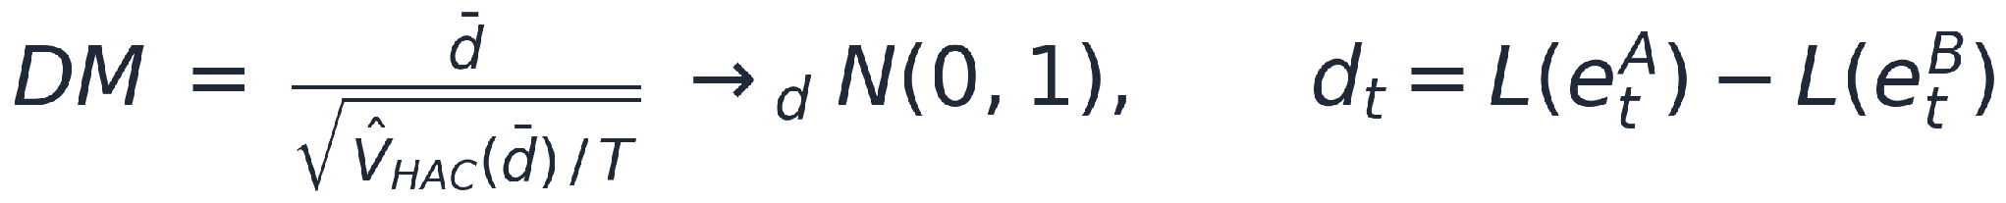
MATH ANNEX · FORECAST EVALUATION
Pinball loss, Diebold–Mariano, Kupiec
Pinball (tick) loss — the strictly proper scoring rule for quantile forecasts (Gneiting & Raftery, 2007)
Diebold–Mariano — H₀: equal predictive accuracy; HAC variance with bandwidth h−1 for the MA(h−1) overlap
Kupiec proportion-of-failures — H₀: the breach frequency matches the nominal rate
Oil-at-Risk · J. A. Rodríguez Garrido — UAM
63
Notes:
Forecast evaluation statistics: the pinball loss (minimised only by the true conditional quantile); the DM statistic on the paired loss differential with HAC bandwidth h−1 matching the overlap-induced MA(h−1) autocorrelation; and Kupiec's likelihood ratio on the breach count, asymptotically chi-squared with one degree of freedom.

Slide 67
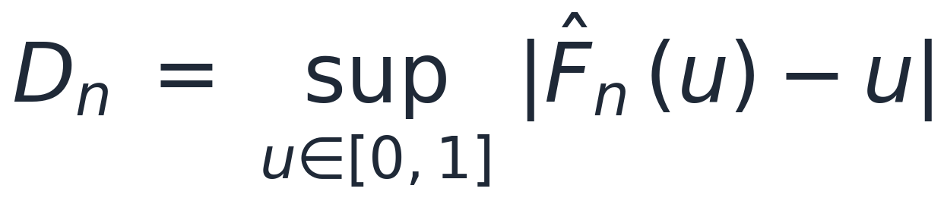
MATH ANNEX · DENSITY EVALUATION
PIT uniformity and the KS statistic
Probability Integral Transform — Uniform(0,1) under a correctly specified forecast density (Diebold, Gunther & Tay, 1998)
Kolmogorov–Smirnov — supremum deviation of the empirical PIT CDF from the uniform
Reading departures: PITs piling near 0 → left tail too thin (Expected Shortfall understated); piling near 1 → right tail too thin; a hump in the centre → forecast densities too wide. The evaluation spans every fitted density in the out-of-sample window simultaneously.
Oil-at-Risk · J. A. Rodríguez Garrido — UAM
64
Notes:
Density evaluation: the PIT is Uniform(0,1) under correct specification; the KS statistic measures the supremum deviation of the empirical PIT CDF from the 45-degree line. How departures localise the failure: mass near 0 = thin left tail; near 1 = thin right tail; central hump = over-dispersed forecasts.

Slide 68
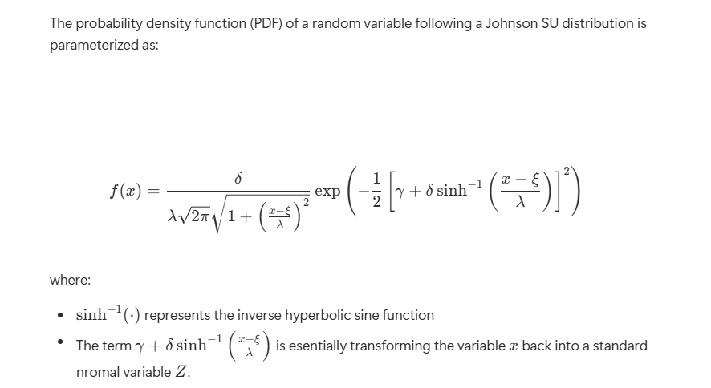
MATH ANNEX · DENSITY EVALUATION
JSU Distribution complete expression
Oil-at-Risk · J. A. Rodríguez Garrido — UAM
64
Notes:
Density evaluation: the PIT is Uniform(0,1) under correct specification; the KS statistic measures the supremum deviation of the empirical PIT CDF from the 45-degree line. How departures localise the failure: mass near 0 = thin left tail; near 1 = thin right tail; central hump = over-dispersed forecasts.

Slide 69
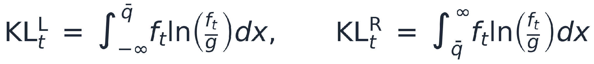
MATH ANNEX · RISK METRICS
Closed forms read from the fitted JSU
Conditional VaR — the closed-form JSU quantile at confidence α
Expected Shortfall — the conditional mean beyond the VaR threshold (numerical integration, 5,000-point grid)
Tail-decomposed KL divergence — split at the tail mark q̄
Oil-at-Risk · J. A. Rodríguez Garrido — UAM
65
Notes:
The closed forms: VaR directly from the JSU quantile function (no root-finding); ES by numerical integration below the threshold on a 5,000-point grid; and the tail decomposition of the KL divergence — the integrals split at the tail mark, giving the left and right entropy components used in the EWS.

Slide 70
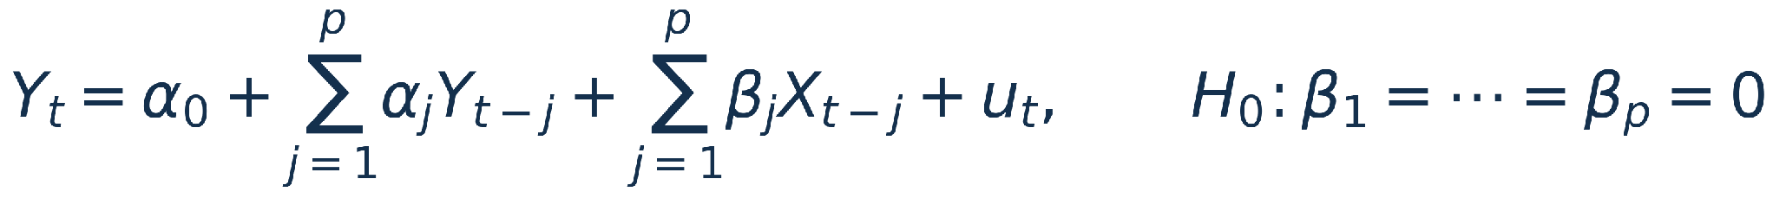
MATH ANNEX · EARLY WARNING TESTS
The CCF and the Granger causality test
Cross-correlation function — h* > 0 means the indicator leads the target; Bartlett band under the iid null
Granger causality — unrestricted model and null hypothesis; F-test on the nested comparison, lags by AIC (ceiling 30)
F-statistic: F = [(RSS_r − RSS_ur)/p] / [RSS_ur/(T − 2p − 1)] ~ F(p, T − 2p − 1) under H₀. Rejection means the entropy lags carry information beyond the returns' own autoregressive structure — forecasting-sense causality, not structural causation.
Oil-at-Risk · J. A. Rodríguez Garrido — UAM
66
Notes:
The EWS test statistics: the CCF with Bartlett's band (valid under the iid null — treat as descriptive); the Granger nested regression with its F-statistic distributed F(p, T−2p−1) under the null, lag order by AIC with a ceiling of 30 days. Emphasise: forecasting causality, not structural.

Slide 71
MATH ANNEX · DYNAMIC QUANTILE TEST
The DQ test of Engle & Manganelli
Centred hit sequence — mean zero under correct specification; H₀: hits are a martingale difference
DQ statistic — Wald form of the projection of hits on a constant, L lagged hits and the lagged fitted quantile
Role in this thesis: the DQ statistic names the dependence the CAViaR augmentations feed back into the model — they internalise the lagged-hit information the test interrogates, so they pass it by construction. It motivates the augmentation; it is not evidence of superiority.
Oil-at-Risk · J. A. Rodríguez Garrido — UAM
67
Notes:
The DQ test: centred hits must be unpredictable from yesterday's information; the Wald projection statistic is asymptotically chi-squared. In this thesis it motivates the breach augmentations — which pass it by construction — rather than serving as evidence of superiority.

