Slide 1

Guardians Advocating for the Support & Empowerment of Animals
| Gerardo García | Andrea Cerón | Samuel Munguía | Eva Longoria | Alejandro López|

Slide 2

ForeverPaws
We believe in the transformative power of the love and companionship that dogs and cats bring into our lives. We are an adoption portal dedicated to connecting loving homes with deserving furry friends, ensuring that their journey together lasts a lifetime.
Our mission is simple yet profound: to create forever homes where wagging tails and purrs fill the air, where hearts are warmed by the unconditional love of a four-legged companion. We strive to make the adoption process seamless, transparent, and joyful, ensuring that each match is a perfect fit, not just for the pet, but for the adopter as well.
As a trusted platform, we work closely with reputable shelters, rescues, and compassionate individuals across the country to bring you a curated selection of dogs and cats in need of a loving family. We take great care in vetting and evaluating each furry friend, ensuring they receive the care and attention they deserve until they find their forever home.
Where Forever Begins with Paws…
Notes:
Elevator Pitch

Slide 3
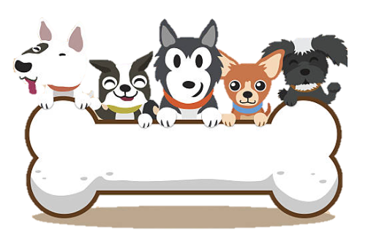
Concept
The Forever Paws Pet Adoption Portal is an innovative platform designed to facilitate the process of pet adoption and connect prospective pet owners with shelters and rescue agencies.
The portal serves as a centralized hub where individuals interested in adopting a pet can browse through a wide variety of available animals and make informed decisions based on their preferences.
The concept behind Forever Paws is to provide a user-friendly interface that streamlines the adoption process, making it easier for both potential pet owners and animal shelters to find suitable matches.
Through the portal, users can search for pets based on factors such as species, breed, age, and location, enabling them to find their ideal companion.
The platform also offers comprehensive profiles for each animal, including photos, descriptions, and relevant details, ensuring that potential adopters have all the necessary information before deciding.
By leveraging technology and collaboration with rescue agencies, Forever Paws aims to increase pet adoptions, promote responsible ownership, and ultimately contribute to the well-being of animals in need of a loving home.

Slide 4
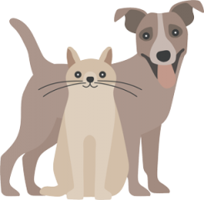
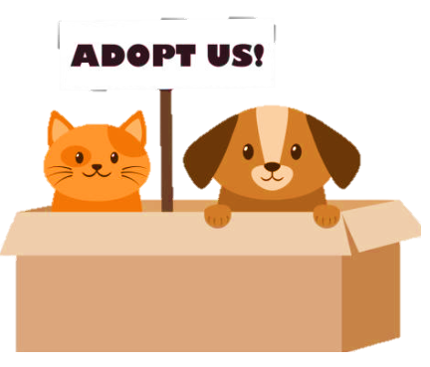

Motivation
Promoting Animal Welfare The primary motivation is to promote and improve animal welfare. By creating an adoption portal, individuals and organizations aim to connect homeless pets with loving and responsible adopters. This helps reduce the number of stray or abandoned animals and provides them with the opportunity to find caring homes.
Increasing Adoption Rates Adoption portals aim to increase the adoption rates of shelter animals. By providing a user-friendly and visually appealing platform, these portals attract more potential adopters and encourage them to consider adopting a pet instead of purchasing from breeders or pet stores. By simplifying the adoption process and showcasing pets in need, the portal helps find suitable matches and facilitates successful adoptions.
Educating and Raising Awareness: Adoption portals serve as educational platforms, providing information about responsible pet ownership, pet care, and the importance of adoption. They raise awareness about the benefits of adopting rather than buying pets and help dispel common misconceptions about shelter animals. By educating the public, these portals aim to create a more compassionate and informed society.

Slide 5

User Story
Acceptance Criteria
As a potential adopter,
I want to be able to search for learn about and adopt a pet through the Forever Paws adoption portal,
so that I can provide a loving home to a homeless animal.
The adoption portal should have a responsive and visually appealing user interface, implemented using Handlebars for efficient front-end rendering.
The portal should utilize Express.js as the backend framework to handle routing and API requests.
The database should be implemented using SQL, and Sequelize should be used as the ORM (Object-Relational Mapping) tool for data modeling and querying.
The adoption portal should support user registration and authentication to ensure secure access to adoption-related functionalities.
Users should be able to search for pets based on various criteria, such as pet type, breed, age range, and location.
The portal should display detailed pet profiles, including information such as name, breed, gender, age, description, and photos.
Users should be able to initiate the adoption process by filling out an adoption application form.
Users should be able to submit pets for adoption using a form and Multer for photo handling.

Slide 6

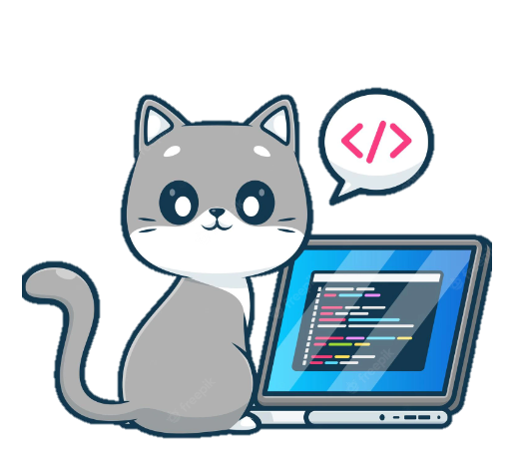
Technologies
The front-end of the portal is built using Handlebars allowing for dynamic content generation and efficient rendering of web pages. Handlebars enables the display of pet profiles, search results, and interactive forms, ensuring a user-friendly interface
On the back-end, Forever Paws leverages Express.js. It enables the creation of APIs and handles server-side logic, routing, and request handling.
To store and manage data, Forever Paws utilizes SQL. It enables efficient storage, retrieval, and querying of pet and user information. Sequelize is used in conjunction with SQL to simplify database operations and provide a convenient interface for interacting with the database.
Styling and visual design are accomplished using Bulma. It ensures a consistent and attractive layout across different devices and screen sizes.
JavaScript (JS) is utilized for scripting and client-side interactivity. JS enhances the user experience by adding dynamic features such as form validation, real-time updates, and interactive elements. It allows for smooth communication between the front-end and back-end components of the portal.
The Forever Paws Pet Adoption Portal also utilizes Multer, a middleware for handling file uploads in Node.js. It seamlessly integrates with Express.js to enable the uploading of pet photos, enhancing the adoption experience by allowing potential adopters to visually connect with the pets they are considering.

Slide 7


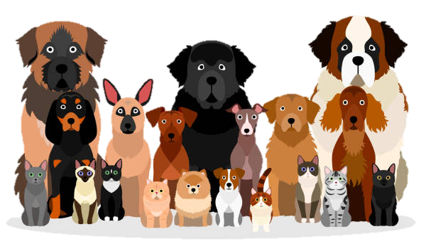
Tasks & Roles
Challenges & Successes
As students new to API routing, we faced several challenges in understanding and implementing this concept in our project. We found it difficult to grasp the fundamental concepts of RESTful architecture and how different HTTP methods map to API endpoints.
Defining routes correctly and handling them appropriately posed another challenge. Determining the route structure, including URL patterns, dynamic segments, and query parameters, required careful planning.
Handling route dependencies, middleware, and ensuring the proper order of route execution seemed daunting at the beginning.
Through proper usage of GitHub merges and commits, we successfully collaborated with each other. By following branching and merging strategies, we ensured that everyone's work remained separate, and conflicts were minimized. This allowed us to work concurrently on different features and merge our changes seamlessly.
We were able to create well-structured and visually appealing handlebar views for the project. We effectively separated the presentation logic from the backend, allowing for better code organization and reusability. We have implemented dynamic data rendering, conditional logic, and iteration over data sets to generate dynamic HTML content.
Proper usage of handlebar views and route controllers has allowed us to follow the Model-View-Controller (MVC) architectural pattern. By separating concerns and adhering to this design pattern, we have achieved code modularity, enhanced maintainability, and improved the overall structure of our web apps.
This project was carried out by a collaborative team, actively working together to achieve our common goal.
We applied the concepts and techniques learned during our bootcamp classes to create a functional and user-friendly web app.
Each team member contributed with their unique skills and expertise to ensure the success of the project.

Slide 8
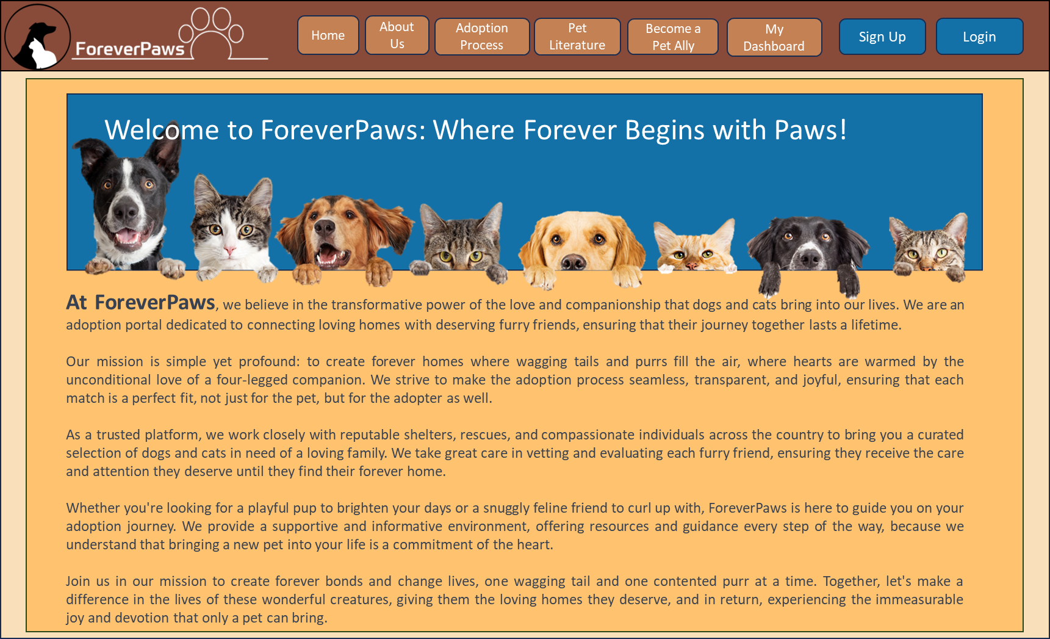
DEMO

Slide 9
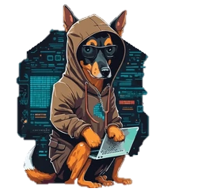

Links
Future Dev
Creating a dashboard that is unique for shelters or rescue agencies where they can add, remove, modify pet records
Implement commenting functionality to allow other users post what they think about the pet and read other users’ comments
Add geolocation functionality to increase our reach
Combine with social media channels to increase our visits volume
ForeverPaws Github
ForeverPaws Heroku

Slide 10
Future Dev
Creating a dashboard that is unique for shelters or rescue agencies where they can add, remove, modify pet records
Implement commenting functionality to allow other users post what they think about the pet and read other users’ comments
Add geolocation functionality to increase our reach
Combine with social media channels to increase our visits volume

Slide 11
Thank You
| Gerardo García | Andrea Cerón | Samuel Munguía | Eva Longoria | Alejandro López|

