Slide 1
SOHO Setup
Alejandro Rodriguez

Slide 2
SOHO Network
Small Office (SO)
Up to 10 users
Business location
Home Office (HO)
One major user
Might be shared with family
Scope
Improve security on either network or devices.

Slide 3
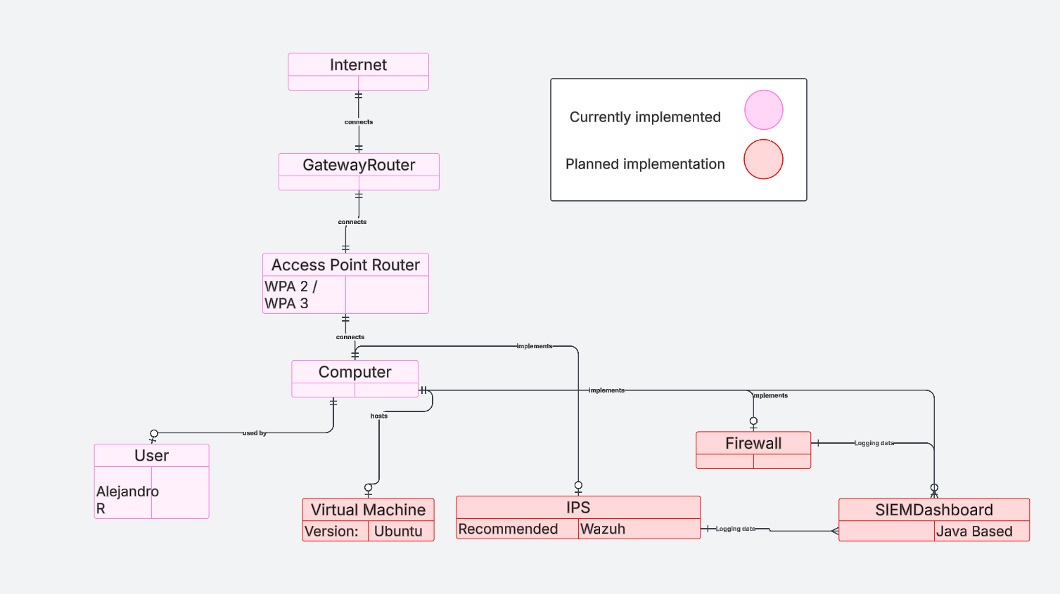
Entity Relationship (Initially Planned)

Slide 4
Threat Modeling
Threat | Likelihood | Impact | Prevention / Mitigation | Current Standard
Data Loss | Low | High | Cloud backup or physical backup | Microsoft one drive uploaded backup.
Weak Passwords or compromised passwords | Medium | Medium | Implement a password manager and 2FA | No active password manager, but 2FA is active for most websites
Phishing attacks | High | Medium | Awareness training and filtering out spam emails | Awareness of potential phishing attacks and Gmail filters out spam
Malware Infection | Medium | High | Antivirus software installed and up to date. | Microsoft Defender Antivirus is on and up to date. Last checked 3/28/2025

Slide 5
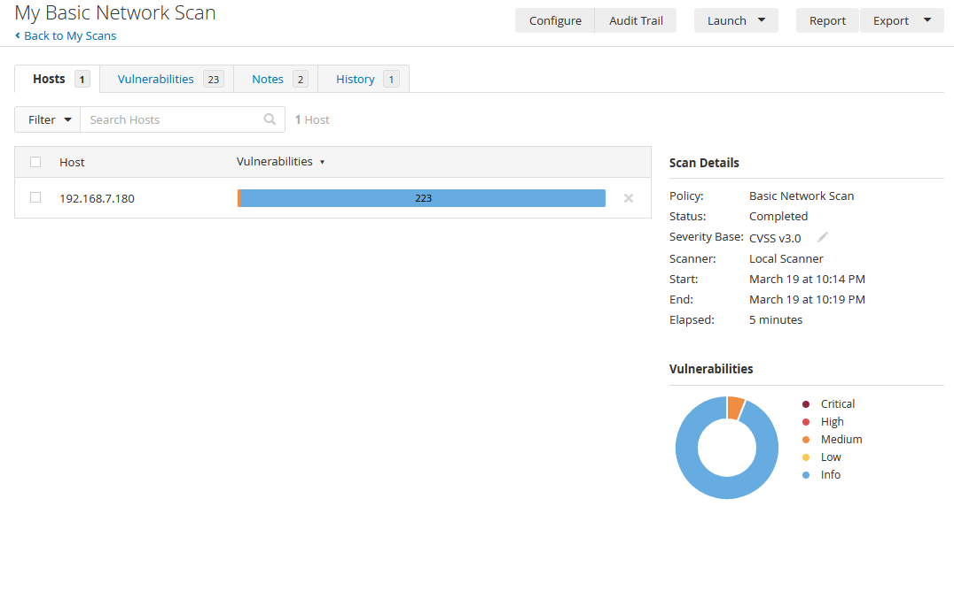
Vulnerability Scanner
Conducted on March 19, 2025
225 total vulnerabilities
223 Informational (189 ports are discovered open)

Slide 6
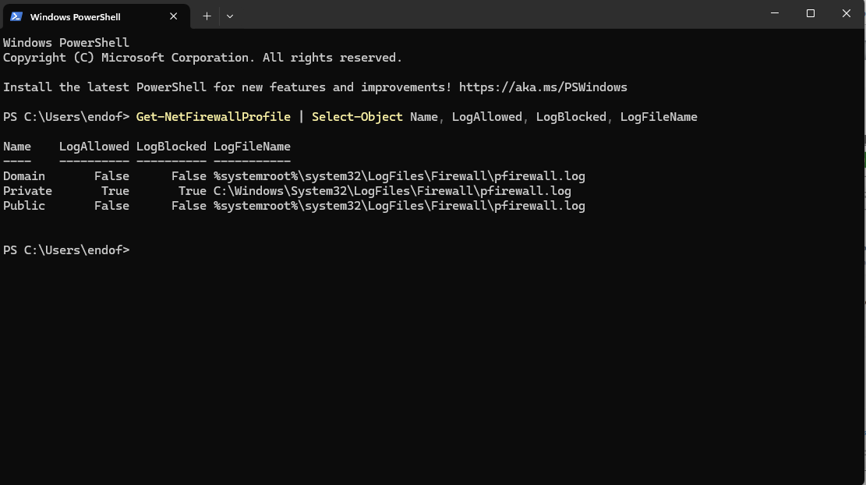
Firewall Modifications

Slide 7
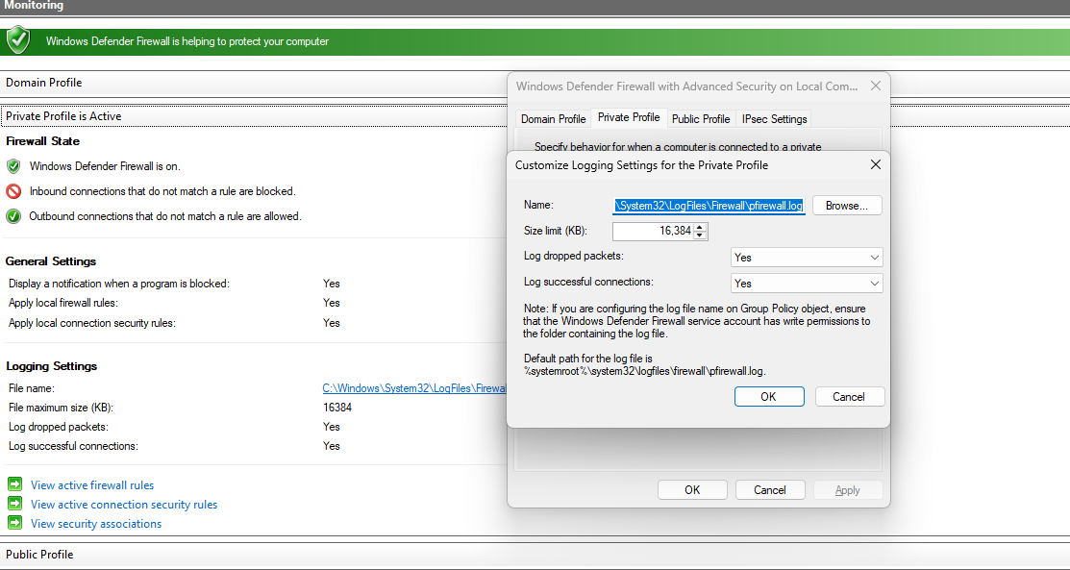
Firewall modifications
Initially treated firewall modifications like I would have with Linux. Upon double checking it, it was not configured in the way I like

Slide 8
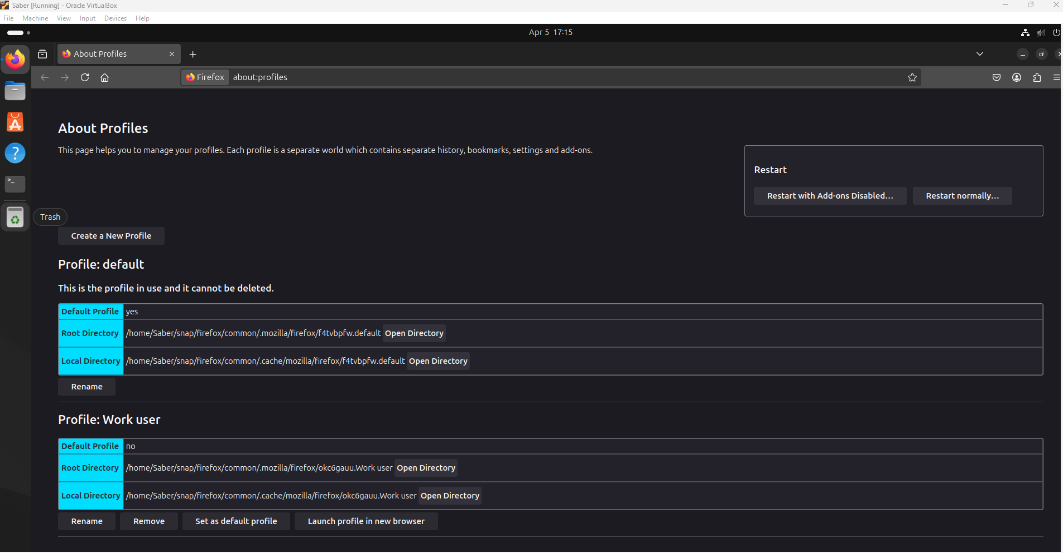
Virtualization
Virtualization is based on my previous experience with my internship utilizing Ubuntu

Slide 9
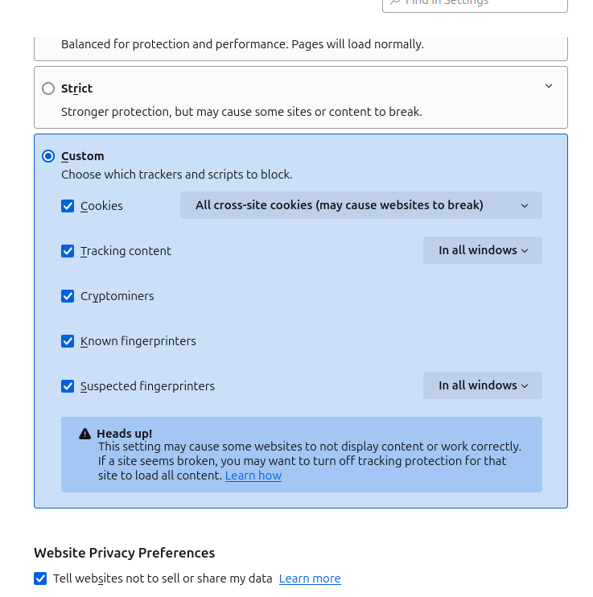
Browser settings : preview : VM

Slide 10
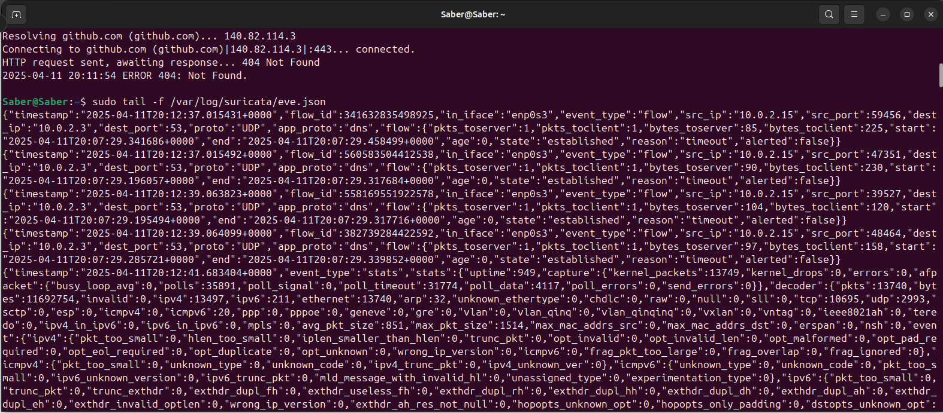
Suricata: VM

Slide 11
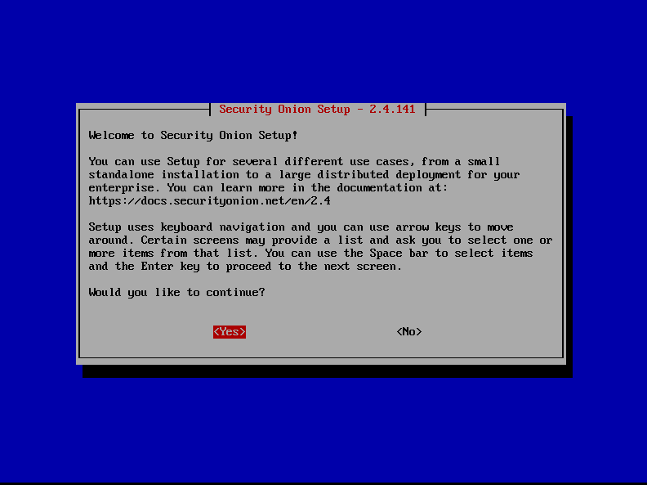
SIEM
Originally was going to be Wazuh. However, I had difficulties with Wazuh.
In order to keep progress going, I decided to go with Security Onion
More difficulties ensued and I learned I required more storage and CPU than I was willing to allocate

