Slide 1

How Agile Development Methods and Artefacts are being used in in the management of Athletics club Demonstration Program
Alejandro Reyes Bautista – Q13134663
User Stories
Product Backlog
Release/Sprint Backlog
Burndown Chart
Pick up user stories from product backlog to create a spring backlog
Split up the user stories into tasks: Work Breakdown Chart

Slide 2

User Stories
Express features on the agile product backlog.
Short, simple descriptions of the desired functionality told from perspective of the user
"As a user, I can view the trainings available, filtered by age group by default, so that I can check programmed trainings for each week”
“As a coach, I can add training records to existing events, so that I can keep update how the trainings are going”
“As a club administrator, I can update events information, so that I can add or change information as transport or date when it was available”

Slide 3
User Stories => Backlog Items
"As a user, I can view the trainings available, filtered by age group by default, so that I can check programmed trainings for each week”
ID: 2 (just an auto-incremented number)
Name: view trainings
Importance: (from 0-150 at the start, can be over 150, high = more important): 80
Initial estimate: 3 Story Points (1 day 3 people or 3 day 1 person working)
How to demo: Log in, choose the filter to search on (age group by default), choose one of the trainings retrieved and check that you can see the details.
Notes: Need an UML sequence diagram

Slide 4
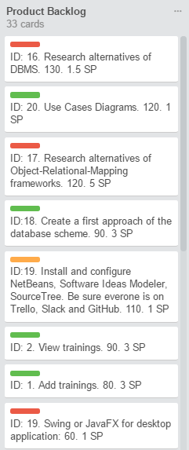
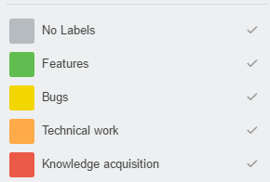
Product Backlog
Short version, but clear, of backlog items.
The completed version is in a external document.
Different types of items needed for
the management of the project.

Slide 5
Communication
Meeting with the Product Owner once a week. He understands each story, even these who had been added by other people to the backlog. He owns the sole right of assign the importance level
Meeting with the team at least once a week. Diary communication throw slack (could be considerate as a daily scrum). Only the team assign the estimation (story points)
Spring planning meeting before each Sprint. Whole team and the product owner are there, so that if the owner wants to introduce changes in the importance level, scope of a story or the estimation of the story , all can be analysed (scope, estimate, importance)
Likewise, due to any change, the team can also valorise the cost about external and internal quality, although internal quality should not be negotiable.
Scrum master role is supplied both by the professor and the own team.

Slide 6
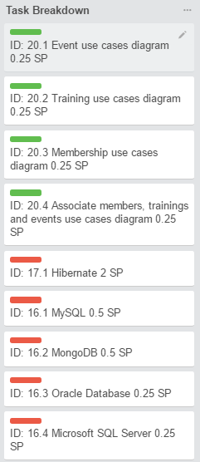
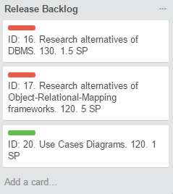
Sprint 1: 2 weeks
Goal:
Get a first version of use cases diagrams
Make majority of decisions about tools and frameworks
Velocity:
4 people x 5 hours week (students availability) = 20 hours week.
(2*20 hours)/8 hours (1 Man-Day) = 5 Man-Days ≃ 5 Story Points

Slide 7
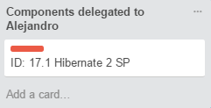
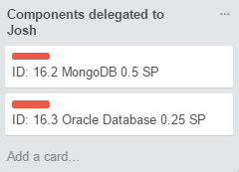
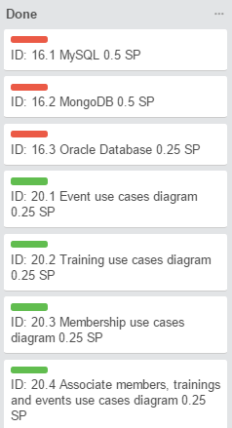
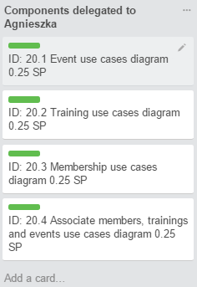
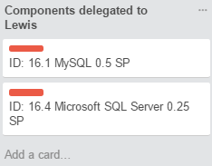

Work Breakdown Chart

Slide 8
Burndown Chart

