Slide 1
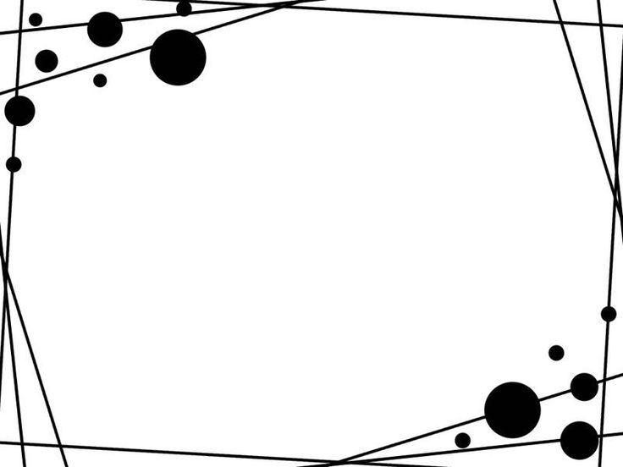
How the Model View Controller pattern is being used to assign responsibilities Athletics club Demonstration Program
Alejandro Reyes Bautista – Q13134663
Model: store of data – entities – no relation with the View or Controller
View: user-interface – no relation with the Model
Controller: business logic – connection between view and model
MVC: software architectural design for implementing user interfaces on computers
Separate input, processing and output of an application

Slide 2

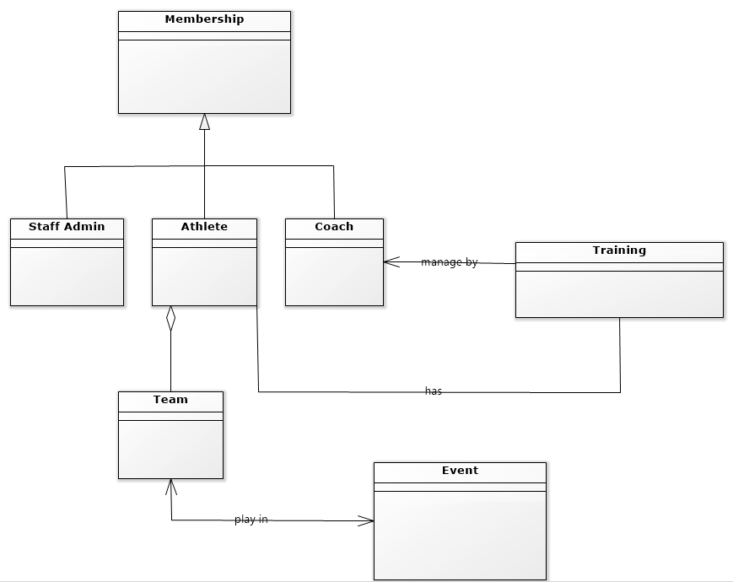
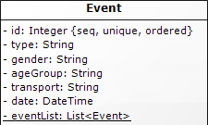
Model: classes
This level defines where the data is stored.
The model doesn’t know anything about views and controllers.
Whenever there are changes done in the model it will automatically notify observers that the changes are made.
The Event class is the model that
stores all the data which belong
to the entity event: id, type, gender, ageGroup,
transport, date…

Slide 3
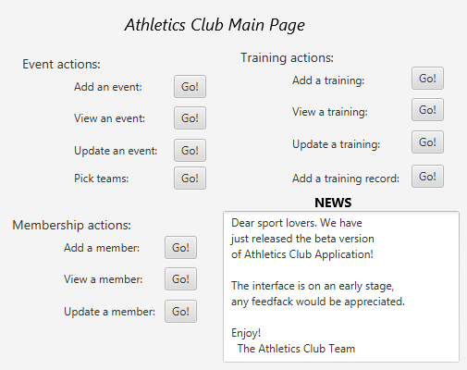
View: user interface
This level creates an interface to show the actual output to the user.
The controller tells the view what to display to the user.
It handles requests from the user and informs controller.
Example of view for the demonstration program main page

Slide 4
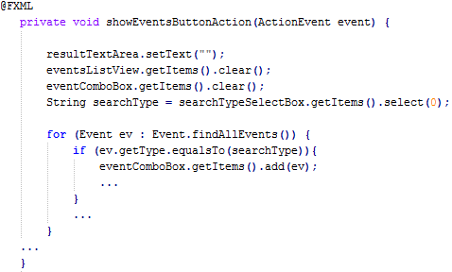
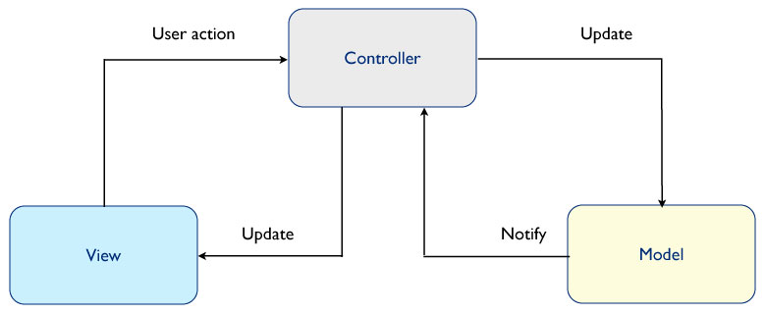
Controller
Controller is a level which acts like a brain of the entire MVC system.
Link between a user and the system. Understands both input and output, converting them into the appropriate messages.
Controller method.
Show the list of events by searchType (ageGroup, type, etc.)
When the user clicks the button, the method binded is called.
It gets the input, works with the model to retrieve the data and displays the output in the right elements.

Slide 5
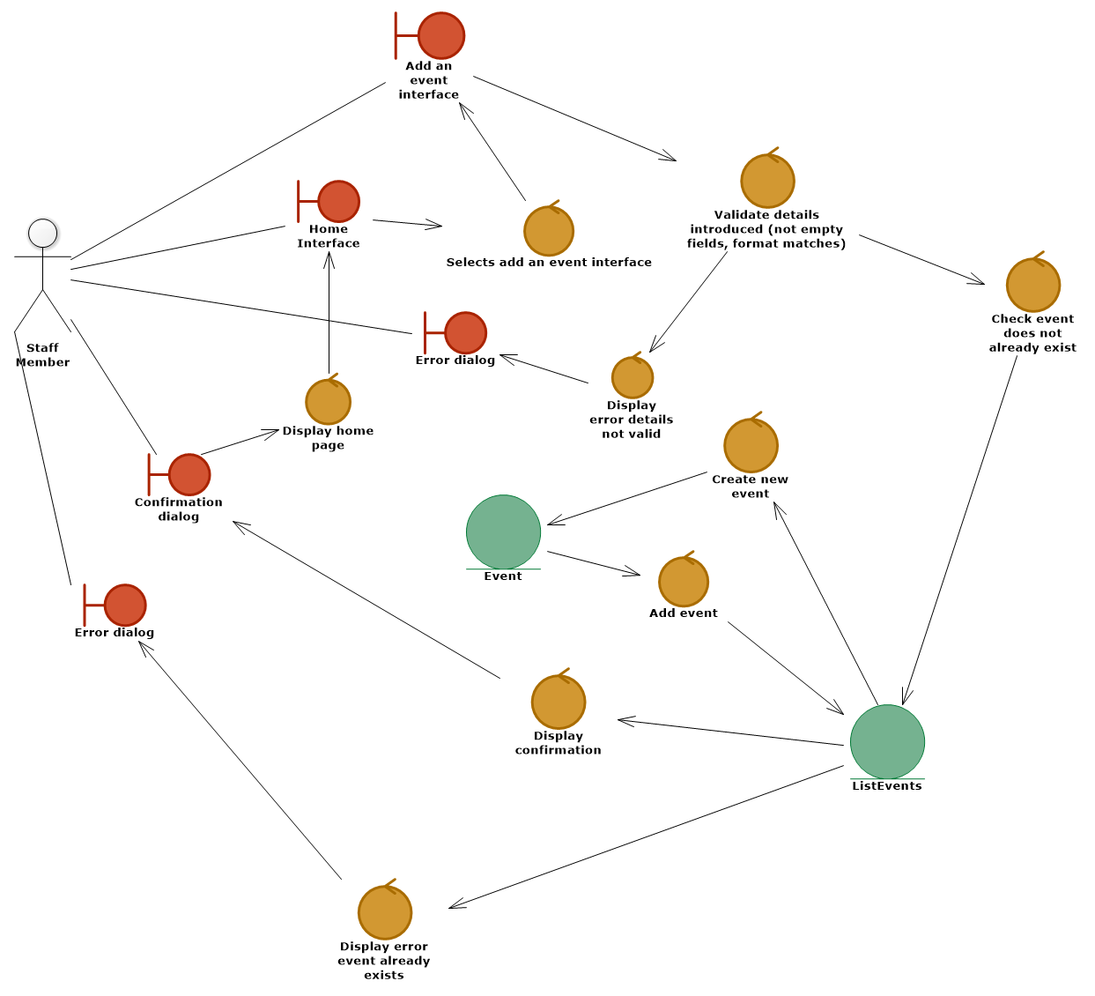
Robustness Diagram: View, Controller and Model are separated (boundaries, controllers, entities) Robustness diagrams divide responsibilities in the manner it identifies distinct kind of objects
Boundary objects (red) represent
different screens of the same view
Control objects (orange) represent
“the brain” that addresses business logic.
Each one is a task that the controller has to do.
Entity objects (green) represent
the distinct objects that compose the model

Slide 6
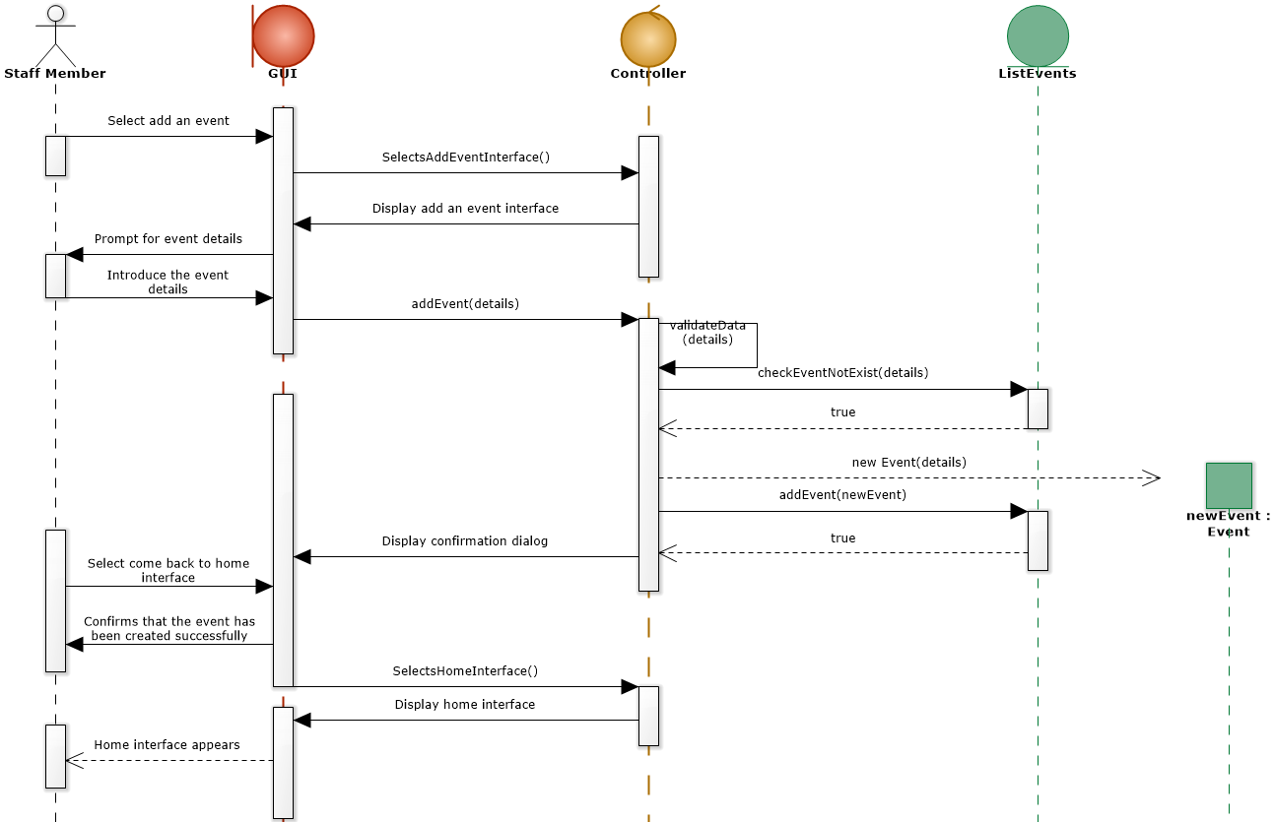
Sequence Diagram
Also fits the MVC pattern about assigning responsibilities. Every part takes it owns responsibility, being isolated.

Slide 7
Main advantages of MVC Model in the project
Faster development process: one programmer can work on the view while the another can work on the controller to create business logic
Ability to provide multiple views
Modification does not affect the entire model:
Adding new type of views does not affect the Model part because it does not depend on the views part.
Therefore, any changes in the Model will not affect the entire architecture.

