Slide 1
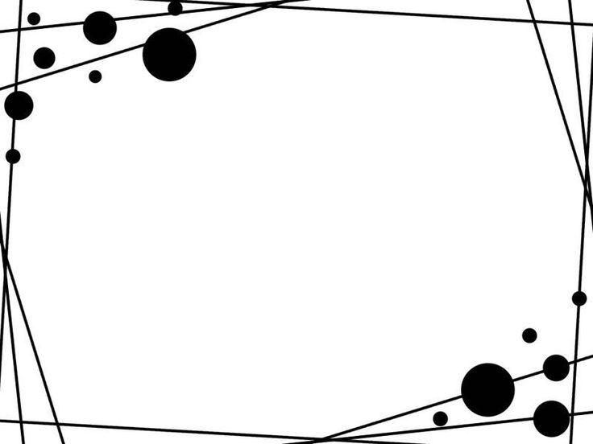
How Robustness and Sequence Diagrams are being used to improve both use cases and domain model. Athletics club Demonstration Program
Alejandro Reyes Bautista – Q13134663
Use Cases and Domain Model
Robustness Diagrams => discover new steps, extensions and classes
Sequence Diagrams => discover methods, classes and attributes
Expanded use cases
Class Diagram

Slide 2

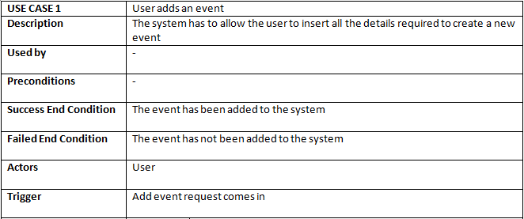
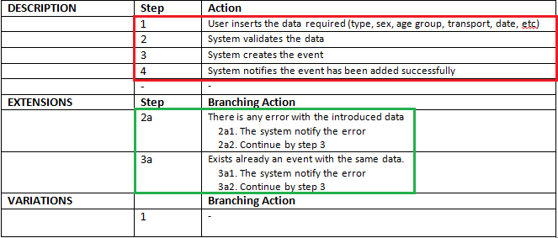
Add event use case
Data needed to contextualize the use case. Name, description, triggers and state of the system after the execution.
At the moment, we have 4 steps (red) and 2 extensions branches (green)

Slide 3

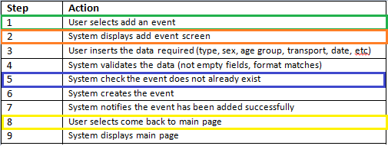
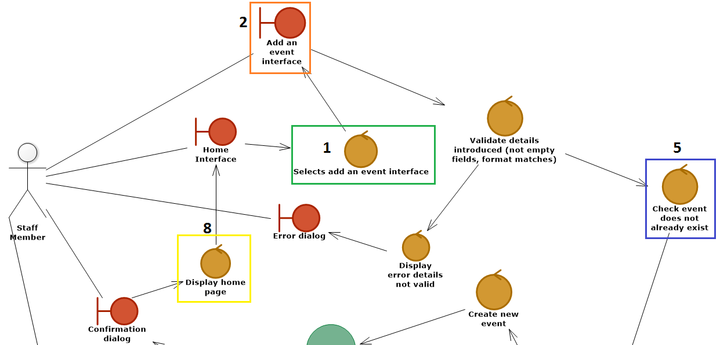
Robustness Diagram
Use Case
Expanded Use Case

Slide 4
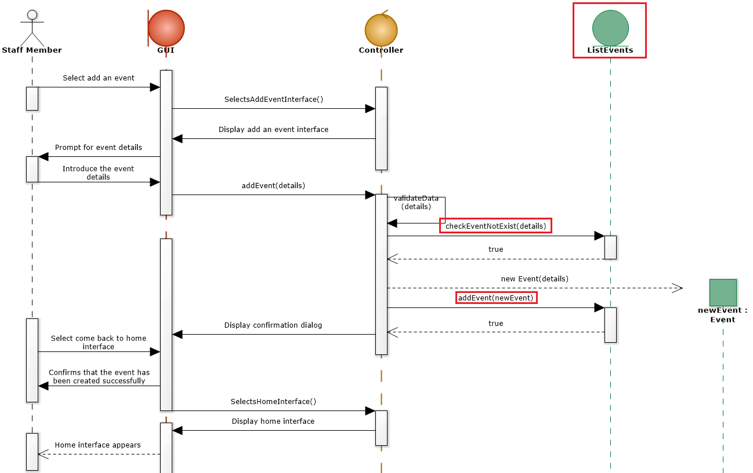
Sequence Diagram
New entity discovered thanks to robustness
and sequence diagrams
New method found. Added to the class diagram
Another method found. Added to the class diagram too.

Slide 5
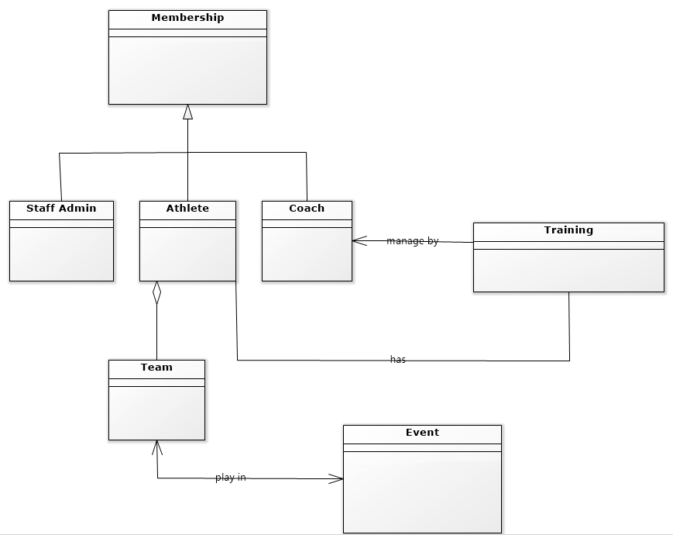

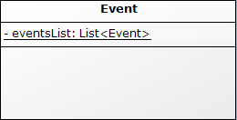
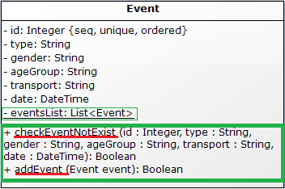
Domain Model
We do not need a new class for
ListEvents entity. It can be a static List
inside Event class.
Class Diagram
New methods!
checkEventNotExist(details)
addEvent(event)
New attribute!
eventsList: List<Event>

