Slide 1

How Version Control is being used in Athletics club Demonstration Program
Alejandro Reyes Bautista – Q13134663
Version Control System (VCS): GIT
Version Control Repository: GitHub
Client: SourceTree (Atlassian)
Netbeans with Github plugin
Tracking analysis, design modeling and associated documentation
Tracking each version of software

Slide 2

Why do we use a VCS?
We can make a change to code, to realize there was a mistake and revert back.
We can review the story of diagrams, use cases text, code, etc. and see the difference between two (or more) versions.
We let other teammates to work in our code.
We track how much work is being done, and where, when and by whom.
We can develop/experiment with a new feature without interfering with working code.

Slide 3
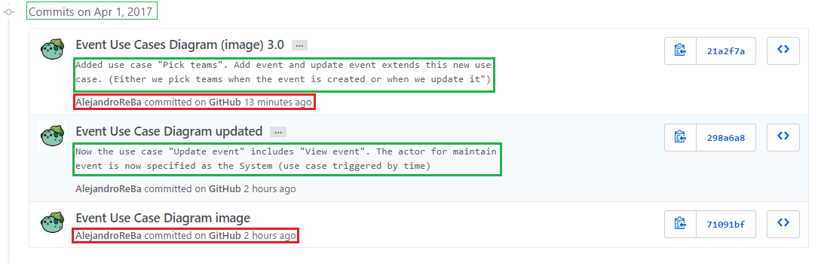
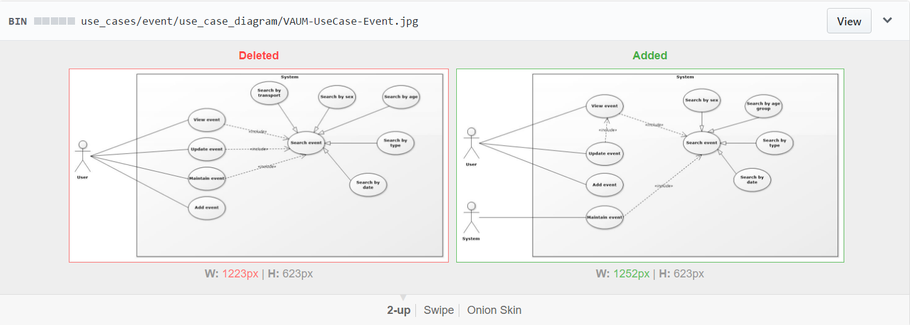
Event Use Cases Diagram History

Slide 4
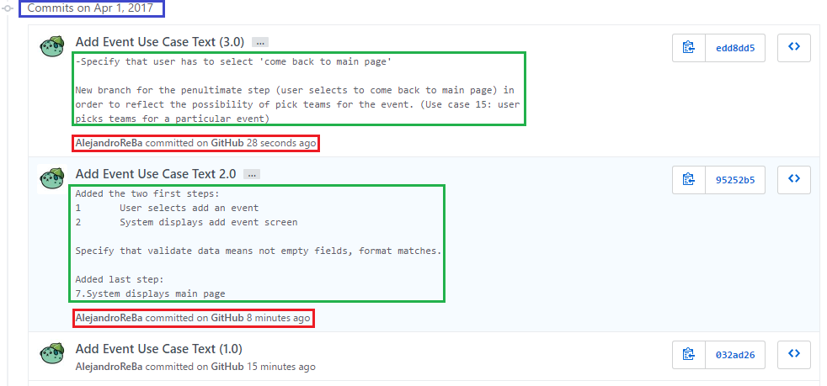
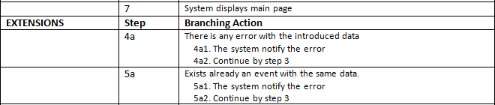
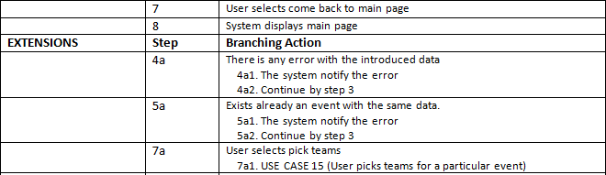

Slide 5
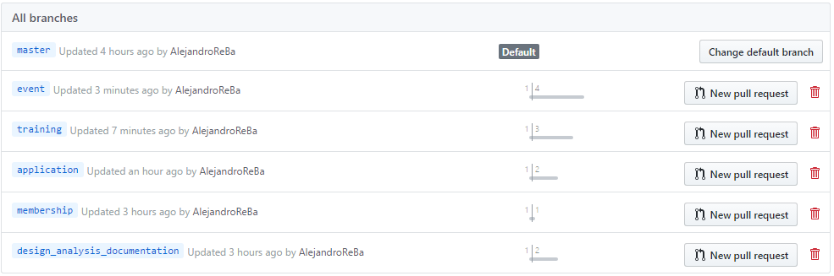
Branches
master: all the project
design_analysis_documentation:
use cases, robustness diagrams, sequence diagrams,
database schemes, considerations and decisions, etc.
application: java project
training: java code implementing features related with trainings
event: java code implementing features related with events
membership: java code implementing features related with memberships

Slide 6
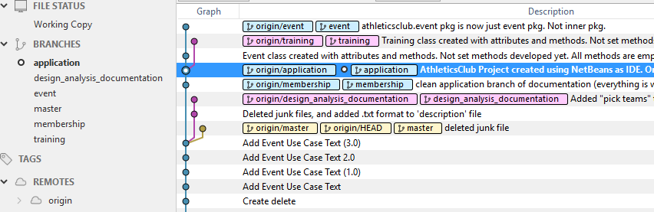
New features are developed without interfering with working code
Both branches training and event have application as root.
Each one is isolated in order to implement a new feature.
When the feature is ready, working and tested, it will be merge into the application branch.
If there are any problem, we revert back the application branch to a previous state while
we work on solve the conflict.

