Slide 1
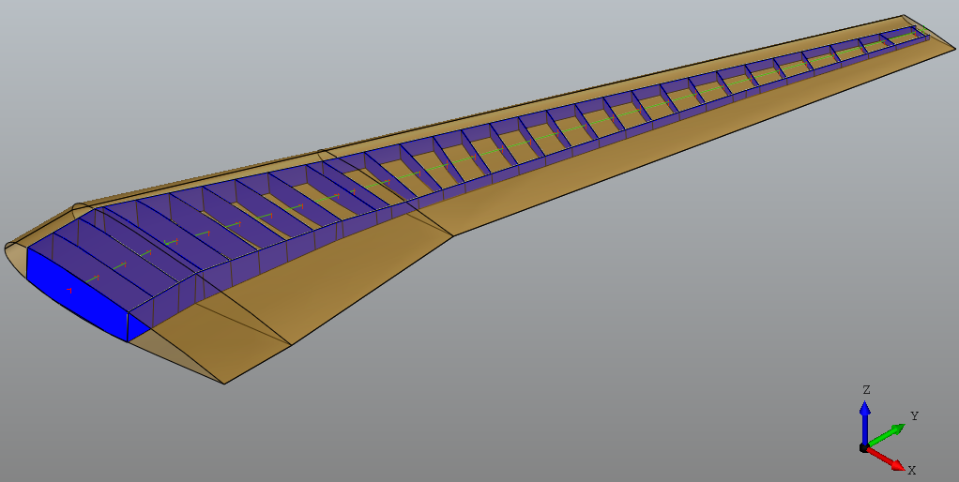
loadReferenceLine
loadApplicationPoint

