Slide 1
Xamarin.Forms + Facebook
Alejandro Ruiz / Guillermo Tinoco
Los Xamarinos
alejandro.ruiz@xamarinos.com - guillermo.tinoco@xamarinos.com

Slide 2
¿Por que Facebook?
Notes:
What makes up a “Native” mobile application? I am sure you have heard the “native” thrown around, but what does that really mean?

Slide 3
934 Millones de Usuarios diarios
Protocolos seguros
Developer Tools
Notes:
A native app needs a lot of things, but three important ones stick out:
Native User Interface: Apps need to look and act correct per platform.
Full SDK Access: As a developer we need to add the latest and greatest features
Native Performance: Needs to be fast and fluid

Slide 4
Objetivos
Crear y configurar Aplicacion de Facebook.
Implementar Login con Facebook en Aplicaciones Xamarin.Forms.
Crear llamadas OpenGraph para publicar texto e imagenes.
Reutilizar codigo en tus futuros proyectos

Slide 5
Manos a la obra
Notes:
What makes up a “Native” mobile application? I am sure you have heard the “native” thrown around, but what does that really mean?

Slide 6
Pasos Iniciales
Generar Cuenta de Desarrollador https://developers.facebook.com
Crear App Dentro de Consola de Desarrollador
Crear Perfiles de Login para Plataformas Mobile
Configurar Proyectos Android/iOS
Implementar Codigo
Notes:
What makes up a “Native” mobile application? I am sure you have heard the “native” thrown around, but what does that really mean?

Slide 7
Generar Cuenta de Desarrollador https://developers.facebook.com
Notes:
What makes up a “Native” mobile application? I am sure you have heard the “native” thrown around, but what does that really mean?

Slide 8
Crear App Dentro de Consola de Desarrollador
Notes:
What makes up a “Native” mobile application? I am sure you have heard the “native” thrown around, but what does that really mean?

Slide 9
Crear Perfiles de Login para Plataformas Mobile
Notes:
What makes up a “Native” mobile application? I am sure you have heard the “native” thrown around, but what does that really mean?

Slide 10
Configurar Proyectos Android/iOS
https://goo.gl/Y8I9Dp
Notes:
What makes up a “Native” mobile application? I am sure you have heard the “native” thrown around, but what does that really mean?

Slide 11
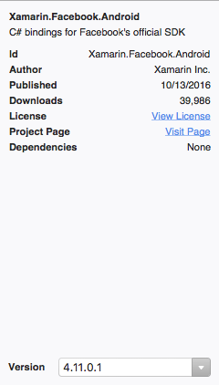
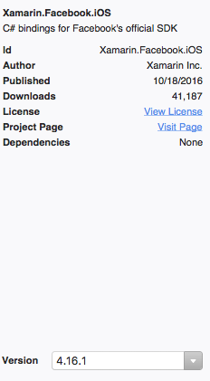
Configurar Proyectos Android/iOS
https://goo.gl/Y8I9Dp
*iOS Custom Entitlements
Notes:
What makes up a “Native” mobile application? I am sure you have heard the “native” thrown around, but what does that really mean?

Slide 12
Custom Renderers vs Dependency Service

Slide 13
Custom Renderers
Permiten renderizar controles custom

Slide 14
FB Login Button

Slide 15
Dependency Service
Permiten hacer llamadas nativas con una implementacion simple de interfaz

Slide 16
Login / Logout / Graph Calls / FB Dialogs

Slide 17
Referencias
FB Developer: https://developers.facebook.com
FB Android SDK: https://developers.facebook.com/docs/android
FB iOS SDK: https://developers.facebook.com/docs/ios
Xamarin Custom Renderers: https://developer.xamarin.com/guides/xamarin-forms/custom-renderer/
Xamarin Dependency Service: https://developer.xamarin.com/guides/xamarin-forms/dependency-service/
Codigo de Ejemplo: https://goo.gl/Y8I9Dp

Slide 18
Gracias, ¿Preguntas?
Alejandro Ruiz / Guillermo Tinoco
Los Xamarinos
Xamarin.Forms + Facebook
alejandro.ruiz@xamarinos.com - guillermo.tinoco@xamarinos.com
@alejandroruizva - @m3mo89
http://alejandroruizvarela.blogspot.com

